Slide 1
Reviving Airbnb NYC Business in the Post-Covid Period
Notes:
Objective

Slide 2
AGENDA
Objective
Background
Key Findings
Recommendations
Appendix:
Data sources
Data methodology
Data model assumptions
Notes:
Objective

Slide 3
OBJECTIVE
Improve our strategies to revive the business in the post-COVID period.
Understand customer preferences and user experience trends for Airbnb NYC business.
Provide early recommendations for new acquisitions and improving customer experience.
Notes:
Objective

Slide 4
BACKGROUND
The COVID-19 pandemic affected Airbnb business due to travel restrictions.
The revenue took the largest hit in NYC in the Q2 of 2020.
Now that the travel restrictions are lifted, the business should be operated to recover the loss.
Notes:
Objective

Slide 5
Target Hosts Offering the Least Min Nights of Stay
In the past, it has been observed that majority of bookings are done for apartments, where the minimum number of days is the least.
For a minimum nights stay from 0 to 5 nights, the maximum number of listings went beyond 12K in the past.
Besides, properties with 30 min nights stay should also be acquired as they have market traction.*
Assumption
With COVID-19, it is reasonable to assume that people will book properties for monthly stays or min nights per stay as 30 as well.
Notes:
Objective

Slide 6
Properties with Least Min Nights to Stay offer Maximum Bookings
Acquiring premium properties should not be prioritized as of now, due to high price.
As the number of nights to stay increases, the price increases and the bookings naturally go down.
It has been observed, that the hosts offering min nights to stay have received the highest booking in the past.
Notes:
Objective

Slide 7
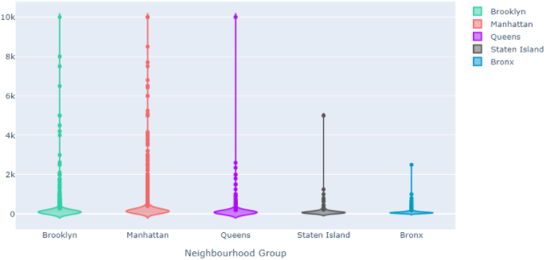
Acquiring Premium Properties in Bronx and Non-Premium Properties in Manhattan
Premium properties in Bronx should be targeted as the rates are already reasonable.
Non-premium properties in Manhattan should be targeted as the rates already are pricey and a reasonable approach will get more customers.
The properties in Manhattan are the most expensive than any other area while those in Bronx are the least expensive.
Notes:
Objective

Slide 8
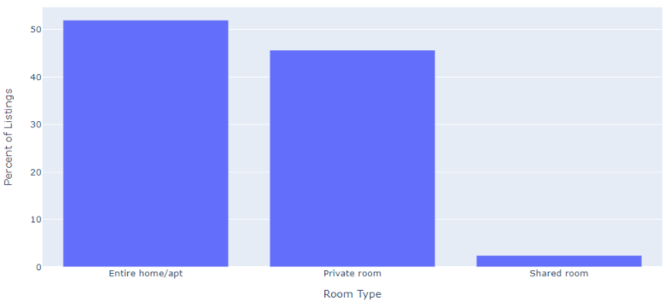
Customer Preferences for Entire Apt/Pvt. Room should remain high post-COVID
Customers prefer Entire home/apt or Private room among all the 3 listings.
The room types ‘Entire home/apt’ and ‘Private room’ account for a major portion of the listed properties (around 97.6%).
Shared rooms account for only 2.4% of the total listed properties.
Notes:
Objective

Slide 9
APPENDIX – Other Insights
The majority of the listings are hosted by a single host each.
Manhattan has a 14.7% higher contribution of ‘Entire home/apt’ compared to the overall contribution of ‘Entire home/apt’.
Queens has a 23.2% higher contribution of ‘Private room’ compared to the overall contribution of ‘Private room’
Notes:
Objective

Slide 10
APPENDIX - DATA METHODOLOGY
We conducted a thorough analysis of the Airbnb data. The process included:
Cleaning the data set for missing values and outliers
Using exploratory data analysis to identify customer preferences based on
Area preferences
Price
Listing Preference
Notes:
Objective

Slide 11
APPENDIX - DATA ASSUMPTIONS
We assumed the data prior to the COVID – 19 period was achieving the desired revenue.
We assumed the company does not want to expand yet to new territories in NYC.
The company’s strategies are decided considering the travel will increased in the post COVID period.
Notes:
Objective

