Slide 1
Open Pit Mining (Case Study)
Key Finding and Recommendations
Submitted by : Prashant Sharmait

Slide 2
Agenda :
Understanding the Problem Statement
Objective
Key Information and Recommendation
Key business Metrics
Advantages of ML Techniques
Annexure

Slide 3
Problem Statement :
Our Client is facing low production at the mine, low operational efficiency.
Client has deployed all the equipment at its optimum capacity.
Crushers – 3
Diggers – 10
Trucks – 57
There is problem in managing the queues efficiently at the Demand (Digger) along with at the supply point (Crusher).

Slide 4
Surprising Observations and its Cause :
Following problems are faced due to manual operating the management of trucks in queues on the digger and crusher sites
Empty trucks were assigned to crusher and loaded trucks to diggers.
In both the cases operations are halted.
Truck assignment is done considering only transit time but not wait time and equipment availability time. Both are playing important role in assignment.
Some Crushers/Diggers have high number of trucks in queues while others are sitting idle or stopped working.

Slide 5
Key Information and Recommendation:
Low Production at the site can be mitigated by applying AI and ML Techniques.
It will increase operational efficiency and equipment usability by optimizing the parameters.
Problems of assignment of trucks, at the demand and supply point can be successfully rectified.
The most compatible trucks can be assigned to the equipment with the help of optimization. i.e. empty trucks at diggers and loaded trucks at crushers.

Slide 6
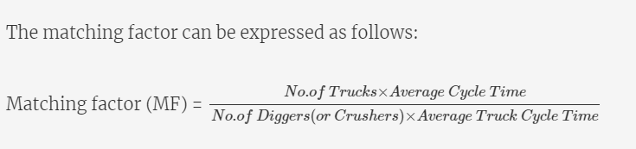
Key business Metrics to follow:
Matching Factor(MF) is the key metric which determines optimum server utilization i.e. Crusher and Digger.
Higher value of MF means higher utilization of equipment/servers.
Lower MF indicates inefficient operation where extra time spent on waiting and travelling and not on diggers and crushers site.
If we increase average cycle time, server utilization
Is more and wait and transitions times become
Less which effectively reduces Truck Cycle Time.
MF ensures appropriate trucks are assigned to
Servers.

Slide 7
Advantages of ML Techniques:
With the help of ML Techniques supply chain can be optimized by regulating MF.
This avoids the error due to manual intervention which was prone to inefficiency of matching appropriate trucks to equipment which leads inadequacy and halting of servers.
MF efficiently handles both wait times and transit times of trucks and it maintains optimized queues which can not be achieved by manual supervision.

Slide 8
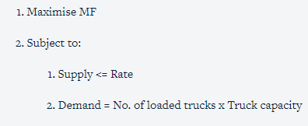

Annexure:
Constraints to be considered at each digger and crusher

Slide 9

Annexures
Truck Cycle Time: Arrival Time of empty Truck at the queue of a Digger to the time again being assigned in a digger in empty state or Time after unloading at any crusher to the time again return to loaded state at any crusher, after accomplishing intermediate steps.
Equipment Available Time: It is defined as sum of Start time, Wait time, and Service Time, after this equipment will starve or available for further assignment.
Queue Wait Time (W): For trucks, W=L/λ , L= Length of queue, λ= Mean Arrival rate

