Slide 1
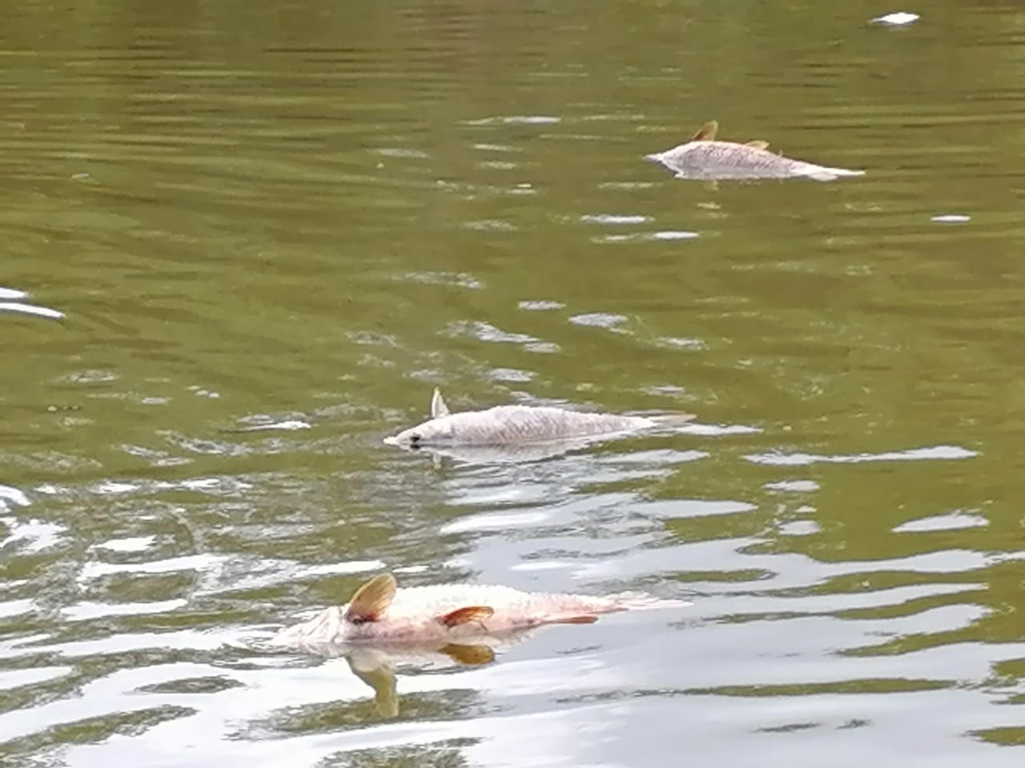

THE PROBLEM
25 million litres a day.
Ten Olympic swimming pools, collecting in the old coal mines beneath eMalahleni.
When it leaves a mine, nobody tests it. That is how Kromdraai killed 112 km of river in 2022.
zMz | Kusile WaterGuard
Sources: Anglo American / UNFCCC; Mail & Guardian (2022); Daily Maverick (2024)
Notes:
12 seconds. Every day, 25 million litres of water collects in the old coal mines beneath eMalahleni. Ten Olympic swimming pools. When it leaves a mine, nobody tests it. That's how Kromdraai killed 112 kilometres of river in 2022. Detail slides are at the back if judges ask.

Slide 2
THE SOLUTION
What if every litre leaving a coal mine had to pass a test first?
That's why we built Kusile WaterGuard.
zMz | Kusile WaterGuard
Notes:
12 seconds. Ask the question, pause one second, then the line. Slightly louder on the product name.

Slide 3
WHAT IT IS
A smart gate between the dam and the river
A low-cost node at the outlet of a mine's pollution control dam. It tests water in batches, releases only clean water, and holds back and treats the rest.
1 Test
2 Decide
3 Treat
4 Record
Every batch, on site
Clean to the river, dirty to the tank
Neutraliser dosed into the tank
Every release logged
No test, no release.
Proof for licensed releases · A stop sign for dirty water
zMz | Kusile WaterGuard
Notes:
15 seconds. A low-cost gate at the dam outlet. It tests every batch, releases only clean water, holds back and treats the rest. No test, no release.

Slide 4
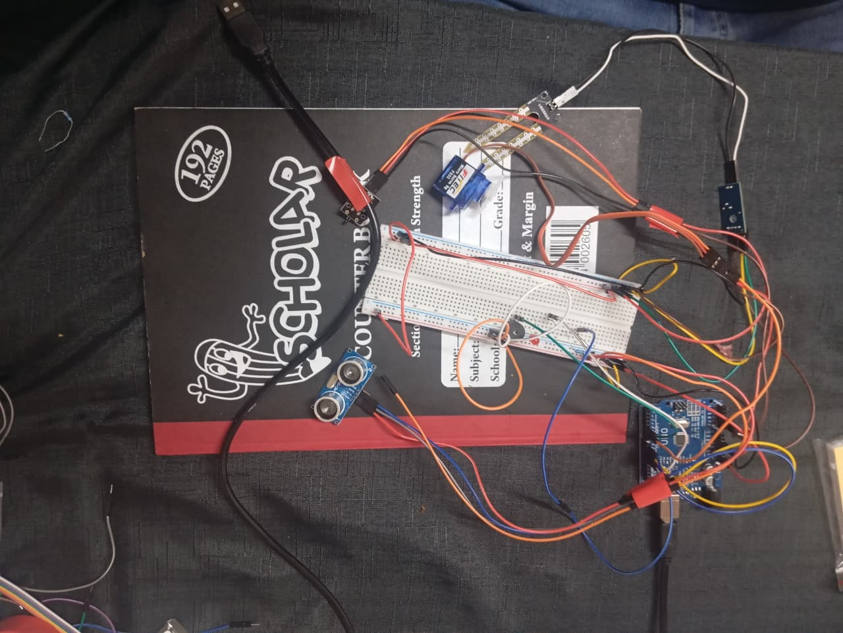
THE PROTOTYPE
Built and running today
1
Conductivity probe
Acid and dissolved metals make water conduct
2
Servo valve
Swings water to the river or the treatment tank
3
Ultrasonic sensor
Watches the treatment tank level
4
Controller
Decides on the board: no internet needed
5
LED and buzzer
Local alarm the moment a batch fails
Fails safe: sensor dead, no release · tank full, the batch waits · neutraliser empty, nothing leaves
zMz | Kusile WaterGuard
Live demo
Notes:
70 seconds, and this is the heart of the pitch. Point at the rig. This is our mine dam. The probe measures conductivity, because acid and dissolved metals make water conduct electricity far more than clean water. It reads clean, so the valve is open to the river. Pour the contaminated water while talking. The reading drops. Three readings in a row are needed before it acts, so a splash can't trigger it. The valve swings, water goes to the treatment tank, LED and buzzer on. Add clean water: three good readings and it returns to the river by itself. Everything decided on the board. No internet, no cloud, no operator. If the demo fails: show the Serial Monitor readings and the recording from this morning.

Slide 5
COMMERCIALISATION
Who pays, how we earn
~R21 000
~R300 million
~R1 billion
One node (range R8,500 – R21,000)
eMalahleni's original 25 ML/day plant
Kromdraai response bill
Who pays | Why they buy
Operating mines | Proof of compliance
Closed mines | Duty continues after closure
Treatment operators | Nodes at plant outlets
Municipalities, water boards | Early warning at intakes
WaterGuard as a Service
Once-off: hardware and installation
Monthly: monitoring and dashboard
Ongoing: service, sensors, neutraliser, reports
Legal driver: GN 704 requires mines to keep polluted water out of rivers.
Prototype → Controlled pilot → Field pilot → Product → Node network
zMz | Kusile WaterGuard
A small gate at every dam outlet costs far less than one spill.
Notes:
20 seconds. One node about R21,000, a plant R300 million, the Kromdraai clean-up a billion. Mines buy it for compliance, municipalities for early warning. Hardware once, monitoring monthly.

Slide 6
THE TEAM
IziMpisi ze-Data
Lindelani Masego
Collen Nkosi
Babongile Ncube
Sabelo Mtshweni
Gift Onwusaka
zMz | Kusile WaterGuard
Notes:
20 seconds. One node about R21,000, a plant R300 million, the Kromdraai clean-up a billion. Mines buy it for compliance, municipalities for early warning. Hardware once, monitoring monthly.

