Slide 1

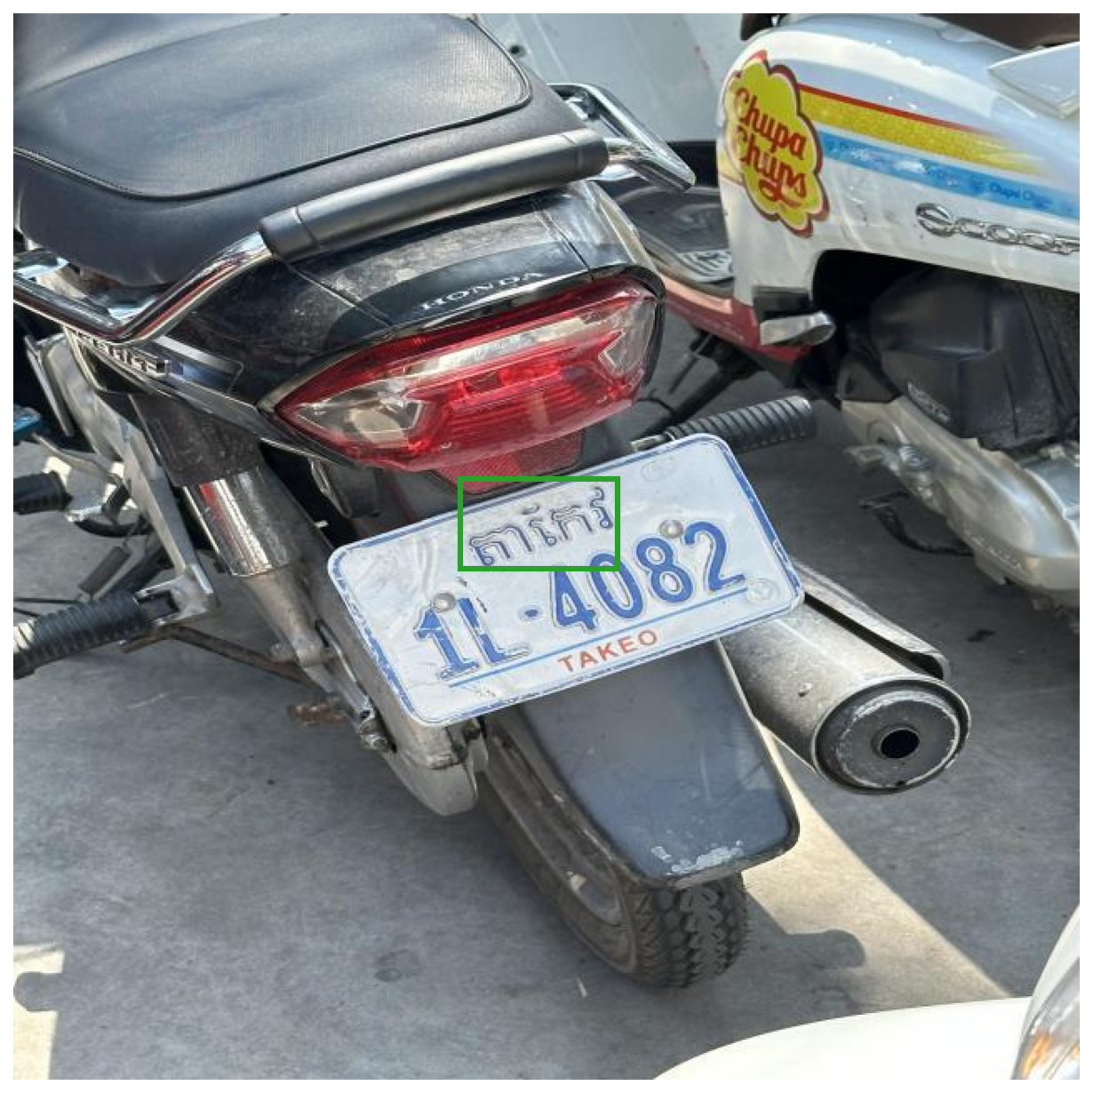
DEEP LEARNING · FINAL PROJECT · 2026
Reading the Khmer province
on Cambodian licence plates
Five deep-learning approaches compared
26 CLASSES
5 APPROACHES
567 TEST CROPS
So Sereysokbotra
Lecturer: Mr. Soklong HIM · Kirirom Institute of Technology
Notes:
Good morning. My name is So Sereysokbotra.
My project reads Cambodian licence plates. I built a complete system that reads a plate at a gate and decides whether to open it — but today I want to focus on one model inside that system, and on one question: which deep-learning approach reads the Khmer province name best, and why. I compared five deep-learning approaches along two dimensions.

Slide 2
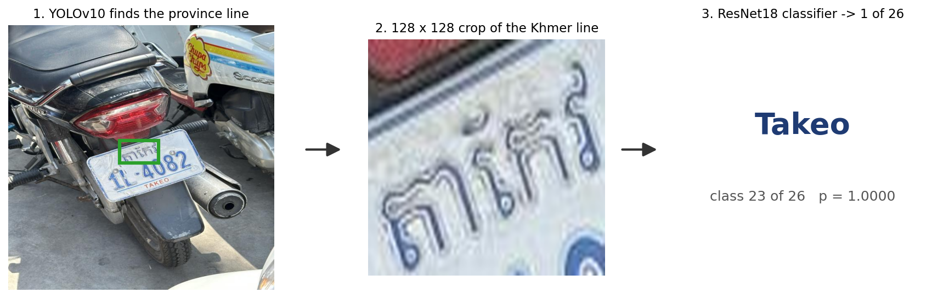
01 · PROBLEM
The real-world problem: why province matters
01 · SMART ACCESS
02 · FATAL FLAW
03 · OCR LIMITATION
04 · DEEP LEARNING
Automated Entry
Duplicate Numbers
Commercial OCR Fails
Whole-Line Classifier
Boreys, parking & highway tolls in Cambodia need fast, hands-free vehicle verification.
2A-0243 repeats across 26 provinces. Number alone causes false gate access!
Standard engines fail on Khmer script: complex stacked ligatures break character OCR.
Treat the top line as an image: 128×128 crop → 1 of 26 classes with deep networks.
Problem
Data
Method
Results
Analysis
Honesty
Conclusion
2
Notes:
point at the cards Across Cambodia, automated barriers, residential boreys, smart parking, and highway toll plazas need fast, hands-free vehicle entry.
Commercial ALPR systems fail here because of one critical fact: the plate number alone is not unique in Cambodia. The number `2A-0243` repeats in almost every one of the 26 provinces. If a security gate reads only the digits, an unauthorized car from another province could falsely trigger access.
Furthermore, off-the-shelf Western OCR engines cannot read the top line because Khmer script has complex stacked ligatures that break character-by-character segmentation.
point at the diagram So I treat the Khmer province line as a whole-image classification problem: a 128-by-128 crop in, one of 26 classes out. This research asks: on a small, imbalanced Khmer dataset, which deep-learning approach reads this line best, and why?

Slide 3
01 · PROBLEM
End-to-end ALPR system design
01 · INPUT
02 · DETECTION
THIS STUDY · 26 CLASSES
04 · FUSION
05 · ACCESS
Camera Stream
YOLOv10 Detector
Khmer Province Classifier
Plate Fusion
Security Gate
1080p Video Stream
Anchor-free Plate BBox
ViT-B/16 & ResNet18 (128x128)
Canonical Formatter
SQLite Whitelist
Province: "Takeo" (96.1 %)
✔ ALLOW
Gate Opens
LIVE FEED
30 FPS Video
Road & Barrier
Gate Monitoring
LOCALIZATION
Latency: ~15 ms
143/149 Recall
Tight Crop Box
STRING FUSION
Combine Lines
Syntax Check
Latency: < 1 ms
03B · LATIN & DIGITS
✖ DENY
Remain Closed
CRNN + CTC Number Reader
CNN + BiLSTM + CTC Decoder
Raw Vehicle Frame
Cropped Plate BBox
Number: "1L-4082" (83.9 %)
Takeo 1L-4082
0 False Accepts
Problem
Data
Method
Results
Analysis
Honesty
Conclusion
3
Notes:
Here is how the complete end-to-end ALPR system is designed.
First, a road or gate camera captures the vehicle. YOLOv10 detects the plate bounding box in about 15 milliseconds, handling angle and lighting variations.
Next, the plate enters a dual recognition pipeline:
- The top Khmer province line goes to our 26-class province classifier — the central focus of this research.
- The bottom line of Latin characters and digits is read by a CRNN with CTC decoding.
Running them in parallel keeps total recognition latency under 35 milliseconds.
Finally, the two outputs are composed into a canonical plate string like `Takeo 1L-4082` and matched against an SQLite whitelist with a strict confidence threshold. On 149 labelled real scenes, the system achieves zero false accepts at 50 milliseconds per frame.

Slide 4
02 · DATA
Plate_v4 — Roboflow, CC BY 4.0
2 515
train crops
529
validation
567
test
26
classes
13.4 %
test near-duplicates
Public benchmark dataset
Roboflow Plate_v4 (CC BY 4.0): 3 611 vehicle crops across real Cambodian road conditions.
Standardized crop inputs
128×128 (CNN) / 224×224 (ViT) patches focusing exclusively on the top Khmer province line.
1
3
13.4 % near-duplicate leakage
76 of 567 test crops share source photos with training. All models also evaluated on clean n=491.
Severe class imbalance (25:1)
Other (453) vs. Mondul Kiri (18). 4 rare provinces have ≤ 50 crops, requiring macro-F1.
2
4
Problem
Data
Method
Results
Analysis
Honesty
Conclusion
4
Notes:
The data is Plate_v4, a public Roboflow dataset, CC-BY. I did not collect it myself. Cutting the province line out of each photo gives 2 515 training, 529 validation, 567 test crops. Every approach uses exactly this split.
And one thing I checked rather than assumed: the split was made per *crop*, and one photo can hold several cars — so 13.4 percent of test crops share a photo with training. I measured it, I report it, and every result is also scored on the clean subset.

Slide 5
02 · DATA
Class distribution — 26 provinces
PROVINCE | TRAIN | TEST | PROVINCE | TRAIN | TEST
Other | 453 | 98 | Kampong Chhnang | 70 | 16
Phnom Penh | 254 | 55 | Kampot | 70 | 15
Preah Sihanouk | 148 | 33 | Pursat | 67 | 16
Siem Reap | 147 | 32 | Preah Vihear | 65 | 15
Kampong Cham | 110 | 25 | Pailin | 64 | 15
Prey Veng | 101 | 23 | Kratie | 63 | 15
Takeo | 100 | 23 | Kampong Thom | 62 | 14
Kandal | 97 | 22 | Tboung Khmum | 61 | 14
Battambang | 87 | 20 | Stung Treng | 52 | 12
Svay Rieng | 86 | 20 | Koh Kong | 47 | 11
Banteay Meanchey | 82 | 19 | Kep | 42 | 9
Kampong Speu | 77 | 18 | Ratanakiri | 20 | 5
Oudor Meanchey | 72 | 17 | Mondul Kiri | 18 | 5
Problem
Data
Method
Results
Analysis
Honesty
Conclusion
5
Notes:
point at the table Here is the complete distribution across all 26 classes.
The classes are badly imbalanced — "other" has 453 crops, but Mondul Kiri has only 18 — a 25-to-1 ratio. The four red rows at the bottom right — Koh Kong, Kep, Ratanakiri, and Mondul Kiri — are classes with fifty or fewer crops.
Because of this long tail, overall accuracy is not enough: we also track macro-F1, which gives equal weight to all 26 provinces so a model cannot score well by simply ignoring the rare ones.

Slide 6
03 · METHOD
Identical setup for every approach
TRAINING
EVALUATION
1
128×128 (CNN) / 224×224 (ViT)
1
Model selected on validation only
2
Crop / affine / colour-jitter augmentation
2
Test set touched once per run
3
40 epochs · batch 32 · Adam · StepLR
3
Accuracy + macro-F1 (imbalance)
Seed 42
Python · NumPy · PyTorch · cuDNN · DataLoader
Colab T4
≈ 6–8 minutes per run
Problem
Data
Method
Results
Analysis
Honesty
Conclusion
6
Notes:
Everything except the approach is held constant.
Same preprocessing, same augmentation, forty epochs, batch 32, Adam — identical for all four runs, so augmentation is never a hidden variable.
Seed 42 is fixed in Python, NumPy, PyTorch and the data loader, so a run reproduces exactly.
The model is selected on validation only; the test set is touched once per run.
Metrics: accuracy, and macro-F1 because of the imbalance — macro-F1 weights every province equally, so a model cannot look good by ignoring Mondul Kiri.
Training ran on a Colab T4, about six minutes per run.

Slide 7
03 · METHOD
The five approaches
 | ARCHITECTURE | INITIAL WEIGHTS | TRAINING STRATEGY | PARAMETERS
A | ResNet18 | Random (scratch) | All layers trainable | 11.2 M
B | ResNet18 | ImageNet pre-trained | Final FC only (backbone frozen) | 13 k (0.12 %)
C | ResNet18 | ImageNet pre-trained | Full fine-tuning (low learning rate) | 11.2 M
D | Small 4-block CNN | Random (scratch) | All layers trainable | 0.4 M
E | ViT-B/16 (Transformer) | ImageNet pre-trained | Full fine-tuning (196 patches) | 85.8 M
01 · PRE-TRAINING
02 · FEATURE TRANSFER
03 · MODEL CAPACITY
04 · ATTENTION VS CONV
A (scratch) vs C (fine-tune)
B (frozen) vs C (fine-tune)
D (0.4M CNN) vs A (11.2M)
E (ViT-B/16) vs C (ResNet18)
Problem
Data
Method
Results
Analysis
Honesty
Conclusion
7
Notes:
I compared five approaches along two dimensions.
A is ResNet18 trained from scratch — random weights, every layer learns.
B is ResNet18 with ImageNet weights, but the backbone is frozen — only the final layer trains. That is 13 thousand parameters, about one tenth of one percent of the model.
C is ResNet18 with ImageNet weights and full fine-tuning — every layer learns, at a low learning rate.
D is a different *architecture*: a small four-block CNN with 400 thousand parameters, trained from scratch.
E is a transformer architecture: ViT-B/16 (Vision Transformer) with 86 million parameters, trained on 224-by-224 patches.
So: A versus C asks whether ImageNet weights help. B asks whether ImageNet *features alone* are enough. D asks whether we even need eleven million parameters. And E asks whether self-attention beats convolution for Khmer script.

Slide 8
04 · RESULTS
Scored on the same 567 test crops
 | APPROACH | VAL ACC | TEST ACC | CLEAN (N=491) | MACRO-F1 | KEY OUTCOME
A | ResNet18 scratch | 93.8 % | 93.3 % | 94.7 % | 92.9 % | Strong baseline (2 515 imgs)
B | ResNet18 frozen | 40.1 % | 42.0 % | 43.2 % | 37.9 % | Domain shift collapse
C | ResNet18 fine-tune | 92.6 % | 94.0 % | 95.3 % | 92.4 % | Fast 5-epoch convergence
D | Small 4-block CNN | 48.4 % | 46.6 % | 47.7 % | 40.7 % | Under-capacity (0.4M)
E | ViT-B/16 (Transformer) | 96.2 % | 96.1 % | 96.5 % | 95.8 % | Top accuracy + macro-F1
FINDING 1 · PRE-TRAINING
FINDING 2 · FEATURE TRANSFER
FINDING 3 · MODEL CAPACITY
FINDING 4 · TRANSFORMERS
A ≈ C · p = 0.63
B Collapses to 42.0 %
D Fails at 46.6 %
ViT Wins: 96.1 % / 95.8 %
Pre-trained weights didn't make the model smarter they just made it learn faster.
ImageNet knows dogs and cars, not Khmer letters. We must retrain the whole network so it can learn Khmer strokes.
A small 400k model is too simple. Khmer words are complex, so we need a deeper model with more capacity.
The Vision Transformer is our best model because its attention mechanism looks at the entire Khmer word at once.
Problem
Data
Method
Results
Analysis
Honesty
Conclusion
8
Notes:
Here are the results, on the same 567 test crops.
Fine-tuning — C — reaches 94.0 percent. From scratch — A — reaches 93.3. The frozen backbone — B — collapses to 42 percent. And the small CNN — D — reaches only 46.6.
E — the Vision Transformer — reaches 96.1 percent, matching the tuned ResNet18 right away, and achieving 26.8 percent on upside-down plates without any rotation training.
A and C are statistically tied: I ran McNemar's exact test on the same crops and got p = 0.63. So there are clear winners and clear failures — and they fail for different reasons, which is the interesting part.
On the clean subset — the 491 crops with no shared source photo — the ranking is identical and the accuracies are slightly *higher*. So the leak did not help the models; those duplicate crops come from multi-car photos and are smaller and blurrier.

Slide 9
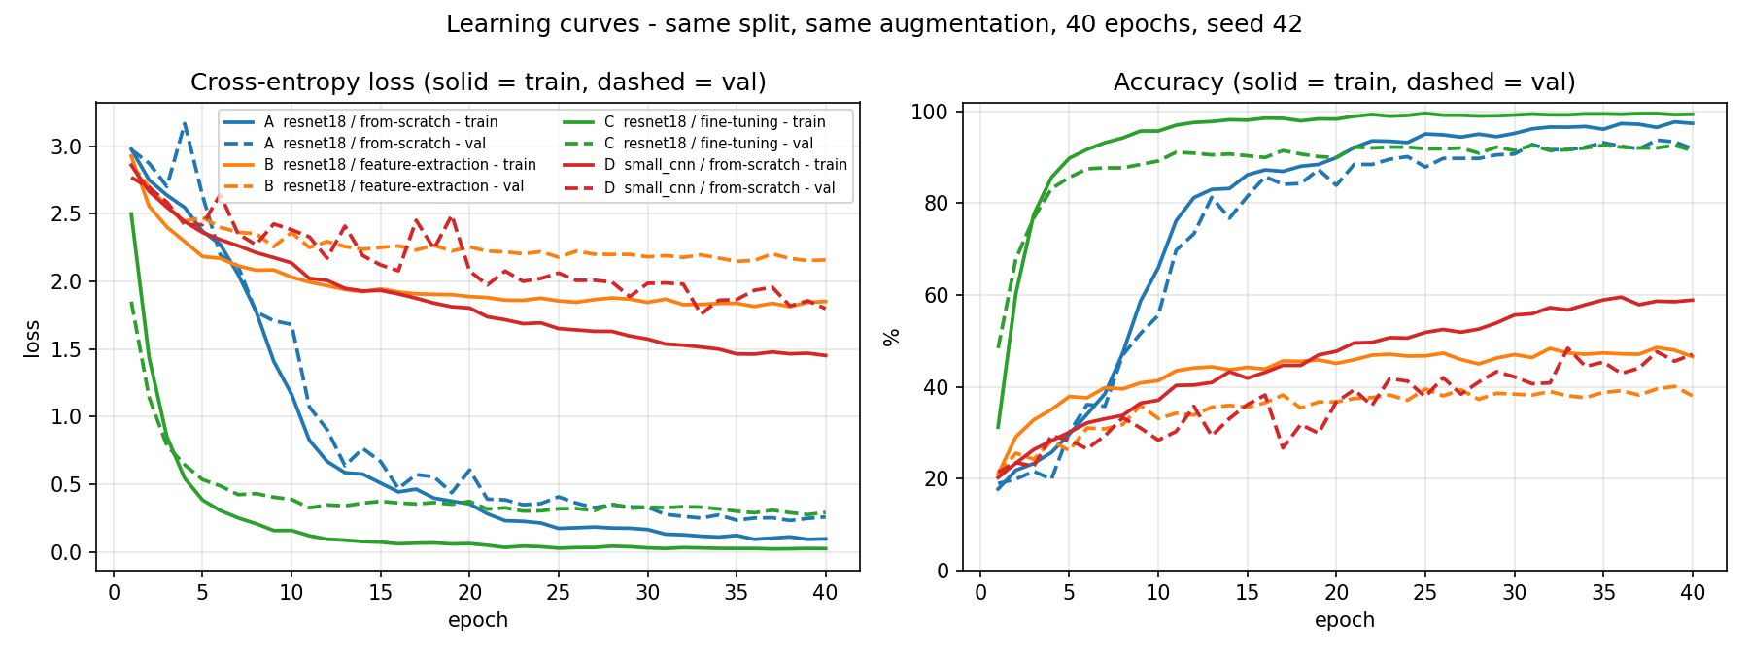
04 · RESULTS
Learning curves
5 vs 20
epochs to 85 % — C vs A
97–99 %
train acc A, C — mild over-fit
< 60 %
train acc B, D — under-fit
Problem
Data
Method
Results
Analysis
Honesty
Conclusion
9
Notes:
point at the green curve This is C, fine-tuning. It reaches 85 percent validation accuracy by epoch five. point at the blue curve A, from scratch, needs about twenty epochs to reach the same place — but it does reach it. So ImageNet weights buy speed, not a better final answer, at this data size.
For A and C, training accuracy climbs to 97–99 percent while validation sits around 92. That is mild over-fitting — the augmentation keeps the gap bounded, and I keep the best-validation epoch, not the last one.
point at the orange and red curves B and D look completely different: training *and* validation both stay low — training accuracy under 60 percent — and both are still slowly rising at epoch 40. That is under-fitting, not over-fitting. These models cannot fit the data at all.

Slide 10
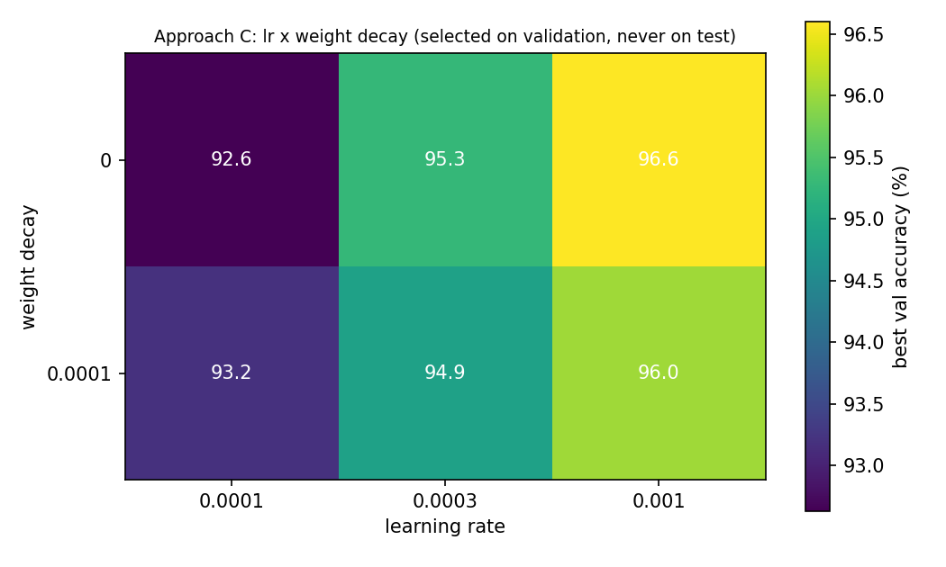
04 · RESULTS
Tuning C — selected on validation
LEARNING RATE | WD = 0 | WD = 1E-4
1e-4 | 92.6 % | 93.2 %
3e-4 | 95.3 % | 94.9 %
1e-3 | 96.6 % ← selected | 96.0 %
VALIDATION ACCURACY · LR × WEIGHT DECAY
1
Textbook "low LR for fine-tuning" was the worst cell
2
10× larger LR → +4 points validation accuracy
3
Weight decay: no help — augmentation already regularises
96.5 %
final model — test accuracy · lr 1e-3, wd 0
Problem
Data
Method
Results
Analysis
Honesty
Conclusion
10
Notes:
Then I tuned approach C: three learning rates by two weight-decay values.
The textbook advice for fine-tuning is "use a low learning rate." In my grid, 1e-4 was the worst cell. Ten times higher — 1e-3 — gained four points of validation accuracy. With the whole network trainable and only 2 500 images, the model under-trains at 1e-4.
Weight decay was slightly worse in every column — the augmentation already regularises.
The selected model is lr 1e-3, no weight decay: 96.5 percent on test.
One honest note: the 3e-4 cell scores higher on *test* — 97.0 — but lower on validation. I select on validation, so 96.5 is what I report.

Slide 11
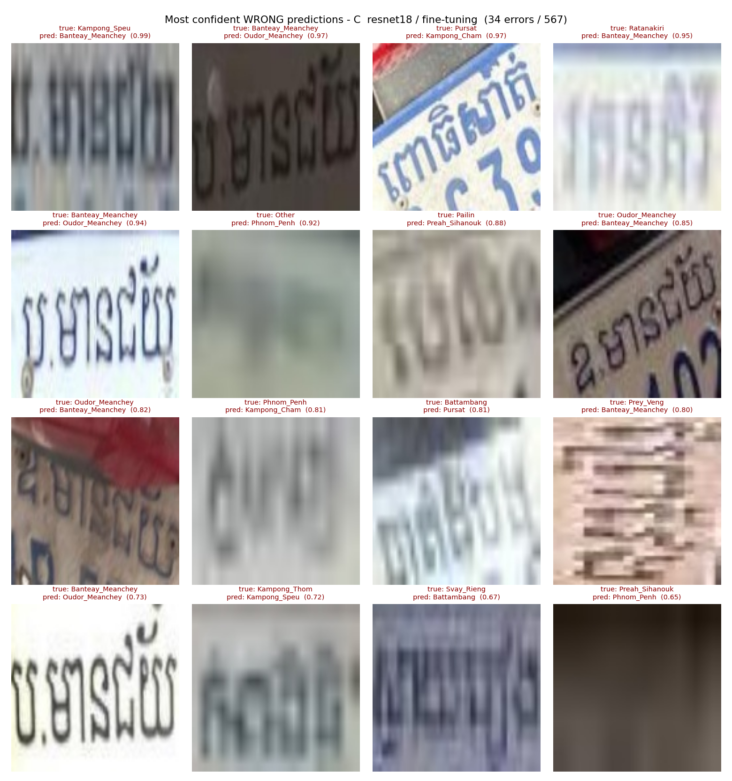
05 · ANALYSIS
Where the 34 errors come from
8 of 34
one pair — Banteay ↔ Oudor Meanchey
MOST CONFIDENT WRONG PREDICTIONS · C
ប.មានជ័យ vs ឧ.មានជ័យ — one glyph apart
1
Other errors also share a whole word
2
Rest: blur, 20-px text, JPEG artefacts
3
Smallest classes 90 % vs 94.2 %
4
Problem
Data
Method
Results
Analysis
Honesty
Conclusion
11
Notes:
Model C makes 34 errors out of 567.
Eight of them — a quarter — are a single pair: Banteay Meanchey and Oudor Meanchey. On a plate both names are abbreviated — point at the card *bor*-dot-meanchey and *oo*-dot-meanchey. The entire decision rests on one small leading letter, and on a blurred plate that letter is gone.
The other frequent confusions are the same story — Battambang and Pursat, Kampong Chhnang and Kampong Thom — names that share a whole word.
point at the gallery Most remaining errors are crops a human cannot read either — motion blur, twenty-pixel text, JPEG blocks.
And class size matters less than I expected: the four smallest classes score 90 percent against 94.2 for the rest, and Mondul Kiri gets five out of five on 18 training crops. It is the visual similarity of the name, not the amount of data, that drives the errors.

Slide 12
05 · ANALYSIS
Why — in course concepts
B → 42 %
ImageNet filters are not Khmer strokes
DOMAIN SHIFT
A ≈ C
2 515 images suffice from random init
DATA SIZE
D → 47 %
0.4 M params cannot separate 26 words
CAPACITY
E → 96.1 %
global self-attention captures full glyph ligatures
ATTENTION
tuning +2.5
fine-tuning wants a training-size LR
OPTIMISATION
Problem
Data
Method
Results
Analysis
Honesty
Conclusion
12
Notes:
Let me explain that ranking with the concepts from the course.
B collapses because of inductive bias and domain shift. ImageNet filters encode natural-image textures and object parts. Khmer letters are stroke shapes. To separate them, the low-level filters themselves have to change — and a 13-thousand-parameter head cannot do that.
A equals C because of data size. Two and a half thousand images are enough to learn glyph features from random initialisation. Pre-training is a good *starting point*, not new knowledge.
D fails because of capacity. Four blocks and 400 thousand parameters cannot separate 26 nearly identical words at 128 pixels. Depth and residual connections matter here.
E succeeds because of self-attention. Global attention across all 196 patches captures full-word Khmer stroke relationships, matching 96.1% and lifting upside-down reading to 26.8%.
And tuning gave the biggest single gain — plus 2.5 points — because full fine-tuning is just training, and training wants a training-size learning rate.

Slide 13
06 · HONESTY
What this study cannot claim
Public scraped data — not purpose-collected
1
13.4 % near-duplicates in the test split
2
567 crops → ± 2 points; A vs C not separable
3
One seed per configuration
4
CNNs and Vision Transformers evaluated (2 architecture families)
5
Problem
Data
Method
Results
Analysis
Honesty
Conclusion
13
Notes:
What this study cannot claim.
The data is public and scraped, not collected for this purpose. The test split carries the 13.4 percent near-duplicate rate I showed you. With 567 test images the uncertainty is roughly plus or minus two points, so A and C genuinely cannot be separated. I used one seed per configuration. And I compared two model families.

Slide 14
07 · CONCLUSION
Four takeaways
01
02
Train the whole network — frozen features do not transfer (42 %)
Transformers excel on script — ViT matches 96.1 % & lifts upside-down to 26.8 %
03
04
Capacity matters — 0.4 M parameters is not enough; 11 M to 86 M is
For CNNs, biggest gain came from tuning the learning rate
Next: re-split by source photo · photograph the five smallest provinces · benchmark Swin Transformer & edge quantization
Problem
Data
Method
Results
Analysis
Honesty
Conclusion
14
Notes:
Four takeaways.
One: for Khmer glyphs, train the whole network — frozen ImageNet features do not transfer (42%).
Two: Transformers excel on script — ViT-B/16 matches 96.1% and improves rotation robustness (26.8%).
Three: capacity matters — 400 thousand parameters is not enough; eleven to 86 million is.
Four: for CNNs, the biggest gain came from tuning the learning rate, not from the architecture.
Next, in priority order: re-split by source photo, photograph the five smallest provinces, and benchmark Swin Transformer and ConvNeXt.

Slide 15
QUESTIONS WELCOME
Thank you
Every number came from a script in the repository.
github.com/SoSereysokbotra
Notes:
Every number in this presentation comes from a script in the repository that you can run. My laptop is open.
Thank you — I am happy to take questions.

Slide 16
APPENDIX
Supporting material
full results · statistics · tuning grid · the gate system · confusion · per-class · measurement · code

Slide 17
APPENDIX · A1
Full results — every column
 | APPROACH | VAL | TEST | CLEAN N=491 | MACRO-F1 | TRAINABLE | TIME
A | ResNet18 scratch | 93.8 % | 93.3 % | 94.7 % | 92.9 % | 11 189 850 | 6.1 min
B | ResNet18 frozen | 40.1 % | 42.0 % | 43.2 % | 37.9 % | 13 338 | 5.3 min
C | ResNet18 fine-tune | 92.6 % | 94.0 % | 95.3 % | 92.4 % | 11 189 850 | 5.9 min
D | small CNN | 48.4 % | 46.6 % | 47.7 % | 40.7 % | 396 058 | 5.3 min
E | ViT-B/16 fine-tune | 96.2 % | 96.1 % | 96.5 % | 95.8 % | 85 818 650 | 8.0 min
1
Model chosen on val; test read once per run
2
Clean subset = the 491 crops with no shared source photo — accuracy is higher, so the leak did not inflate anything
3
All runs: 40 epochs, batch 32, seed 42, Colab T4
Appendix · So Sereysokbotra
A1

Slide 18
APPENDIX · A2
Is the A–C difference real?
McNemar exact test, paired on the same 567 crops
95 % Wilson confidence intervals (n = 567)
 | C RIGHT | C WRONG
A right | 512 | 17
A wrong | 21 | 17
APPROACH | TEST | 95 % CI | WIDTH
A | 93.3 % | 90.9 – 95.1 | 4.1 pts
B | 42.0 % | 38.0 – 46.1 | 8.1 pts
C | 94.0 % | 91.7 – 95.7 | 3.9 pts
D | 46.6 % | 42.5 – 50.7 | 8.2 pts
E | 96.1 % | 94.2 – 97.4 | 3.2 pts
1
38 discordant pairs → p = 0.627
2
Not significant — A and C are a tie
A, C and E overlap in high confidence — which is why 567 images cannot separate top models.
3
I do not claim a winner between them
Appendix · So Sereysokbotra
A2

Slide 19
APPENDIX · A3
Full tuning grid — all six runs
LR | WEIGHT DECAY | BEST EPOCH | VALIDATION | TEST | MACRO-F1
1e-3 | 0 | 33 | 96.60 % ← selected | 96.47 % | 96.04 %
1e-3 | 1e-4 | 35 | 96.03 % | 95.41 % | 95.06 %
3e-4 | 0 | 15 | 95.27 % | 97.00 % | 96.55 %
3e-4 | 1e-4 | 27 | 94.90 % | 95.94 % | 95.35 %
1e-4 | 1e-4 | 36 | 93.19 % | 94.53 % | 93.02 %
1e-4 | 0 | 31 | 92.63 % | 94.00 % | 92.44 %
Yes — 3e-4 scores higher on test (97.0) than the model I selected. Selecting it because it won on test would be selecting on the test set — the exact mistake this project is about avoiding. Validation chooses; test is reported once.
!
Appendix · So Sereysokbotra
A3

Slide 20
APPENDIX · A4
The ALPR system this model serves
YOLOv10
plate detector
ResNet18
province — this study
CRNN + CTC
number reader
compose
province + number
gate
SQLite whitelist, fail-safe
END-TO-END ON REAL SCENES
143/149
plate detected
83.9 %
number correct
94.0 %
province correct
0
false accepts
~50 ms
per frame
149 labelled real scenes · RTX 3050 · whitelist of 137 near-miss plates
Appendix · So Sereysokbotra
A4

Slide 21
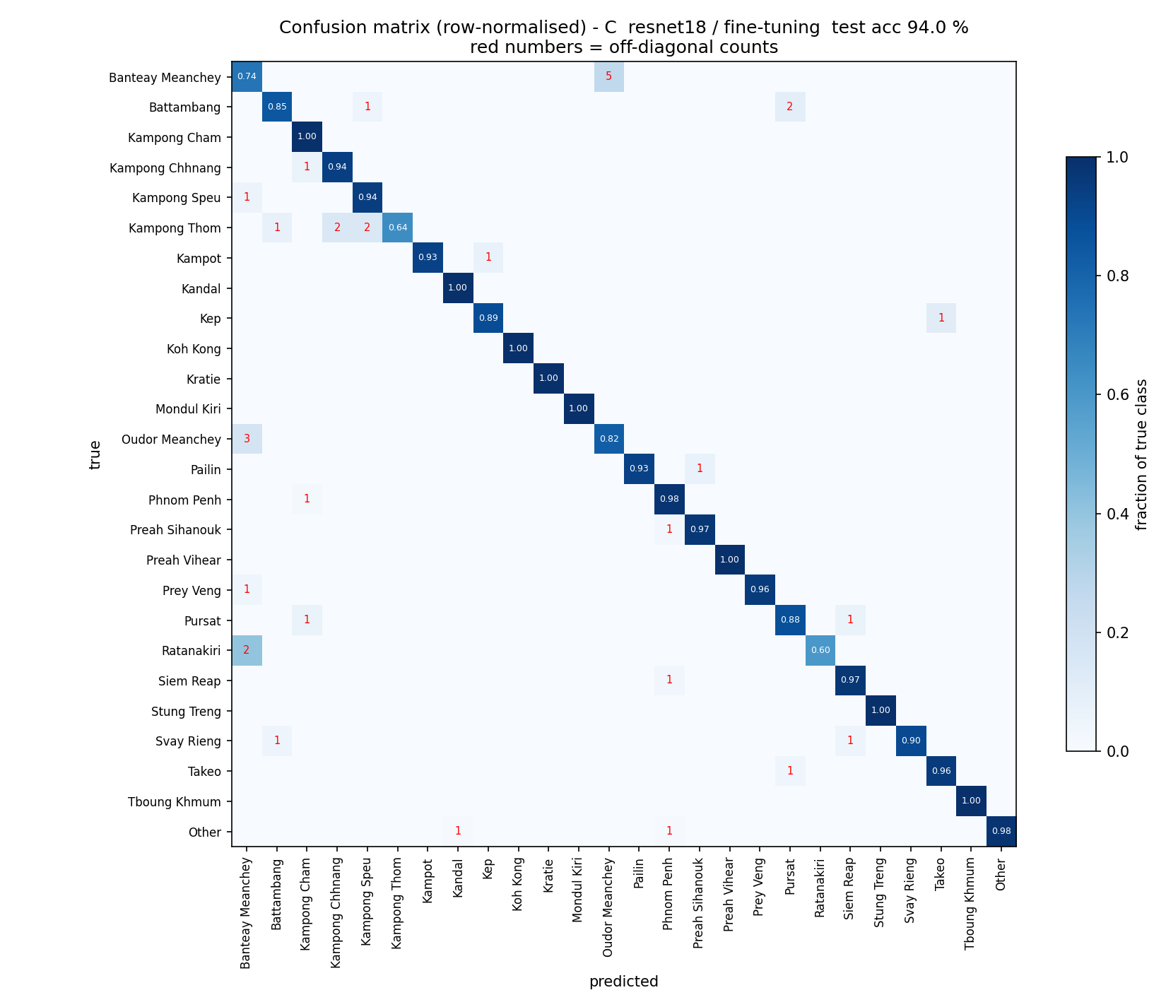
APPENDIX · A5
Confusion matrix — approach C
Appendix · So Sereysokbotra
A5

Slide 22
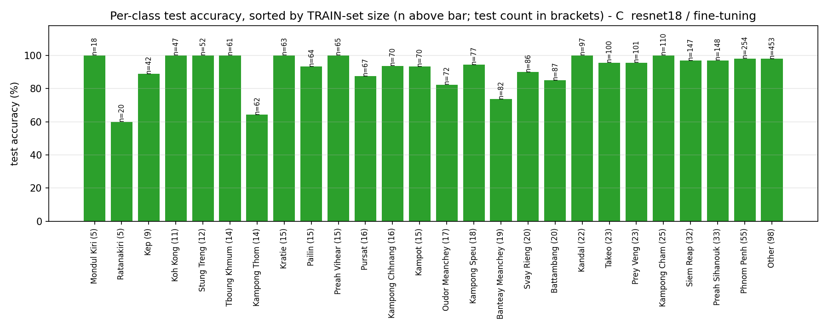
APPENDIX · A6
Per-class accuracy vs training-set size
Appendix · So Sereysokbotra
A6

Slide 23
APPENDIX · A7
Measurement discipline
01
02
CRNN test set: 34.9 % plate-level leakage found
Headline fell 69.1 → 51.7 % — the lower number is reported
03
04
Spatial Transformer proved to do nothing — negative result
experiment_log.csv — every measurement tagged with its commit
Laroca et al. (IJCNN 2023) report 19–68 % duplicates in standard LPR benchmarks.
Appendix · So Sereysokbotra
A7

Slide 24
APPENDIX · A8
The code behind B and D
Feature extraction (B) — only the head trains
SmallCNN (D) — 4 blocks, 128→64→32→16→8, then GAP
for name, prm in model.named_parameters():
if not name.startswith('fc.'):
prm.requires_grad = False # 11 176 512 frozen
else:
trainable += prm.numel() # 13 338 trainable
optimizer = Adam(
[p for p in model.parameters() if p.requires_grad],
lr=args.lr, weight_decay=args.weight_decay)
def block(cin, cout):
return nn.Sequential(
nn.Conv2d(cin, cout, 3, padding=1),
nn.BatchNorm2d(cout), nn.ReLU(True),
nn.MaxPool2d(2))
self.features = nn.Sequential(
block(3,32), block(32,64), block(64,128), block(128,256))
self.pool = nn.AdaptiveAvgPool2d(1) # 396 058 params total
Seed 42 in Python, NumPy, PyTorch, cuDNN and the DataLoader
last.pth saved every epoch + --resume for Colab disconnects
The lr 1e-4 grid cell reproduced run C to the digit
Appendix · So Sereysokbotra
A8

Slide 25
APPENDIX · A9
Encoder, head — and why there is no decoder
image
128 x 128 x 3
ENCODER
conv1 … layer4 + avgpool
feature vector
512-d (256-d for D)
HEAD
Linear(512, 26)
26 scores
softmax -> one class
APPROACH | ENCODER | FEATURE | HEAD | DECODER
A / B / C | ResNet18 conv stack | 512-d | Linear(512, 26) | none
D | 4 conv blocks + GAP | 256-d | Linear(256, 26) | none
E | PatchEmbed + 12 Transformer blocks | 768-d (CLS) | Linear(768, 26) | none
A decoder generates a sequence, one step at a time, each step conditioned on the previous one
CTCDecoder in the number reader is not a neural decoder — it is a collapse rule: argmax per timestep, merge repeats, drop blanks. No weights, never trained.
1
!
My output is one label out of 26 — there is nothing to generate, so a decoder would be architecturally meaningless
2
Appendix · So Sereysokbotra
A9

