Slide 1
An ELECTRE-based outranking method for multiple criteria decision making using interval type-2 fuzzy set Batch No. 14
SOAMYA AGRAWAL VIDYA RAVISHANKAR MANAN AGARWAL
2014A7PS0185H 2014AAPS0212H 2014B4A40926H

Slide 2
BEFORE MID SEMESTER WORK COMPLETED
Collection of required study material
Understanding the algorithm
Acquaint with MATLAB
Calculation of algorithm on paper

Slide 3
AFTER MID SEMESTER WORK COMPLETED
Implementation of above algorithm
Testing the above code on supplier selection problem
Validate for the hypothetical situation
Analyzing the result.

Slide 4
INRTODUCTION
Develop an ELECTRE based outranking method for multiple criteria group decision making within the environment of interval type-2 fuzzy sets.
Trapezoidal fuzzy numbers are considered.
Employs signed distances to determine concordance and discordance indices.
Decision graph is constructed to determine partial-preference ordering of alternatives and ELECTREcally non-outranked solutions.

Slide 5
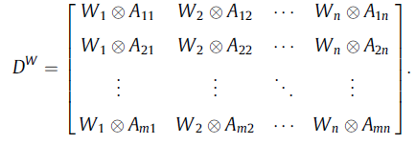

ALGORITHM
1.The weighted collective decision matrix DW with IT2TrFNs can be constructed as follows:
2.The signed distance from A to ~0 is expressed as follows:
3.The concordance set and discordance set respectively are:

Slide 6


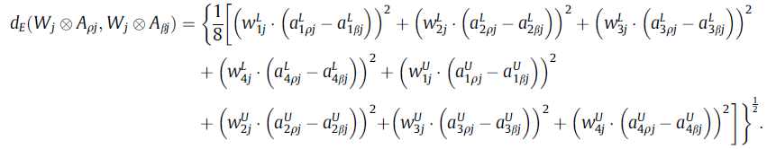


ALGORITHM
4.The concordance set is defined as follows:
5.Average concordance index:
6.Normalized Euclidean distances between the weighted collective evaluation values:
7.The discordance index is defined as follows:
8.Average discordance index:
9.Concordance outranking matrix G1:
Each element of the matrix has value 0 or 1, 1 indicates the majority of criteria favoring Zp

Slide 7


ALGORITHM
10.Discordance matrix:
It is the opposite of concordance matrix. 1 indicates that the majority
Of criteria favor Zp over Zb
11.aggregate outranking matrix G:
Found by conducting the intersection operation between concordance and discordance matrix
12.Based on G, we can construct a decision graph to obtain the partial-preference ordering of the m alternatives. The conditions for determining if zq is not outranked by the ELECTRE-based outranking procedure are:

Slide 8
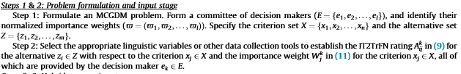
ALGORITHM

Slide 9
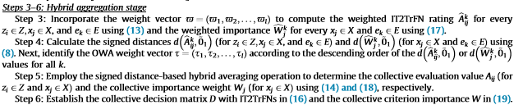

Slide 10
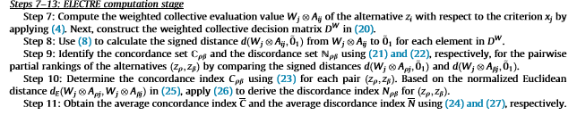
ALGORITHM

Slide 11
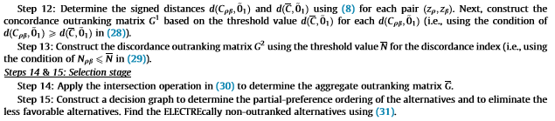

Slide 12
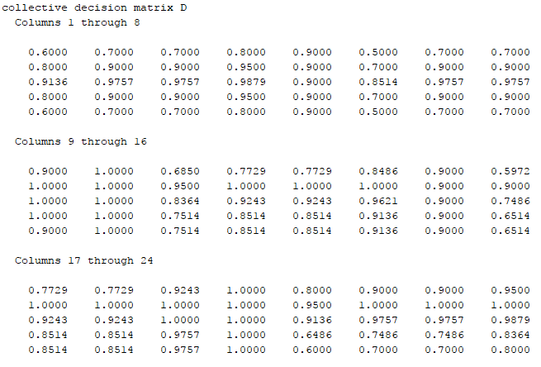
SUPPLIER SELECTION PROBLEM

Slide 13
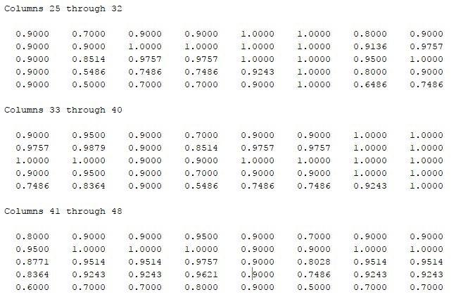
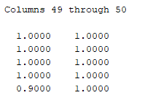
SUPPLIER SELECTION PROBLEM

Slide 14
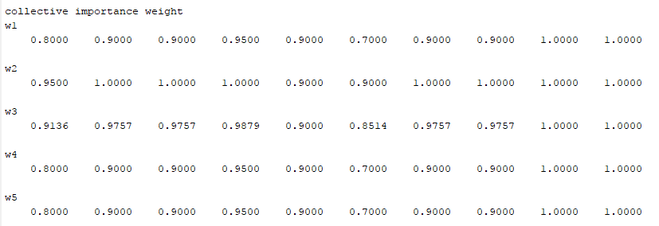
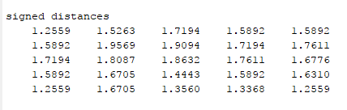
SUPPLIER SELECTION PROBLEM

Slide 15
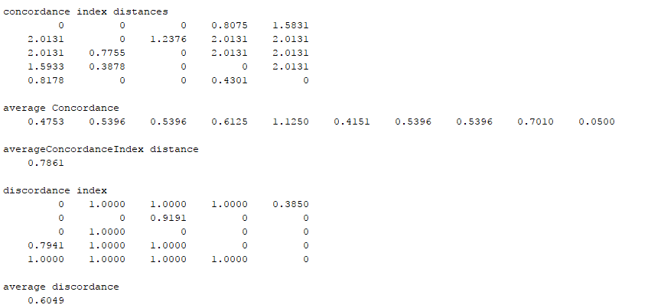
SUPPLIER SELECTION PROBLEM

Slide 16
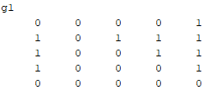
SUPPLIER SELECTION PROBLEM
Concordance outranking matrix G¹

Slide 17
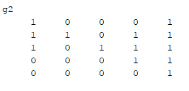
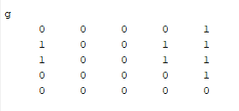
SUPPLIER SELECTION PROBLEM
Discordance matrix G² using the threshold value for the discordance index
Apply the intersection operation to determine the aggregate outranking matrix G.

Slide 18
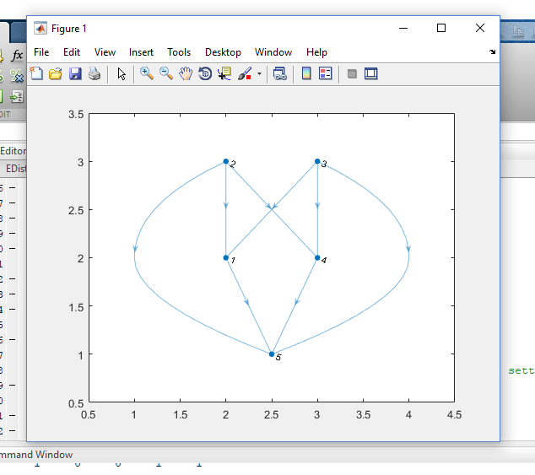
DECISION GRAPH
Decision graph to determine partial preference ordering of the alternatives and to eliminate less favorable alternatives.

Slide 19
RESULT ANALYSIS
We obtained the decision graph for the supplier selection problem .
It follows that z1,z4,z5 can be eliminated with the proposed ELECTRE-based outranking method.
We cannot discern the preference relation between z2 and z3.
These two alternatives are therefore the ELECTREcally non-outranked alternatives.

Slide 20
FUTURE WORK THAT CAN BE DONE
The existing algorithm could be extended to give linear ordering of the alternatives too using appropriate aggregate functions.

Slide 21
THANK YOU.
SOAMYA AGRAWAL VIDYA RAVISHANKAR MANAN AGARWAL
2014A7PS0185H 2014AAPS0212H 2014B4A40926H

