Slide 1
Fuzzy analytic hierarchy process with interval type-2 fuzzy sets
SOAMYA AGRAWAL MANAN AGARWAL
VIDYA RAVISHANKAR RAHUL LADDA

Slide 2
INTRODUCTION
Type-1 Fuzzy Sets Membership functions associated with Type-1 Fuzzy Sets have no uncertainty associated with it.
Type-2 Fuzzy Set lets us incorporate the uncertainty of membership functions into the fuzzy set theory.
Analytic Hierarchy Process (AHP) is a widely used multi criteria method for organizing and analyzing complex decisions that can take into account various conflicting criteria at the same time.
An interval type-2 fuzzy set is a special case of a generalized type-2 fuzzy set.
Interval type-2 fuzzy sets are the most commonly used type-2 fuzzy sets because of their simplicity and reduced computational effort with respect to general type-2 fuzzy sets. For this reason, we used interval type-2 fuzzy sets.

Slide 3
OBJECTIVES
Our objective is to develop an interval type-2 fuzzy AHP method together with a new ranking method for type-2 fuzzy sets.
We apply the proposed method to a supplier selection problem.
An interval type-2 fuzzy AHP method is developed. The linguistic scale of fuzzy AHP is expressed in a more detailed and flexible way by interval type-2 fuzzy sets.
New defuzzification methods for both triangular and trapezoidal type-2 fuzzy sets are also incorporated into the developed method.

Slide 4
METHODOLOGY
Basics of Interval Type-2 Fuzzy sets.
defuzzification methods including two methods DTriT and DTraT.
proposed interval Type-2 fuzzy AHP method.
Illustration
Conclusion

Slide 5
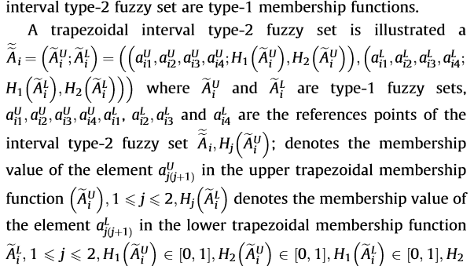

BASICS OF INTERVAL TYPE-2 FUZZY SETS

Slide 6
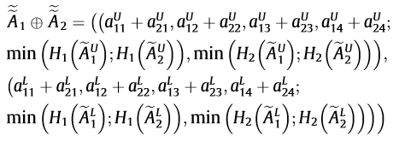
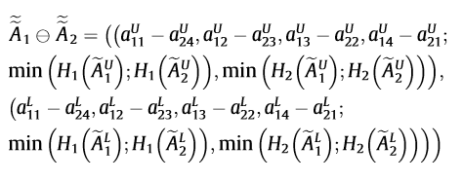
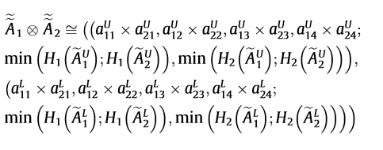
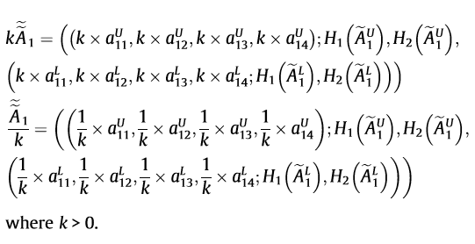
Operations On INTERVAL TYPE-2 FUZZY SETS

Slide 7



Defuzzification methods for TYPE-2 FUZZY SETS

Slide 8
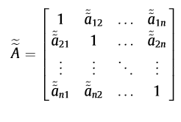
PROPOSED INTERVAL TYPE-2 FUZZY AHP
We are extending Buckley’s fuzzy AHP approach using interval type-2 fuzzy sets.
Step-1
Fuzzy pairwise comparison matrices among all the criteria in the dimensions of the heirarchy system are constructed as following:

Slide 9
PROPOSED INTERVAL TYPE-2 FUZZY AHP
Step-2
The consistency of each fuzzy pairwise comparison matrix is examined using proposed DTriT and DTraT approach.

Slide 10


PROPOSED INTERVAL TYPE-2 FUZZY AHP
Step-3
The geometric mean of each row is calculated and then the fuzzy weights are computed for normalization.
Geometric mean of each row ->
Fuzzy weight of the ith criterion>

Slide 11


PROPOSED INTERVAL TYPE-2 FUZZY AHP
Step-4
The fuzzy weights and fuzzy performance scores are aggregated as follows:
Step-5
The classical AHP’ method’s procedure is applied to determine the best alternative.

Slide 12
FUTURE WORK EXPECTED TO BE COMPLETED
Implementation of above algorithm on supplier selection problem
The problem has 4 criteria and 2 alternatives.
Criteria are Price, Quality, Delivery and Capacity.

Slide 13
THANK YOU.
SOAMYA AGRAWAL MANAN AGARWAL
VIDYA RAVISHANKAR RAHUL LADDA

