Slide 1

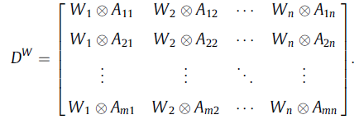

Signed distances in the IT2TrFN context:
The signed distance from A to ~0 is expressed as follows:
The weighted collective decision matrix DW with IT2TrFNs can be constructed as follows:
The concordance set and discordance set respectively are:

Slide 2


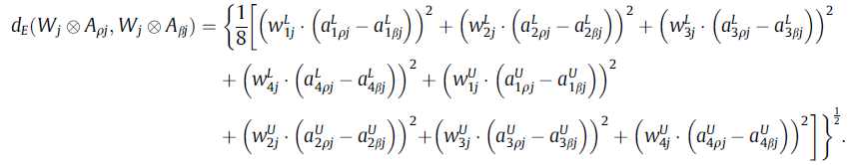


The concordance set is defined as follows:
average concordance index:
normalized Euclidean distances (dEÞ) between the weighted collective evaluation values:
the discordance index is defined as follows:
average discordance index:
concordance outranking matrix G1:
Each element of the matrix has value 0 or 1, 1 indicates the majority of criteria favoring Zp

Slide 3




It is the opposite of concordance matrix. 1 indicates that the majority
Of criteria favor Zp over Zb
Discordance matrix:
aggregate outranking matrix G:
Found by conducting the intersection operation between concordance and discordance matrix
Based on G, we can construct a decision graph to obtain the partial-preference ordering of the m alternatives. The conditions for determining if zq is not outranked by the ELECTRE-based outranking procedure are:
net concordance outranking value of each alternative:
net discordance outranking value of each alternative:

