Slide 1

Networks
START

Slide 2
Which best describes a network?
Two or more computers connected together in order to communicate

Slide 3
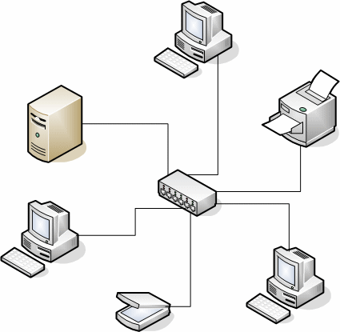
Correct
A network is when two or more computers are connected together and can communicate with each other, this has many benefits/advantages.
NEXT

Slide 4
Click on ALL the advantages of using a computer network
You need to get all 8 in order to get all the numbers, once you have revealed all 8 numbers click each one in ascending order at the bottom. (like an 8 digit code)
Sharing hardware
7
Online shopping
Sharing software
Communicate with the dead
14
4
Store personal information
Expensive to set up
Monitor user access
6
Communication
Access to a lot of information
Free email
10
2
Unlimited memory
Backing up data
Share files
12
15
1
2
3
4
5
6
7
8
9
10
11
12
13
14
15

Slide 5
What does LAN stand for?
Long Area Network
Local Automated Network
Local Area Network
Lateral Authentic Network

Slide 6
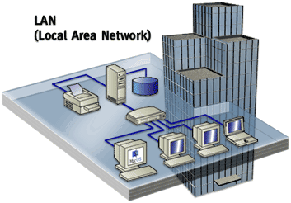
Correct
LAN- stands for Local Area Network and is a type of Network where the computers are connected in a local environment such as an office block or a school.
NEXT

Slide 7
What does WAN stand for?
Wide Access Network
Wide Automatic Network
Weathered Access Network
Wide Area Network

Slide 8

Correct
A wide area network is when computers are connected on a much larger scale, even globally, when Local area networks are connected together they form a WAN. The internet is an example of a WAN.
NEXT

Slide 9

What is the main computer of the network, and stores the users files created on the network?
Mainframe
File server
Master computer
Router

Slide 10
Name the hardware from the description
Each computer MUST have one of these to be connected to a network. It communicates with the file server and other computers on the network.
GRAPHICS CARD
NETWORK INTERFACE CARD
MODEM
SOUND CARD

Slide 11
Name the hardware from the description
Created to take digital signals from a computer and convert them to analogue so that they can be transmitted down a telephone line.
SWITCH
SERVER
MODEM
ROUTER

Slide 12
What is an ISP?
Internet Station Protocol
Internet Service Protocol
Internet Service Provider
Internet Station Provider

Slide 13

Read this…
Correct Internet Service Provider. An ISP sells Internet access to companies and individuals.
It provides web servers which connect to the Internet.
An ISP will provide it’s customers with a wide range of services…
  Bandwidth options.
  Email service.
  Web Hosting.
  Online and Telephone assistance.
NEXT

Slide 14
You can access a website or web page by typing its URL into the address bar of your browser. An example of a URL is http://www.bbc.co.uk.
What does URL stand for?
Universal Resource Locator
Uniform Resource Locator
Unidentified Resource Location
Uniform Resource Logic

Slide 15
A computer that is not connected to any network is known as what?
Lonely Machine
Solitary Computer
Workstation
Stand Alone computer

Slide 16

Networks: Security
Because networks are almost vital to an organisation’s daily activities, they must be kept safe and secure…
NEXT
There are 3 main types of network security…
Physical, Access and Data.

Slide 17
Which one of these is an example of PHYSICAL security?
Using encryption
Installing a firewall
Locking the doors of the computer lab
Leaving the windows open
passwords
Security cameras
Backing up files
Anti virus software

Slide 18
CORRECT!!
Physical security means that the hardware of the network is protected from theft and kept safe.
NEXT

Slide 19

Which of these is an example of Access security?
Using encryption
Installing a firewall
Locking the doors of the computer lab
Username
passwords
Security cameras
Backing up files
Anti virus software

Slide 20
CORRECT!
Access security means that there is a limit to the amount of access a user has to the information held on the network.
NEXT

Slide 21

Which of these is an example of Data security?
Rottweilers
Installing a firewall
Locking the doors of the computer lab
Leaving the windows open
passwords
Security cameras
Backing up files
Using expensive machines

Slide 22
CORRECT!
Data security means that there are measures taken to prevent the loss of data held on the system.
NEXT

Slide 23
CONGRATULATIONS
Password= BANDWIDTH

Slide 24
Incorrect
Try Again
You failed! You now have to start from the beginning lol!

