Slide 1
Used video games trade site
Name: Yi Liu
NUID: 001819429

Slide 2
The Used Video Games Trade Site serves as an intermediary to players needing to sell games they have already cleared or games they don't like anymore.
Since video games are getting more and more expensive, and a video game may not be attractive to players when they beat this game, putting these games aside? What a waste!
The Used Video Games Trade Site based on SSH(Spring, Spring MVC, Hibernate), it’s a website looks like a market where players could post their used video games, other players could search specific games or sorted used video games by time.
The Used Video Games could provide used video games details for customer who want to buy used video games.

Slide 3
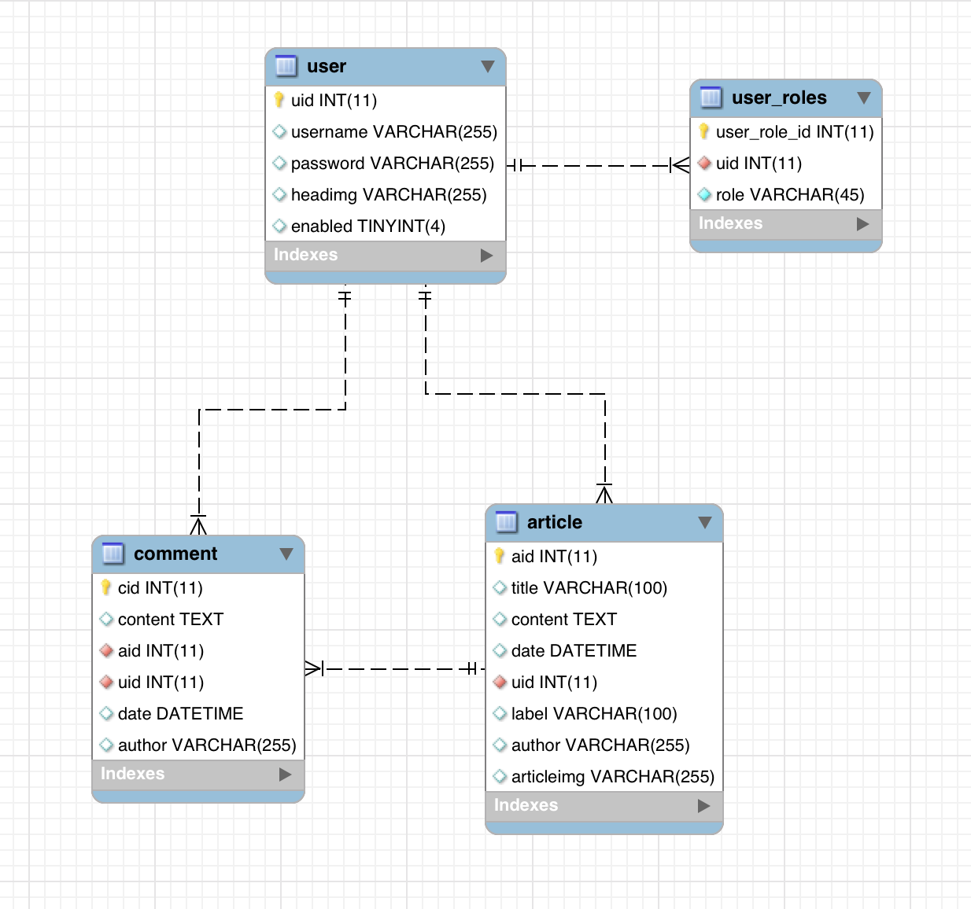
Data ER diagram
Satisfying with 3NF

Slide 4
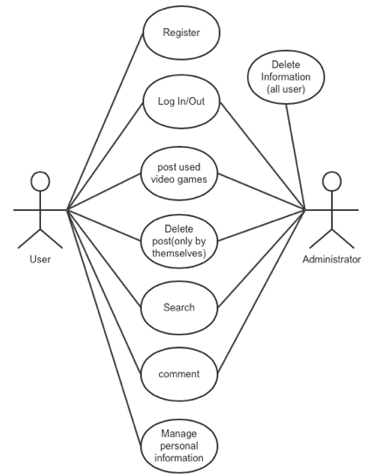
Here is an use case diagram, describes the mainly function of my project, as an user, after your registration, you could post your games into this trade site or you could review a game after you login this system.
There is a search function, you could search games by keywords or tags.
Also you can click someone you interested in, enter his personal home page, you can see his previous posts.
People could register for an user, you could delete your own posts or reviews.
System administrator could delete each person’s posts and reviews.

Slide 5
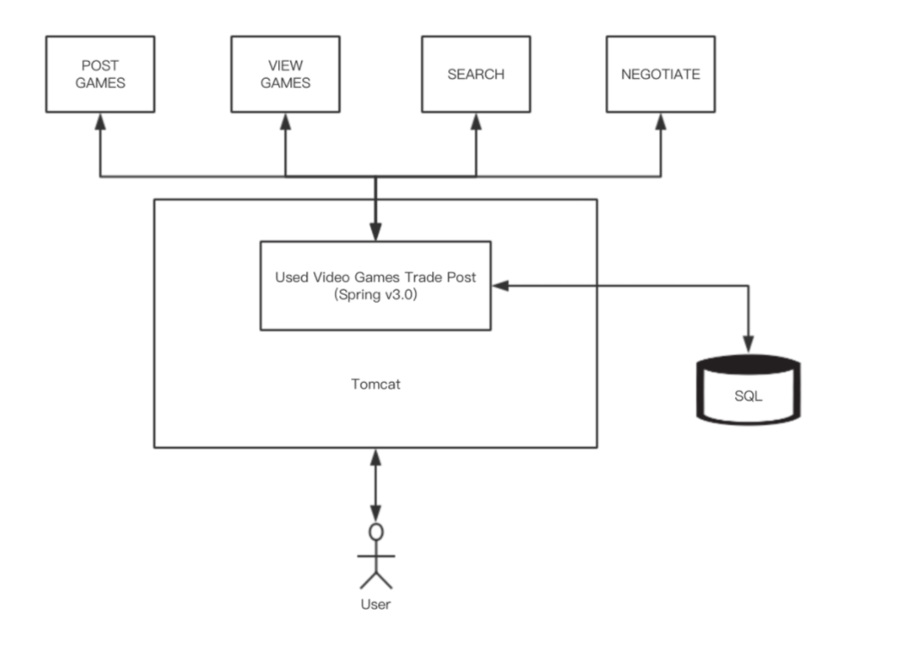
Conceptual view

Slide 6
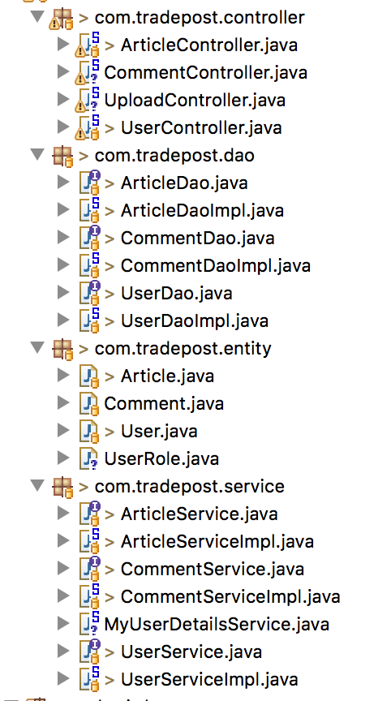
There are four packages in my project, controller package is for dealing with input in specific ways.
Entity package is for abstracting data into objects.
Dao package is for manipulating database.
Service package is for encapsulating business logic.

Slide 7
Demo

Slide 8
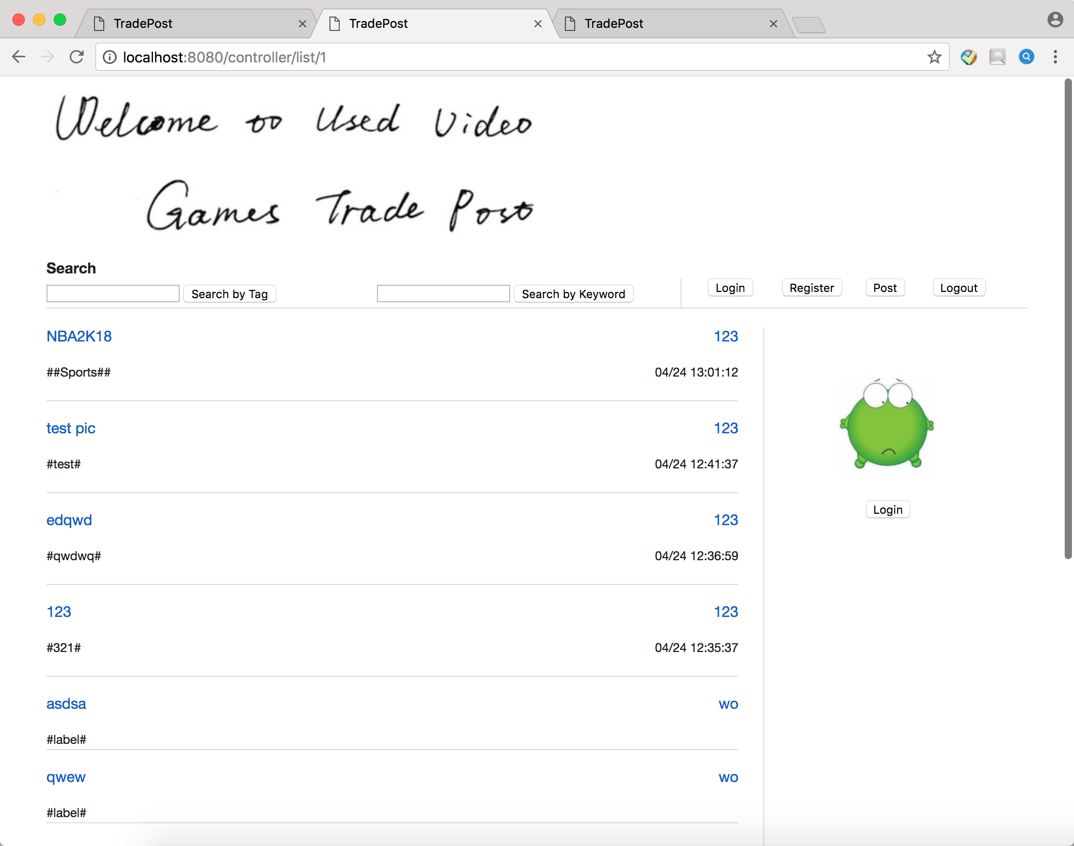
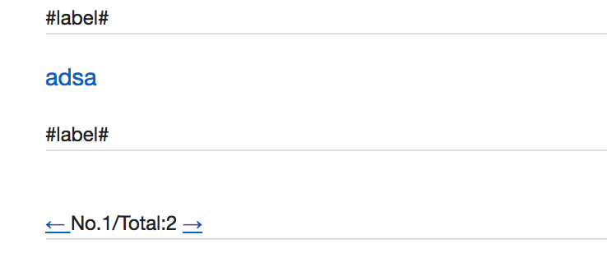
Main page

Slide 9
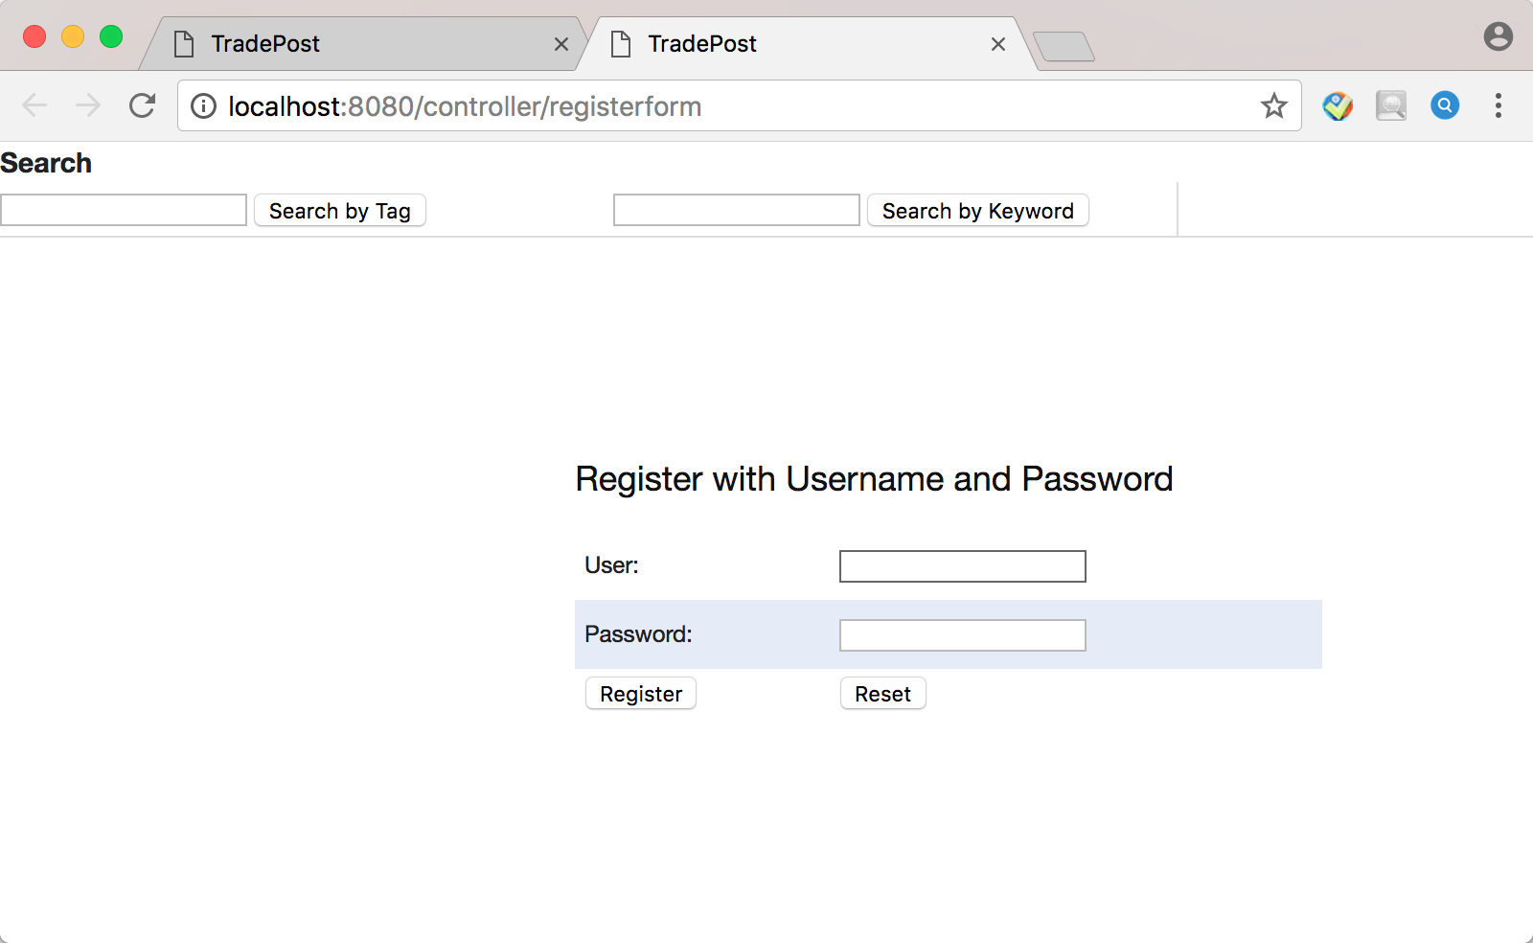
Function implements: Register / Login / Post / Logout

Slide 10
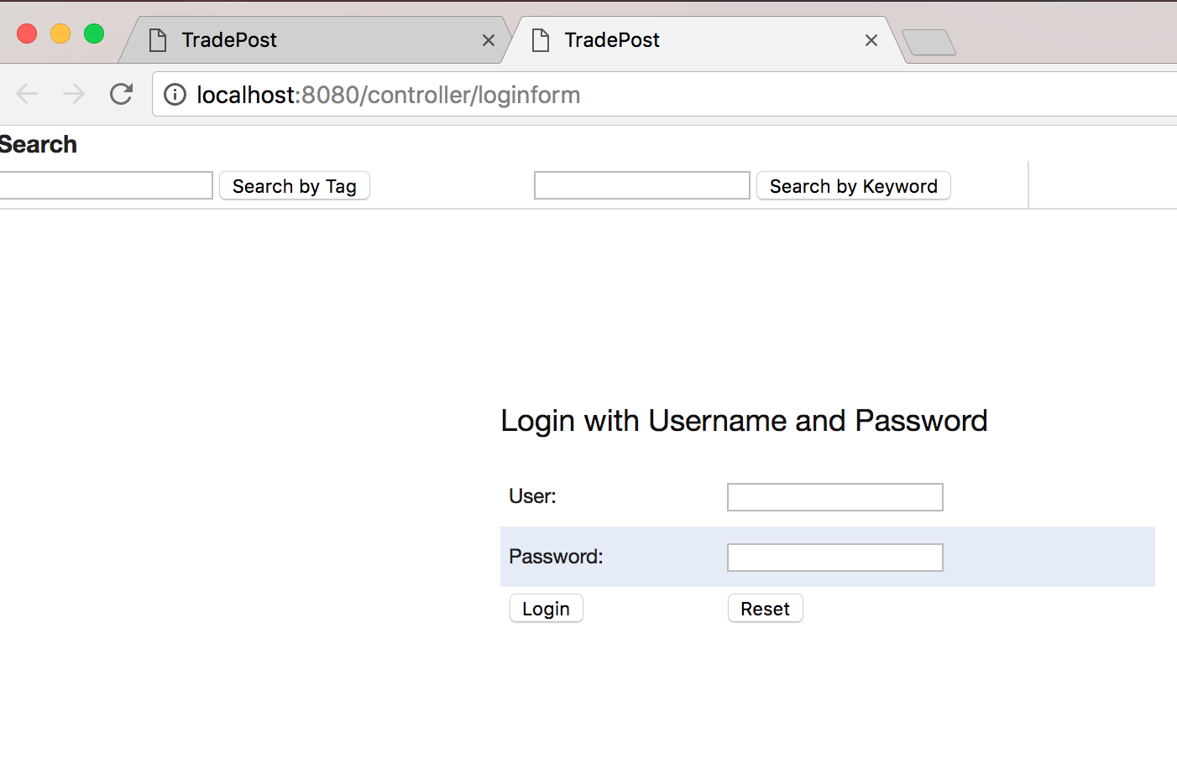
Function implements: Register / Login / Post / Logout

Slide 11
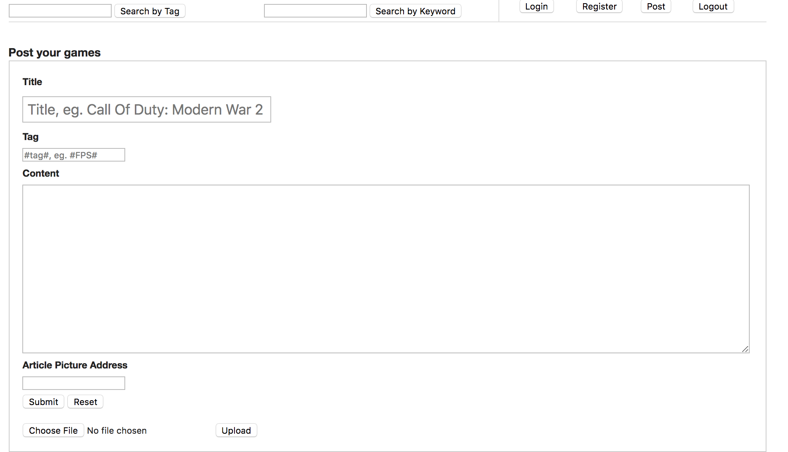
Function implements: Register / Login / Post / Logout

Slide 12
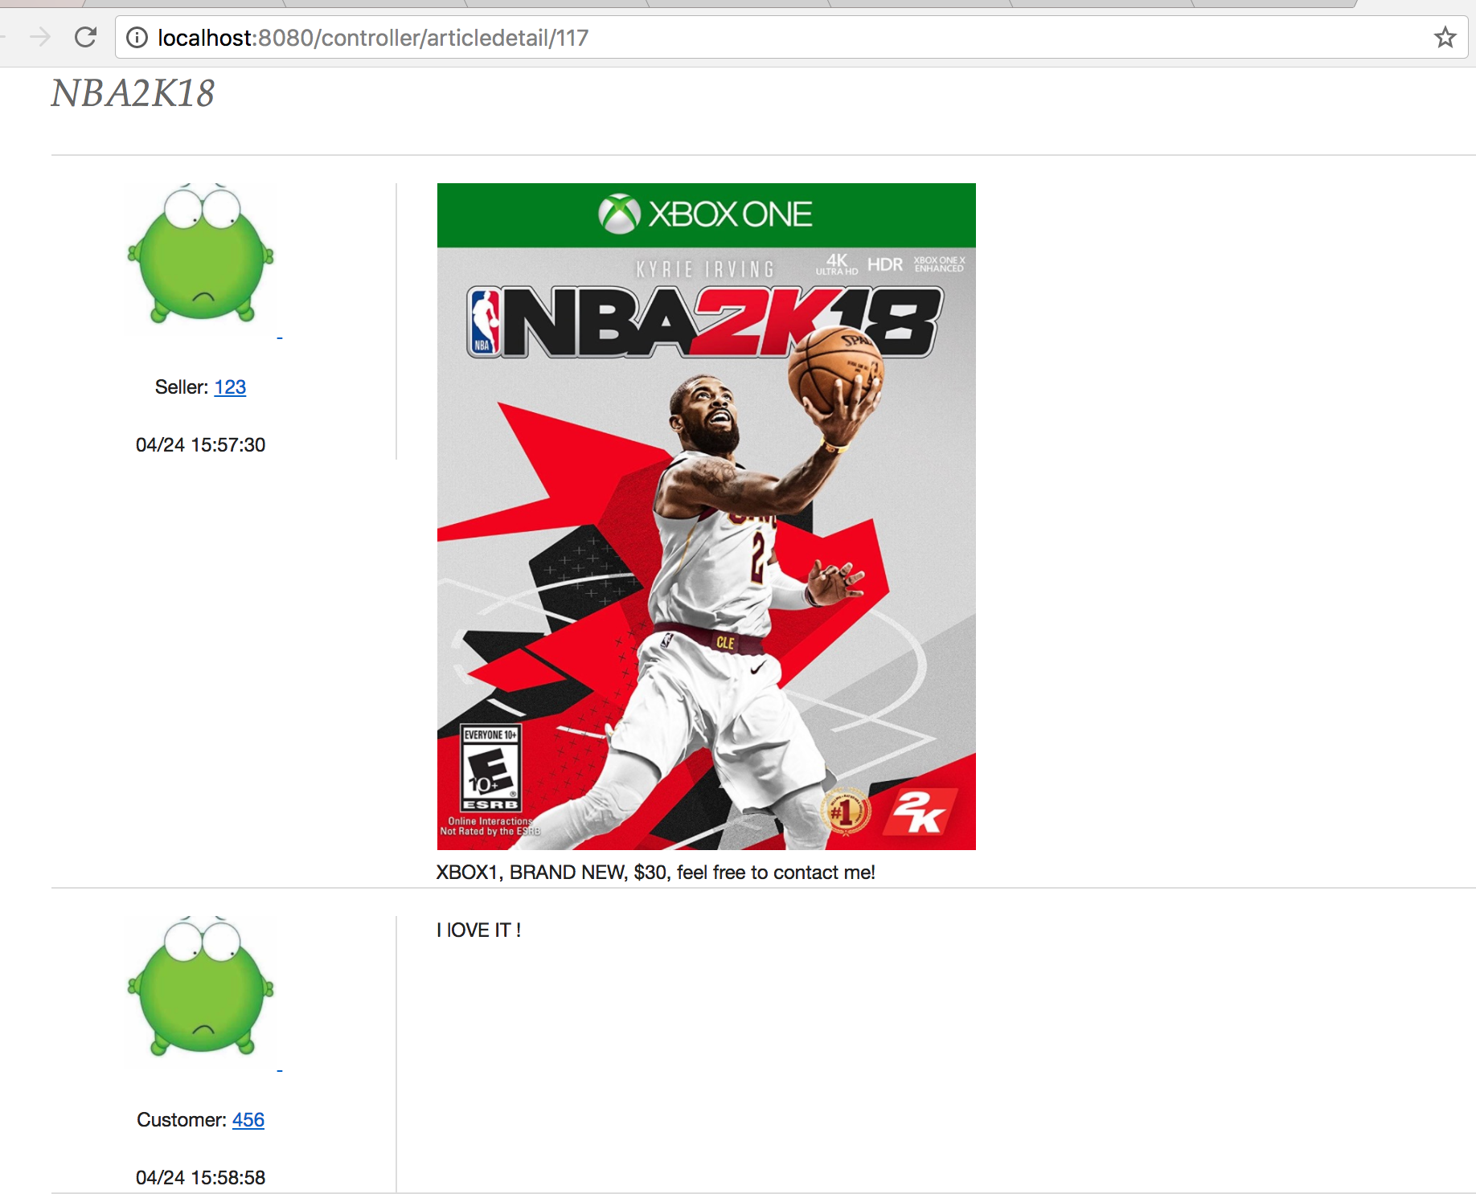
Post Details
And reviews

Slide 13
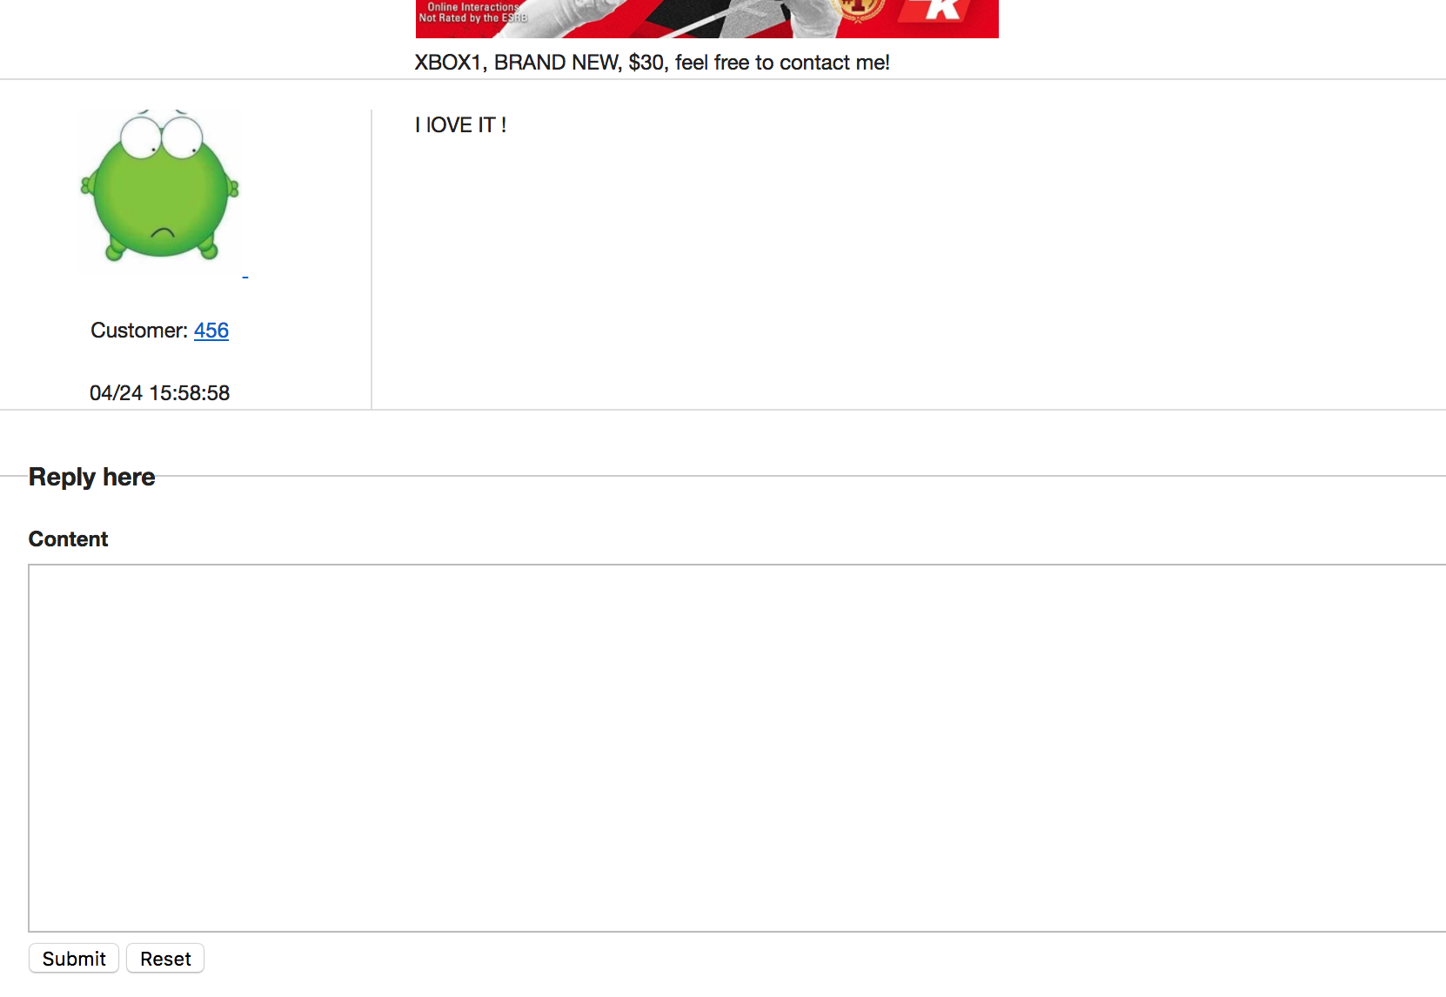
Reviews and
reply function

Slide 14
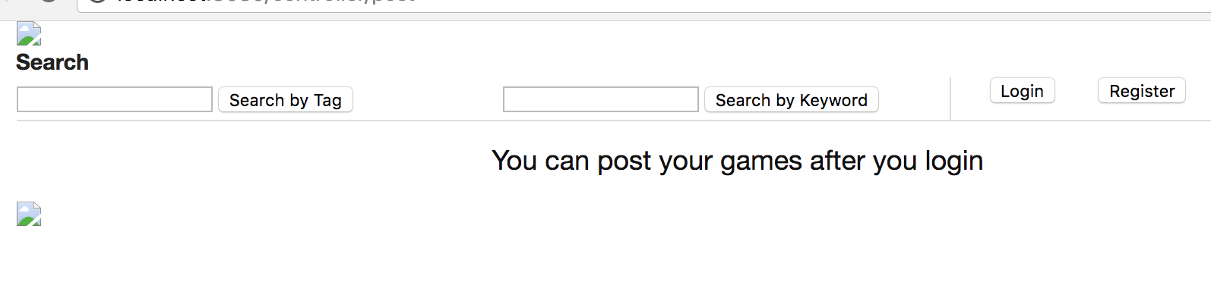
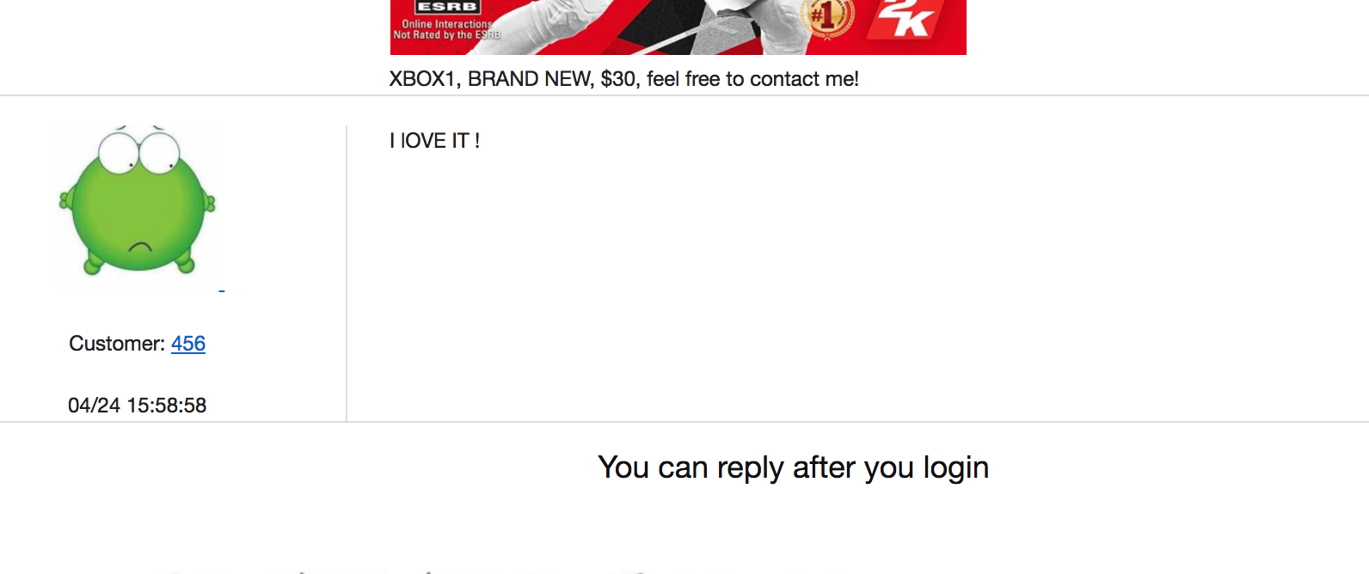

Slide 15
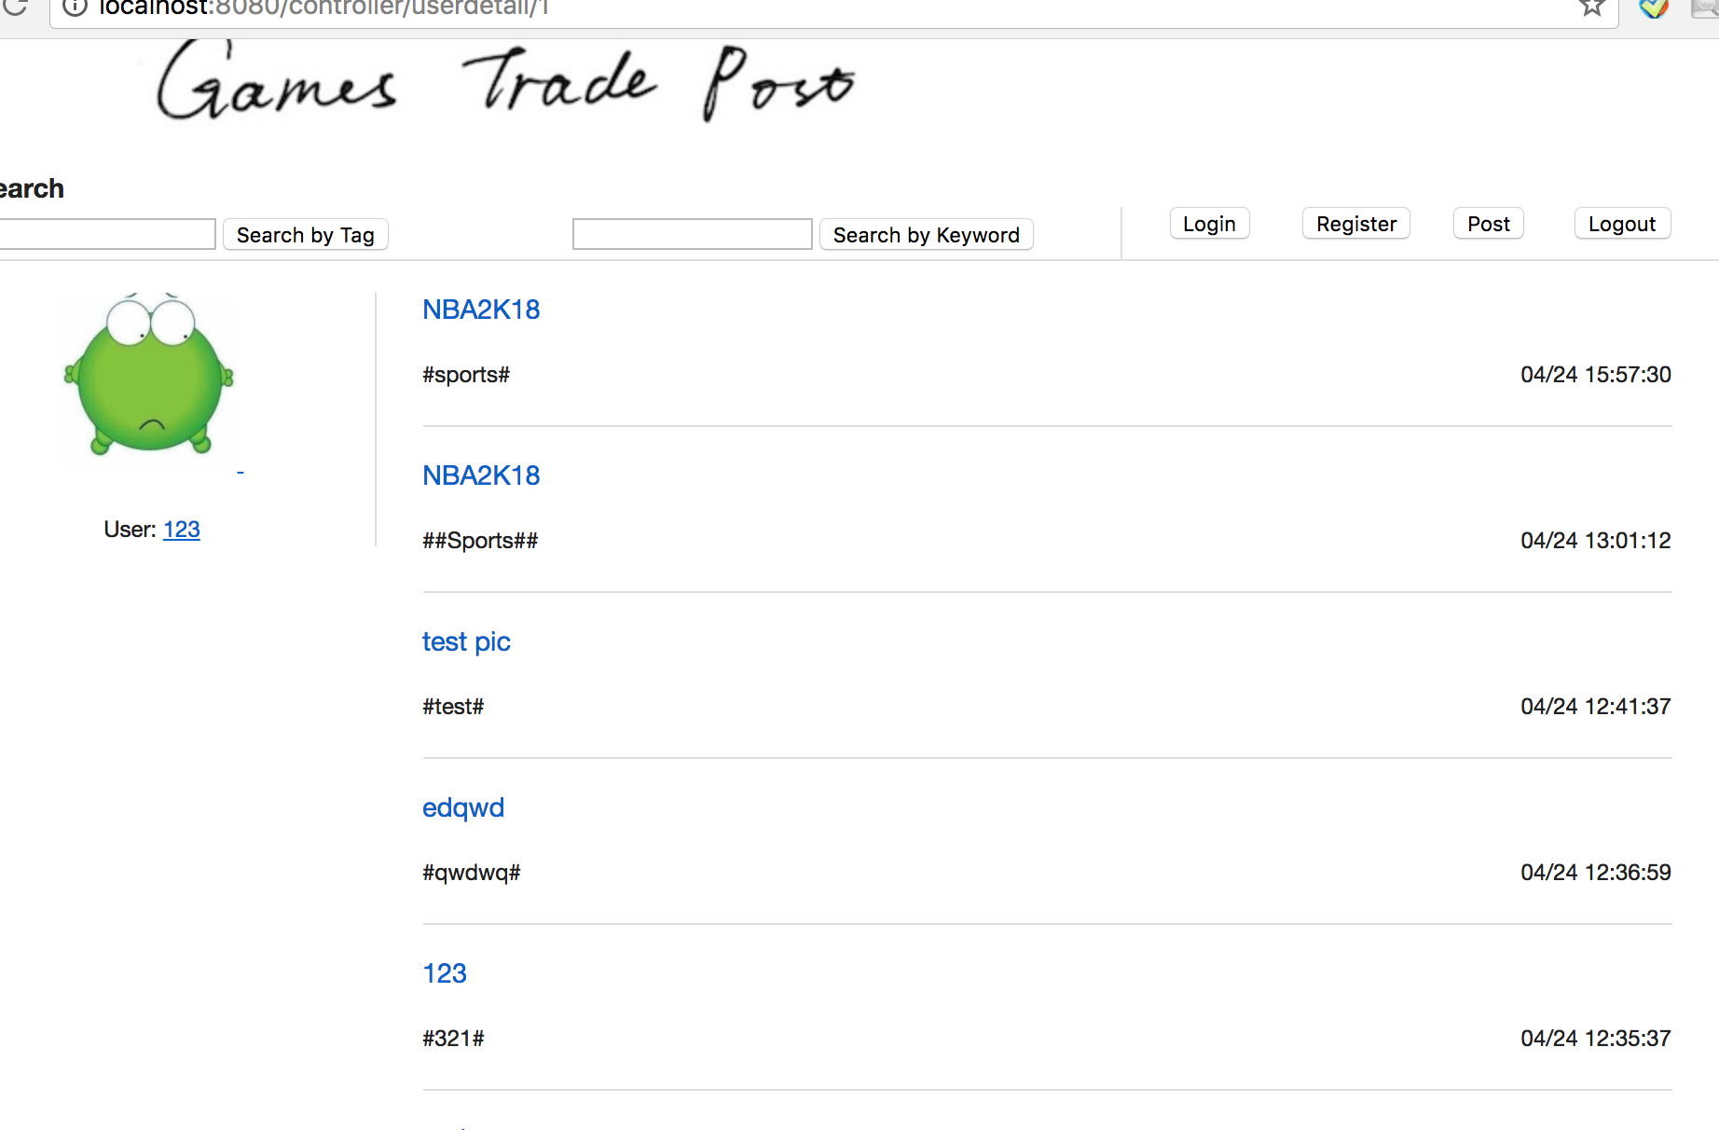
previous posts

Slide 16
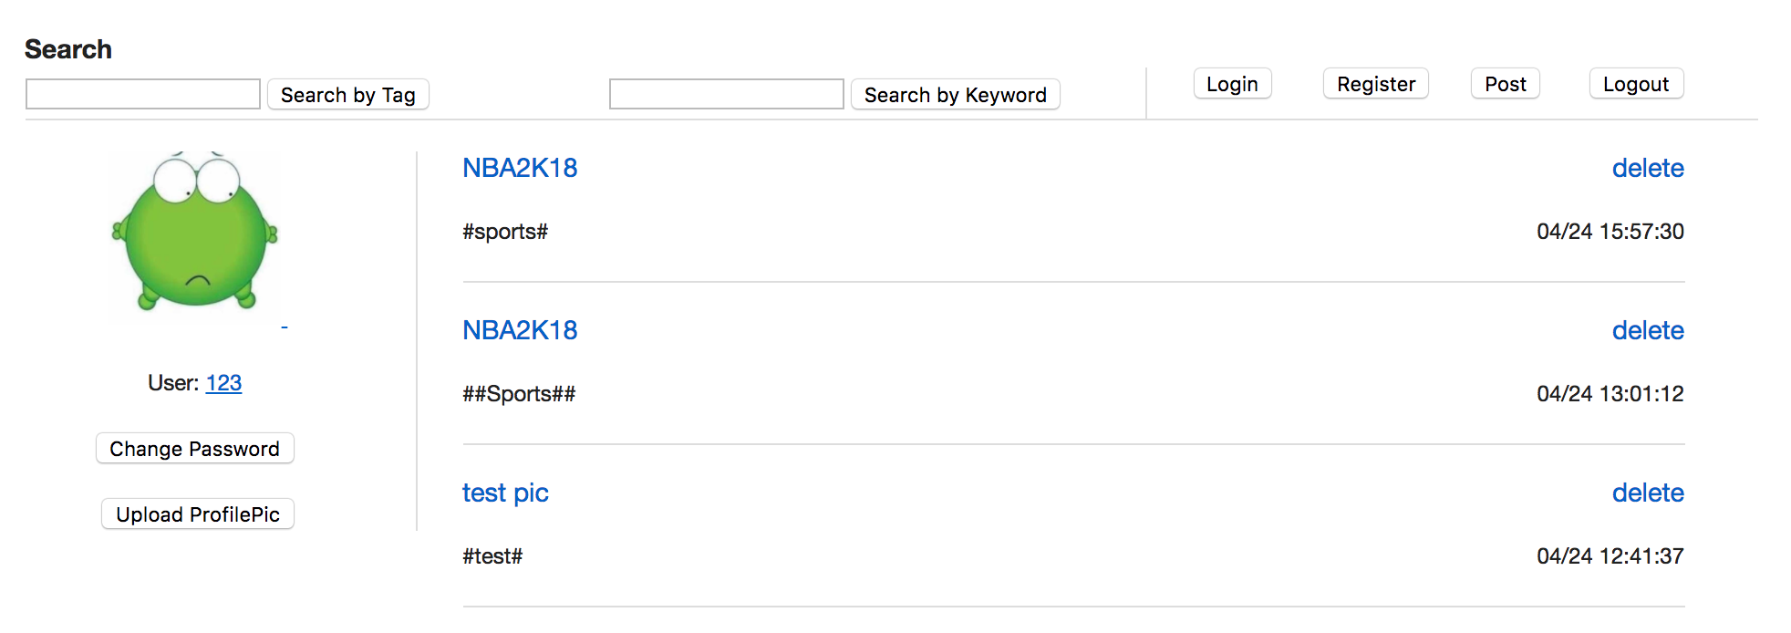
If you own this account, this page will show management button for you, for example, you can change your profile photo by reuse upload picture function, or you could change your password here.
If your games was sold out or you don’t want to sell it, you can delete your posts here!

Slide 17
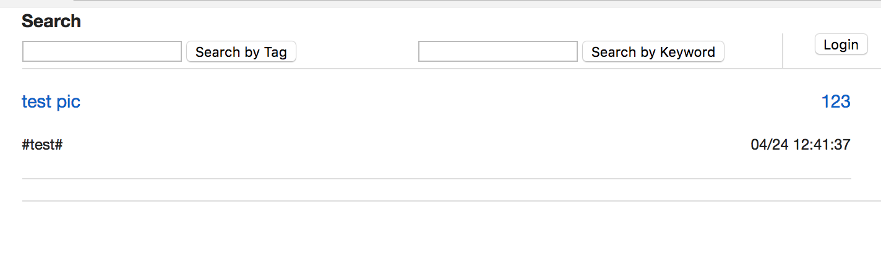
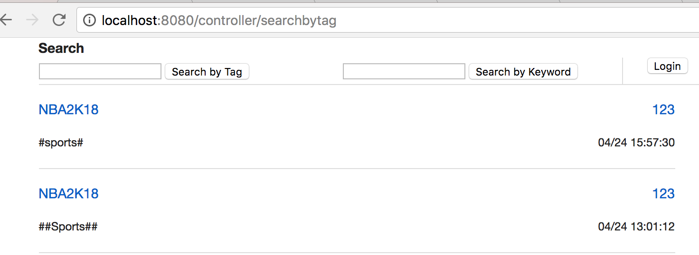
Function implements: Search

Slide 18
THANK YOU!

