Slide 1
KaiOS FOTA ODM Configuration Guide

Slide 2
Modify history
2018/01/06 create for 9820E for JIO
2018/05/14 Modidy by Bojan

Slide 3
Contents
Modify for Building
Add release key into building
Configure FOTA Information for upgrade
How to generator Diff Package
Select image for upgrade
Generator the diff Package
Generator the full Package
Test Fota install locally
Test Fota download part

Slide 4
Add Release key--Customize Keys
Release key
Edit cert.mk
PRODUCT_DEFAULT_DEV_CERTIFICATE := vendor/release/releasekey
Put cert.mk into vendor/release/(this path can customized by yourself)
Copy release and other keys(testkey, platform, shared and media from build/target/product/security) into vendor/release/
Add -include vendor/release/cert.mk on top of code path : device/sprd/scx35l/common/device.mk
Test key
Remove cert.mk

Slide 5
FOTA Master Server Address
MUST be configured to an available kaiOS FOTA server.
Add property:
ro.fota.SUMaster
ro.fota.network_type
ro.fota.network_port
E.g:
ro.fota.SUMaster = fota.mst.dev.jiophone.net
ro.fota.network_type = http
ro.fota.network_port = 80
Refer to JIO Spec “Ril Fota Rules_Guideline”

Slide 6
Product Rule
Each ODMs uses a different CU Ref
Add property: ro.fota.cu_ref.
E.g ro.fota.cu_ref = LS2401-FBJIINB
Apply a unique CU number from JIO/KaiOS.
Refer to JIO Spec [Ans]
Its max length is 20

Slide 7
Version Numbering Rule
Every version has a unique version number
Add property: ro.fota.sw_ver
E.g ro.fota.sw_ver = 01220100
Refer to JIO Spec for the version naming
Its max length is 20

Slide 8
Images select
For secure boot
please sign the modem bins and select all the signature bins.
select the signature images: boot, recovery, uboot, spl, sml and tos
For non-secure boot
Select all the un-signature bins and images above
select system, oem_fota_meta.zip, ramdisk.img and ramdisk-recovery.img

Slide 9
Generator diff and full Package
Apply signature release key:
Configure the release key and the password of release private key in file gen_update_pkg_start.sh and gen_full_update_pkg_start.sh
Diff Package:
Put the selected images(Page 8) into software/src and software/tgt
Command: ./prepare_pkg_start.sh
Command: ./gen_update_pkg_start.sh
Full Package:
Put the selected images(Page 8) into and software/tgt
Command: ./prepare_pkg_start.sh
Command: ./gen_full_update_pkg_start.sh

Slide 10
Test Fota install locally
Only Installing Function
Push update.zip to SD Card
Enter Recovery mode.
Select “Apply update from SD Card”
Check result
Installing and animation
adb root and adb push update.zip /data/fota/update.zip;
adb shell and cd cache/recovery(if recovery is not existed, just do: mkdir recovery);
echo "--update_package=/data/fota/update.zip" > command;
reboot recovery

Slide 11
Publish the package on the FOTA server
First to Sign in the FOTA Server
Bind devices to Test
Test with PUBLISH function

Slide 12
Bind devices to Test
Create device IMEI: Click Test->Devices->Create->Device Type: IMEI->Input the IMEI->Save.
Note: you can create new device group for your test device.
Create CU: Main Data->Product Class->Create->...->Save
Upload Diff Package to KaiOS FOTA server: Software->Upload->Choose product family and CU reference->Uploading Directory->Then upload.
Notes: Follow the .zip name rule when you choose zip file to upload,
e.g.: QCT_CS123_000_20171124V7_to_20171130V8_1204_IncrementOTA.zip
Bind IMEI Test->Bind Device->Choose target version->Bind & Unbind Devices-> Input the IMEI->Save

Slide 13
Test with PUBLISH function
Publish->Publish Management->Choose the target version->Publish & Save Diff Status
You can also enter to Setting to do advanced settings for this update: like Download Priority:
Setting->Download Priority->Mandatory->Choose auto download or auto install as needed

Slide 14
Test Download—Configure fota information
This is only for userdebug
Please do the bellow commands:
adb root
adb shell setprop ro.fota.cu_ref F50Y-EBJIINA
adb shell setprop ro.fota.sw_ver 0119
adb shell setprop ro.fota.network_type https or http
Adb shell setprop ro.fota.network_port 443 or 80
adb shell setprop ro.fota.SUMaster fota.mst.kai.jiophone.net

Slide 15
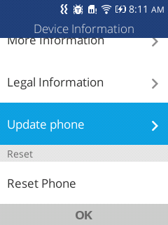
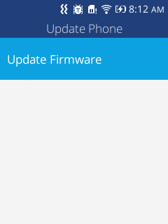
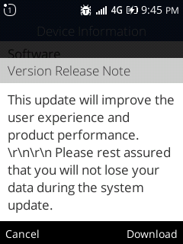
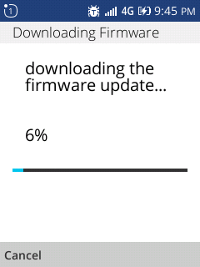
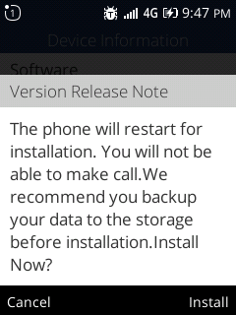
Test Download
Settings->Device -> Device Information -> Update phone
Then install it

Slide 16
Delivery Checklist
Release notes
Certificate report
JIO TA letter
FOTA test report
Install Failed, please send the log(cache/recovery/last_log) to us
Download Failed, please catch the logcat and send it to us

Slide 17
THANKS

