Slide 1
KaiOS FOTA ODM Configuration Guide

Slide 2
Modify history
2018/01/06 create for 9820E for JIO

Slide 3
FOTA Master Server Address
MUST be configured to an available kaiOS FOTA server.
Add property:
ro.fota.SUMaster
ro.fota.network_type
ro.fota.network_port
E.g:
ro.fota.SUMaster = fota.mst.dev.jiophone.net
ro.fota.network_type = http
ro.fota.network_port = 80
Refer to JIO Spec “Ril Fota Rules_Guideline”

Slide 4
Product Rule
Each ODMs uses a different CU Ref
Add property: ro.fota.cu_ref.
E.g ro.fota.cu_ref = LS2401-FBJIINB
Apply a unique CU number from JIO/KaiOS.
Refer to JIO Spec [Ans]
CU max length is 20

Slide 5
Version Numbering Rule
Every version has a unique version number
Add property: ro.fota.sw_ver
E.g ro.fota.sw_ver = 01220100
Refer to JIO Spec for the version naming
Version max length is 20

Slide 6
Customize diff tool
Adapt partition table for diff tool
SPRD platform: Copy modem.cfg and nvmerge.cfg into projects\fireware_cfg
Apply signature release key:
Configure the release key, eg: releasekeys/releasekey
Core command:
Put the two version into software/src and software/tgt
Command: ./prepare_pkg_start.sh
Command: ./gen_update_pkg_start.sh

Slide 7
Customize Keys
Release key
Make cert.mk
PRODUCT_DEFAULT_DEV_CERTIFICATE := vendor/release/releasekey
Add -include vendor/release/cert.mk on top of code path : device/sprd/scx35l/common/device.mk
Test key
Remove cert.mk

Slide 8
Image select
For secure boot
please sign the modem bins before build.
select the signature images: boot recovery uboot spl
For non secure boot
No need to sign the modem bins before build
Select the unsignature images:boot recovery uboot spl

Slide 9
OEM_FOTA_META.ZIP
The FOTA tools pick up the modem from $(Product_OUT)
The file path and name relationship
SC9600_sharkle_pubcp_Feature_Phone_modem.dat -> ltemodem.bin
SharkLE_FEATURE_PHONE_LTEA_DSP.bin -> ltedsp.bin
SHARKLE1_DM_DSP.bin -> ltegdsp.bin
sharkle_cm4.bin -> pmsys.bin
gnssbdmodem.bin -> gnssbdmodem.bin
gnssmodem.bin -> gnssmodem.bin
PM_sharkle_cm4.bin -> wcnmodem.bin
sharkle_pubcp_Feature_Phone_kois_nvitem.bin -> ltenvitem.bin
First copy those bins into Product_OUT

Slide 10
MODEM_BINS_DIR := $(call my-dir)
ifeq ($(TARGET_BOARD),sp9820e_1h10)
DEVICE_NVITEMS_FILE := $(MODEM_BINS_DIR)/sharkle_pubcp_Feature_Phone_Kois_nvitem.bin
else ifeq ($(TARGET_BOARD),sp9820e_2c10)
DEVICE_NVITEMS_FILE := $(MODEM_BINS_DIR)/sharkle_pubcp_Feature_Phone_LB4020E_nvitem.bin
else ifeq ($(TARGET_BOARD),sp9820e_2h10)
DEVICE_NVITEMS_FILE := $(MODEM_BINS_DIR)/sharkle_pubcp_Feature_Phone_Kois_nvitem.bin
else
$(error Unknown device, can't copy nvitems files.)
endif
define fota_update_vendor_modem_files
$(hide) cp -f $(DEVICE_NVITEMS_FILE) $(PRODUCT_OUT)/ltenvitem.bin
$(hide) cp -f $(MODEM_BINS_DIR)/SharkLE_FEATURE_PHONE_LTEA_DSP.bin $(PRODUCT_OUT)/ltedsp.bin
$(hide) cp -f $(MODEM_BINS_DIR)/SHARKLE1_DM_DSP.bin $(PRODUCT_OUT)/ltegdsp.bin
$(hide) cp -f $(MODEM_BINS_DIR)/sharkle_cm4.bin $(PRODUCT_OUT)/pmsys.bin
$(hide) cp -f $(MODEM_BINS_DIR)/SC9600_sharkle_pubcp_Feature_Phone_modem.dat $(PRODUCT_OUT)/ltemodem.bin
$(hide) cp -f $(MODEM_BINS_DIR)/gnssbdmodem.bin $(PRODUCT_OUT)/gnssbdmodem.bin
$(hide) cp -f $(MODEM_BINS_DIR)/gnssmodem.bin $(PRODUCT_OUT)/gnssmodem.bin
$(hide) cp -f $(MODEM_BINS_DIR)/PM_sharkle_cm4.bin $(PRODUCT_OUT)/wcnmodem.bin
endef

Slide 11
FOTA Package Generation
Required material:
Released image files
Previous released versions.
Private key for sign images
Use customized script to generate diff package
$gen_update_pkg src=source.zip tgt=target.zip key=releasekey –pwd=xxx update.zip
Pack images
Rename zip file as strict naming rule: /.*?_.*?_.*?_(.*?)_to_(.*?)_.*?_IncrementOTA.zip/
Follow： /.*?_.*?_.*?_(source svn)_to_(target svn)_.*?_IncrementOTA.zip/

Slide 12
Upload to the FOTA FTP Server
Access FOTA FTP and upload all diff package
File list:
images files: out/target/product/$device/
Diff package, -XXXOTA.zip.
Pac file.

Slide 13
Offline Test
Push update.zip to SD Card
Enter Recovery mode.
Select “Apply update from SD Card”
Check result

Slide 14
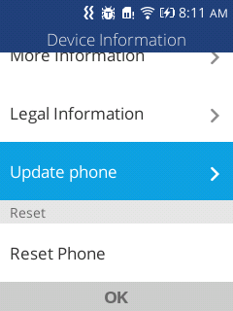
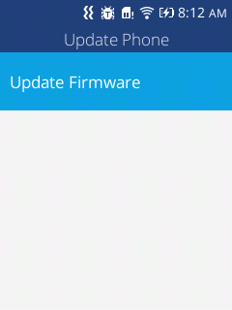
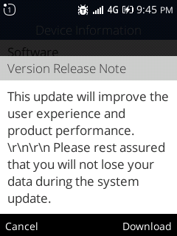
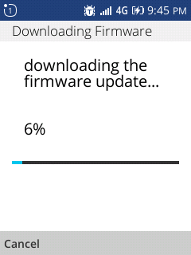
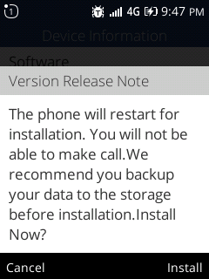
Test on Device
Settings->Device -> Device Information -> Update phone
Then install it

Slide 15
Delivery Checklist
Release notes
Certificate report
JIO TA letter
FOTA test report

Slide 16
THANKS

