Slide 1
KaiOS FOTA ODM Configuration Guide

Slide 2
Modify history
2017/07/14 add logo_uboot image into upgrade files list
2017/07/10 Update secure boot rule and tools(Block-V1.0.8, File-V2.8.4)
2017/07/05 Update secure boot rule
2017/06/15 Add oem_fota_meta.zip rule
2017/05/02 Add secure boot verify methods
2017/04/20 Add Customize Keys rule
2017/04/13 Update diff package name rule, remove “version.txt”

Slide 3
FOTA Master Server Address
MUST be configured to an available kaiOS FOTA server.
Add property:
ro.fota.SUMaster
ro.fota.network_type
ro.fota.network_port
E.g:
ro.fota.SUMaster = fota.mst.dev.jiophone.net
ro.fota.network_type = http
ro.fota.network_port = 80
Refer to JIO Spec “Ril Fota Rules_Guideline”

Slide 4
Product Rule
Each ODMs uses a different CU Ref
Add property: ro.fota.cu_ref.
E.g ro.fota.cu_ref = LS2401-FBJIINB
Apply a unique CU number from JIO/KaiOS.
Refer to JIO Spec [Ans]

Slide 5
Version Numbering Rule
Every version has a unique version number
Add property: ro.fota.sw_ver
E.g ro.fota.sw_ver = 01220100
Refer to JIO Spec for the version naming

Slide 6
Customize diff tool
Adapt partition table for diff tool
SPRD platform: Copy modem.cfg and nvmerge.cfg into projects\fireware_cfg
Apply signature release key:
Configure the release key, eg: releasekeys/releasekey
Add secuboot key if needed
\vendor\projects\secure_boot_tools
Core command:
./build/tools/releasetools/ota_from_target_files -v --block -p $(HOST_OUT) -k $(KEY_DIR) -i $(A_target_file).zip $(B_target_file).zip update.zip

Slide 7
Customize Keys
Release key
Make cert.mk
PRODUCT_DEFAULT_DEV_CERTIFICATE := vendor/release/releasekey
Add -include vendor/release/cert.mk on top of code path : device/sprd/scx35l/common/device.mk
build/core/Makefile
@python2.7 ./build/tools/dumpkey.py $(PRIVATE_OTA_PUBLIC_KEYS) $(extra_keys) > $@ change to java -jar ./build/tools/dumpkey.jar $(PRIVATE_OTA_PUBLIC_KEYS) $(extra_keys) > $@
Put the dumpkey.jar in to build/tools
Test key
Remove cert.mk

Slide 8
Secure Boot Rule
Prepare 2 different version(.img), one have signature, another one not.
Use signature version to generate .pac, flash to device(have Efuse)
Use no signature version to generate diff package
Notes：
Set in sp9820A_refh10_native.mk
#secure boot enable
SECURITY_BOOT_MACRO := true

Slide 9
Secure Boot Rule
2. Config in BoardConfig.mk
# secure boot macro
The SECURE_BOOT_SIGN_TOOL is configured in device/sprd/scx35l/common/BoardConfigCommon.mk, please check if it is right
3. Config key：
Key invoke from: build/tools/relasetools/sprd_secure_boot_sign.py
self.cfgfile = os.getenv("SPRD_SECURE_BOOT_SIGN_CONFIG", “vendor/sprd/open-source/tools/sprd_secure_boot_tool/key.txt” ---this is default key, please replace key and path.

Slide 10
OEM_FOTA_META.ZIP
The FOTA tools pick up the modem from oem_fota_meta.zip, need update the modem file
Decompress the oem_fota_meta.zip
Copy ltedsp.bin, ltegdsp.bin, ltemodem.bin, ltenvitem.bin, pmsys.bin, to oem_fota_meta/radio
Compress the oem_fota_meta.zip
Copy wcnfdl.bin, wcnmodem.bin to software file root path
The file path and name relationship
ltedsp.bin | FM_BASE_15C_PIKEL_W17.xx.x/pikel_tddcsfb_3592_V11_RTM7910V31_builddir/LTE_DSP.bin
ltegdsp.bin | FM_BASE_15C_PIKEL_W17.xx.x/pikel_tddcsfb_3592_V11_RTM7910V31_builddir/PIKEL_DM_DSP.bin
ltemodem.bin | FM_BASE_15C_PIKEL_W17.xx.x/pikel_tddcsfb_3592_V11_RTM7910V31_builddir/SC9600_pikel_tddcsfb_3592_V11_RTM7910V31.dat
ltenvitem.bin | FM_BASE_15C_PIKEL_W17.xx.x/pikel_tddcsfb_3592_V11_LF01_builddir/pikel_tddcsfb_3592_V11_LF01_nvitem.bin
Pmsys.bin | FM_BASE_15C_PIKEL_W17.xx.x/pikel_arm7_builddir/PM_pikel_arm7.bin
wcnmodem.bin | Marlin_15C_Integration_W17.xx.x/EXEC_KERNEL_IMAGE0.bin
wcnfdl.bin | Marlin_15C_Integration_W17.xx.x/fdl1.bin

Slide 11
Add logo_uboot into upgrade files list
1: Please put logo_uboot into upgrade files list like boot.img
2: Logo_uboot name is logo_uboot.*
3: Upate rules
3.1 If it is existed in source and target, it’s updated increasedly;
3.2 If it is only existed in target, it’s updated fully;
3.3 If it is not existed in source or target, it’s no updated

Slide 12
FOTA Package Generation
Required material:
Released image files
Previous released versions.
Private key for sign images
Use customized script to generate diff package
$gen_update_pkg src=source.zip tgt=target.zip key=releasekey –pwd=xxx update.zip
Pack images
Rename zip file as strict naming rule: /.*?_.*?_.*?_(.*?)_to_(.*?)_.*?_IncrementOTA.zip/
Follow： /.*?_.*?_.*?_(source svn)_to_(target svn)_.*?_IncrementOTA.zip/

Slide 13
Upload to the FOTA FTP Server
Access FOTA FTP and upload all diff package
File list:
images files: out/target/product/$device/
Diff package, -XXXOTA.zip.
Pac file.

Slide 14
Offline Test
Push update.zip to SD Card
Enter Recovery mode.
Select “Apply update from SD Card”
Check result

Slide 15
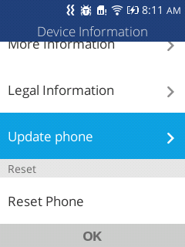
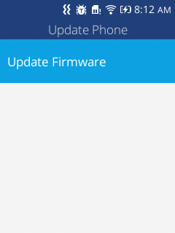
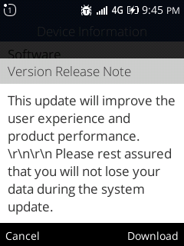
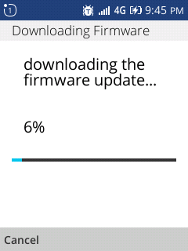
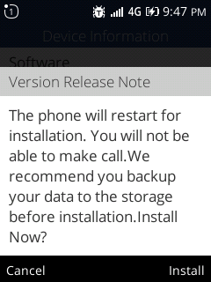
Test on Device
Settings->Device -> Device Information -> Update phone
Then install it

Slide 16
Delivery Checklist
Release notes
Certificate report
JIO TA letter
FOTA test report

Slide 17
THANKS

