Slide 1

Project 07: Practice Debugging
The Engineer’s Guide to Soar
Course 01: Soar Essentials
By Dr. Bryan Stearns, 2024

Slide 2
Problem
Solution
We have a substate set up,
But our agent doesn’t yet use it to sort suppliers with complex reasoning.
We still sort only by total-score.
We also don't have much experience using debugging commands to inspect our code when things go wrong.
Use substate operators to:
Iterate over attribute weights given on the input-link
In descending order
For each weight, sort suppliers by their attribute scores for that weight.
Get practice using the matches -w command for rule debugging!

Slide 3
Project Goal
We will use our substate to sort suppliers based on:
The score for each attribute for each supplier relative to other suppliers
The weight of each attribute relative to other attributes
Not just a single attribute like total-score.

Slide 4
Lesson 07 – Outline
This lesson explains the following new concepts:
Copying down superstate WMEs for efficiency
Nested condition conjunctions within rules
Debugging with matches -w
LHS conjunctions and disjunctions
This lesson starts to put you in the front seat:
More coding design up to you!
More debugging up to you!

Slide 5
Lesson Focus
This lesson will:
Equip you with concepts that you will find useful as you develop your code
Show you debugging techniques to empower you to code more independently
This lesson will not:
Walk you through each step of coding this project

Slide 6
Sorting Logic Review
The Goal for Supplier Sort

Slide 7
Input Review: Attribute Weights and Rank Scores
S1 ^io.input-link I2
^priorities P1
^total-cost 11.01
^sustainability 11
^quality 10
^availability 8
^packaging 8
^speed 7
^candidate-supplier C1
^name |supplier01|
^total-score 12
^total-sats 2
^total-cost 35.0
^sustainability 3
^availability 3
^quality 1
^packaging 3
^speed 2
...
Our input for Supplier Sort comes in two types of structures:
Priorities
A single object that gives the global priority weight for each attribute type
These weights apply for the whole task across all suppliers
Each supplier is expected to have a value for each of these attributes
Example: Attribute “quality” has a higher weight than attribute “speed”.
Candidate Supplier
Gives the name and other attribute scores for a particular supplier.
For total-cost, lower is better
For all other weighted attributes, higher is better
There is a separate ^candidate-supplier object per supplier.
Example: Supplier01 has “quality” score of 1 and a ”speed” score of 2.
There are two special attributes:
total-score: The sum of all rank scores (non-cost)
total-sats: The count of data needs this supplier can satisfy

Slide 8
Sorting Steps
S1 ^io.input-link I2
^priorities P1
^total-cost 11.01
^sustainability 11
^quality 10
^availability 8
^packaging 8
^speed 7
^candidate-supplier C1
^name |supplier01|
^total-score 12
^total-sats 2
^total-cost 35.0
^sustainability 3
^availability 3
^quality 1
^packaging 3
^speed 2
...
By the end of this tutorial series, we want to have the following routine:
Exclude suppliers where total-sats == 0
Sort suppliers by total-sats in descending order
Iteratively sort suppliers by attributes in priority weight order
Sort remaining tied suppliers by total-score
Sort remaining tied suppliers randomly
We’ve already implemented step 4.
We will now implement step 3. (described further in the next slide)

Slide 9
Iterating Through Weights
S1 ^io.input-link I2
^priorities P1
^total-cost 11.01
^sustainability 11
^quality 10
^availability 8
^packaging 8
^speed 7
^candidate-supplier C1
^name |supplier01|
^total-score 12
^total-sats 2
^total-cost 35.0
^sustainability 3
^availability 3
^quality 1
^packaging 3
^speed 2
...
Our agent should sort suppliers by their scores in priority weight order.
Example:
total-cost has the highest weight at 11.01, so first sort suppliers in ascending order of their total-cost score:
completeness has the next-highest weight at 11, so sort remaining suppliers in descending order by their completeness score:
and so on…
total-cost
25.0
25.0
25.0
35.0
35.0
35.0
operator’s supplier
supplier03
supplier04
supplier05
>
supplier01
supplier02
supplier06
completeness
3
3
2
3
2
2
operator’s supplier
supplier04
supplier05
>
supplier03
supplier01
>
supplier02
supplier06

Slide 10
Handling Tied Weights
S1 ^io.input-link I2
^priorities P1
^total-cost 11.01
^sustainability 11
^quality 11
^availability 8
^packaging 8
^speed 7
^candidate-supplier C1
^name |supplier01|
^total-score 12
^total-sats 2
^total-cost 35.0
^sustainability 3
^availability 3
^quality 1
^packaging 3
^speed 2
...
What if two attributes share the same weight?
Then sort by the sum of those attribute scores
Example: Say completeness and quality both have weight 11
completeness + quality
3+3
3+3
3+2
2+3
3+1
2+1
operator’s supplier
supplier03
supplier05
>
supplier04
supplier02
>
supplier01
>
supplier03
For now, though, we will pretend that weights are always unique. We will account for tied weights in Project 08.

Slide 11
STEP 1: Copy Superstate WMEs
Prepping Our Substate For Easy Use

Slide 12
Starting Point: Define Your WMEs
When working in a substate, plan ahead what superstate WMEs you will use often.
Then copy them to the substate for easy access in the rules you write, like so:
This simplifies the rest of your code.
It is easier to reference (<s> ^fizz <buzz>) than (<s> ^superstate.io.input-link.fizz <buzz>)
This also can make backtracing simpler:
It provides backtracing with a single point of reference to the superstate WME, rather than one for each rule that separately accesses the same superstate WME.
sp {elaborate*my-tie*superstate*fizz-buzz
(state <s> ^superstate.io.input-link.fizz <buzz>)
-->
(<s> ^fizz <buzz>)}

Slide 13
STEP 1: Copy Input Priority WME
Open your agent_starter.soar file and find the section labeled “STEP 1”.
Write a rule there to copy the input-link ^priorities WME to the substate.
Name the rule “elaborate*suppliersort-tie*priorities”
Test on your own whether your rule works:
After your agent has had a chance to fire rules in the substate (step 3), ensure that S2 has a WME that points to the input-link priorities ID.
Make sure it’s the same ID that is used on the input-link, such as “P1”.
Commands you might use:
“step” (step 1 decision cycle)
“e” (step 1 elaboration cycle)
“print S2” (print the WMEs under S2)
“print I2” (print the WMEs under the input-link, which always has this ID)

Slide 14
Rule Naming Conventions
Knowing Your Rule at a Glance

Slide 15
Rule Naming Conventions
When naming your rules, the following convention is suggested:
Separate the following elements by asterisks:
The rule type (“elaborate” / “propose” / “prefer” / “apply”)
The state name it is supposed to fire in (such as “suppliersort-main”)
The operator name (if any is relevant)
Any additional key words as needed that indicate what makes this rule unique from others that share the same naming for elements 1-3
There are other conventions you can use (such as swapping the order of steps 1 and 2)
But be consistent!
A good naming scheme gives you confidence that your rule names are unique.
It also helps you know immediately what your rule does just from the name.
1
2
3
4
sp {propose*suppliersort-tie*my-operator-name*special-case-42

Slide 16
Debugging Rule Matching
How To Diagnose a LHS Bug

Slide 17
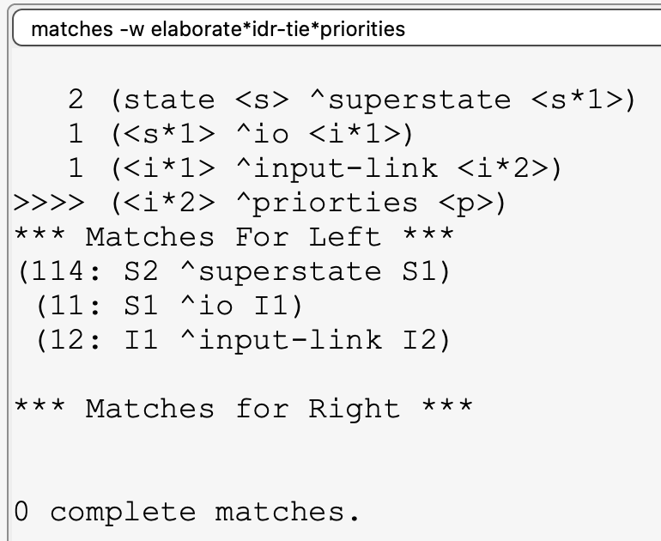
The matches –w [rule_name] Command
The first thing to check when your rule doesn’t seem to fire when you thought it would:
matches –w your*rule*name*here
This will show which parts of your rule’s LHS are currently satisfied.
Dot notation is expanded
The leading number before each condition indicates how many WMEs match that condition.
(Here, there are 2 states, but only 1 of them has ^io, and that ^io structure only has 1 ^input-link.)
If you see “>>>>” before a condition, it means that condition was not found in WM.
(Here, this helps me see that ”priorties” is misspelled, which is why the rule doesn’t match.)
The “Matches For Left/Right” show what WMEs Soar was able to match on until it hit the non-matching condition.

Slide 18
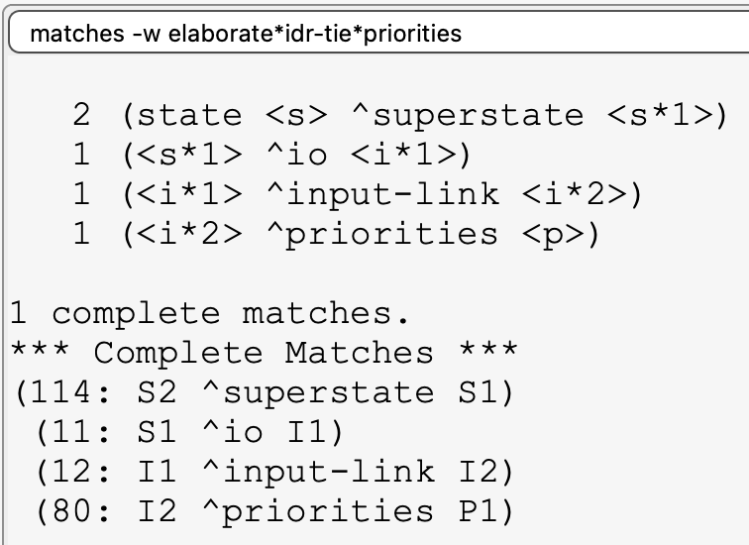
The matches –w [rule_name] Command
The first thing to check when your rule doesn’t seem to fire when you thought it would:
matches –w your*rule*name*here
This will show which parts of your rule’s LHS are currently satisfied.
After fixing the typo, I see at least a “1” for each condition.
The command output then shows me which WM IDs matched my rule.
(This can be very useful for diagnosing my rule if it fired when I didn’t expect it to.)

Slide 19
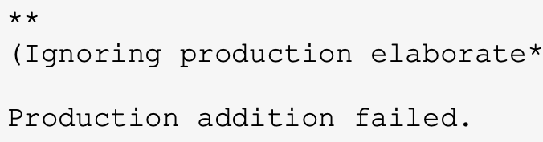
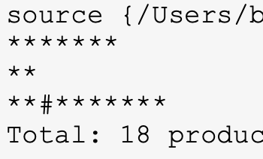
Other Steps When Debugging A Rule
“My rule isn’t working. Why doesn’t my rule work?”
Check that you don’t have syntax errors in your rules.
Soar will print error/warning messages if it detects any.
(And will then abort loading further rules)
Common errors:
A starting variable in your RHS doesn’t match anything on the LHS
Forgetting a space in “sp {“
Forgetting to mark your root <s> ID with “state”.
Check that your rule doesn’t share a name with other rules.
If two rules share the same name, the one imported second will overwrite the first.
If you see a “#” among the “*”s when importing rules, it means a rule got overwritten.
Check that you are inspecting a point in time when your rule is supposed to have fired.
For instance: An apply rule won’t fire until the Apply Phase.
Check that it didn’t fire sooner than you expected.
If the matches command says your rule matched completely, but you don’t see its effects in WM, it might have fired a while ago, and you might have other rules that already removed its effects.

Slide 20
STEP 2: Propose (evaluate-weight)
An Operator to Iterate Over Weights

Slide 21
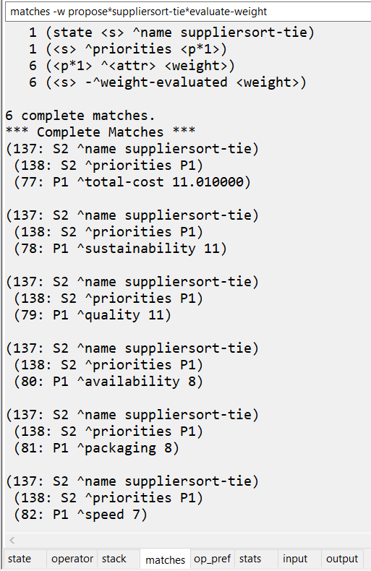

STEP 2: Propose (evaluate-weight)
Find the comment section in agent_starter.soar labeled “STEP 2”
Follow the instructions there to propose an (evaluate-weight) operator with indifferent (“=“) preference.
It should be proposed for each input priority weight.
After you make your rule, test it by running the agent for 3 steps.
You should get an operator tie (S2) for tied (select-supplier) operators and then another operator tie (S3) for a tie involving (evaluate-weight).
Run the matches -w command on your rule. You should see 6 matches →

Slide 22
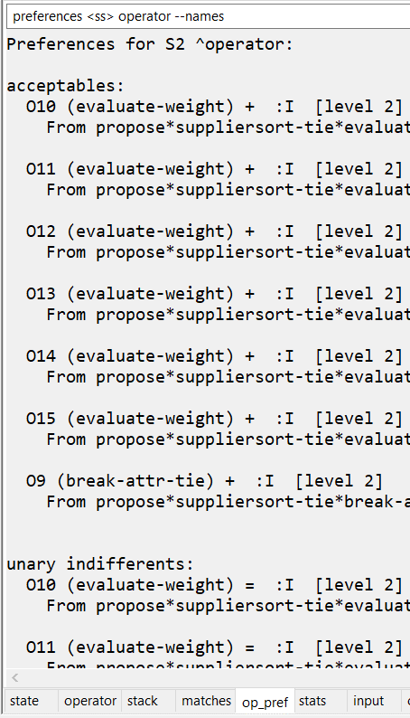
STEP 2: Diagnose the Tie
Why does (evaluate-weight) lead to a tie when it has indifferent preference?
Figure it out: Use the “preferences <ss> operator --names” command to see competing preferences.
The command is provided in a tab in the Java Debugger.
(You might have to replace the <ss> component of the command though.)
You should see output like what is shown to the right. →
What does this tell us?
The tie is between (evaluate-weight) and (break-attr-tie).
Not between different (evaluate-weight) operators.
We need our agent to prefer (evaluate-weight) over (break-attr-tie).

Slide 23
STEP 3: (break-attr-tie) Is the Worst
Perform (evaluate-weight) Before It

Slide 24
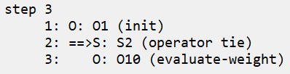
STEP 3: Modify (break-attr-tie)’s Preference
Find the comment section in agent_starter.soar labeled “STEP 3”
Follow the instructions so (break-attr-tie) is proposed with worst (“<“) preference.
After making this small change, run the agent from the beginning for 3 steps.
You should now see the following:
Proceed to the next slide when you’re ready for STEP 4.

Slide 25
STEP 4: Evaluate Weights in Order
In Descending Order of Weight Value

Slide 26
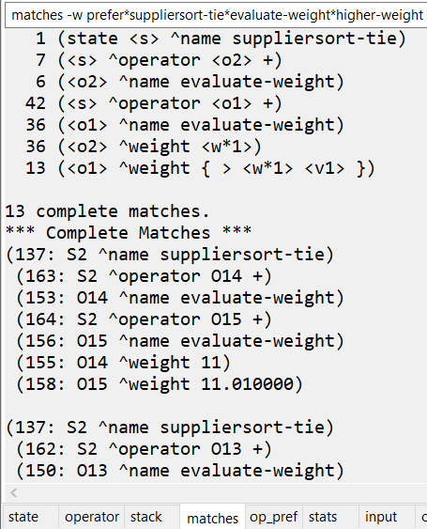
STEP 4: Evaluate Weights in Descending Order
Find the comment section in agent_starter.soar labeled “STEP 4”
Follow the instructions: Make a preference rule for (evaluate-weight).
Your rule should prefer one evaluate-weight operator over another if it has a higher weight than the other.
(Check that your proposal rule from STEP 2 attached this weight to the operator when it proposed the operator, so that you can reference it here in this preference rule.)
After adding this rule, run the agent from the beginning for 3 steps.
The matches -w command should show you something like this →
Proceed to the next slide when you are done.

Slide 27
STEP 5: Applying (evaluate-weight)
The First Apply Rule: total-cost

Slide 28
(evaluate-weight) Apply Rules Objective
Our next step will be to apply our (evaluate-weight) operator.
We will need multiple apply rules. The main two rules will look something like this:
IF: (evaluate-weight) is selected, AND for two tied items in this state, one has a lower total-cost value, AND this operator’s attribute is total-cost, THEN: In the superstate, prefer the item with the lower cost over the other item.
IF: (evaluate-weight) is selected, AND for two tied items in this state, one has a higher score for this (evaluate-weight) operator’s attribute, AND that attribute is not total-cost, THEN: In the superstate, prefer the item with the higher score over the other item.

Slide 29
STEP 5: Sort by total-cost
Find “STEP 5” in agent_starter.soar and uncomment the given rule outline there.
Follow the instructions to make the first apply rule (this will be a complex rule!):
NOTE: You will probably want to avoid using dot-notation for this rule. You will need to use each ID.
The supplier score is located here: <s> ^item.supplier.<attr> <score>
IF: (evaluate-weight) is selected, AND for two tied items in this state, one has a lower total-cost value, AND this operator’s attribute is total-cost, THEN: In the superstate, prefer the item with the lower cost over the other item.
Return a result to the superstate: <ss> ^operator <o1> > <o2>

Slide 30
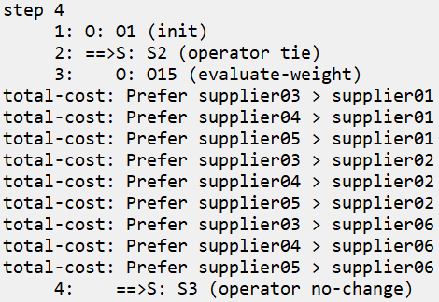
STEP 5: Run and Test
To test your apply rule, run your agent for 4 steps.
You should see something like this →
Check for each of the following:
Your rule prints 9 preference messages
Suppliers 3, 4, and 5 are preferred over suppliers 1, 2, and 6
Your rule tests that the selected (evaluate-weight) operator’s attribute is total-cost.
(The rule will look like it still works without this test, because the agent only selects total-cost‘s weight so far anyway. But if the agent selected another weight, the logic would fail.)
If your rule matches on incorrect supplier pairs, use the matches -w command to debug it!

Slide 31
STEP 6: Completing a Weight
So the (evaluate-weight) Proposal Retracts

Slide 32
STEP 6: Marking a Weight as Evaluated
In order to avoid op no-change impasses, we need the (evaluate-weight) operator’s proposal to retract once the weight is evaluated.
Look back to the comment instructions for the proposal rule (STEP 2).
See that the proposal should test for the absence of a ^weight-evaluated WME.
We will write an apply rule that will create this WME for the selected operator’s weight.
Uncomment the “STEP 6” rule outline and fill in the underscores according to the instructions.
The LHS only needs to reference the current operator’s ^name, ^weight, and ^attribute WMEs.
(The ^attribute WME is just for the sake of the (write) message, which is useful for seeing what the agent is doing.)

Slide 33
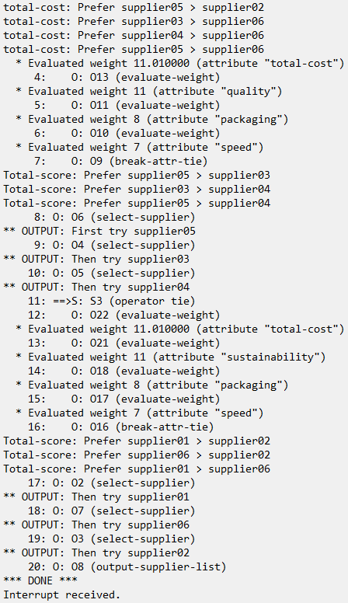
STEP 6: Run and Test
To test your rule, you can now run your agent from start to finish:
After sorting by total-cost, your agent should iterate through each weight in descending order.
It won’t do any sorting for non-cost weights yet.
After exhausting all weights, it will then sort by total-score using (break-attr-tie).
If instead you still get an op no-change impasse:
Check that your proposal rule tests for the same WME as you create in your new apply rule (tests that it is missing).
Check that your new apply rule creates the correct value for ^weight-evaluated (no typos in your variable names).
Inspect your proposal rule with matches -w after your apply rule fires to see if/why it is still matching.

Slide 34
Condition Conjunctions and Disjunctions
Setting Multiple Constraints Per LHS Value

Slide 35
How To Combine Conditions?
Our remaining apply rule should sort for attributes that are not |total-cost|. How do we test that?
(<o> ^attribute <> |total-cost|)
But we also need to get a supplier’s score value for the selected operator’s attribute:
(<o> ^attribute <attr>) (<sup1> ^<attr> <value>)
So how do you combine (<o> ^attribute <> |total-cost|) and (<o> ^attribute <attr>)?
You might try to include both conditions separately…
But this could lead to an error if <o> ever had more than one ^attribute WME.
One ^attribute condition might match on a different WME from the other.
Example:
(<o> ^attribute <> |total-cost|)
(<o> ^attribute <attr>) (<sup1> ^<attr> <value>)
(O1 ^attribute |quality|)
(O1 ^attribute |total-cost|) (C2 ^total-cost 25.0)
Could match
✗

Slide 36
Condition Conjunctions
The solution: Conjunctions!
Soar lets you use curly brackets to combine multiple tests for a single WME:
You can combine as many tests as you like within the curly brackets.
Order doesn’t matter. The above is the same as the following:
(<o> ^attribute {<attr> <> |total-cost|} )
Condition 1
Condition 2
(<o> ^attribute {<> |total-cost| <attr>} )

Slide 37
Condition Disjunctions
If Soar supports Conjunctions (AND logic), does it also support Disjunctions (OR logic)?
Yes! (You won’t need it for this project, but we’ll explain it here for completeness’ sake.)
To test that a WME satisfies a disjunction of values, use double angle brackets (<< >>).
The following is satisfied if the value is either |total-cost| or |total-sats|:
Disjunctions must have spaces between the angle brackets and the contents.
Disjunctions may not include variables nor be used with binary comparisons.
(<o> ^attribute << total-cost total-sats >>)
✗
✓
(<s> ^fizz <<buzz1 buzz2>>)
(<s> ^fizz << buzz1 buzz2 >>)
✗
✗
(<s> ^fizz << <var> buzz >>)
(<s> ^fizz < << buzz1 buzz2 >>)
✗
✓
(<s> ^fizz << buzz1 < buzz2 >>)
(<s> ^fizz {<var> << buzz1 buzz2 >>})

Slide 38
STEP 7: Applying (evaluate-weight)
The Last Apply Rule: Non-Costs

Slide 39
STEP 7: Sort by Non-Cost Attributes
Find “STEP 7” in agent_starter.soar and uncomment the given rule outline there.
Follow the instructions to fill in the underscores for this remaining apply rule.
(You can copy a lot from your solution to STEP 5.)
Use a conjunction to ensure <attr> <> |total-cost|, as per the previous slides
IF: (evaluate-weight) is selected, AND for two tied items in this state, one has a higher score for this (evaluate-weight) operator’s attribute, AND that attribute is not total-cost, THEN: In the superstate, prefer the item with the higher score over the other item.
Remember to reverse the logic from the first apply rule: Higher scores are better.

Slide 40
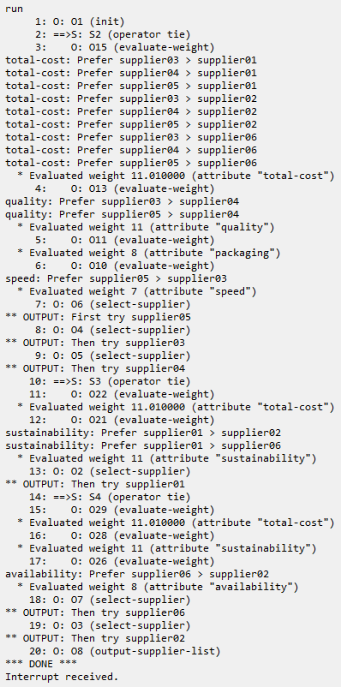
STEP 7: Run and Test
After finishing STEP 7, you should be able to run and see the following →
The agent sorts tied suppliers by each weight in descending order:
total-cost: Suppliers 3, 4, 5 > Suppliers 1, 2, 6
At this point, only Suppliers 3, 4, and 5 are still tied.
So Suppliers 1, 2, and 6 are omitted from the rest of substate S2.
quality: Suppliers 3, 5 > Supplier 4
packaging: No sorting (Suppliers 3 and 5 are the same)
speed: Supplier 5 > Supplier 3
The agent outputs Suppliers 5 > 3 > 4, then hits a new tie for the rest:
total-cost: No sorting
quality: Supplier 2 > Suppliers 1, 6
The agent outputs Supplier 2, then hits a new tie for the remainder:
… speed: Supplier 1 > Supplier 6
The agent outputs Supplier 1 then 6, and then is done!
S2
S2
S3
S3
S4
S4

Slide 41
The Power of Preferences
We coded this dynamic substate behavior with a single operator
Using only 5 rules!
As you get more comfortable with Soar, you will often find that is can be much faster to code some logic routines with Soar rules than with traditional linear programming languages.
Like all tools, each language has its own strengths
Congratulations! You have finished Lesson 07!

