Slide 1

A New Soar Debugger
In Java
Douglas Pearson
June 16, 2005
douglas.pearson@threepenny.net

Slide 2
Why a New Debugger?
Want to add a lot of new capabilities
Extend TSI?
  Based around string parsing – brittle
  Kernel always embedded within debugger
  gSKI inclusion required substantial rewrite anyway
  Want plug-in and user-configurable architecture
  Long-term Eclipse IDE goal
So decision to create a new debugger in Java

Slide 3
Some Initial Capabilities
Structured (tree) trace
  Watch more useful
Filtered trace
  Watch even more useful
Automatic window updates at end of run
  “watch windows” in other debuggers
Visual Soar integration
  Edit production / send file
Dynamic connection to Soar kernels
  Connect/disconnect to external processes

Slide 4
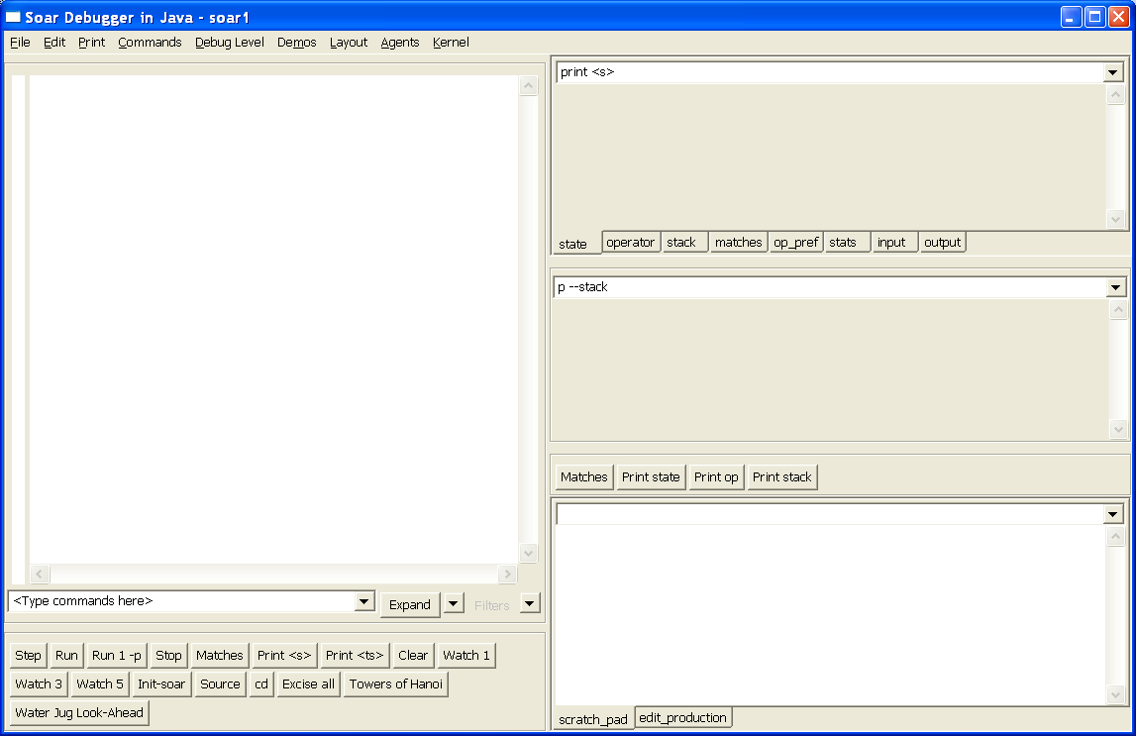
Quick Demo

Slide 5
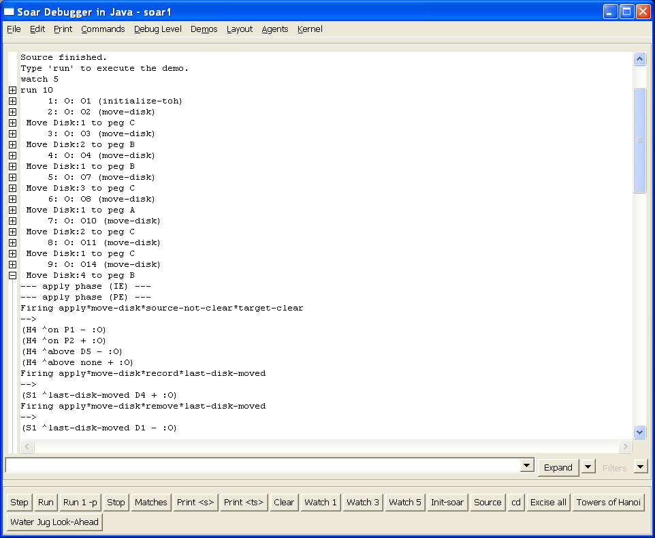
Structured/Tree Trace

Slide 6
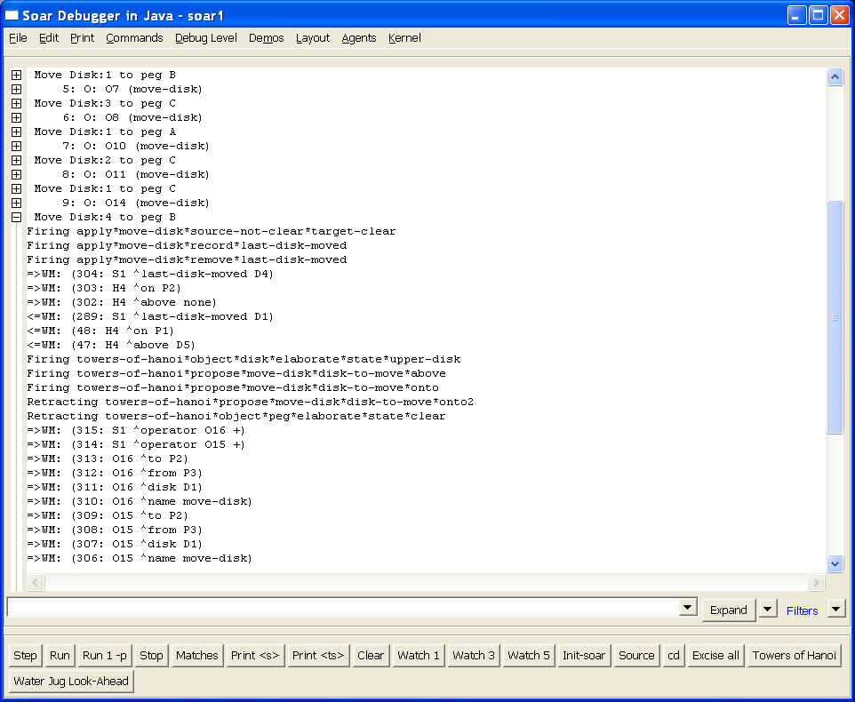
Filtering

Slide 7
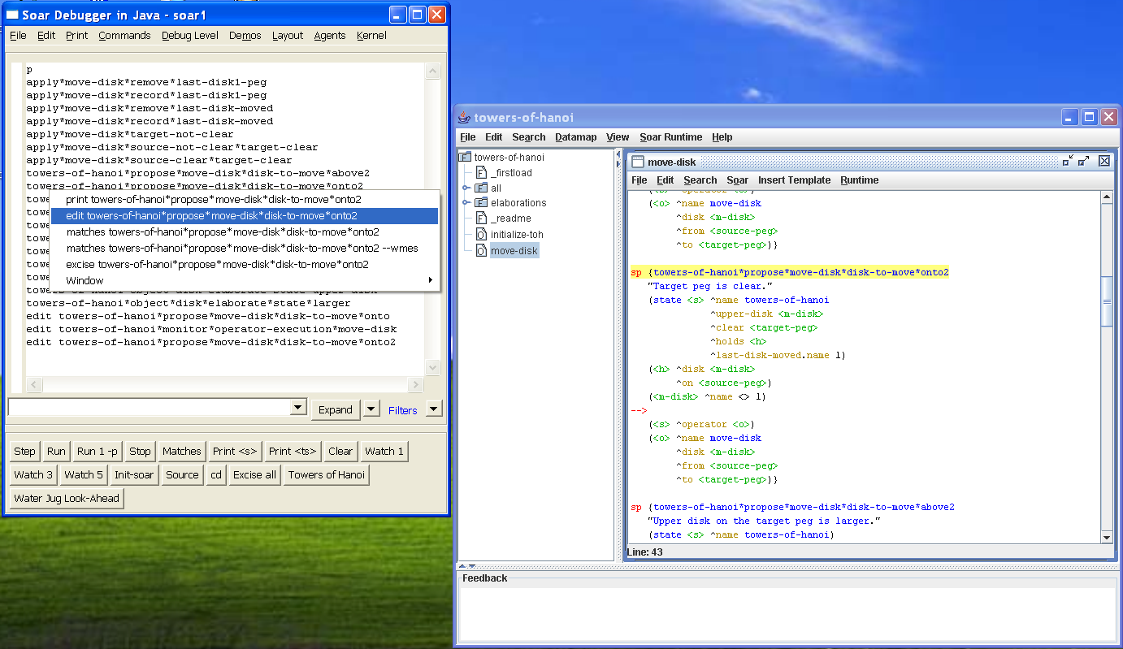
Visual Soar Integration

Slide 8
Design Principles
XML based
  Interface into Soar via XML (SML: Soar Markup Language)
  No more string parsing, supports new capabilities
  But maintain high performance
Plug-in Architecture
  Debugger made up of a series of modules
  Future extensions and user additions
User configurable
  Select elements you find useful
  Combine as you like
  Easier decision making on whether to include features

Slide 9
Performance Comparison
Towers of Hanoi | TSI (8.5.2) | Java Debugger (Text) | Java Debugger (Tree)
Watch 1 (Run 100) | 1.25 secs | 0.73 secs | 0.75 secs
Watch 5 (Run 100) | 59.68 secs | 2.14 secs | 1.51 secs 0.58 secs (full filtering)
Faster than 8.5.2 even when using XML
Watch 5: 40 times faster than 8.5.2
Watch 5 in 8.6. comparable to watch 1 in 8.5.2
  In process and Towers of Hanoi

Slide 10
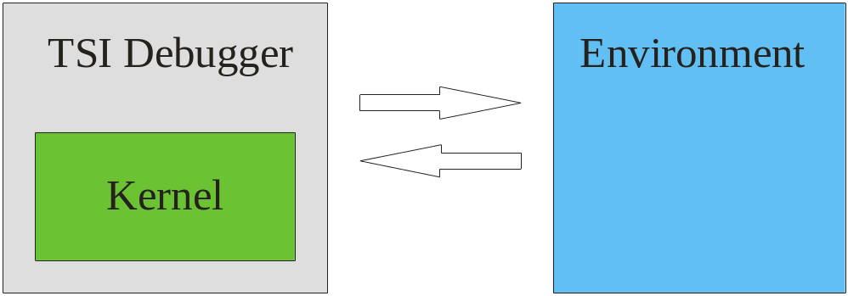
Remote Kernels &
Dynamic Connections
Debugger and kernel created and destroyed together
No way to debug kernel embedded in environment

Slide 11
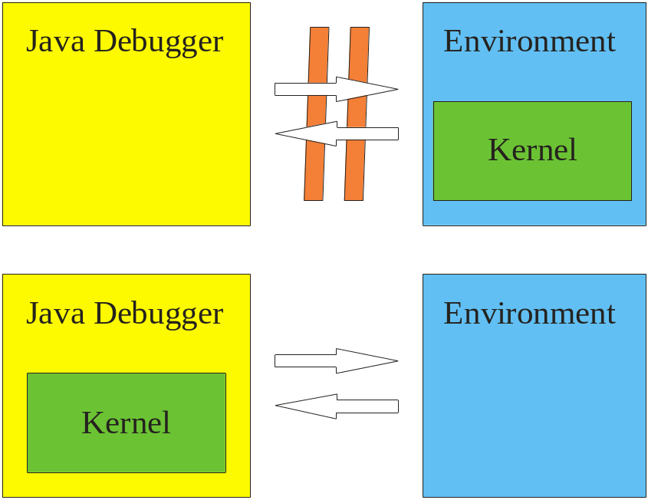
Remote Kernels &
Dynamic Connections
Connect and disconnect debugger as needed
Embedded speed with debugging access
  If remote connection and little tracing get embedded speed

Slide 12
Nuggets
More power
  Structured trace
  Filtered trace
  Integration with Visual Soar
  Dynamic connection and disconnection
  Debugging embedded kernels
Higher performance
  Order of magnitude improvements
  Solid foundation
More flexible
  Customizable layouts
  User plug-ins
  XML based; no special access to kernel

Slide 13
Coal and the Future
Early days
  Mostly been building up the foundation
  Lots and lots more we’d like to add
  Lots of new code, so there will be some bugs lurking
  “stop” looks really slow/unresponsive
Documentation
  “Intro to the Soar Debugger in Java.doc”
  No documentation on the internals yet (beyond comments)
Wishlist – please do speak up now
soar-sml-list@umich.edu or winter.eecs.umich.edu/soarwiki/Debugger_wish_list

