Slide 1

The Inside Story on the Java Debugger
Douglas Pearson
June 17, 2005
douglas.pearson@threepenny.net

Slide 2
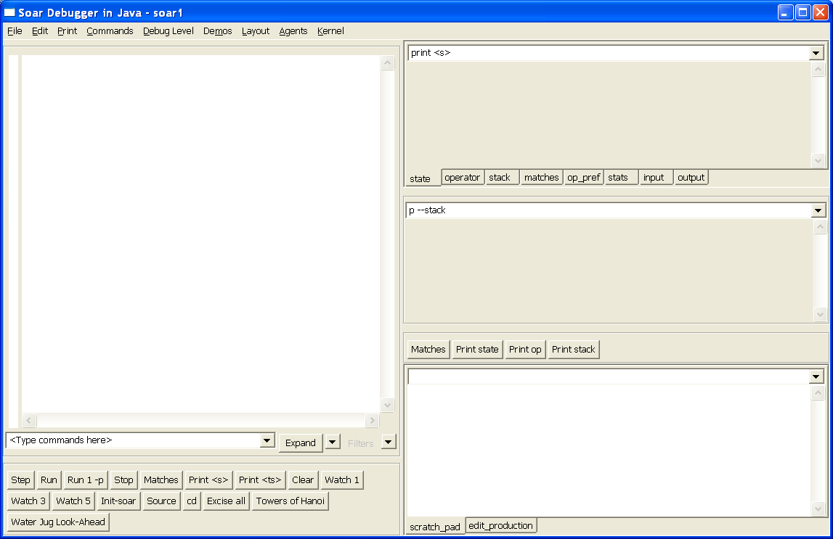
Reminder

Slide 3
Design Principles
XML based
  Interface into Soar via XML (SML: Soar Markup Language)
  But maintain high performance
Plug-in Architecture
  Debugger made up of a series of modules
  Future extensions and user additions
User configurable
  Select elements you find useful
  Combine as you like
  Easier decision making on whether to include features

Slide 4
Plug-in Architecture
Simple plug-in approach
  Each window is instance of a separate class
  All derive from abstract base class
  Rest of code deals only with the base class
SWT based
  May help with Eclipse integration
  Eclipse defines a full OGSI plug-in model etc.
Building a plug-in module is pretty simple
  Hope user community will build/modify them

Slide 5
Existing modules
AbstractView (base)
  AbstractComboView (combo box for commands)
    FoldingTextView (tree trace)
    TextTraceView (text trace)
    UpdateCommandView (updating window)
  ButtonView (button panel)
  EditorView (edit production)
Extend from AbstractView or an existing class
  No need to be text based

Slide 6
Each View’s Responsibilities
Register for events it is interested in
  E.g. Listen for trace output events
  Multiple windows listening for same event is efficient
Store and retrieve its internal settings (as XML)
  E.g. command history; button names; specific properties
  Stored as part of a layout file (.dlf)
Implement its windows within an SWT Composite parent window
  Can do anything you like inside that
Optional:
  Support execution and display of commands (e.g. from menus/buttons)
  Support entry of commands or other parameters from user (e.g. combo box)
  Support find
  Support user configurable properties

Slide 7
AbstractView structure
Event handling
  void registerForAgentEvents(Agent agent) ;
  void unregisterForAgentEvents(Agent agent) ;
Command execution
  String executeAgentCommand(String command, boolean echoCommand) ;
  void displayText(String text) ;
Initialization and storage
  void init(MainFrame frame, Document doc, Pane parentPane) ;
  ElementXML convertToXML(String tagName, boolean storeContent) ;
  void loadFromXML(MainFrame frame, Document doc, Pane parent, ElementXML element)
Actions
  void showProperties() ;
  boolean find(String text, boolean searchDown, boolean matchCase, boolean wrap, boolean searchHiddenText) ;
  void fillInContextMenu(Menu contextMenu, Control control, int mouseX, int mouseY) ;

Slide 8
User configurable
Changing the display w/o recompiling
  Add/remove windows (plug-in modules)
  Adjust properties to change behavior
    E.g. update window every n-th decision
Can save multiple window layouts
  Please send us layouts you like, we’ll share them

Slide 9
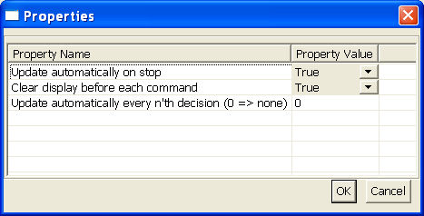
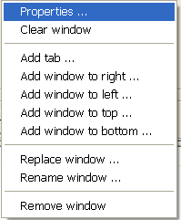
Configuring Window Properties

Slide 10
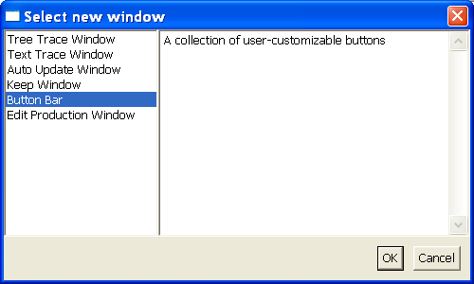
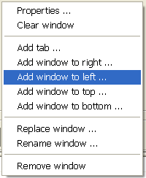
Adding/Removing Windows

Slide 11
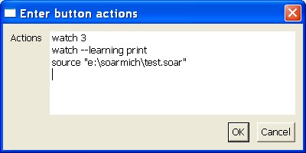
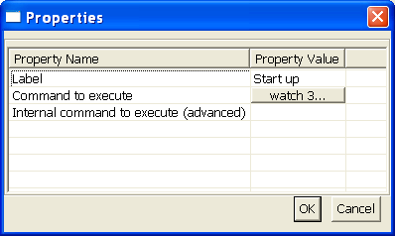
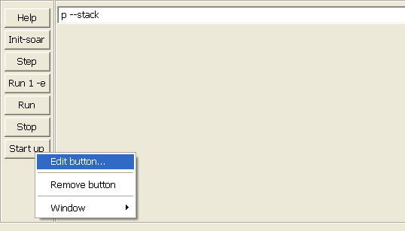
Adding/Removing Buttons

Slide 12
Nuggets and Coal
Nuggets
  Java
  Plug-in approach works
  Customization works
Coal
  SWT can be tricky but the results look good
  Plug-in framework needs to mature
  Interaction between plug-ins will need extension
  Not integrated with Eclipse yet
Want to try a plug-in? Please let us know:
soar-sml-list@umich.edu

