Slide 1
Performance Evaluation of Declarative Memory Systems in the Soar Cognitive Architecture
John Laird,
Nate Derbinsky , Jonathan Voigt
University of Michigan
Funded by ONR, AFOSR, TARDEC
Notes:
Develop a methodology for empirical evaluation

Slide 2
Performance Issues in Supporting Persistent Real-time Behavior
Maintain reactivity as knowledge grows
50-100 msec. real-time internal processing cycle
Affordable memory requirements
10’s of Gbytes
Our long-term goal is 1 year continuous operation
Today we will focus on 3 hours
Notes:
Previous evaluations have not focused on real-world tasks.

Slide 3
Outline of Talk
Real-world Task: Mobile Robot Control
Performance Evaluation of
Working Memory
Semantic Memory
Episodic Memory
How do these memories perform on a real-world task where information grows over time?
Does Soar meet our performance goals for a persistent learning agent?

Slide 4
Experimental Details
Task: Find green square blocks in rooms and return them to the storage rooms.
Must plan routes
from blocks to storage area,
storage area to blocks, and
storage area to unvisited areas.
Use map of 3rd Floor of Michigan CSE Building:
>100 rooms, 100 doorways, 70 objects
All runs 3 hours real time: 10800 seconds
~25-30M processing cycles
Aggregate data 10 sec. bins (70K cycles)
Notes:
Single agent (~600 rules) parameterized for all conditions
Intel i7 860@2.8 Ghz, 8 Gbytes.

Slide 5
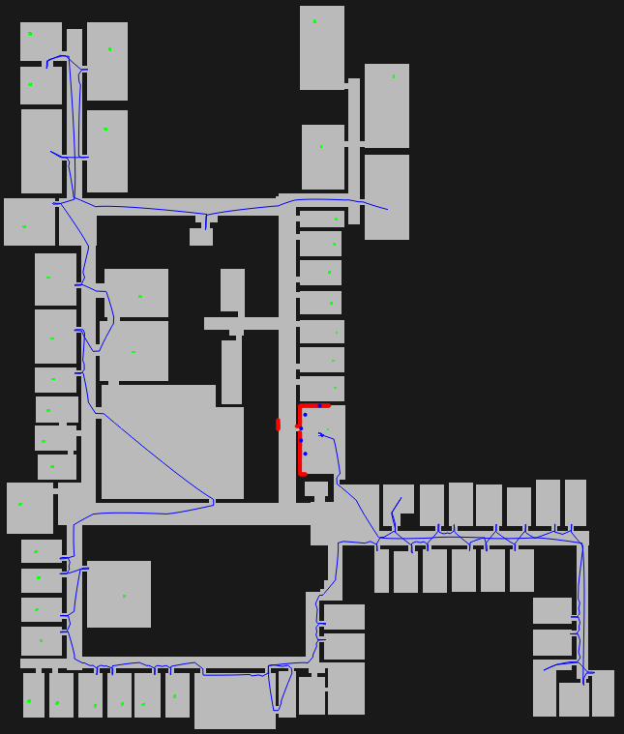
Notes:
.05 Msec/dec average

Slide 6
Working Memory
Agent’s current awareness
Interface to perception, action, and long-term memories
Relational graph structure
In this task
Maintain complete map in working memory
Rooms, walls, gateways, objects
Impacts performance because of rule matching

Slide 7
Working Memory Results
Map in Working Memory
Includes map of rooms, walls, and doors and location of each object
Average WM size
Average Msec./Decisions
When robot finds storage room
Max Msec./Decisions

Slide 8
Semantic Memory in Robot Task
Stores all map and object data
~7000 elements/run, ~2MBytes
Retrieves data to WM when necessary
~6000 retrievals
Removes WM data from distant rooms
To minimize working memory and force need for retrieval

Slide 9
Semantic Memory Results
Map in Working Memory
Average WM size
Map in Semantic Memory
Retrieves from SMEM into WM
as needed
Average Msec./Decisions
Max Msec./Decisions

Slide 10
Episodic Memory in Robot Task
Stores episode when action is taken
Episode includes contents of working memory
~4 times/second (42,000 total)
Remembers blocks that need to be picked up
Cue-based retrieval of most recent episode where robot sees block with right features that is not in storage area

Slide 11
Episodic Memory Results
Episodic Memory with Map in Working Memory
Max Msec./Decisions
Episodic Memory with Map in Semantic Memory
Episode reconstruction in working memory is a major cost (linear with size of episode).
MBytes of LT Memory
Notes:
6, 9, 7, 8
Reconstruction cost is significant for working memory map: 30 msec. in touch example.
That is the major difference between SMEM and WM for the touch-recent task

Slide 12

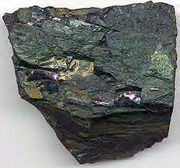
Nuggets and Coal
Achieve performance goals for this task
3 hour continually running
< 50 max msec./decision
10M memory for SMEM and EPMEM
Semantic Memory out performs working memory
With and without episodic memory
Scaling to 1 year (X 3,000)?
EPMEM + SMEM memory = ~30Gbytes
Processing
Semantic Memory appears stable, but difficult to extrapolate
Episodic Memory appears to grow with at least a log component

