Slide 1

Cognitive Architectures for Virtual Humans
Paul S. Rosenbloom | 6/15/2011
The projects or efforts depicted were or are sponsored by the U.S. Army Research, Development, and Engineering Command (RDECOM) Simulation Training and Technology Center (STTC). The content or information presented does not necessarily reflect the position or the policy of the Government, and no official endorsement should be inferred.

Slide 2
Outline
Desiderata
Dichotomies
Techniques
Results

Slide 3


Desideratum I Broad Spectrum Architectures
Easy to create simple virtual humans
Data driven, like NPCEditor (as in SimCoach and other systems)
Can create very sophisticated virtual humans
Model based, like SASO and MRE
Incrementally extend to arbitrary points in between

Slide 4
Combining Paradigms
Data driven (shallow)
Simple statistical architecture in combination with large amounts of (uncertain) data/knowledge
Achieves robustness through breadth of data/knowledge and focus on statistical regularities
Model based (deep)
Sophisticated symbolic reasoning architecture in combination with articulated models of domains of interest
Achieves robustness via combinatoric flexibility of first principles reasoning over comprehensive models
The ideal solution is a mixed approach
Probabilistic (statistical) + symbolic (relational)
Each provides strengths, and can counterbalance other’s weaknesses, in authoring, learning, reasoning, perception, etc.
Multiplicative effect on robustness
Notes:
Need examples

Slide 5
Desideratum II Tightly Integrated
Within the cognitive system
Typical focus within work on cognitive architecture
Between cognition and perceptuomotor system
Needed for virtual humans, intelligent robots, etc.
Implies hybrid systems
Combining discrete and continuous representations and processing
Also can benefit from mixed systems
Supporting general reasoning in presence of uncertainty

Slide 6
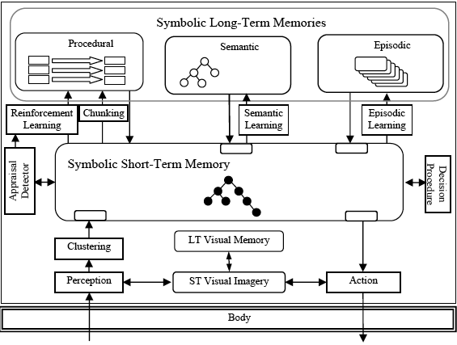
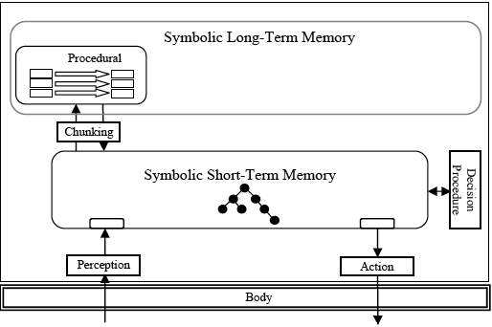
Desideratum III Functionally Elegant
Broad scope of capability and applicability
Embodying a superset of existing VH capabilities (cognitive, perceptuomotor, emotive, social, adaptive, …)
Theoretically elegant, maintainable, extendible
Hybrid Mixed Long-Term Memory
Decision
Prediction-Based Learning
Hybrid Short-Term Memory
HMGA
Soar 9
Soar 3-8

Slide 7
Summary of Desiderata
Broadly and incrementally functional
Theoretically elegant and simple for simple things
Mixed and hybrid
Supporting truly robust systems
Maintainable and extendible

Slide 8
Dichotomies Faced by Cognitive Architectures
Data-driven versus model-based
Probabilistic versus logical
Central versus peripheral
Discrete versus continuous
Uniform versus diverse
Explicit versus implicit
Symbolic versus subsymbolic/neural
Procedural versus declarative
Goal-based versus utility-based
Reactive versus deliberative
…

Slide 9
Resolving Dichotomies
Choose a side
Can work for some, particularly until challenges get too diverse
But usually inadequate over the long run
Bridge the dichotomy
Addition: Add a box for each side
Yields two points on broad spectrum, but not full spectrum
Neutral on tight integration
Supports functional side of functional elegance, but not elegance
Reduction: Extract commonality that exists across dichotomy
Can yield full spectrum
Can provide leverage in tight integration based on what is shared
Can add elegance to functionality
+ May uncover deep scientific results
- May require compromise or yield residual

Slide 10
Reduction Methods
Create generalization that subsumes both sides
Markov logic yields a generalization over logic and probability
Also generalizes over other dichotomies
Traditional shallow rule systems can be thought of as generalizing over data-driven and model-based
Compromises both ends of dichotomy for simplicity and efficiency
Implement one side via other
Soar implements deliberation via reactivity (plus decision proc.)
Data chunking tried to implement declarative via procedural
Graphical architecture implements diversity via uniformity
Requires level/time-scale difference and non-peer integration
Generalize implementation level beneath dichotomy
Factor graphs implement both procedural and declarative

Slide 11
Techniques
Piecewise continuous functions
Subsumption generalization for representational primitives
N-ary predicates become N-dimensional functions
Embodies aspects of both discrete and continuous functions
Exact for discrete and symbolic functions
Can represent some continuous functions exactly and approximate others as closely as needed
Factor graphs w/ summary product algorithm
Implementation generalization for complex reps. and processing
Generalizes over algorithms underlying many capabilities
Implement memories, decisions, etc.
Both are relevant to bridging all listed dichotomies

Slide 12
Space of Piecewise Continuous Functions
Types of regions
Hypercubes (squares, cubes, etc.)
Hyperrectangles/orthotopes (rectangles, etc.)
Polytopes (polygons, etc.)
Types of functions over regions
Constant, linear, polynomial, exponential, Gaussian, wavelet, ...
Additional sources of variation
Axially aligned or not (for hypercubes/orthotopes)
Totally explicit or inactive regions implicit
Local borders or space-wide slices
0
0
7
4
0
0
5
2
.2
.3
1
3
.6
.2
.4
1
.5y
0
x+.3y
1
x-y
1
0
6x
x-y
1
1
x+.3y
6x
x
t

Slide 13
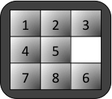
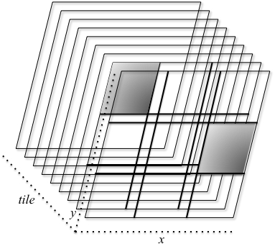
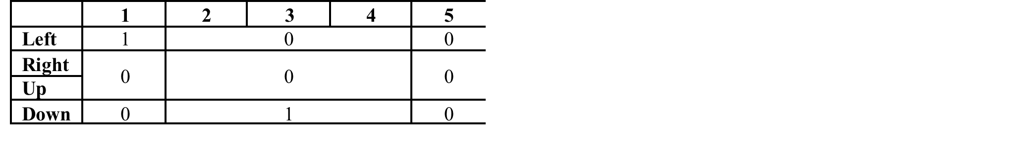
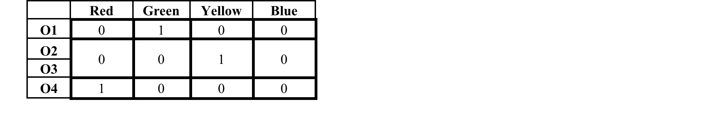
Examples
Working memory
(O1 ^color Green) (O2 ^color Yellow) (O3 ^color Yellow) (O4 ^color Red)
Episodic memory
Mental imagery
Probability densities
1
1
.75
.75
…
operator
.5
.5
time
.25
.25
0
4
0
4

Slide 14
Factor Graphs w/ Summary Product
Factor graphs are the most expressive form of GM
More complex rep. + inference
Summary product processes messages on links
Implements a generalized conditional language
w
y
u
x
z
f(u,w,x,y,z) = f₁(u,w,x)f₂(x,y,z)f₃(z)
f₁
f₂
f₃
CONDITIONAL Concept-Weight
condacts: (concept object:O1 class:c)
(weight object:O1 value:w)
function:
CONDITIONAL Transitive
conditions: (Next ob1:a ob2:b)
(Next ob1:b ob2:c)
actions: (Next ob1:a ob2:c)
w\c | Walker | Table | …
[1,10> | .01w | .001w | …
[10,20> | .2-.01w | “ | …
[20,50> | 0 | .025-.00025w | …
[50,100> | “ | “ | …
Pattern
Join
WM
WM
Pattern
Join
Function

Slide 15
Some Recent Results
Decision making
Mental imagery
Episodic learning
Statistical question answering
Prediction-based supervised learning

Slide 16
Decision Making
Preferences encoded via actions and functions
Most processing happens in graph via SP algorithm
Complete implementation of Eight Puzzle
747 nodes (404 variable, 343 factor)
Solves a simple problem in 9 decisions
1713 messages/decision, 2.5 seconds/decision
Also initial implementation of reflection, but slow(er)
CONDITIONAL goal-best ; Prefer operator that moves a tile into its desired location
:conditions (blank state:s cell:cb)
(acceptable state:s operator:ct)
(location cell:ct tile:t)
(goal cell:cb tile:t)
:actions (selected states operator:ct)
:function 10
CONDITIONAL previous-reject ; Reject previously moved operator
:conditions (acceptable state:s operator:ct)
(previous state:s operator:ct)
:actions (selected - state:s operator:ct)
Join
Negate
Changes
WM
–
+

Slide 17
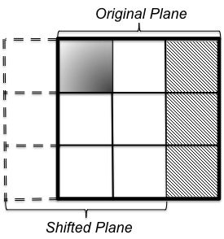
Mental Imagery
Beginnings of mental imagery
2D imagery with translation operation
Translation requires an angled, shifted delta function
Need extended functional form for efficiency in uniform rep.
Implemented a special purpose optimization: offset factors
Also currently important in reflection and may be relevant to EM
Need 3D, time, scaling, rotation, …
Need more focus on predicate extraction
CONDITIONAL Move-Right
:conditions (selected state:s operator:o)
(operator id:o state:s x:x y:y)
(board state:s x:x y:y tile:t)
(board state:s x:x+1 y:y tile:0)
:actions (board state:s x:x+1 y:y tile:t)
(board – state:s x:x y:y tile:t)
(board state:s x:x y:y tile:0)
(board – state:s x:x+1 y:y tile:0)
Funded by AFOSR/AOARD
Notes:
A memory architecture specifies the nature of the long-term and short-term memories
Structure of the memory for concepts with a particular set of attributes (Boolean, symbolic, discrete numeric, and continuous)
Numbers are unnormalized

Slide 18
Episodic Learning
Initialize LTM with a temporal prior and an EM conditional for each predicate that includes state
History of top-level state in WM is recorded in temporal slices of functions in EM conditionals
Scope & slope of temporal prior updated each cycle
Retrieve best previous state given cues by SP/max
CONDITIONAL Time
Condacts: (Time value:t)
Function: [1,2) – .6667t
CONDITIONAL Time-Selected
Condacts: (Time value:t)
(Selected state:0 operator:op)
Function: [1,∞)×[Left,Right,Up,Down] – 1
operator
Final region extends to ∞,
implicitly extrapolating to future
time
Function: [1,5) – .0833t

Slide 19
Statistical Question Answering
Joint with S. Raveendran and A. Leuski
The NPCEditor learns to choose appropriate answers to questions from statistics gathered over pairs of questions and answers
Also has additional dialogue components that can affect choice
Implemented Bayesian computation of language model of answers given question
Compiled sentence-pair statistics into semantic memory
Can be used directly to choose best answer
Extending to full Kullback-Liebler divergence
Also looking to further extend capabilities and run scale-up experiments

Slide 20
Plans
Continue with mental imagery
Including extending function representation
Pervasive prediction
Decisions choose next operator and predict next situation
Support perception, understanding, learning, appraisal, …
Implement more complete learning capability
Based on predictions, actuals and dependencies
Chunking, reinforcement, supervised and unsupervised
Pursue further capabilities
Theory of Mind, behavior understanding, speech and natural language, perceptuomotor behavior (SLAM), …
Evaluate, optimize and apply architecture
Notes:
Considering word sense disambiguation and dialogue management

Slide 21
Gold
Coal
On path to bridge dichotomies
Decisions, reflection and beginnings of imagery with little additional code
Continued promise of functional elegance
Step towards tight integration
Getting experience with data-driven statistical processing
A significant step towards broad spectrum
First bit of learning
Lots of exciting projects starting
Still little learning and no true perception
Function representation needs significant rethinking
Speed of code becoming an issue

