Slide 1
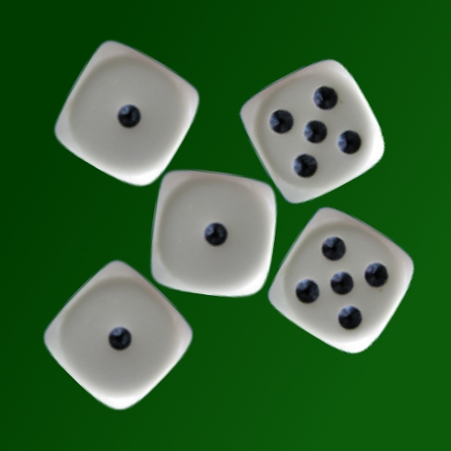

Playing Dice with Soar Soar Workshop June 2011
John E. Laird
Nate Derbinsky, Miller Tinkerhess
University of Michigan

Slide 2
Supporting Software
Freedice.net [Nate Derbinsky]
Supports correspondence dice games for humans and bots through web interface
Used for original development
Dice World [Miller Tinkerhess]
Java based dice game
Many times faster than Freedice
Used for generating results
Both give same information available to all players
QnA [Nate Derbinsky]
Allows easy attachment of external software device where there is an immediate response.
Similar to I/O but with single access for input & output
Dice Probability Calculator [Jon Voigt & Nate Derbinsky]
Computes simple probabilities: how likely is it for there to be 6 dice of the same face if there are a total of 20 dice.

Slide 3
Dice Game Rules
Roll dice in cup
Everyone starts with five dice
Actions
Bid: number of dice of a given rank: six twos
Bid and reroll: push out a subset of dice and reroll
Exact: exactly the number of dice bid in play
Challenge: < number of dice bid in play
Pass: all dice are the same (must have >= 2 dice).
Lose die if lose a challenge
Last one with remaining dice wins

Slide 4
Key Strategic Considerations
If you raise too high, you might be challenged.
If you don’t raise high enough, it will come around again for another turn.
Can only lose a die if you challenged or are challenged.
Pushing dice increases information for other players and reduces your flexibility.

Slide 5
Research Issues in Dice Game
Multi-faceted uncertainty
What dice are under other cups?
What did that bid indicate?
What will the next player do after my bid?
How combine different sources of uncertainty?
Non-trivial cognitive challenge for humans
Actions take seconds to minutes
Human performance correlated with experience
A fair amount to learn beyond the rules
Potential for opponent modeling
Potential for learning

Slide 6
Decision making under multi-faceted uncertainty in Soar?
Agent 1: Expected Values
Compute expected value for the bid based on known and unknown dice.
If there are 6 unknown dice, and I have 2 2’s, then there are most likely 6/6 = 1 + 2 = 3 2’s.
Compare bids to that expected value and classify as certain, safe, risky, very risky.
Similar to what we think humans do.
Agent 2: Probability Values
Compute probability of bids being successful.
Uses external software calculator.
Additional heuristics contribute to final bid:
Don’t pass or challenge if have another good bid.
Don’t bid and push if bid alone is a good bid.
…

Slide 7
Overall Approach
Propose operators for all legal actions
Raises, raises with pushes, exact, pass, challenge
Tie impasse arises between operators
Evaluate all of the operators in selection space
Create preferences based on evaluations
symbolic evaluations → symbolic preferences
probability-based evaluations → numeric preferences
Decision procedure picks the best operator.

Slide 8
Dice Problem Space Operators
Raise bid
Next legal bid given last bid for each die rank (1-6)
Special processing to determine first bid and lowest reasonable bid
Raise, push, and roll
Next legal bid given last bid for each die rank where there is a possible push
Only consider pushing all relevant dice (no Valerie Bids)
Challenge
Previous bid, or two back if previous is a pass
Exact (if available)
Pass
A few more operators for initialization and counting up available dice on each turn.
Total dice showing for each rank
Total dice under other players’ cups
Totals for my dice under my cup

Slide 9
One-step Look-ahead Using Selection Problem Space
(on A Table)
(on B Table)
(on C A)
Tie Impasse
A
move(C, B)
B
Prefer move(C, Table)
C
move(C, Table)
Goal
C
move(B, C)
A
B
Evaluation = 1
Evaluation = 0
Evaluation = 0
Evaluate(move(C, Table))
Evaluate(move(C, B))
Evaluate(move(B,C))
copy
Evaluation = 1
(on A Table)
(on B Table)
(on C A)
move(C, Table)
(on A Table)
(on B Table)
(on C Table)
A
B
C
Notes:
Applies to any problem, whether blocks world, planning movement in the world, configuring a computer, …
If Failure – no way to predict future, then can still evaluate – may bias toward exploration or not.
Why is this good? Minimal internal memory – no search through memory – maintains reactivity, …
What knowledge is required?
If no model – can just punt and act in the world.

Slide 10
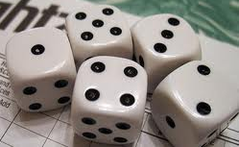
Replace Look-Ahead Evaluation with Expected-Value Calculation (Agent 1)
Tie Impasse
Bid: 6[4]
Challenge > Bid
Challenge > Pass
Bid > Pass
Conversion of evaluations to preferences is done by a bunch of rules with many special cases.
Challenge
Pass
Evaluation = risky
Evaluation = safe
Evaluation = very risky
Evaluate(bid: 6[4])
Evaluate(challenge)
Evaluate(pass)
[Exposed 4’s] +
[in my cup 4’s] +
[unknown]/6 –
[# of dice bid: 6]
=
Bid difference
Evaluation = risky
compute-bid-
difference
compute-bid-
likelihood
-1
Possible Evaluations: lose, very risky, risky, safe, certain
Notes:
Applies to any problem, whether blocks world, planning movement in the world, configuring a computer, …
If Failure – no way to predict future, then can still evaluate – may bias toward exploration or not.
Why is this good? Minimal internal memory – no search through memory – maintains reactivity, …
What knowledge is required?
If no model – can just punt and act in the world.

Slide 11
Approach #1 Operators for Evaluation
Simple Bid (Raises)
Compute-bid-difference [-N to +M]
Evaluate-bid-likelihood [lose, very risky, risky, safe, certain]
Bid, Push, and Reroll
Compute-bid-push-difference
Evaluate-bid-likelihood
Challenge
Compute-challenge-bid-difference
Evaluate-challenge-bid-likelihood
Compute-challenge-pass-likelihood
Exact
Compute-exact-difference
Evaluate-bid-likelihood
Pass
Compute-pass-likelihood

Slide 12
Replace Look-Ahead Evaluation with Probability Calculation (Agent 2)
Tie Impasse
Bid: 6[4]
Conversion of evaluations to preferences is done by a bunch of rules with many special cases.
Challenge = .9
Bid: 6[4] = .3
Pass = .08
Challenge
Pass
Evaluation = .3
Evaluation = .9
Evaluation = very risky
.08
Evaluate(bid: 6[4])
Evaluate(challenge)
Evaluate(pass)
Evaluation = .3
compute-bid-
probability
[using QnA]
.3
Notes:
Applies to any problem, whether blocks world, planning movement in the world, configuring a computer, …
If Failure – no way to predict future, then can still evaluate – may bias toward exploration or not.
Why is this good? Minimal internal memory – no search through memory – maintains reactivity, …
What knowledge is required?
If no model – can just punt and act in the world.

Slide 13
Approach #2 Evaluation Operators
Simple Bids (Raises)
Compute-bid-probability
Bid, Push, and Reroll
Compute-bid-push-probability
Challenge
Compute-challenge-probability
Compute-challenge-pass-likelihood
Exact
Compute-exact-probability
Pass
Compute-pass-likelihood

Slide 14
Observations
Plays a good game!
Doesn’t make stupid bids and is a bit unpredictable
Tends to be conservative on bids
Tends to be aggressive on challenges
Has beaten human “experts”
Bluffs when it doesn’t have a good bid.
But doesn’t explicitly decide to bluff
Does not always take the safest bid
Sometimes from randomness
Sometimes because of selection knowledge
Don’t take certain pass when have another safe bid

Slide 15
Model Previous Player
Agent tends to challenge too often.
A player usually makes a specific bid for a reason!
Approach:
Add selection space operator that computes likely dice under previous player’s cup based on most recent bid.
Selected only if no certain bid using known dice.
Analysis of previous player’s bid
Iterate through possible number of dice bid starting with 1 until
find a number that would make the bid reasonable or
reach a number that is very unlikely
Use result to recalculate expected value/probabilities of possible bids.

Slide 16
Results for 1000 two player games
 | No Model – Probability | No Model – Expectation
Model – Probability | 761/239 | 703/297
Model – Expectation | 681/319 | 607/393
 | Expectation – No Model | Expectation – Model
Probability – No Model | 451/549 | 319/681
Probability – Model | 703/297 | 571/429
Player against self is ~480/520
Without model, expectation-based is better.
With model, probability-based is better.
Model is more important for the probability-based agent.

Slide 17
Three & Four Player Games with Models
Expectation | 414
Expectation | 289
Probability | 297
Expectation | 246
Probability | 231
Expectation | 267
Probability | 256
Expectation | 384
Probability | 284
Probability | 332
Expectation | 381
Expectation | 230
Probability | 146
Probability | 243
Probability | 346
Probability | 331
Probability | 323

Slide 18
Future Work: More Opponent Modeling
Extend evaluation calculations
Worst case analysis for next player for my best bids
“No matter what he has, he won’t challenge that bid.”
Allows agent to bluff more.
Possibly biased by next player’s last bid.
Episodic memory:
History of how next player responded to similar bids.
History of what player had when made similar bid.
Model other players to have better estimates of hidden dice.

Slide 19
Future Work: Chunking and RL
Use chunking to learn (lots of) RL rules.
Hard to write these by hand – too many cases
Chunking works with the current agents to learn rules that test features relevant to created preference.
Numeric preferences are initial values for RL.
Use RL to “tune” rules learned by chunking.
Need lots of experience.
Interesting proposal for the source of RL rules.
Initial results are not promising…

Slide 20
Future Work: More Baselines and Experiments
Pure probability and expectation-based without heuristics.
RL agents with different value functions.
Fair number of state-action pairs:
Number of possible prior bids (>200) * possible configurations of dice (10⁶) * number of next bids (~15) = 3 Billion
Human players (from the web?).
Create (large) set of cases that can be used for direct comparison:
Find states where different agents make different bids.

Slide 21
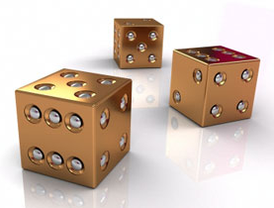
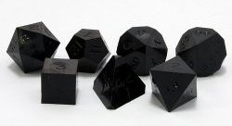
Nuggets and Coal
Nuggets:
Two different approaches for reasoning with probabilities in Soar that fits in “naturally”.
Example of using opponent model.
Leads to a competent dice player.
Coal
Don’t understand strengths and weaknesses.
Has promise for generating and using RL rules but haven’t achieved it.

