Slide 1
Current Applied Soar Agent Development

Slide 2
Applied Soar Agents
Agents developed for DoD projects, for which:
Application of Soar is the emphasis of research/development of Soar
Primary design and implementation goal of Soar programs is to meet application-specific reasoning and behavior generation requirements
General emphasis of this talk is on reasoning agents that interact as role players in some DoD simulation environment

Slide 3
General Highlights
There continues to be interest in applied (in contrast to research) systems that use Soar agents
Soar continues to demonstrate advantages for certain types of applied, interactive systems
Potential transition of some applied Soar agents to actual DoD programs
Significant amounts of reuse across agents and development of new, reusable rule sets and/or patterns
Soar 9 mechanisms beginning to move into the mainstream
Improving focus on when and where to use Soar

Slide 4
Points of emphasis for Soar applications
The integrated cognitive/reasoning capabilities in Soar provide an engineering advantage in situations where:
Integrated knowledge, reasoning, and expertise are necessary to the capability to manage the large number of special cases and exceptions
Knowledge-based reasoning can generate decisions, actions, and expectations, and evaluate alternative hypotheses
that are highly situation dependent
that change fluidly as the dynamics of a situation unfold

Slide 5





IRM-CGF
Manual Detection
DCA
Individual Response
Word of Mouth
General Announcement
Fire Team Response
Repair Locker Leader
Naval ship recovery management simulator
Simulation of weapons, damage, fire, smoke, flooding effects on ships
Crew members modeled with “omniscient” hierarchical task decompositions, implemented in TCL
Use of Soar
No reimplementation of existing task hierarchies in TCL
Soar code provides higher-level situation understanding and decision making, using TCL tasks as primitives
Soar code also monitors progress of TCL tasks and interrupts where appropriate
Soar agents are not “omniscient” and so must reason about attention, situation understanding, and communication using ship comm channels and chains of command
Simple set of initial prototype agents under development
Significant reuse of code “libraries” from other projects
“NGS-extra-lite” goal handling
Reception and processing of incoming messages
Delayed/synchronous response generation

Slide 6
NSS-CGF
Naval Ship Simulation – simulation of fleet operations and command decision making
Simulation of individual ships and aircraft
Each vehicle has a set of reactive tasks associated with it
No interruptibility, no learning, only very simple reactivity and situation understanding, no teamwork
Use of Soar
Model various command roles for ships in the fleet
Management of investigation and engagement of threats, with variations including:
Reinforcement learning about decoy tracks
Teamwork modeling to allocate engagement resources
Cognitive load modeling, to demonstrate errors under high load
Situation understanding and interruptible adaptive reasoning
Simple set of prototype agents for each type of capability
Developing reusable “libraries” for message processing and delayed response handling
July workshop and tutorial in San Diego, targeting DoD and Defense Contractor users (and potential users) of NSS

Slide 7
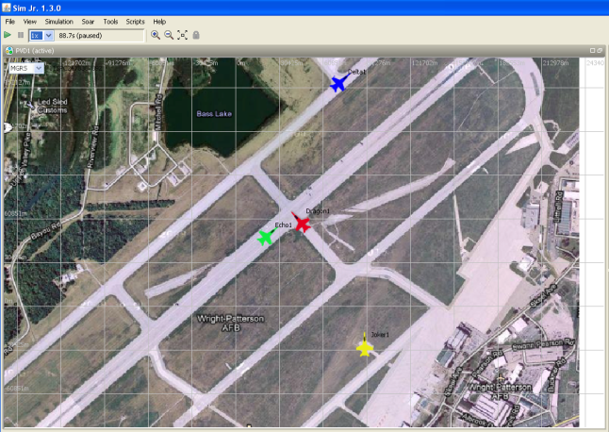

ESPRIT
Collision-course-okay (aircraft1,aircraft2)
Taxiway2
Stop
Possible Collision Course (aircraft1,aircraft2)
Aircraft has upcoming stop (aircraft2)
Aircraft(n) moving toward Aircraft(m) on collision course
(aircraft1,aircraft2)
Aircraft slows
(aircraft2)
Aircraft stops
(aircraft2)
Aircraft2
Taxiway2
Aircraft1
Taxiway1
Generation of expectations, prediction of intent, and appropriate reaction for autonomous air vehicles in the terminal area of operations
Customer currently wants focus on cognitive capabilities developed in simulation
Working relationship with Dr. Ella Atkins to target actual vehicles, if possible
SimJr as simulation platform for research, development, and evaluation
Use of Soar
Adapting Soar-based Schema Engine (previously seen in projects for cultural reasoning and air traffic control)
Extending Schema Engine to handle multiple agents simultaneously and to parameterize to different situations (geography, physical platform)
Future plans to incorporate Soar implementation of “Explanation Based Learning of Correctness” (knowledge-patch learning mechanism)
Project cited in the popular press

Slide 8
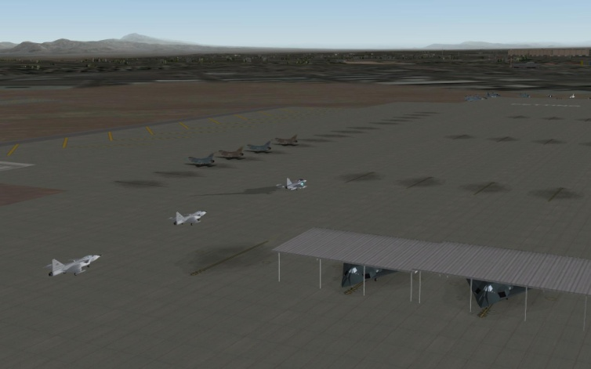
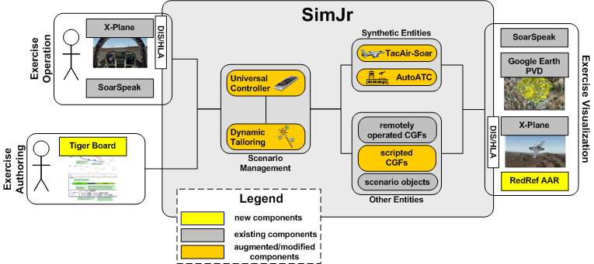
RedRef
A portable, authorable practice environment for international participants which will allow them to rehearse Red Flag flight domestics
Self-contained, deployable product with SimJr and Soar at the core
Major goals are system portability, content authoring, and sufficient level of realism for useful rehearsal
Use of Soar
Fully autonomous friendly and enemy synthetic aircraft using TacAir-Soar and new enhancements
Adaptation of Schema Engine to detect and anticipate violations and provide instant feedback to the pilot
Integrated speech recognition and generation via SoarSpeak

Slide 9
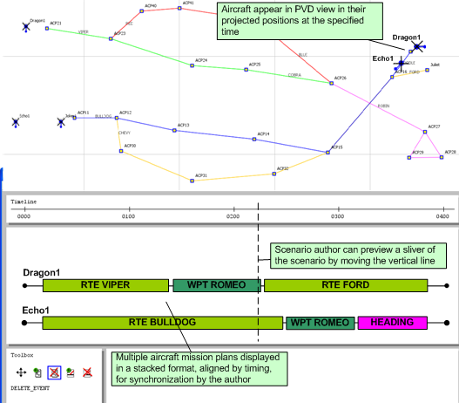
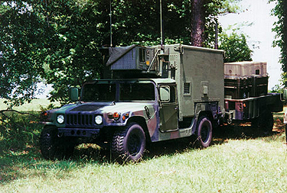
Tiger Board
Scenario composition tool for airspace management training
Easy authoring of robust new training content
Realistic and correct interaction of synthetic aircraft with air-traffic control trainees
Use of Soar
Smart Interface Device (using Schema Engine) to task synthetic aircraft (Soar and non-Soar) with varying autonomous capabilities
Helo-Soar agent provides some aircraft behaviors
Investigating transition to the Army’s Tactical Airspace Integration System, to support training (tentative program start in 2012)

Slide 10
Summary
Gold
Continued demand for applied Soar-based agents
Making gradual in-roads to “prime time”
Fair degree of reuse across systems, making systems more cost effective to build
Starting to use Soar 9 features
Coal
Haven’t yet used semantic or episodic memories in an applied agent
Some applications remain simple prototypes
Some reusable code units have not yet been “packaged up”
Some “unapproved” uses of Soar, for the sake of engineering
Heavy use of NGS, no use of UM-style goals
But see other talk on this topic

