Slide 1
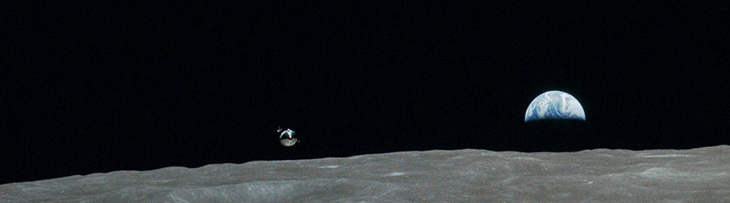



Modeling Astronaut Decision-Making and Judgment during Lunar Landing
Zarrin Chua
Georgia Institute of Technology
31th Soar Workshop
June 2011
Commitee
Dr. Karen M. Feigh
Dr. Robert D. Braun
Dr. Amy R. Pritchett

Slide 2
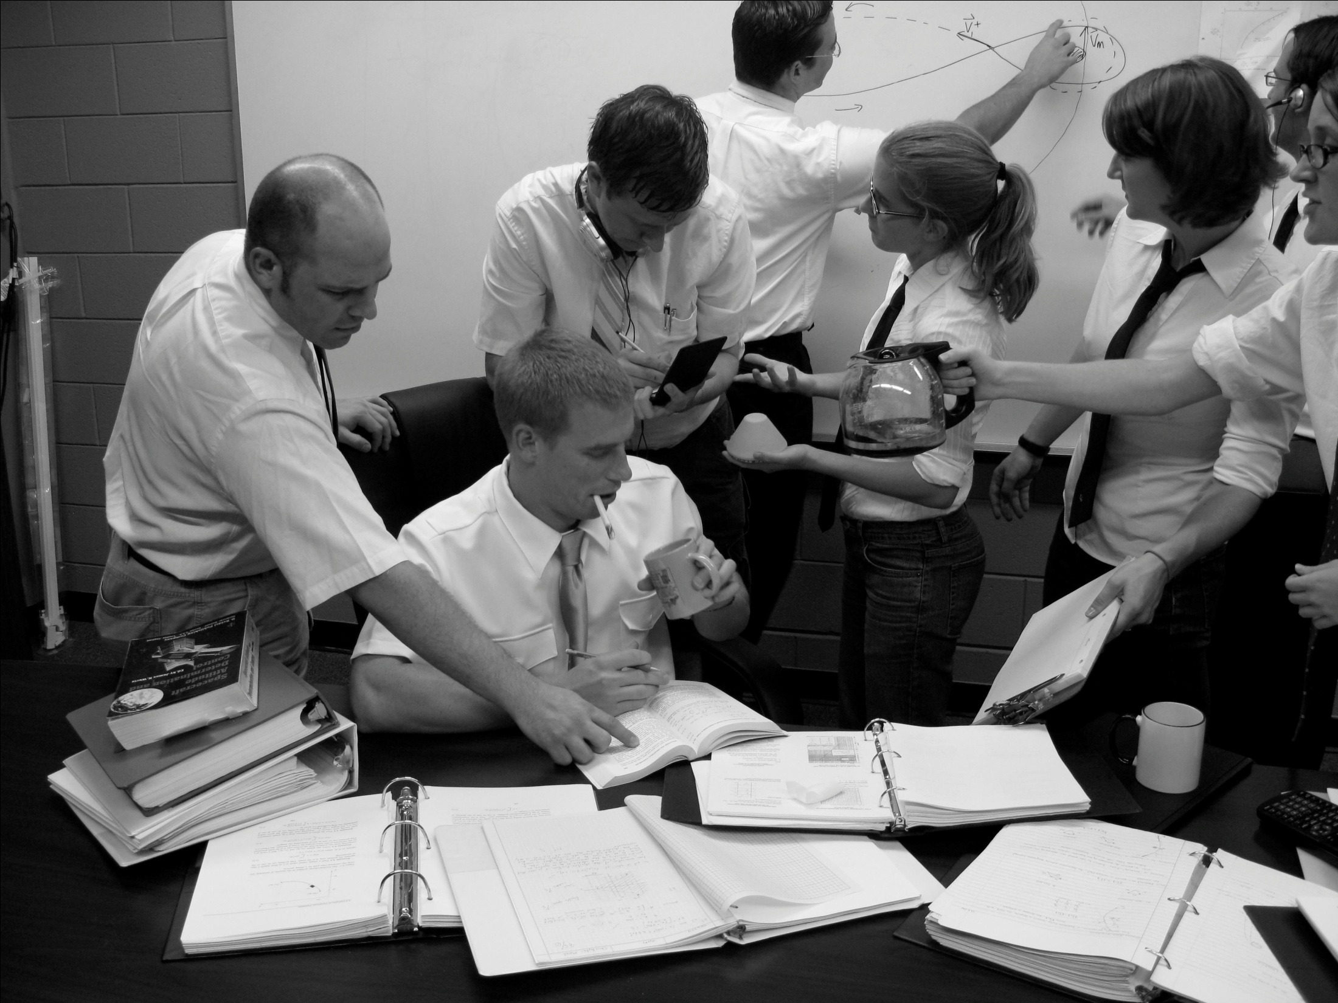
“ In manned vehicles, the same performance goals come easier in a system not handicapped by idiosyncrasies of the human being…”
NASA Assoc. Admin. Richard Horner
“I was just absolutely adamant about my God-given right to be wishy-washy about where I was going to land.”
Cdr Neil Armstrong
“Apollo mission planners and designers sacrificed much to save on weight and fuel, eliminating useful equipment to make the vehicle and its trajectory highly efficient.”
Historian David Mindell

Slide 3
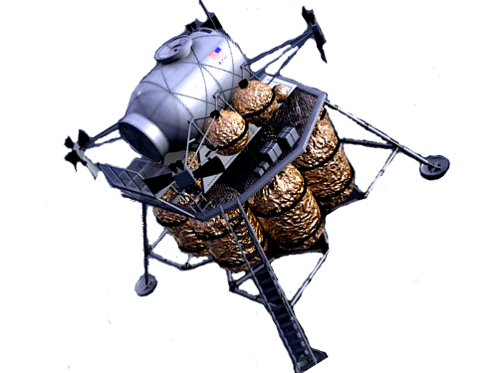
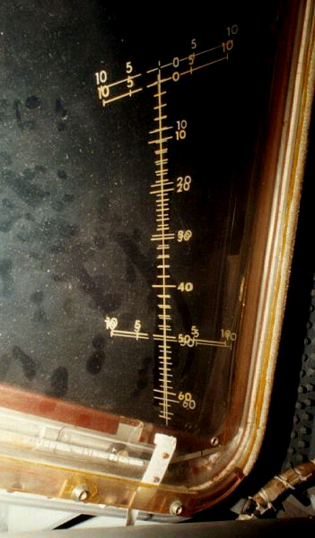
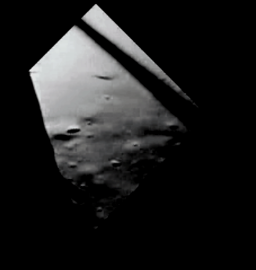
Landing Point Designation (LPD)

Slide 4
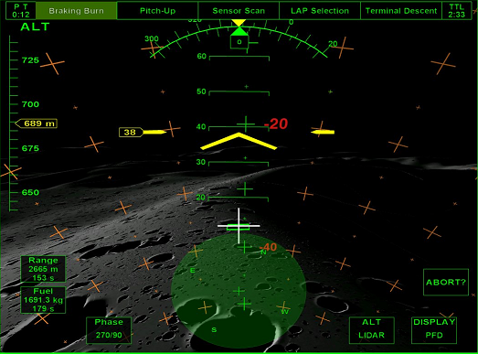
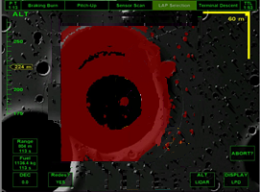
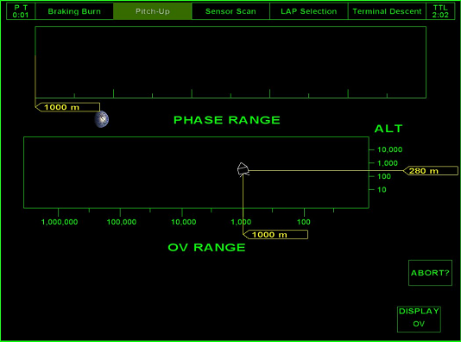
apollo-like
0
Scan expected landing area
LPD display
Pitch up vehicle
Perceive terrain
1
Search
for a known
2
Receive
AFM results
Window
Reorient to terrain
3
Search
for site
Reach
end
3
Evaluate
vehicle state
Maneuver
joystick
Select
site
PFD
OV
judgment
Human | Auto

Slide 5
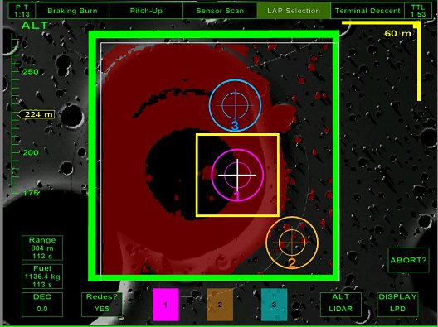
moderate
0
Scan expected landing area
LPD display
Pitch up vehicle
Perceive terrain
1
Search
for a known
2
Receive
AFM results
Window
Reorient to terrain
3
Track time remaining
Examine
site
Select
landing zone
Partition
map into zones
4
Evaluate
site terrain
5
Select
site
Press
selection
Press
confirm
Reach
end
OV display
PFD
LPD display
decision-making
Human | Auto

Slide 6
Comprehensive Landing Model
Mission scenario
Terrain properties
Mission status
Vehicle state
HSI display status
Landing sites (Moderate)
ALHAT System
Auto
Trajectory
outputs
is input to
is input to
Interaction with Auto
Vehicle Maneuvers
Targets
Cognitive Model
(Soar or Other)
outputs
is input to

Slide 7
Questions
Is Soar the appropriate tool?
What development is needed to model the apollo-like and moderate cases?
Can Soar communicate well with other software?

