Slide 1
Soar-RL and Reinforcement Learning
Introducing talks by Shiwali Mohan, Mitchell Keith Bloch & Nick Gorski

Slide 2

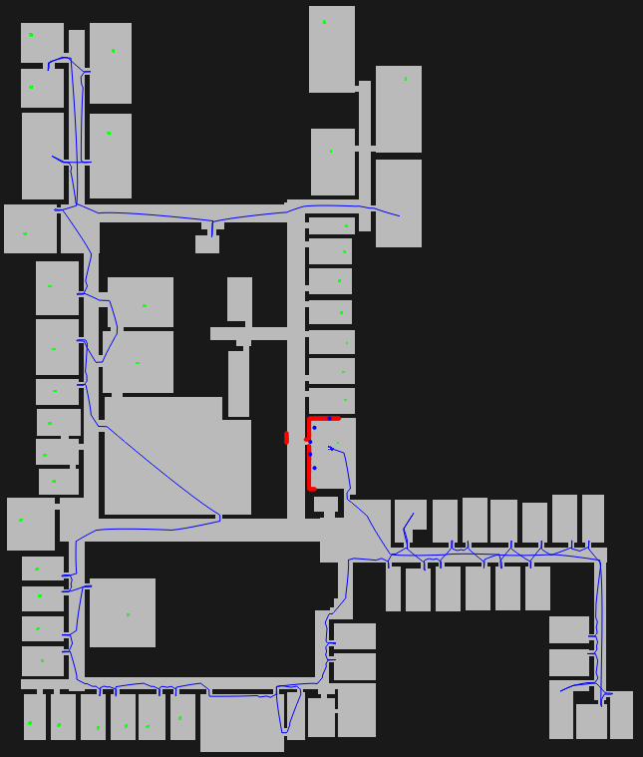
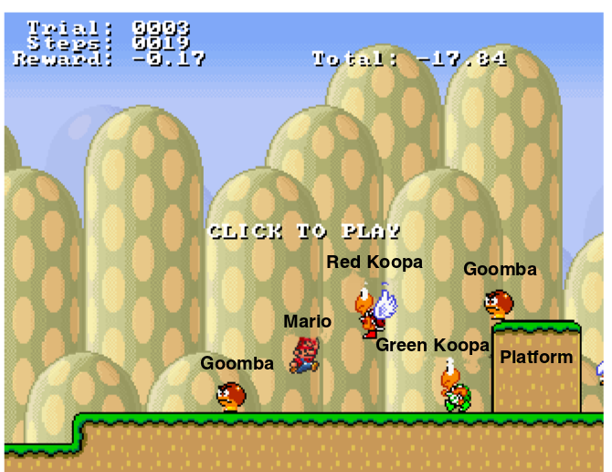
Reinforcement Learning
Environment
Observations
Rewards
Actions
Agent

Slide 3
Value in Reinforcement Learning
Value: future expected reward
RL goal: maximize value
RL agent: select actions with highest value

Slide 4
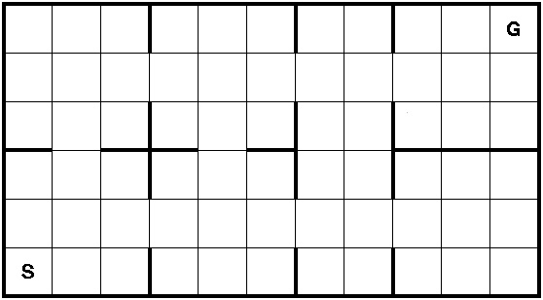

State and Observability
Agent observes a representation of world state
Can be Markovian or partial
Agent doesn’t observe semantics of task
Must does learn the meanings of symbols and actions
0, 2
Markovian representation
Partial representation

Slide 5
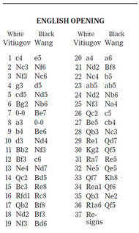
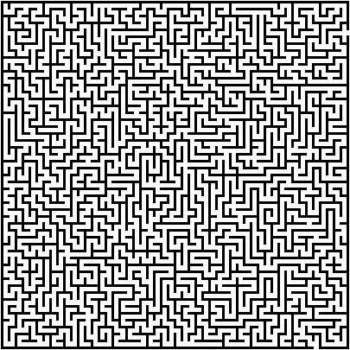
Why Reinforcement Learning Is Hard
Temporal credit
Assignment problem
Exploration / exploitation
tradeoff
Curse of dimensionality

Slide 6
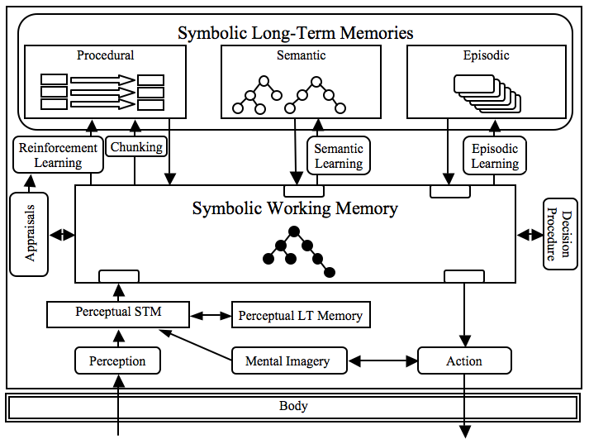
Soar 9.3.1

Slide 7
Soar-RL
Reward
<state>
^reward-link
^reward
^value float
Value representation
sp {rl*move*left
(state <s> ^name left-right ^operator <op> +)
(<op> ^name move ^dir left)
-->
(<s> ^operator <op> = -1.0) }
Decisions
Move*left -0.8
Move*right -0.2
Move*sit -1.2
Adaptive behavior
Notes:
Ask Nate for slides from tutorial

Slide 8
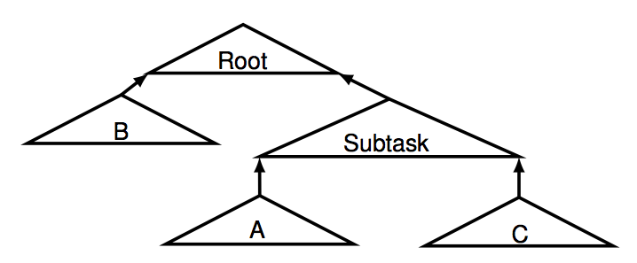
Soar-RL Talks
Modular RL in Soar Shiwali Mohan
Improving Off-Policy HRL Mitchell Keith Bloch
Learning to Use Memory Nick Gorski
C
A/B
Notes:
TODO

