Slide 1
Soar-RL Discussion: Future Directions, Open Questions, and Why You Should Use It
31st Soar Workshop

Slide 2
Soar-RL Today
Robust framework for integrated online RL
Big features:
Hierarchical RL
Internal actions
Architectural constraints
Generalization, time
Active research pushing in those directions

Slide 3
Soar-RL Tomorrow
Future research directions
Additional architectural constraints
Fundamental advances in RL
Increased adoption
Usage cases
Understanding barriers to use
Notes:
Agenda: step through these items
Interrupt and discuss points of interest
2nd half more practical than 1st half
I will be stating opinions: feel free to disagree!

Slide 4
Why You Should Use Soar-RL
Changing environment
Optimized policies over environment actions
Balanced exploration and exploitation
Why I would use Soar-RL if I were you

Slide 5
Non-stationary Environments
Dynamic environment regularities
Adversarial opponent in a game
Weather or seasons in a simulated world
Variations between simulated and embodied tasks
Limited transfer learning, or tracking
Agents that persist for long periods of time
Notes:
Gain these advantages from a learning rate

Slide 6
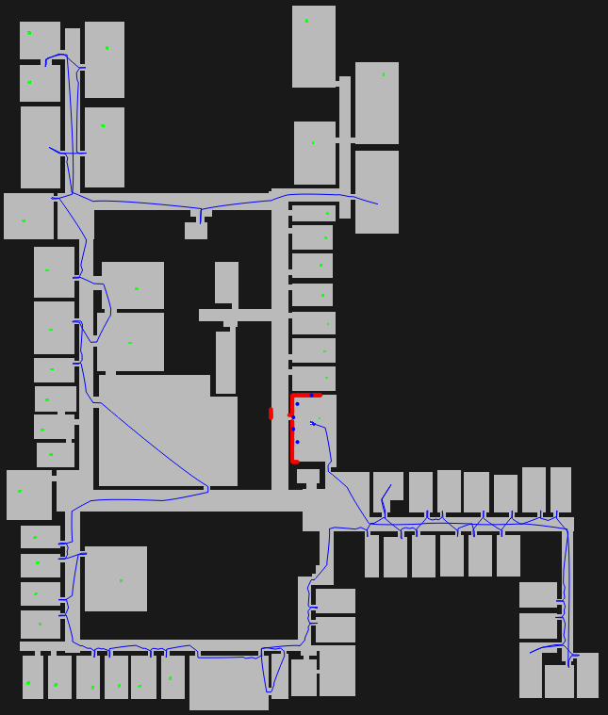
Pragmatic Soar-RL
Get-all-blocks
Go-to-room
Plan-path
Drive-to-gateway
op1
op2
op3
Turn-left
Turn-right
Go-forward

Slide 7
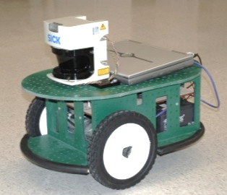
Optimizing External Actions

Slide 8
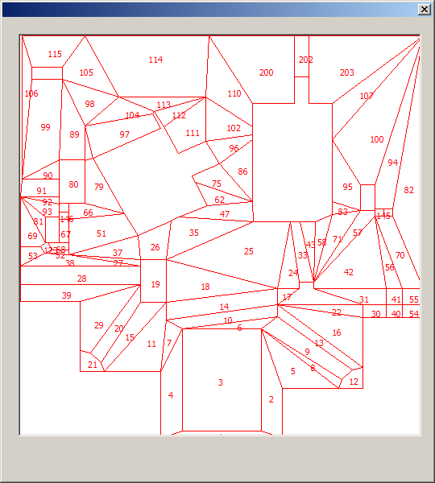
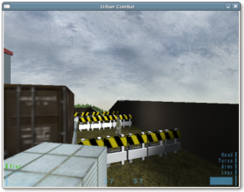
Balanced Exploration & Exploitation
Stationary, but stochastic actions

Slide 9
Practical Reasons
Programmer time is expensive
Learn in simulation, near-transfer to embodied agent
If hand-coded behavior can guarantee doctrine, then so can RL behavior
Mix symbolic and adaptive behaviors FIX

Slide 10


Biggest Barrier to Using Soar-RL

Slide 11

Other Barriers to Adoption?

Slide 12
I Know What You’re Thinking

Slide 13
Future Directions for Soar-RL
Parameter-free framework
Issues of function approximation
Scaling to general intelligence
MDP characterization

Slide 14
Parameter-free framework
Want fewer free parameters
Less developer time finding best settings
Stronger architectural commitments
Parameters are set initially, and can evolve over time
Policies
Exploration
Gap handling
Learning algo.
Knobs
Learning rate
Exploration rate
Initial values
Eligibility decay
Notes:
One poke at ACT-R in the past was its reliance on parameters – different reasons, but still
An ideal architecture is parameter free
Can view function approximation, RL rules, and RL state as features

Slide 15
Soar-RL Value
Q-value: expected future reward after taking action a in state s
state
action
Q-value
<op> move-forward
-0.8
<op> move-left
-1.2
<op> move-forward
-0.1
<op> move-left
-0.3
…
<op> move-forward
0.4

Slide 16
Soar-RL Value Function Approximation
Typically agent WM has lots of knowledge
Some knowledge irrelevant to RL state
Generalizing over relevant knowledge can improve learning performance
Soar-RL factorization is non-trivial
Independent rules, but dependent features
Linear combination of rules & values
Rules that fire for more than one operator proposal
Soar-RL is a good framework for exploration

Slide 17
Scaling to General Intelligence
Actively extending Soar to long-term agents
Scaling long-term memories
Long runs with chunking
Can RL contribute to long-term agents?
Intrinsic motivation
Origin of RL rules
Correct factorization
Rules, feature space, time
What is learned with Soar-RL and what is hand coded
Learning at the evolutionary time scale
Notes:
Odd man out – these are bigger issues
IMRL: reward that doesn’t come from the environment

Slide 18
MDP Characterization
MDP: Markov Decision Process
Interesting problems are non-Markovian
Markovian problems are solvable
Goal: use Soar to tackle interesting problems
Are SARSA/Q-learning the right algorithms?
(The catch: basal ganglia performs temporal-difference updates)

Slide 19


