Slide 1
New SVS Implementation
Joseph Xu
Soar Workshop 31
June 2011

Slide 2
Outline
Functionality in old SVS
Addition of continuous control
New implementation
Conclusions

Slide 3
The Gist of SVS Past
Hypothesis: Important properties of continuous environments cannot be completely captured with purely symbolic representations
Use continuous representation to supplement symbolic reasoning
Continuous spatial scene graph
Symbolic Soar extracts information by asking questions in the form of spatial predicates
Symbolic Soar modifies scene graph using imagery commands

Slide 4
Spatial Scene Graph
World
Set of discrete objects
Hierarchy of “part-of” relationships
Each object is transformed relative to parent in terms of position, rotation, and scaling
Each leaf object has a concrete geometric form
P [ 0.1, 3.4, -12 ]
R [ 0.0, 0.0, 1.7 ]
S [ 1.0, 1.0, 1.0 ]
B
C
P [ ... ]
R [ ... ]
S [ ... ]
A
P [ ... ]
R [ ... ]
S [ ... ]
B
C

Slide 5
SVS Commands
Predicate extraction
Ask a question about the current state
Is car A intersecting box B?
Imagery
Imagine a change to the state for the purpose of reasoning about it
If A is to the right of B, is it to the left of C?
SVS is only a mechanism, it’s not smart
Needs knowledge about which predicates to extract and imagery operations to perform
Environment
Spatial Scene Graph
Working Memory
world
Commands
(<s1> ^svs <s3>)
(<s3> ^command <c3>)
(<c3> ^extract <e1>)
(<e1> ^predicate intersect
^a A ^b B
^result false)
B
A_{x}: 0.2
A_{y}: 1.2
B_{x}: 3.4
B_{y}: 3.9
A
A
B
predicates

Slide 6
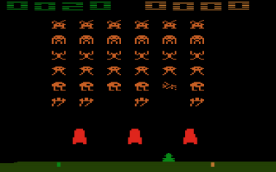
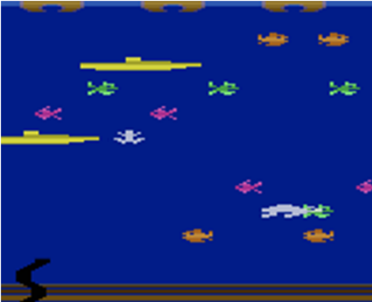
Applications
Applied to domains where spatial properties of state are important
Controlled with given discrete sets of actions
One step predictions using ad-hoc model learning methods
Soar
Discrete actions
Env
imagery
SVS
Continuous
state
predicates

Slide 7
Continuous Control
Many real world environments expect continuous control signals from agent
Example: robot domain expects left and right motor voltages
Traditional approach is to hand-code middleware to translate set of discrete actions into continuous output
Action discretization is a priori, leading to non-adaptive and non-optimal behavior
Not part of the cognitive architecture theory
Need new middleware for every new environment

Slide 8
My Motivation
Augment SVS to allow agents to automatically learn continuous control
Agent autonomously derives a set of relational actions that it can plan over symbolically
SVS learns how to translate relational actions to continuous output
Symbolic
Soar
Discrete actions
Env
imagery
SVS
Continuous
state
predicates
Symbolic
Soar
Relational
actions
SVS
Continuous
actions
Env
imagery
Continuous
state
predicates

Slide 9
Environment Assumptions
Environment
Agent
Input to the agent is a scene graph
Output is fixed-length vector of continuous numbers
Agent doesn’t know a priori what numbers represent
Agent runs in lock-step with environment
Fully observable
Some noise tolerable
-9.0
B
5.8
Output
A
Input
A_{x}: 0.2
A_{y}: 1.2
B_{x}: 3.4
B_{y}: 3.9
A.x
0.2
A.y
1.2
B.x
3.4
A
B
B.y
3.9
Notes:
Be able to defend why deterministic and what aspects of your approach would not generalize to the non-deterministic case.

Slide 10
Relational Actions
The value of an extracted predicate is the smallest unit of change that’s distinguishable to symbolic Soar
Each potential predicate value change is a relational action
Combinations of predicates?
+intersect(A, B)
(<s1> ^svs <s3>)
(<s3> ^command <c3>)
(<c3> ^extract <e1>)
(<e1> ^predicate intersect
^a A ^b B
^result false)
B
A
B
(<s1> ^svs <s3>)
(<s3> ^command <c3>)
(<c3> ^extract <e1>)
(<e1> ^predicate intersect
^a A ^b B
^result false)
A
B
(<s1> ^svs <s3>)
(<s3> ^command <c3>)
(<c3> ^extract <e1>)
(<e1> ^predicate intersect
^a A ^b B
^result true)
A

Slide 11
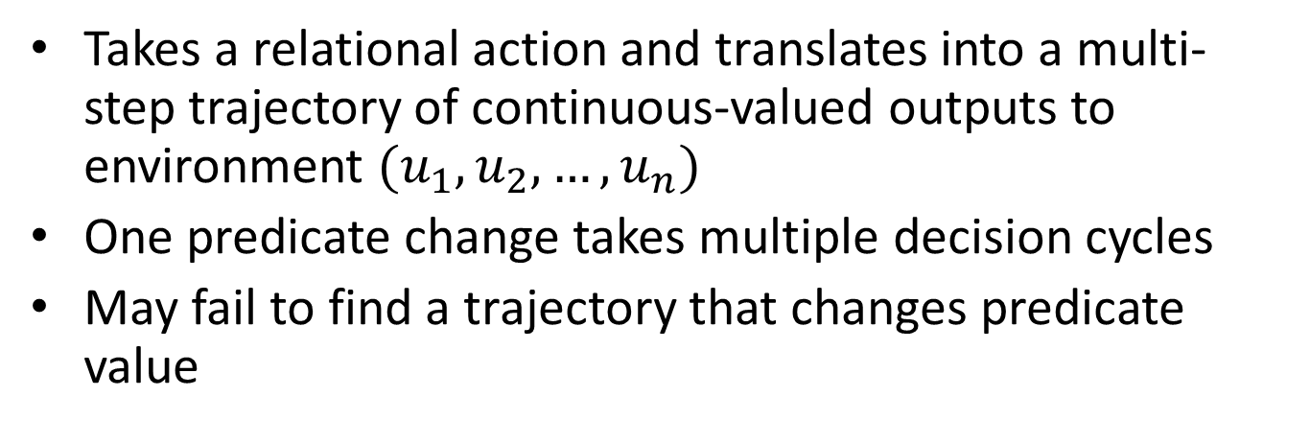
Continuous Controller
Takes a relational action and translates into a multi-step trajectory of continuous-valued outputs to environment $(u_{1},u_{2},…,u_{n})$
One predicate change takes multiple decision cycles
May fail to find a trajectory that changes predicate value
Symbolic
Soar
Discrete
actions
SVS
Continuous
actions
Env
Continuous
Controller
imagery
Continuous
state
predicates

Slide 12
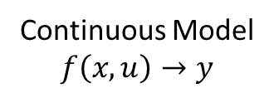
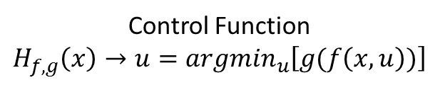
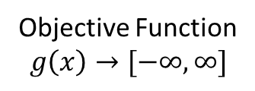
Continuous Planning
Find the trajectory that will lead to the predicate change the fastest
Continuous Model
$$f\left(x, u\right)→y$$
Objective Function
$$g\left(x\right)→[−∞, ∞]$$
Control Function
$${H_{f, g}\left(x\right)→u=argmin}_{u}\left[g(f\left(x, u\right))\right]$$
Learned (subject of next talk) or hand-coded
Given a priori for each predicate
Fixed in architecture
GreedySearch(s, objective):
for u in sample(outputs):
y = continuous-model(s, u)
o = objective(y)
if o < best:
best = o
best-output = u
return best-output
Vector of transform values in flattened scene graph
A
Downhill
Simplex
B
Euclidean Distance
intersect(A, B)=true

Slide 13
Imagery with Control
Agent can perform relational prediction by simulating a trajectory using continuous model on the internal scene graph, instead of sending it out to the environment
Modified scene graph updates predicates as usual
Discrete
actions
Continuous
actions
Symbolic
Soar
SVS
Env
Continuous
Controller
Continuous
Model
imagery
Continuous
state
Scene
Graph
Continuous
state
predicates

Slide 14
Summary
Sam focused on theory of translating continuous environment state into relational symbolic representations
I’ve added theory about where relational actions come from and how to ground them into continuous trajectories in the environment
Ultimate goal: agents that can learn relational abstractions and plan over them in continuous environments

Slide 15
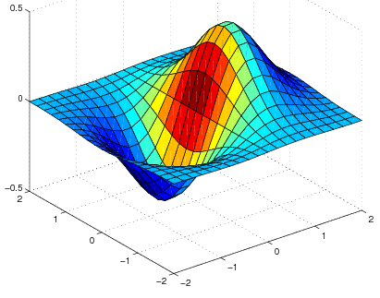
Relational State
Available Actions
Relational State
¬intersect
(robot, red_wp)
¬intersect
(robot, green_wp)
+intersect(robot, red_wp)
+intersect(robot, green_wp)
intersect
(robot, red_wp)
¬intersect
(robot, green_wp)
Relational Planner
Relational Model
Relational
Abstraction
(Predicate
Extraction)
Relational
Abstraction
(Predicate
Extraction)
Relational
Action
Continuous State
Objective Function
Continuous State
Continuous Model
Pre
out
Post
State
Update
communication
Controller
Motor
Signals
learning
Environment
usage

Slide 16
New Implementation
Integrated into kernel rather than communicate on IO link
Removes dependencies on external libraries (WildMagic, CGAL) to ease installation
Structured code to be extensible
Easy to add new predicates, commands, models
Main idea: keep it clean enough that future students won’t throw it away and start over (happened twice already)

Slide 17
Nuggets & Coal
Nuggets
Coal
Adds a task independent mechanism for continuous control
Usable implementation, soon to be released
Dropped some functionality from previous implementations
Not optimized, haven’t measured performance in non-trivial domains

Slide 18
Extract Rule
sp {cursor-target-intersect
(state <s> ^superstate nil
^svs ( ^command <c>
^spatial-scene (
^child.id splinter
^child.id target)))
-->
(<c> ^extract <e>)
(<e> ^type bbox_intersect ^a <a> ^b <b>)
(<a> ^type bbox ^x <n1>)
(<n1> ^type node ^name splinter)
(<b> ^type bbox ^x <n2>)
(<n2> ^type node ^name target)}
node(splinter)
x
bbox
a
Working
Memory
bbox_intersect
result
node(target)
x
bbox
b

Slide 19
Generate Rule
sp {gen-target
(state <s> ^superstate nil
^svs.command <c>)
-->
(<c> ^generate <g>)
(<g> ^parent world
^node <n>)
(<n> ^type gen
^name target
^points.type singleton
^pos <pos>)
(<pos> ^type vec3 ^x 5.0 ^y -5.0 ^z 0.0)}
singleton(0.0, 0.0, 0.0)
points
result
Working
Memory
gen(target)
generate(world)
vec3(5.0, -5.0, 0.0)
pos
node
scene graph
modification

Slide 20
Control Rule
sp {seek-target
(state <s> ^superstate nil
^svs ( ^command <c>
^spatial-scene ( ^child.id splinter
^child.id target)))
-->
(<c> ^control <ctl>)
(<ctl> ^type simplex ^depth 20 ^outputs <out>
^objective <obj> ^model model1)
(<out> ^left <left> ^right <right>)
(<left> ^min -1.0 ^max 1.0 ^inc 1.0)
(<right> ^min -1.0 ^max 1.0 ^inc 1.0)
(<obj> ^name euclidean ^a splinter ^b target)}

