Slide 1
Hallucinating Robots
or
A Mixed Real / Virtual Environment
For Robot Instruction
Miller Tinkerhess
University of Michigan

Slide 2
Overview
Motivation
Example
UI
Software
Research
Demo
github.com/voigtjr/soarrobot

Slide 3
Motivation
Why robotics?
  Complex environment, real-world applications
  Continuous state & actions, symbolic reasoning
Why virtual?
  Abstractions over complicated sensors, actuators
  Easier to run many experiments / iterate
Why real?
  Demonstrate applicability
  Deal with some real-world issues, e.g. SLAM

Slide 4
Example

Slide 5
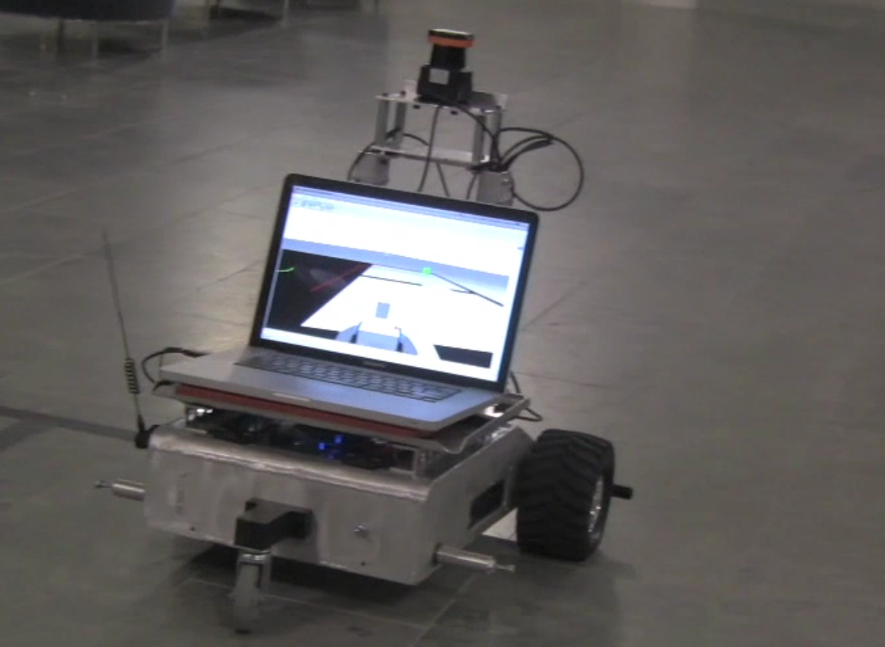
Lidar
Real World
Network
Server
Network
Robot
Notes:
“laptop instead of macbook – it's platform agnostic
LCM is network – not WiFi

Slide 6
Soar Agent
Server
Simulated
Environment
Robot,
walls,
objects,
dynamics

Slide 8
UI

Slide 9
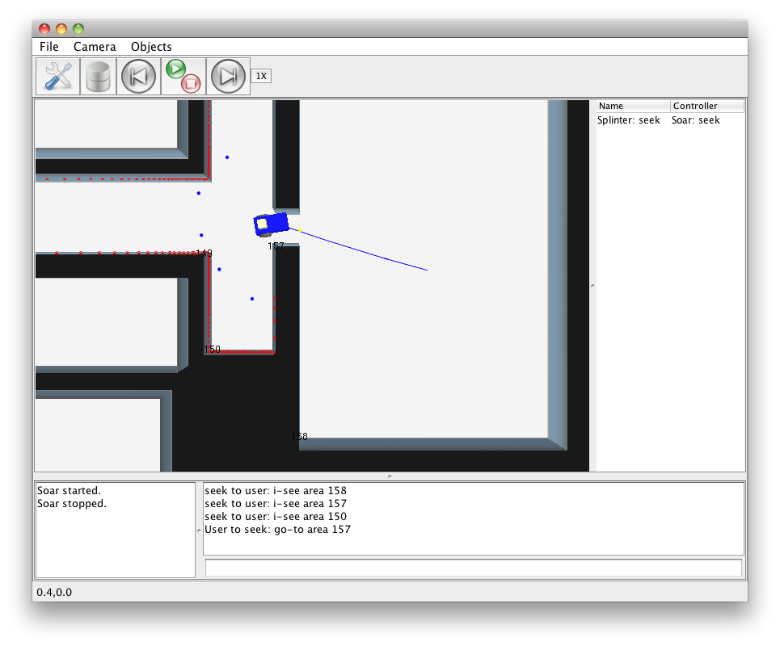
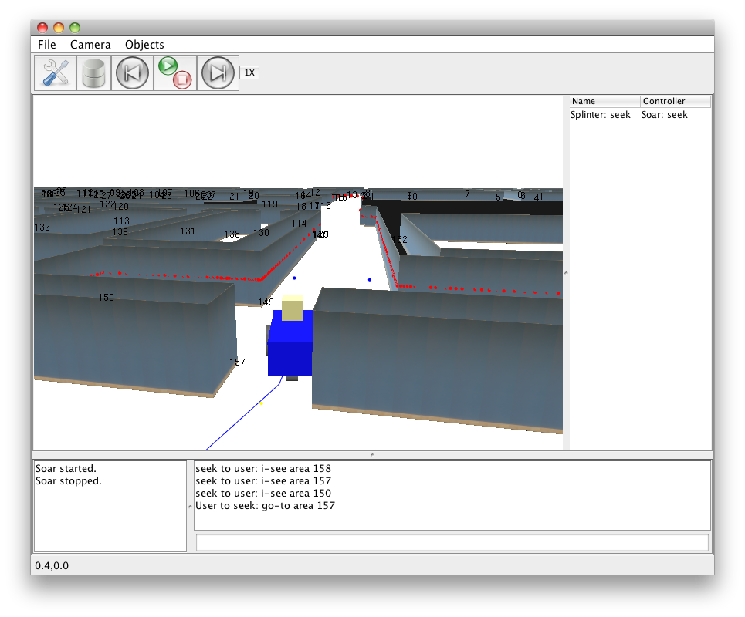
Desktop GUI
  Visualizer
  Rooms and walls
  Robot location
  Raw lidar
  Binned lidar
  Waypoints
  Movement history
  UI
  Manipulate environment
  Agent selection
  Controls for Soar
  Chat dialog
Notes:
Manipulating the environment – also, it's dynamic, not just static

Slide 10
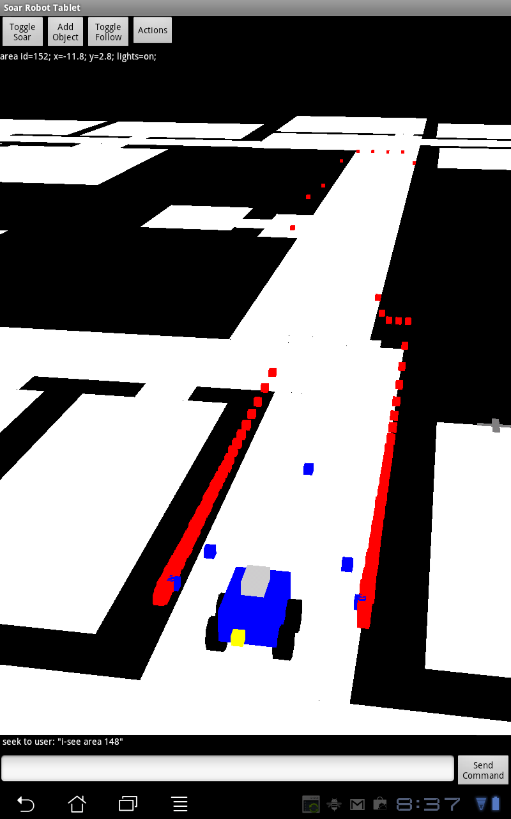
Android GUI
  Communicates with server over network
  Use touch-based commands to manipulate the environment or select areas or objects
  Communicate with agent via chat dialog
  Shortcuts for common commands
Notes:
“simulation” – can't this also work with robotics hardware
“Platform” is a more genenral word for the whole enchilada

Slide 11
Software

Slide 12
LCM
http://code.google.com/p/lcm
Framework for message passing over UDP multicast
C, Java, Python, C#, Matlab
Good for real-time data between processes or machines

Slide 13
April Robotics Toolkit
http://april.eecs.umich.edu/wiki
A bunch of robotics-related libraries
  LCM
  Lidar
  SLAM
  3D rendering
Java

Slide 14
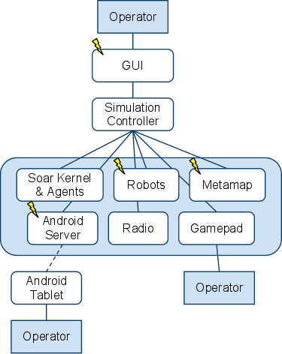
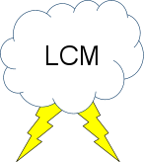
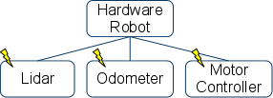
Project Structure
Notes:
Gamepad = gamepad + gamepad dirver software
Simlation controller should be a title for the blue box, not separate item

Slide 15
Software Design
Modular
  Components communicate over LCM
  Individual components are interchangeable
Mixed real / virtual simulation
  Agents perceive a single, unified environment
  Allows for arbitrary virtual environment dynamics
  Deals with real-world problems, e.g. SLAM
Notes:
Fix animation stuff

Slide 16
Research
Memory
  Learning from experience in an environment
Instruction
  Middle ground between manual control and full autonomy
Action Modeling
  Learning continuous models for control
SLAM
  Better localization for long-lived agents
Notes:
Motivate thess a little more – maybe examples
Titles of talks, and speakers
Add joseph

Slide 17
Nuggets & Coal
Nuggets
Modular, extensible system
Best of both real & virtual worlds
Basic environment for agent designers to use as a starting point
Coal
Large codebase, many dependencies
Limited built-in environment dynamics

Slide 18
Demo

