Slide 1

Using Soar to Teach
Probabilistic Reasoning
Jim Thomas
6/5/2013
Soar Technology, Inc. Proprietary 11/08/26

Slide 2

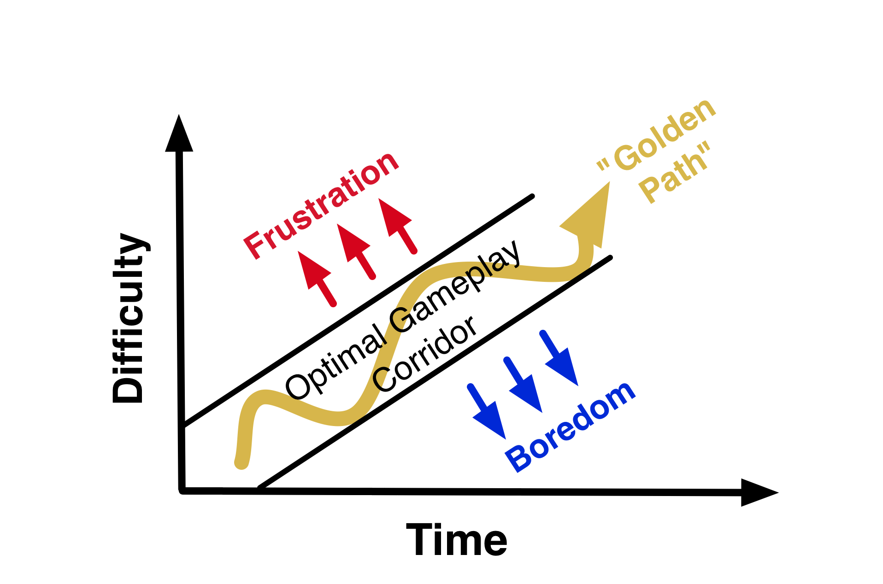
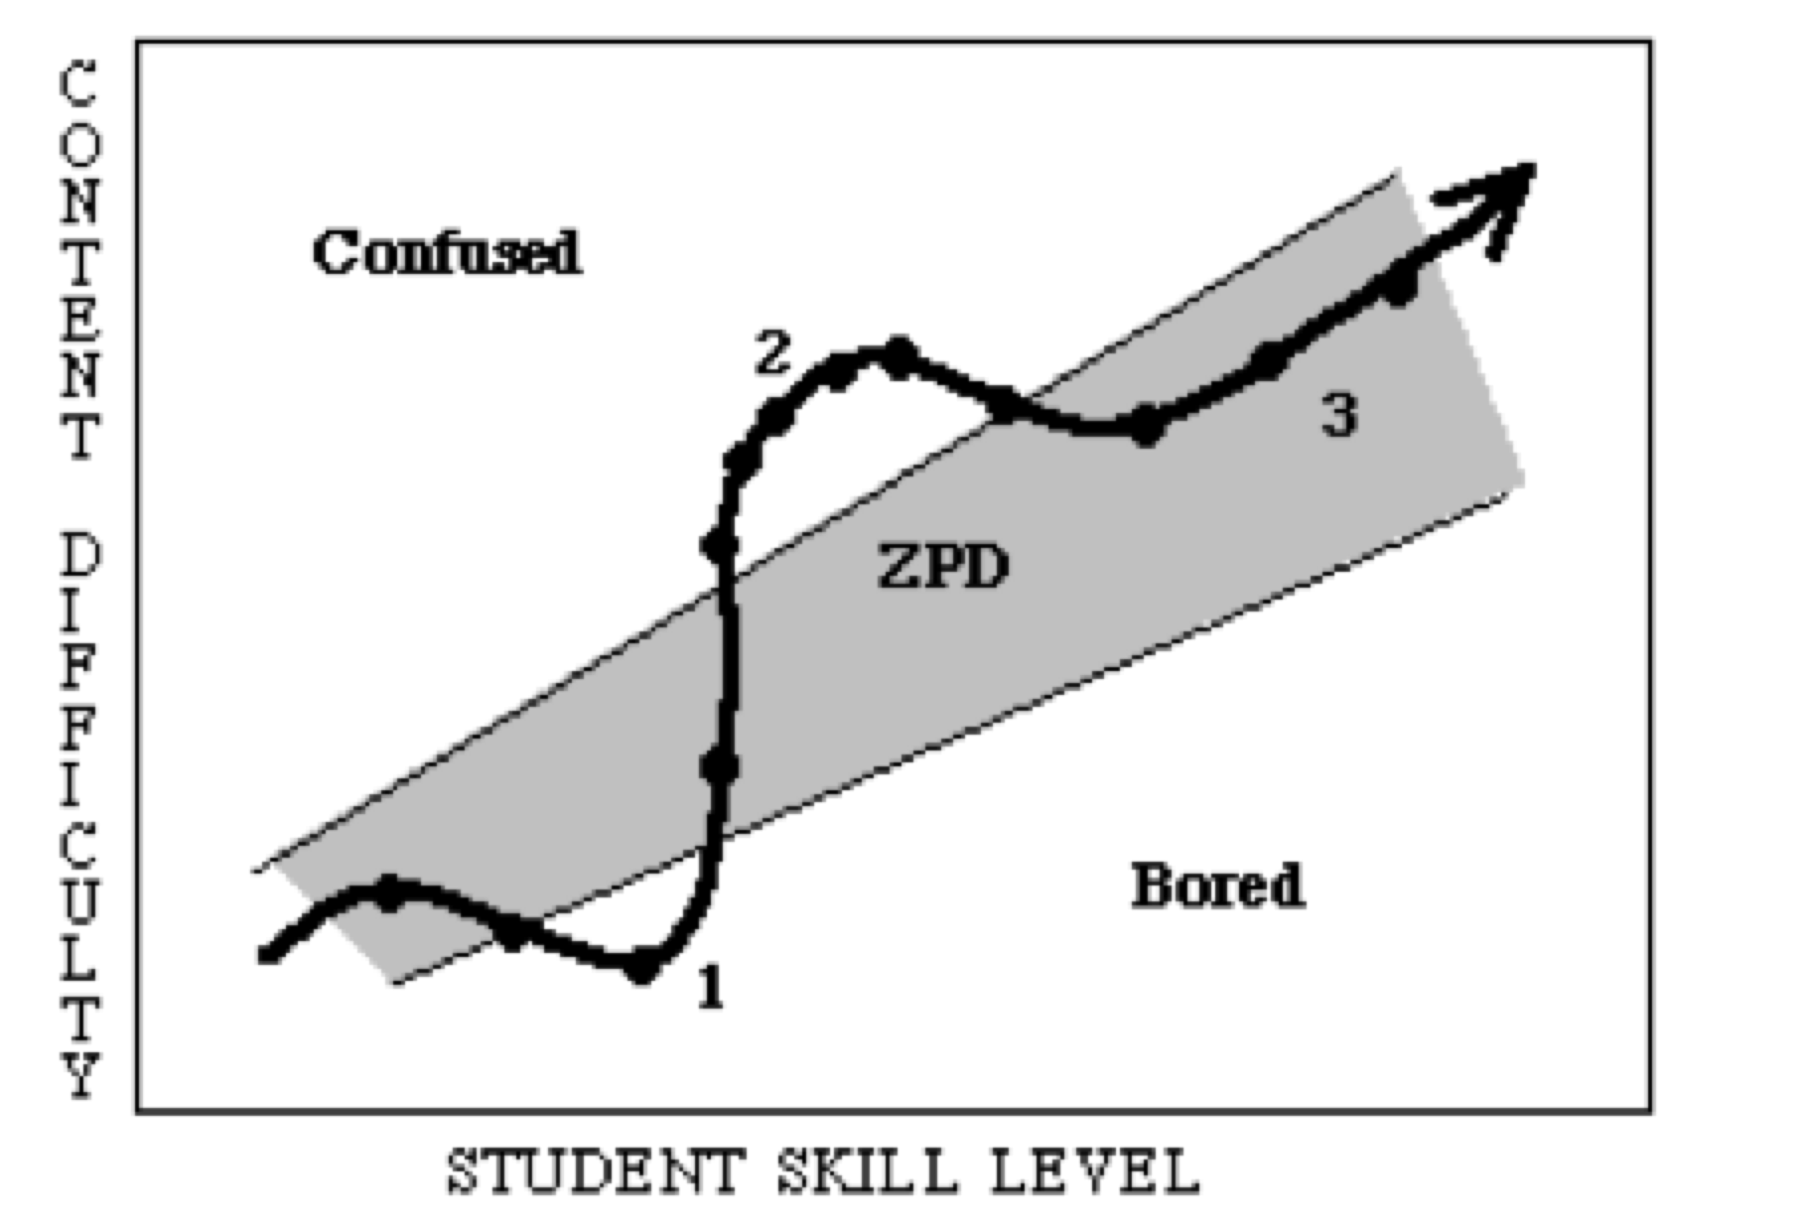
Intelligent Tutoring Systems (ITS)
    Human 1-on-1 tutoring much more effective than classroom
    Intelligent agents can emulate human tutors
      Guide in Zone of Proximal Development (Vygotsky)
      Similarity with game-based player guidance
    Successful in well-defined domains:
      Physics, Math, Computer Science, Medicine

Slide 3
Using Soar to Teach: Dynamic Tailoring
Dynamic Tailoring
    Apply ITS techniques in game/simulation learning
    Guide learners in complex, ill-defined domains
    Use Soar to tailor instruction for individual learners
      Monitor student knowledge / proficiency
      Manage progress against pedagogical goals
      Manipulate experience to maximize learning

Slide 4
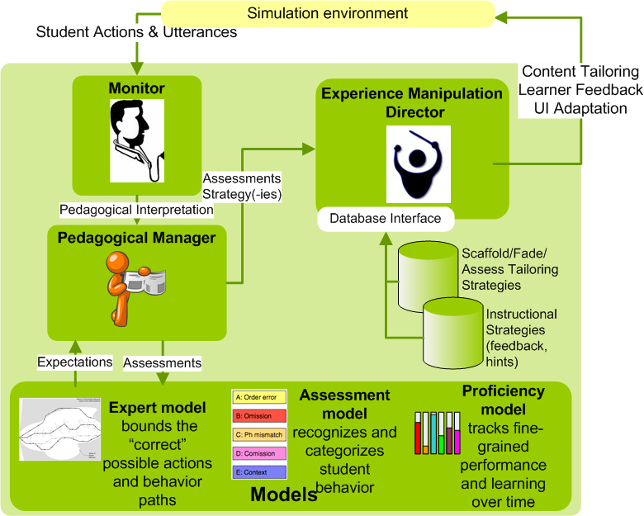
Dynamic Tailoring Components

Slide 5
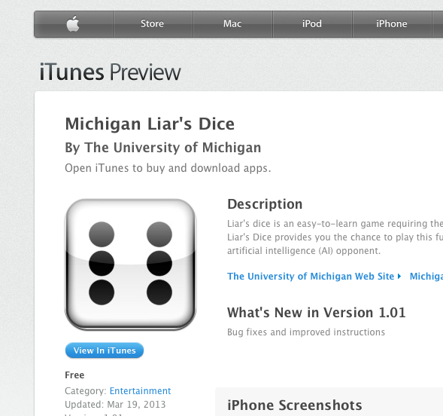
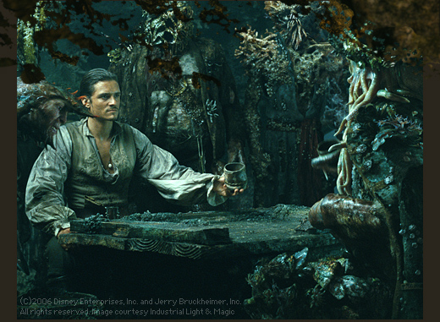

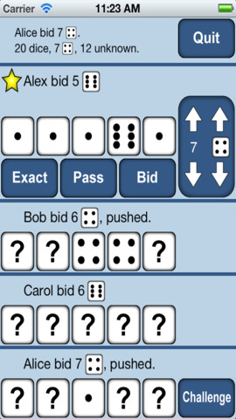
Michigan Liar’s Dice (aka Dudo / Perudo)

Slide 6
Rules?
…more like guidelines
Bids based on total of all players’ dice (mostly unseen “?”)
Player must exceed previous bid, or challenge, or pass, or push, or …
Aces are wild

Slide 7





Liar’s Dice + Dynamic Tailoring = DiceSharks
Dual Soar-controlled game modes:
Direct competition against a ladder of progressively smarter opponents (sharks) whose strategies map to curricular goals
Instructional mini-games to introduce, demonstrate and provide opportunities for practice of curricular concepts
Trusting
Ted
Shady
Sue
Face-Up
Frank
Babs
Bookman
Bugsy

Slide 8
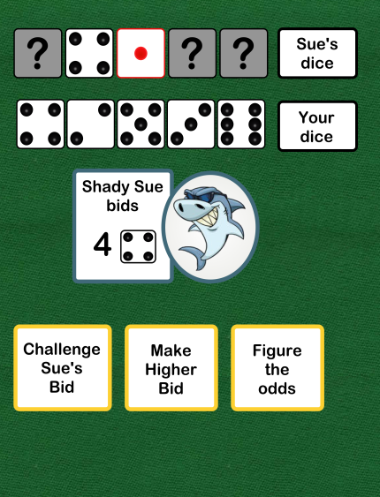
DiceSharks: Competition Mode
Multiple “scaffolds” exposed to allow DT/Soar to adjust the simplicity of game play
Tools to tie pedagogy to game success (e.g. “figure the odds”)
Managed progress reporting to teachers, leader boards, achievement advertisement via social media

Slide 9
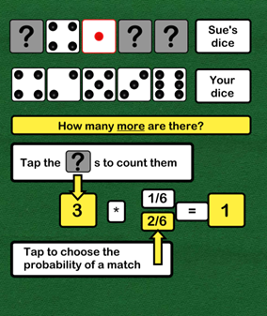
DiceSharks: Instructional Mini-Games
Multiple strategies for mini-game-based instruction:
  Logged game play
  Hypothesis testing
  10K dice rolls
  Reverse engineering
  Alternative dice
  Alternative rules

Slide 10
DiceSharks: (High School) Curricular Goals
Common Core State Standards Categories:
Interpreting Data:
ID.A.2 “Compare central tendency and spread of two or more data sets”
Make Inferences and Conclusions:
IC.B.5 “Summarize categorical data in two way frequency tables”
Conditional Probability:
ID.A.2 “P(A|B) can be computed as P(A and B) / P(B)”
Making Decisions:
ID.A.2 “Develop prob distibution for a random var; find expected value”

Slide 11
Coal
Current status:
    DiceSharks is under-specified and under-implemented
WARNING:
  Grant opportunities may be smaller than they appear
Skepticism over pedagogical potential of “gambling”
    Amplifies prejudice against game-based instruction

Slide 12
Nuggets
Soar is being used to solve difficult problems in ITS
The Liar’s Dice app is sufficiently compelling to inspire:
    A tutor to help humans compete with Soar agents
    Teaching exercises than span a majority of the HS common core probability/statistics curriculum
Your ideas?

Slide 13
References
Laird, J. E., Derbinsky, N., & Tinkerhess, M. (2011). A case study in integrating probabilistic decision making and learning in a symbolic cognitive architecture: Soar plays dice. Papers from the 2011 Fall Symposium Series: Advances in Cognitive Systems (pp. 162-169).
Wray, R., Woods, A., & Priest, H. (2012). Applying Gaming Principles to Support Evidence-based Instructional Design. In The Interservice/Industry Training, Simulation & Education Conference (I/ITSEC) (Vol. 2012, No. 1). National Training Systems Association.
Wray, R., Lane, H. C., Stensrud, B., Core, M., Hamel, L., & Forbell, E. (2009). Pedagogical experience manipulation for cultural learning. In Proceedings of the 2nd Workshop on Culturally Aware Tutoring Systems at the 14th International Conference on Artificial Intelligence in Education (pp. 35-44).
Silver, N. (2012). The signal and the noise: why so many predictions fail—but some don’t. New York, NY, Penguin Press. P. 308.

