Slide 1
Learning Integrated Symbolic and Continuous Action Models
Joseph Xu & John Laird
May 29, 2013

Slide 2
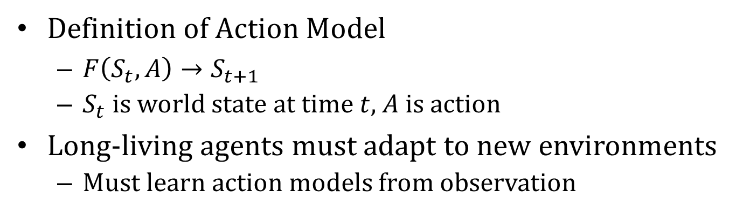
Action Models
Definition of Action Model
$F\left(S_{t},A\right)→S_{t+1}$
$S_{t}$ is world state at time $t$, $A$ is action
Long-living agents must adapt to new environments
Must learn action models from observation
?

Slide 3
Benefits
Accurate action models allow for
Internal simulation
Backtracking planning
Learning policies via trial-and-error without incurring real-world cost
Exploration
Agent
World
Reward
Exploration
Agent
Model
Policy
World
Reward

Slide 4
Requirements
Model learning should be
Accurate
Predictions made by model should be close to reality
Fast
Learn from few examples
General
Models should make good predictions in many situations
Online
Models shouldn’t require sampling entire space of possible actions before being useful

Slide 5
Continuous Environments
Agent
Environment
Discrete objects with continuous properties
Geometry, position, rotation
Input and output are vectors of continuous numbers
Agent runs in lock-step with environment
Fully observable
-9.0
5.8
Output
A
Input
B
A
B
0.2
1.2
0.0
0.0
0.0
0.2
3.4
3.9
0.0
0.0
0.0
0.0
px
py
pz
rx
ry
rz
px
py
pz
rx
ry
rz

Slide 6
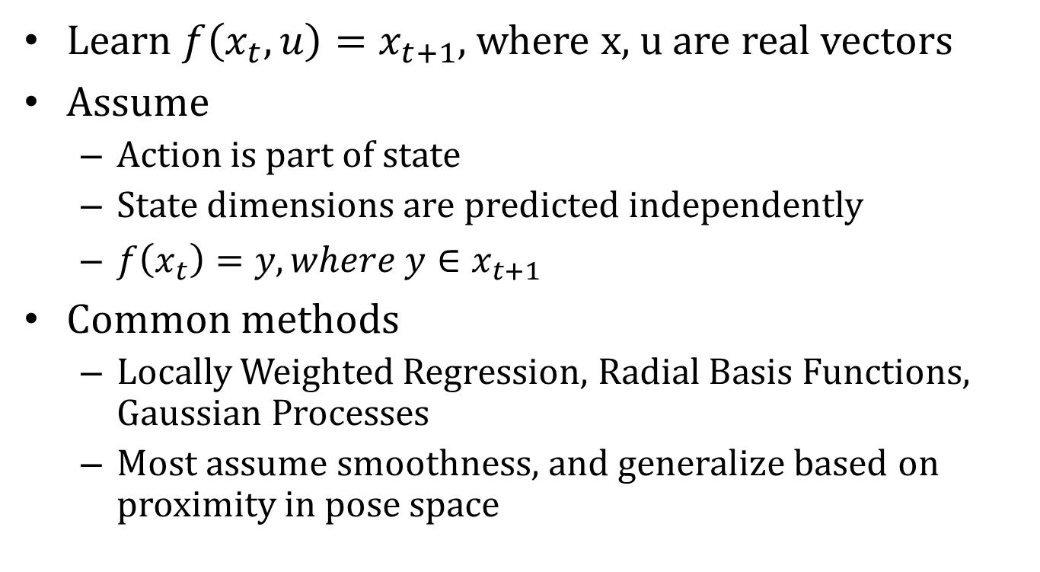
Action Modeling in Continuous Domains
Learn $f\left(x_{t},u\right)=x_{t+1}$, where x, u are real vectors
Assume
Action is part of state
State dimensions are predicted independently
$f\left(x_{t}\right)=y,where y∈x_{t+1}$
Common methods
Locally Weighted Regression, Radial Basis Functions, Gaussian Processes
Most assume smoothness, and generalize based on proximity in pose space

Slide 7


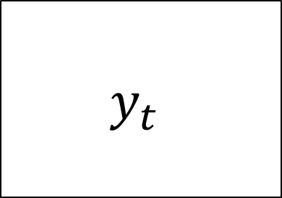
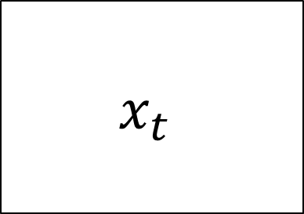
Locally Weighted Regression
$$x_{t}$$
$$y_{t}$$
$$x_{t}$$
$$y_{t}$$

Slide 8


Locally Weighted Regression
?
x
$$x_{t}$$
$$y_{t}$$
Weighted
Linear
Regression
k nearest neighbors
Notes:
Fix equation

Slide 9
LWR Shortcomings
LWR generalizes based on proximity in pose space
Smoothes together qualitatively distinct behaviors
Generalizes with examples that are closer in absolute coordinates instead of similarity in object relationships
?

Slide 10
LWR Shortcomings
LWR generalizes based on proximity in pose space
Smoothes together qualitatively distinct behaviors
Generalizes with examples that are closer in absolute coordinates instead of similarity in object relationships

Slide 11
Our Approach
Type of motion depends on relationships between objects, not absolute positions
Learn models that exploits relational structure of the environment
Segment behaviors into qualitatively distinct linear motions (modes)
Classify which mode is in effect using relational structure
Flying mode
(no contact)
Ramp rolling mode
(touching ramp)
Bouncing mode
(touching flat surface)

Slide 12








Learning Multi-Modal Models
Continuous state
Scene Graph
Relational State
A
~intersect(A,B)
above(A,B)
ball(A)
0.2
1.2
0.0
0.0
0.0
0.2
B
$$x_{1}$$
Time
$$r_{1}$$
A
intersect(A,B)
above(A,B)
ball(A)
0.3
0.9
0.0
0.0
0.0
0.2
B
$$x_{2}$$
$$r_{2}$$
$$(x_{1},y_{1})$$
$$(r_{1},I)$$
Relational Mode Classifier
$$(x_{2},y_{2})$$
mode I
$$(r_{2},II)$$
mode II
RANSAC + EM
FOIL
Segmentation
Classification

Slide 13



Predict with Multi-Modal Models
Scene Graph
Relational State
Continuous state
~intersect(A,B)
above(A,B)
ball(A)
A
~intersect(A, B)
0.2
1.2
0.0
0.0
0.0
0.2
B
$$x_{t}$$
$$r_{t}$$
prediction
Relational Mode Classifier
$$y_{i}$$
mode I
mode II

Slide 14
bx01, by01, vy01
~(b,p), ~(b,r)
t01
RANSAC
t = vy – 0.98
bx02, by02, vy02
~(b,p), ~(b,r)
t02
bx03, by03, vy03
~(b,p), ~(b,r)
t03
ball
ball
ball
Notes:
Say learning y-velocity
Explain noise mode, can’t be classified into existing modes
Change noise to unknown

Slide 15
RANSAC
Discover new modes
Choose random set of noise examples
Fit line to set
Add all noise examples that also fit line
If set is large (>40), create a new mode with those examples
Otherwise, repeat.
New mode
1.
2.
3.
4.
Remaining
noise

Slide 16
bx01, by01, vy01
~(b,p), ~(b,r)
t01
RANSAC
t = vy – 0.98
bx02, by02, vy02
~(b,p), ~(b,r)
t02
bx03, by03, vy03
~(b,p), ~(b,r)
t03
ball
Notes:
Say learning y-velocity
Explain noise mode, can’t be classified into existing modes
Change noise to unknown

Slide 17
t = vy – 0.98
bx01, by01, vy01
~(b,p), ~(b,r)
t01
bx02, by02, vy02
~(b,p), ~(b,r)
t02
bx03, by03, vy03
~(b,p), ~(b,r)
t03
bx04, by04, vy04
~(b,p), ~(b,r)
t04
EM
bx05, by05, vy05
~(b,p), ~(b,r)
t05
bx06, by06, vy06
~(b,p), ~(b,r)
t06
ball
ball
ball
ball

Slide 18
Expectation Maximization
Simultaneously learn:
Association between training data and modes
Parameters for mode functions
Expectation
Assume mode functions are correct
Compute likelihood that mode 𝑚 generated data point 𝑖
Maximization
Assume likelihoods are correct
Fit mode functions to maximize likelihood
Iterate until convergence to local maximum

Slide 19
t = vy – 0.98
bx07, by07, vy07
(b,p), ~(b,r)
t07
bx01, by01, vy01
~(b,p), ~(b,r)
t01
bx02, by02, vy02
~(b,p), ~(b,r)
t02
bx03, by03, vy03
~(b,p), ~(b,r)
t03
bx04, by04, vy04
~(b,p), ~(b,r)
t04
bx05, by05, vy05
~(b,p), ~(b,r)
t05
bx06, by06, vy06
~(b,p), ~(b,r)
t06
FOIL
Clause: ~(b,p)
ball
ball

Slide 20
FOIL
Learn classifiers to distinguish between two modes (positives and negatives) based on relations
Outer loop: Iteratively add clauses that cover the most positive examples
Inner loop: Iteratively add literals that rule out negative examples
Object names are variablized for generality
Clause | # pos. ex.
~intersect(target, any) | 16221
~z-overlap(target, any) | 6162
east-of(target, x) | 36
~x-overlap(target, any) | 21
east-of(x, target) | 9
~ontop(target, any) & above(target, x) | 2

Slide 21
FOIL
FOIL learns binary classifiers, but there can be many modes
Use one-to-one strategy:
Learn classifier between each pair of modes
Each classifier votes between two modes
Mode with most votes wins

Slide 22
t = vy – 0.98
bx07, by07, vy07
(b,p), ~(b,r)
t07
bx01, by01, vy01
~(b,p), ~(b,r)
t01
bx08, by08, vy08
(b,p), ~(b,r)
t08
RANSAC
t = vy
bx02, by02, vy02
~(b,p), ~(b,r)
t02
bx09, by09, vy09
(b,p), ~(b,r)
t09
bx03, by03, vy03
~(b,p), ~(b,r)
t03
bx04, by04, vy04
~(b,p), ~(b,r)
t04
bx05, by05, vy05
~(b,p), ~(b,r)
t05
bx06, by06, vy06
~(b,p), ~(b,r)
t06
Clause: ~(b,p)
ball
ball
ball

Slide 23
t = vy – 0.98
t = vy
bx01, by01, vy01
~(b,p), ~(b,r)
t01
bx07, by07, vy07
(b,p), ~(b,r)
t07
bx02, by02, vy02
~(b,p), ~(b,r)
t02
bx08, by08, vy08
(b,p), ~(b,r)
t08
bx03, by03, vy03
~(b,p), ~(b,r)
t03
bx09, by09, vy09
(b,p), ~(b,r)
t09
bx04, by04, vy04
~(b,p), ~(b,r)
t04
bx10, by10, vy10
(b,p), ~(b,r)
t10
bx05, by05, vy05
~(b,p), ~(b,r)
t05
bx11, by11, vy11
(b,p), ~(b,r)
t11
bx06, by06, vy06
~(b,p), ~(b,r)
t06
bx12, by12, vy12
(b,p), ~(b,r)
t12
bx13, by13, vy13
(b,p), ~(b,r)
t13
FOIL
Clause: ~(b,p)
Clause: (b,p)
ball
ball
ball
ball
ball

Slide 24
t = vy – 0.98
t = vy
bx14, by14, vy14
~(b,p), (b,r)
t14
bx01, by01, vy01
~(b,p), ~(b,r)
t01
bx07, by07, vy07
(b,p), ~(b,r)
t07
RANSAC
t = vy – 0.7
bx08, by08, vy08
(b,p), ~(b,r)
t08
bx15, by15, vy15
~(b,p), (b,r)
t15
bx02, by02, vy02
~(b,p), ~(b,r)
t02
bx16, by16, vy16
~(b,p), (b,r)
t16
bx03, by03, vy03
~(b,p), ~(b,r)
t03
bx09, by09, vy09
(b,p), ~(b,r)
t09
bx04, by04, vy04
~(b,p), ~(b,r)
t04
bx10, by10, vy10
(b,p), ~(b,r)
t10
bx05, by05, vy05
~(b,p), ~(b,r)
t05
bx11, by11, vy11
(b,p), ~(b,r)
t11
bx06, by06, vy06
~(b,p), ~(b,r)
t06
bx12, by12, vy12
(b,p), ~(b,r)
t12
bx13, by13, vy13
(b,p), ~(b,r)
t13
Clause: ~(b,p)
Clause: (b,p)
ball
ball
ball
ball

Slide 25
t = vy – 0.98
t = vy
t = vy – 0.7
bx01, by01, vy01
~(b,p), ~(b,r)
t01
bx07, by07, vy07
(b,p), ~(b,r)
t07
bx14, by14, vy14
~(b,p), (b,r)
t14
bx02, by02, vy02
~(b,p), ~(b,r)
t02
bx08, by08, vy08
(b,p), ~(b,r)
t08
bx15, by15, vy15
~(b,p), (b,r)
t15
bx03, by03, vy03
~(b,p), ~(b,r)
t03
bx09, by09, vy09
(b,p), ~(b,r)
t09
bx16, by16, vy16
~(b,p), (b,r)
t16
bx04, by04, vy04
~(b,p), ~(b,r)
t04
bx10, by10, vy10
(b,p), ~(b,r)
t10
bx05, by05, vy05
~(b,p), ~(b,r)
t05
bx11, by11, vy11
(b,p), ~(b,r)
t11
bx06, by06, vy06
~(b,p), ~(b,r)
t06
bx12, by12, vy12
(b,p), ~(b,r)
t12
bx13, by13, vy13
(b,p), ~(b,r)
t13
FOIL
Clause: ~(b,p)
Clause: (b,p)
Clause: (b,r)
ball

Slide 26
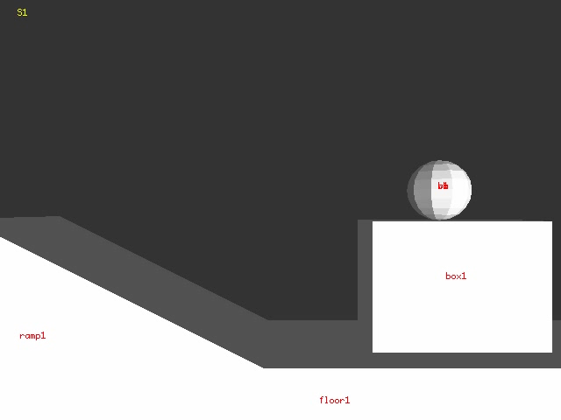
Demo
Physics simulation with ramp, box, and ball
Learn models for x and y velocities
link

Slide 27
Physics Simulation Experiment
2D physics simulation with gravity
40 possible configurations
Training/Testing blocks run for 200 time steps
40 configs x 3 seeds = 120 training blocks
Test over all 40 configs using different seed
Repeat with 5 reorderings
gravity
origin
random offset

Slide 28
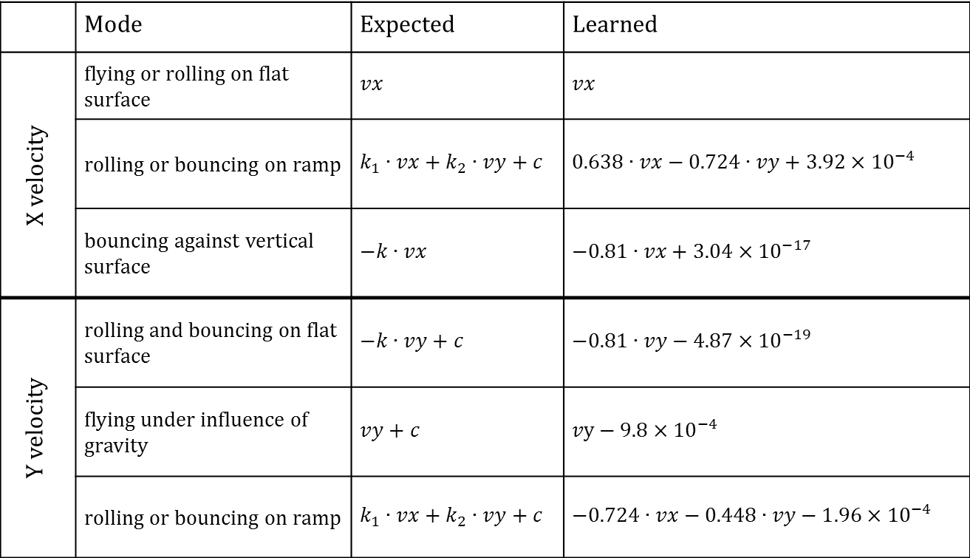
Learned Modes
 | Mode | Expected | Learned
X velocity | flying or rolling on flat surface | $$vx$$ | $$vx$$
 | rolling or bouncing on ramp | $$k_{1}∙vx+k_{2}∙vy+c$$ | $$0.638∙vx−0.724∙vy+3.92×{10}^{−4}$$
 | bouncing against vertical surface | $$−k∙vx$$ | $$−0.81∙vx+3.04×{10}^{−17}$$
Y velocity | rolling and bouncing on flat surface | $$−k∙vy+c$$ | $$−0.81∙vy−4.87×{10}^{−19}$$
 | flying under influence of gravity | $$vy+c$$ | $$vy−9.8×{10}^{−4}$$
 | rolling or bouncing on ramp | $$k_{1}∙vx+k_{2}∙vy+c$$ | $$−0.724∙vx−0.448∙vy−1.96×{10}^{−4}$$

Slide 29
Prediction Accuracy
Compare overall accuracy against single smooth function learner (LWR)

Slide 30
Classifier Accuracy
Compare FOIL performance against classifiers using absolute coordinates (SVM, KNN)
K
K
Notes:
Hack legend

Slide 31
Nuggets
Multi-modal approach addresses shortcomings of LWR
Doesn’t smooth over examples from different modes
Uses relational similarity to generalize behaviors
Satisfies requirements
Accurate. New modes are learned for inaccurate predictions
Fast. Linear modes are learned from (too) few examples
General. Each mode generalizes to all relationally analogical situations
Online. Modes are learned incrementally and can immediately make predictions

Slide 32
Coals
Slows down with more learning – keeps every training example
Assumes linear modes
RANSAC, EM, and FOIL are computationally expensive

