Slide 1

Using Soar for an indoor robotic search mission
Scott Hanford
Penn State University Applied Research Lab

Slide 2
Background
Michigan (Laird et al. 1991, Laird 2012)
SoarTech (with Drexel, Sultanik et al. 2008)
ADAPT project (Benjamin et al. 2004)
Penn State
  Lyle Long (http://www.personal.psu.edu/lnl/)
  Outdoor navigation
  Indoor search mission

Slide 3
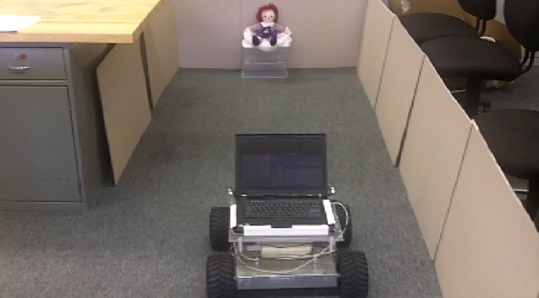





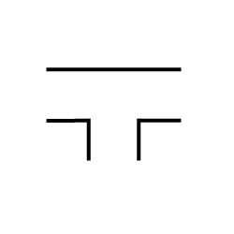

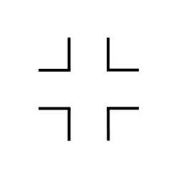
Search unknown building for specific objects
Build a map of landmarks in the environment useful for reasoning in Soar
Identify an object of interest and describe its location with respect to landmarks
Use inexpensive sensors (webcam, ultrasonic & infrared distance sensors, wheel encoders)
R
L
D
S
Tl
T
Tr
X

Slide 4
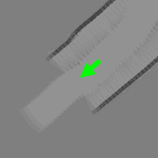
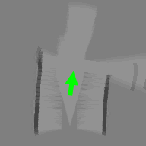
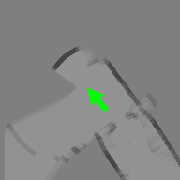
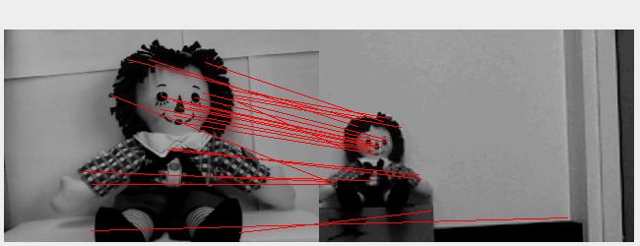
Generation of symbolic information
Fuzzy logic used with information from dynamically generated occupancy grid and image processing algorithms to detect common intersection types
Intersection type | Presence of wall:
 | To left | In front | To right
S | Y | N | Y
Tl | Y | N | N
L | N | Y | Y
S
Tl
L
Robot pose represented by green arrow
SIFT (Scale Invariant Feature Transform, Lowe 2004) used to detect objects of interest
Prior image
Test image
Training image
Test image

Slide 5
Soar agent description
Search a building for object of interest:
  Detect common types of intersections
    consider expected quality of information from perception systems
  Build a topological map of intersections and their connections
After finding object of interest, use topological map and Soar’s planning and learning mechanisms to return to start location
Generate directions from start location to object of interest
initialize-hallNavigator
initialize-intersectionDetection-AndHoughInfo
search
returnHome
recordObject
recordIntersection

Slide 6
Search complex operator
Used to locate object of interest
Navigate: used to keep robot in middle of hall (follow middle, follow wall, maintain orientation)
Set plan: when an intersection is recorded, agent uses this operator to select and set a plan that tells the robot how to move through intersection (go-straight, turn-left, etc.)
  The agent attempts to realize if it has previously visited intersection
    Assumes no loops and a static topological environment
    Uses this information to set plans to visit areas more likely to contain objects of interest
Perform plan: agent navigates to waypoint(s) to move through intersection

Slide 7
Return home complex operator
Used to return the robot back to the start location once object of interest is detected
Includes navigate and perform plan operators very similar to those used by the search complex operator
Set plan: agent has a specific location it is trying to reach
  agent uses an internal model of how to move through the environment & Soar’s selection problem space to set plans that will move robot towards the start location
End test: topological map and location of object are used to generate instructions to object using Soar’s planning mechanism

Slide 8
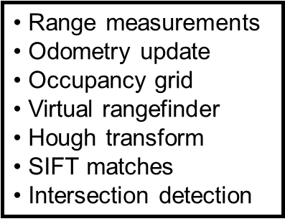
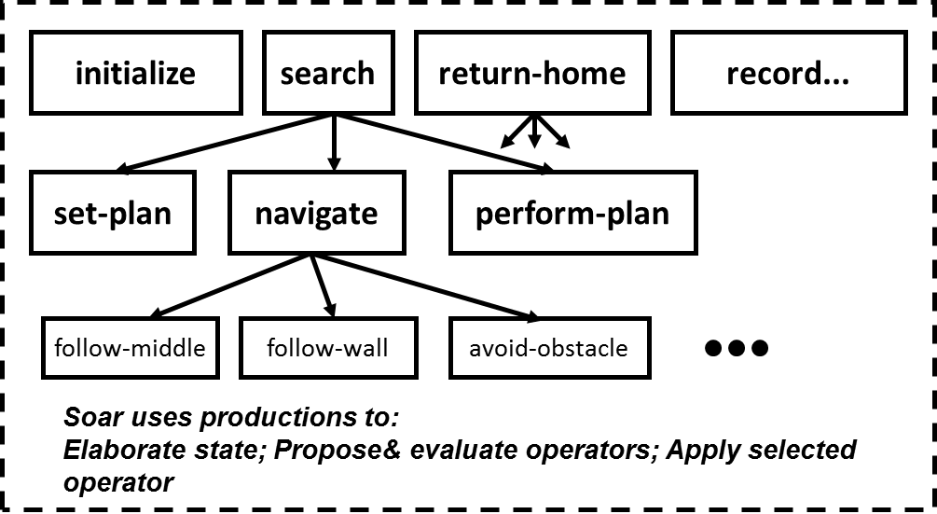
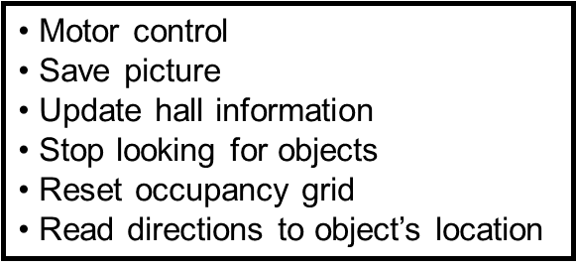
Perception
Soar for decision making
Actions

Slide 9
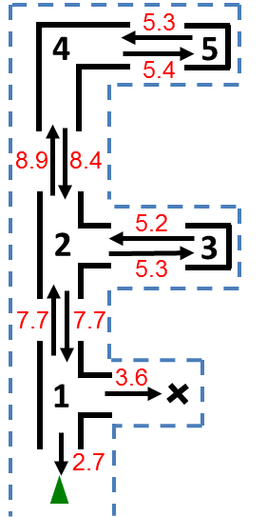
Topological map & directions
Directions from start location to object of interest generated by agent
  1. goStraight.
  2. In Tl, turnRight.
  3. goStraight.
  4. Look for doll.
Black numbers are nodes in topological map
Red numbers are cost values (distances in m)
Green triangle = start location
‘X’ = object of interest
Dashed blue lines = hallway walls

Slide 10
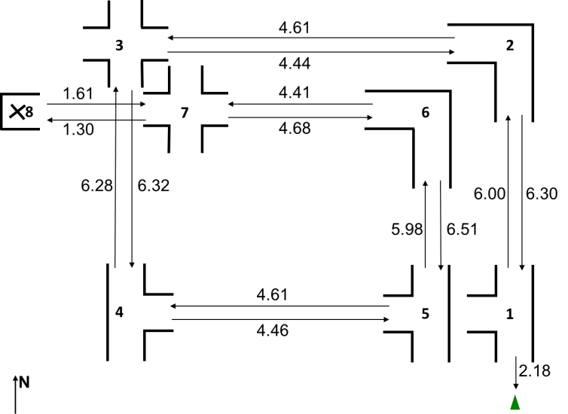
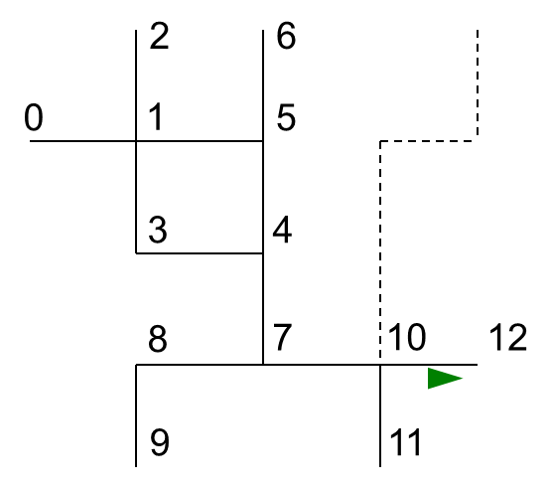
Additional results
Other environments (loop, X intersection)
  Agent did not consider possibility of loops
  Information available to likely identify loops (distances, intersection types & orientations)
Simulation of planning & learning
  Uses same rules in selection problem space as for physical robot
  For larger environments, chunking has potential to speed up internal search for returnHome operator

Slide 11
Conclusions
Nuggets
  Used perception algorithms to generate symbols from limited sensing capabilities useful for reasoning in Soar
  Planning in Soar very useful once topological model of environment was available
  Soar was well-suited to represent shortcomings of limited perception system (when to trust sensor information, reset occupancy grid)
Coal
  Limited to specific hallway environments
  Soar rules for building topological map and for implementing search were developed for topologically simple environments and dependent on accurate intersection detection
  Did not take advantage of newer Soar features

