Slide 1
OntoSoar: Soar Finds Facts in Text
Peter Lindes, Deryle Lonsdale, David Embley
Brigham Young University
33rd Soar Workshop, June 2013

Slide 2
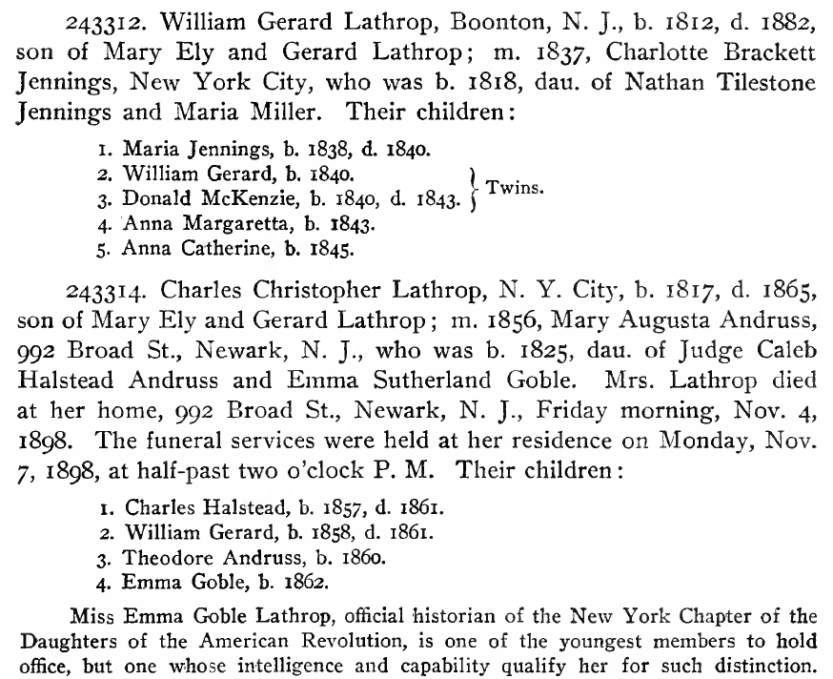
The Challenge

Slide 3
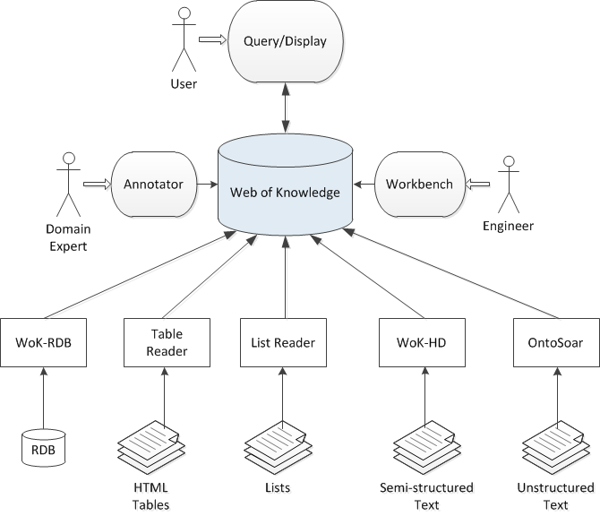
OntoES

Slide 4
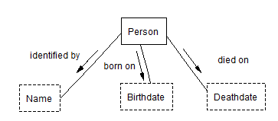
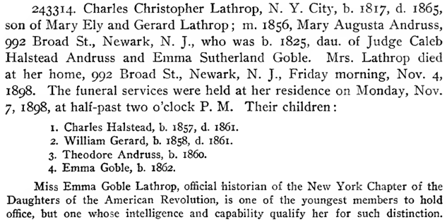
The Challenge

Slide 5
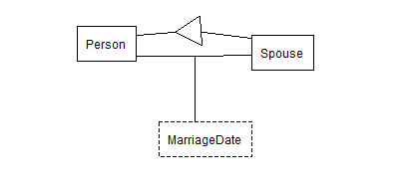
The Challenge

Slide 6
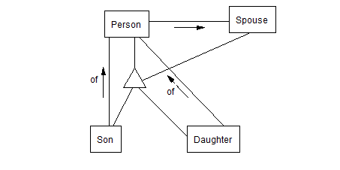
The Challenge

Slide 7
The Challenge

Slide 8
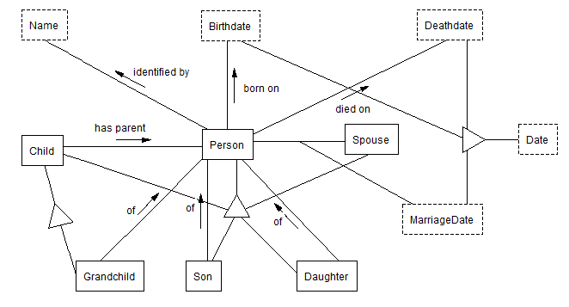

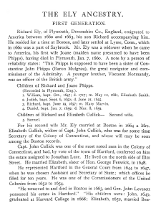
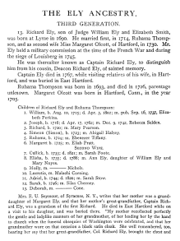
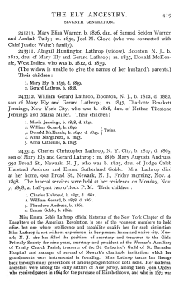
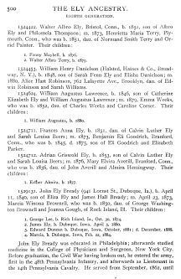
The Goal – A Web of Knowledge

Slide 9
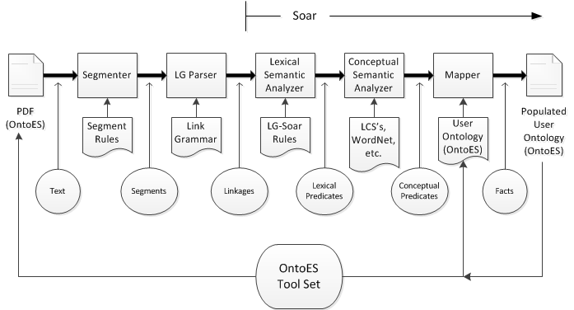
The Solution - OntoSoar

Slide 10
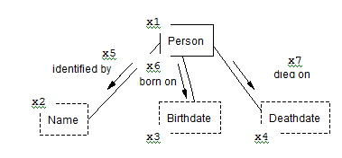
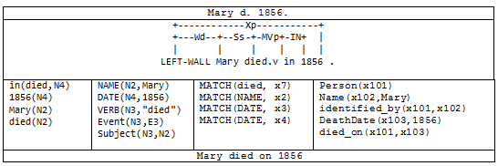
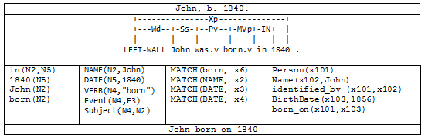
Examples

Slide 11
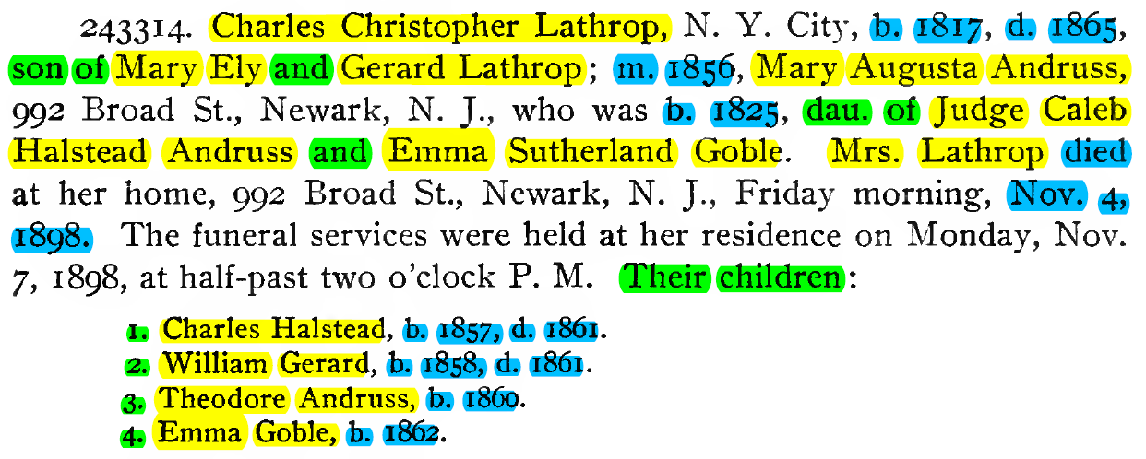
Evaluation

Slide 12
Conclusions
NUGGETS
COAL
Find many facts
Domain flexible according to user-defined ontology
Can improve with more linguistic knowledge
Inferencing can find more
Works with OntoES tools
Future learning opportunity
Model of human semantics
Early in implementation
Unsure of matching to ontologies
Unsure of domain flexibility
OCR errors are problematic
Need to integrate with OntoES tool set

