Slide 1
Spatial Visual System
Joseph Xu
Soar Workshop 2013

Slide 2
Overview
Provides a general framework for Soar to reason about continuous environments
Environment state is represented as 3D scene graph
Has working memory interface similar to EpMem and Smem
(S1 ^svs S3)
(S3 ^spatial-scene S4 ^command C3)

Slide 3
Typical Environment Setup
Environment reports state with task-specific representation
All possibly important relations are reported all the time
Environment Code
Soar Agent
Input Link
Scene
Relations
SML API
(I2 ^on O1 ^on O2
^clear C1
^clear C2)
(O1 ^top C ^bot B)
(O2 ^top A ^bot table)
(C1 ^obj A)
(C2 ^obj C)
C
on(C, B)
on(A, table)
clear(A)
clear(C)
A
B
table

Slide 4
With SVS
Environment reports state with task-agnostic language (Scene Graph Edit Language)
Agent queries only relations of interest
Relations fixed across environments
Environment Code
Soar Agent
SVS
WM
(S1 ^svs S3)
(S3 ^command C3)
(C3 ^extract E2)
(E2 ^a A1 ^b B1
^type on
^result R7)
(A1 ^id A ^type node)
(B1 ^id B ^type node)
(R7 ^record R17)
(R17 ^params P1
^value f)
(P1 ^a A ^b B)
Scene
Scene Graph
Filters
SGEL
on(A,B)
C
C
A
B
A
B
on(B,C)
table
table
clear(A)

Slide 5
Scene Graph
Organizes objects as tree of nodes
Child nodes are a part of the parent node
Group nodes
Geometry nodes
Each node as position, rotation, transform
Copied to each substate
(S1 ^svs S3)
(S3 ^command C3 ^spatial-scene S4)
(S4 ^id world ^child C1 ^child C2)
(C1 ^id pole)
(C2 ^id car ^child C3 ^child C4
^child C5 ^child C6 ^child C7)
(C3 ^id wheel0)
(C4 ^id wheel1)
(C5 ^id wheel2)
(C6 ^id wheel3)
(C7 ^id chassis)
world
pole
car
wheel0
wheel1
wheel2
wheel3
chassis

Slide 6
Commands
Agent issues SVS commands via command link
“add_node”, “property” commands performed on substate scene graph copies allows for look-ahead search
extract | Show the results of filter pipelines in working memory
add_node | Add a new node (generated by filter pipeline) into the scene graph
property | Change the position, rotation, scaling of existing objects
project | Find position that satisfies spatial relation to an object

Slide 7
Filters
Transforms continuous information from scene graph into symbolic information in working memory
Implements spatial relations, among other things
Can be combined into pipeline
Caches results and avoids recomputation when possible
Filter
Inputs
Output
Extract Command (WM)
Filter
arg1
Filter
arg2

Slide 8
Working Memory Interface
(S1 ^svs S3)
(S3 ^command C3 ^spatial-scene S4)
(C3 ^extract E2)
(E2 ^a A1 ^b B1 ^type intersect)
(A1 ^id b1 ^type node)
(B1 ^id b2 ^type node)
(S1 ^svs S3)
(S3 ^command C3 ^spatial-scene S4)
(C3 ^extract E2)
(E2 ^a A1 ^b B1 ^type intersect ^result R7
^status success)
(A1 ^id b1 ^type node ^status success)
(B1 ^id b2 ^type node ^status success)
(R7 ^record R17)
(R17 ^params P1 ^value f)
(P1 ^a b1 ^b b2)
Scene Graph
node
Extract Command Result
intersect
node

Slide 9
Multiple Inputs to Filters
Sometimes you want to run a filter on many objects
Example: Does X intersect anything?
It’s annoying and inefficient to make a filter for every pair of objects
Filters can take multiple objects as inputs and outputs
Different combination methods:
Cartesian product (most common)
Grouped
Flattened
A
B
intersect
f(A,C)
f(A,D)
f(A,E)
f(B,C)
f(B,D)
f(B,E)
C
D
E

Slide 10

Filter Subclasses
A
B
map_filter
(dist, intersect)
f(A,C)
f(A,D)
f(A,E)
f(B,C)
f(B,D)
f(B,E)
C
D
E
A
B
reduce_filter
(colinear)
f(AC,AD,AE,BC,BD,BE)
C
D
E
A
B
rank_filter
(min, closest)
$$\begin{matrix}\text{a}\text{rgmax} \\ x\end{matrix}f(x)$$
C
D
E

Slide 11
Some Built-in Filters
Filter | Parameters | Type | Output type
node | id | map | node
all_nodes | none | special | node
[xyz]-greater-than | a, b | map | boolean
[xyz]-less-than | a, b | map | boolean
[xyz]-aligned-than | a, b | map | boolean
on-top | a, b | map | boolean
intersect | a, b | map | boolean
distance | a, b | map | float
closest | a, b | rank | node
smaller-than | a, b | map | boolean

Slide 12
Writing a New Filter
Write new class inheriting from an existing filter subclass (probably typed_map_filter)
Register the new filter with the filter_table
Recompile Soar
class custom_filter : public typed_map_filter<bool>
{
public:
custom_filter(Symbol *root, soar_interface *si, filter_input *input, scene *scn)
: typed_map_filter<bool>(root, si, input) // call superclass constructor
{}
bool compute(const filter_params *params, bool adding, bool &out, bool &changed)
{
// do your computation here
};
};

Slide 13
SML Interface
SML environment updates SVS scene graph once per decision cycle via Agent::SendSVSInput
Commands are text strings in the Scene Graph Edit Language
Environment
Soar Agent
Input Event Callback
Scene Graph
Update Environment
Generate SGEL
Call SendSVSInput
Input
Phase
C
A
B
table
SGEL

Slide 14
Scene Graph Edit Language
a NAME TYPE PARENT [GEOMETRY] [TRANSFORM]
Add object to the scene graph
d NAME
Delete object from scene graph
c NAME [GEOMETRY] [TRANSFORM]
Change object geometry and/or transform
p NAME PROPERTY VALUE
Set custom property
Geometries
Ball: b RADIUS
Convex polyhedron: v X1 Y1 Z1 X2 Y2 Z2 ...
Transforms
[p X Y Z] [r X Y Z] [s X Y Z]

Slide 15
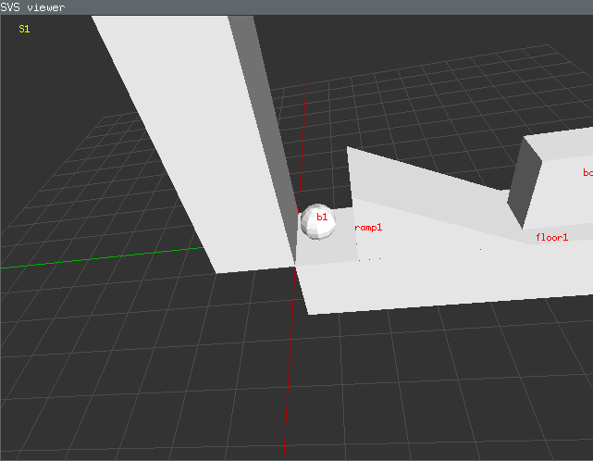
SVS Viewer
Displays scene graph contents
Separate program that SVS communicates with via TCP sockets
Run program
svs_viewer -s PORT
Tell SVS to connect
svs connect_viewer PORT

Slide 16
SVS Command Line
You can interact with most objects in SVS via the svs command
General form
svs state.0.scene.sgel a g1 grp world
svs <path> dir # lists children
svs <path> help # print help
Paths have dot notation
state.0.scene # top state scene graph
filters.intersect # intersect filter
path
arguments

Slide 17
Conclusion
Nuggets
Filter pipelines are expressive and general
Works on all OSes
Doesn’t add any library dependencies to Soar
Used in three projects
Coal
Missing some functionality from old SVS
Still has bugs (opportunities)
Trades performance for simplicity

Slide 18
Credits
SVS theory was developed by Sam Wintermute
Wintermute, S. Imagery in Cognitive Architecture: Representation and Control at Multiple Levels of Abstraction. Cognitive Systems Research, 19-20,1-29.
Soar Visual Imagery (SVI) was developed by Scott Lathrop
Lathrop, S.D., and Laird, J.E. (2007). Towards Incorporating Visual Imagery into a Cognitive Architecture. Proceedings of the Eighth International Conference on Cognitive Modeling. Ann Arbor, MI.

Slide 19
Git Repo
SVS is still not in main Soar SVN yet
https://github.com/jzxu/SVS

