Slide 1
SimRadio
Jonathan Voigt
with Carbone, DeHaan, Dunham, Furtwangler, Haley, Newton, Schermerhorn, Stensrud
and others
11/08/26
Soar Technology, Inc.
Notes:
Introduction
Built with a team of engineeers
Many simulations, many involve radio
E.g. ATC

Slide 2
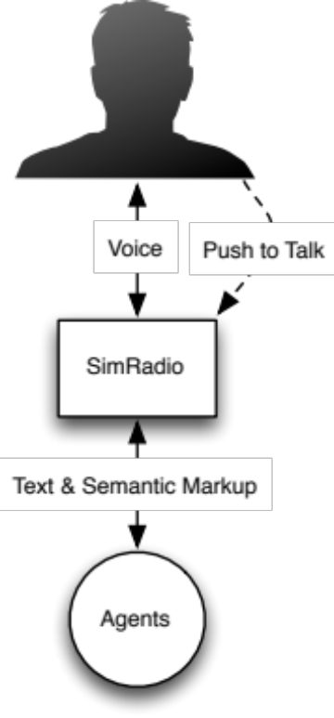
What is SimRadio?
Radio simulation
Realistic real-time interaction between humans and agents
  Broadcast messaging
  Channels
  Speech/Text conversion
Will be open source software
Soar Technology, Inc.
Notes:
SimRadio is a radio simulation service supporting real-time interaction between humans and synthetic agents
Radio simulation means concepts for
Radios
Channels
Interference
Space set aside for things like power, distance, signal strength, jamming, etc.
Humans use voice
SimRadio converts speech to text using conv svc plug-in arch, runtime implementation
Agents use text
SimRadio converts text to speech using…
Agents can use raw text, but barring a system like nl soar,
More useful for agents to utilize output of a text to markup service, also plug in
Off the shelf tools can do this

Slide 3
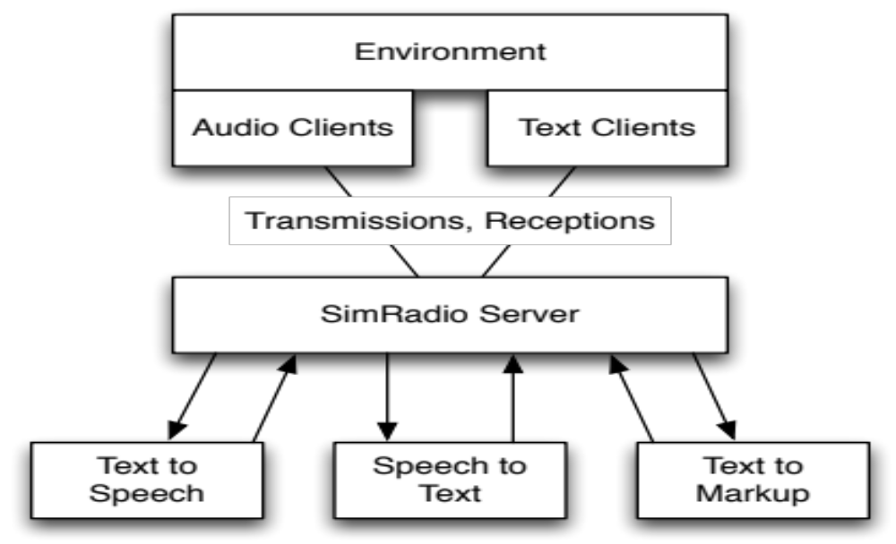
Simplified Architecture
Soar Technology, Inc.
Notes:
Simplified view of the architecture
Environment loads clients
Clients chat with server over network
Server utilizes conversion interfaces
Implementations loaded at runtime
Everything implemented in Java,
Though protocol is an open specification using open transport and serialization
Conversion services free to do IPC

Slide 4
Demo
Soar Technology, Inc.
Notes:
Quick demo

Slide 5
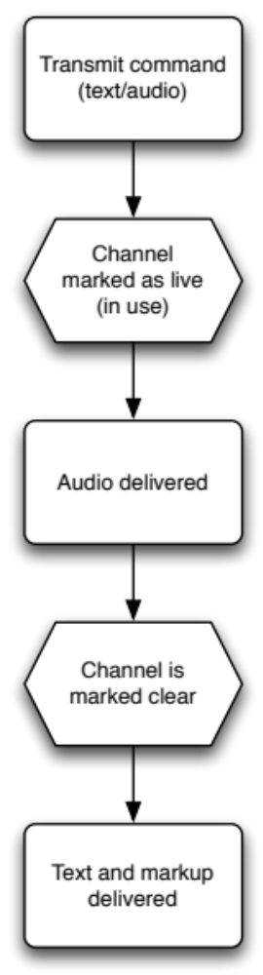
Realistic, Unified Interaction
Radio simulation,
not instant messaging
Shared channel:
One transmitter at a time
Soar Technology, Inc.
Notes:
SimRadio built to replace an older system
System was good for a lot of things
Fell short for real-time interaction with a radio metaphor
Agents can just IM each other, TTS gets queued up and played in order
No real radio simulation so things like changing channel didn’t stop speech that was already queued
Humans talk and their text wouldn’t get delivered until after it was recognized
Many other issues
SimRadio addresses all of this and is a good environment for many planes chatting with ATC
When either text or audio is delivered, speech gets sent first, then text and markup after speech
Events for channel state are delivered, too

Slide 6
Markup
Makes life easier for agents
“clearance delivery viper two one cleared on the l s v two zero four squawking four one zero one”
(M1 ...
^content C1)
(C1 ^type clearance-request-confirm
^transponder 4101
^nav-id |LSV-204|)
Soar Technology, Inc.

Slide 7

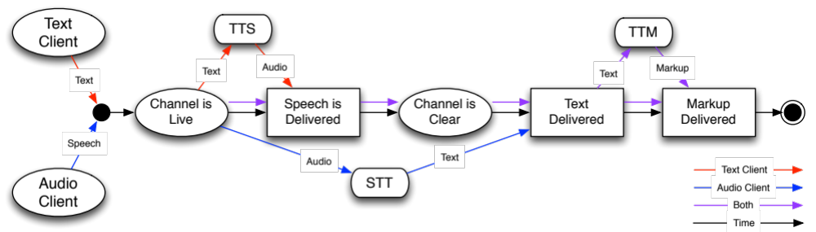
Transmission Pipeline
Soar Technology, Inc.

Slide 8
Implementations
STT: Sphinx
TTS: Festival, Google, `exec say`
TTM: Regular Expressions
SoarTech uses proprietary solutions
Open-source compatible implementations
will exist
Soar Technology, Inc.

Slide 9
Decoupled Services
Speech to text, text to speech, text to markup
  All independently usable
Don’t want the radio simulation?
  Use the plug-ins directly
// STT
ListenableFuture<String> convert(AudioInputStream i);
// TTS, (SpeakableText is voice/message tuple)
AudioInputStream convert(SpeakableText message);
// TTM
ListenableFuture<String> convert(String message);
Soar Technology, Inc.

Slide 10
Interfaces
Soar
Java
JVM JavaScript (via Rhino)
  Excellent for clutter/lightweight agents
RabbitMQ/Protobuf protocol specification
  Any platform supported by these tools
  … with some work
Soar Technology, Inc.

Slide 11
Soar Interface
Soar Technology, Inc.

Slide 12
Radio Commands
(<ol> ^radio-command <cmd>)
Soar Technology, Inc.
Notes:
All radio commands are defined as arguments under a radio-command WME

Slide 13
Declaring a Radio
(<ol> ^radio-command <cmd>)
(<cmd> ^radio-id my-radio-id
^initial-channel channel)
Soar Technology, Inc.
Notes:
Radios have IDs (arbitrary, client-side reference string)
Supports multiple radios in a single agent
Radios start tuned to the initial channel

Slide 14
Detecting Radio State
(<il> ^radios <rs>)
(<rs> ^my-radio-id <r>)
(<r> ^channel current-channel
^transmitting *no*
^receiving *no*)
Soar Technology, Inc.
Notes:
Radios, once created, exist by ID under a radios WME
Transmitting: I am currently speaking
Receiving: Someone is transmitting

Slide 15
Reception
(<il> ^radio-messages.radio-message <m>)
(<m> ^radio-id my-radio-id
^channel some-channel
^client-id 1
^text |Hello Steve, I'm Bob|
^markup <m>)
...
Soar Technology, Inc.
Notes:
The client ID is the only information given about who is sending the message
There is no entity “from” state transmitted, it must be pulled from markup
The structure under “markup” will vary depending on TTM service used
Text is always included with markup

Slide 16
Transmission
(<ol> ^radio-command <cmd>)
(<cmd> ^radio-id my-radio-id
^transmit |Hello, listeners!|)
Soar Technology, Inc.
Notes:
Pass a transmit WME with the content of the message
Optionally specify the radio to use
Unnecessary if only one radio on the agent
Sending markup along with text is future work

Slide 17
Evaluation
Nuggets
Coal
Works
Fun to use
Decoupled
Open Source (soon)
Immature
Concurrency is difficult
Soar Technology, Inc.
Notes:
Evaluation is a bit weird
* Project is young
* Product announcement

