Slide 1
Strategic Approximation of Human Algorithms: a Request for Comments on a Thesis
Ryan Kaulakis (rmk216@ist.psu.edu)
Applied Cognitive Science Lab
Penn State College of IST
Presented at the
2013 Soar Workshop
At the University of Michigan

Slide 2
Outline
Why here?
  Generalizing from ACT-R to Soar (theory should apply to most rule-based architectures)
  Need feedback on getting human-like timings from Soar
Abstract
Strategic Approximation of Human Algorithms (SAHA):
  Bootstrapping Phase
  Post-Process Phase
Questions

Slide 3
Abstract
A nonlinear general regression technique for matching human data with cogni-
tive architectural models is introduced. This technique is named the Strategic
Approximation of Human Algorithms (SAHA), and it provides a means of repre-
senting both individual behaviors and aggregate behaviors, as well as functions
that operate over these representations to support experimental applications.
Sequential problem-solving data generated by humans is used to construct pro-
grams in ACT-R which approximate how that data was generated by the humans.
These programs will be constructed with Genetic Programming variants designed
to evolve programs in ACT-R that solve the same task as the original human,
and that accurately match the observed data of a single human by maximizing
their match percentage over the greatest subset of the human data. The resulting
programs can be viewed as approximations of the algorithm used by the indi-
vidual human to generate the original data. Further, the results from multiple
humans will be aggregated in Program Space and clustered to produce groups
of programs that solve problems in similar ways. These clusters are defined
as fuzzy clusters, and referred to as Strategy Groups. They are groups which
approximate some heuristic which humans use when solving the original problem.
Strategy Groups can be used to perform additional key operations which the
original unaggregated data cannot, including Expansion and Sampling.

Slide 4
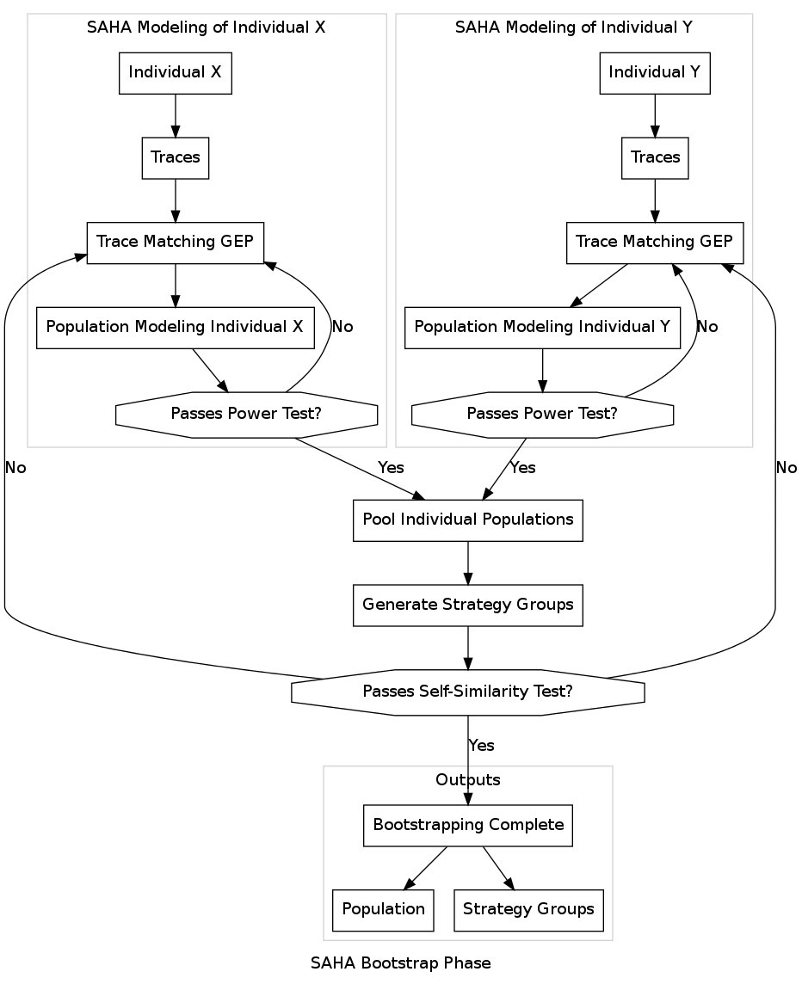

Slide 5
