Slide 1

Leaving the Script
Justin Permar
Soar Workshop
June 5, 2013
ADAM LAB @ GT
http://adam.cc.gatech.edu/
1

Slide 2
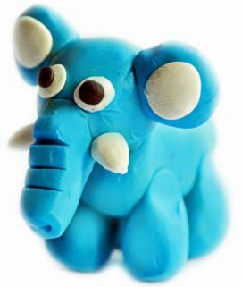
PROBLEM
Creative generation of activities
Freeform narrative domains
Search and recognition
http://adam.cc.gatech.edu/
2
Notes:
We present an approach to the generation of activities in freeform narrative domains like pretend play. Pretend play involves a high degree of improvisational narrative construction among participants, which frequently results in modifications to familiar scripts based on everyday experience, cultural experiences, and previous play experiences. Our computational model of activity generation, based upon conceptual integration theory, generates blended scripts when provided with two familiar input scripts. There are two primary problems for an intelligent agent that uses conceptual blending: 1) search existing knowledge representations to generate new script and 2) recognition of actions as belonging to familiar scripts

Slide 3
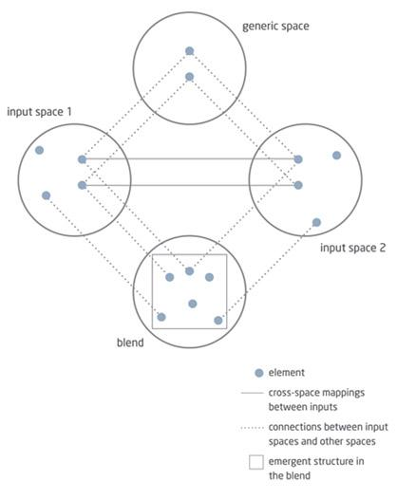
FORMALIZATION: CONCEPTUAL BLENDING
Image source: http://blindmen6.tumblr.com/post/24629045267/conceptual-blending-theory-according-to
http://adam.cc.gatech.edu/
3
Notes:
The blend may also contain emergent structure, which is new meaning not found in the inputs.

Slide 4
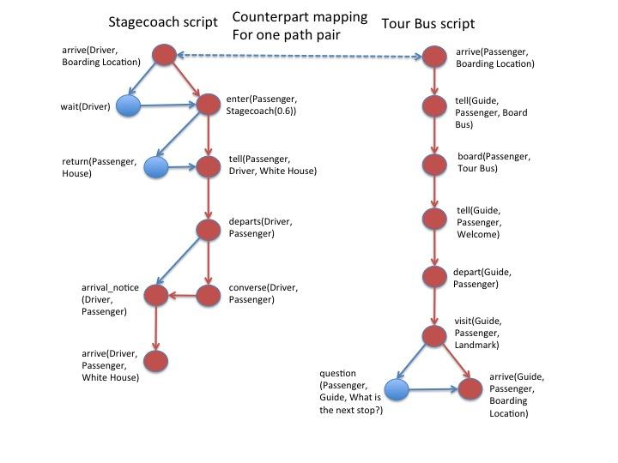
EXAMPLE BLEND
http://adam.cc.gatech.edu/
4

Slide 5
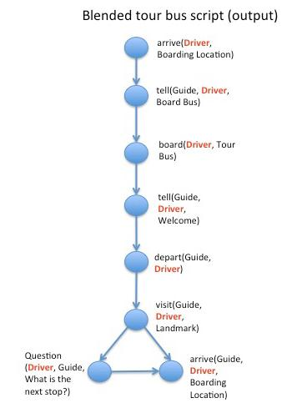
EXAMPLE OUTPUT
http://adam.cc.gatech.edu/
5

Slide 6
ALGORITHM
Input: Two simple directed acyclic graphs (DAGs)
Counterpart mapping
Find all paths, accounting for temporal ordering
Counterpart-collection via rules
Exact-match
Predicate-match
Ordered-entity-match
Mapping-selection
Iconicity preference
Default heuristic: Maximize # of pair matches
Modify-target
Exact-match: no change
Predicate-match: change one entity
Ordered-entity-match: change predicate
Output: One "blend" DAG
http://adam.cc.gatech.edu/
6
Notes:
At a high level, our approach combines the path representation mentioned by Veale et al. with the notions of one-to-one mapping and parallel connectivity from structure-mapping theory. Our algorithm contains three phases: 1) counterpart mapping, 2) mapping selection, and 3) mapping application.

Slide 7

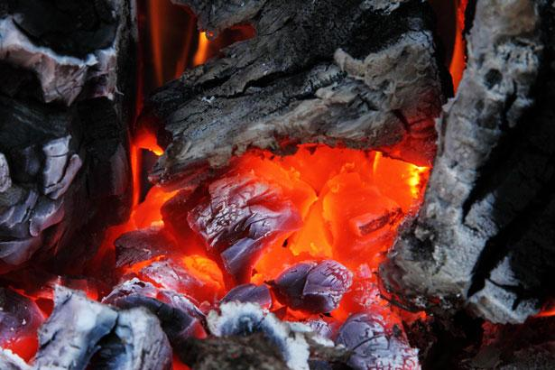
NUGGETS AND COAL
Simple knowledge representation
Satisfying temporality constraints
Creative blends!
Human-like blends by using iconicity
Need to conduct evaluation
Produces zero or one blends
Causality is a tricky problem
Performance
Optimal blends
Context??
http://adam.cc.gatech.edu/
7
Notes:
Ensuring causality requires large amount of general and specific knowledge; smaller knowledgebases could be created to ensure causality for specific domains

