Slide 1
Soar and StarCraft
By Alex Turner

Slide 2
What is StarCraft: Brood War?
A Real-Time Strategy (RTS) computer game released in 1998.
A sci-fi war simulation
Continually improved upon after its release
Improved to be very balanced
Balanced: There are always multiple strategies to win
Provides an ideal environment for an AI research
A player plays as one of three races
Each has distinct advantages and disadvantages

Slide 3
What is Soar-SC?
AI has challenges with some areas of RTS games
Soar-SC designed to help solve these challenges
Challenges
Spatial Reasoning
Interacting and reasoning about the world around the AI
Large amounts of Perceptual Information
Terrain Information
Unit Position Information
Imperfect and Inaccurate Information
Fog of War
Strategy and Tactics
Attacking/Defending
When and What to build

Slide 4
Soar-SC Design
Uses the Brood War Application Programming Interface (BWAPI)
Provides an interface for software to interact with StarCraft: Brood War
Interface is identical in functionality to what a human experiences
Heavily relies on SVS

Slide 5
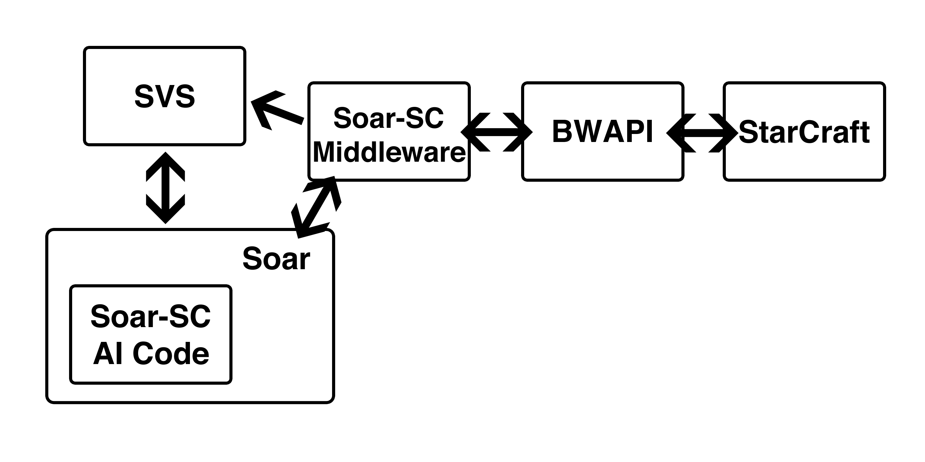
Soar-SC Overview

Slide 6
Soar-SC Design
Middleware
Handles communication between StarCraft (BWAPI) and Soar
Sends game information to Soar
Unit types and counts
Unit positions and Terrain Information to SVS
Takes output from Soar-SC and performs actions in StarCraft
Attack a unit
Build a building
Agent
Takes input from middleware and SVS
Potentially reacts to the information
May output an action to the middleware

Slide 7
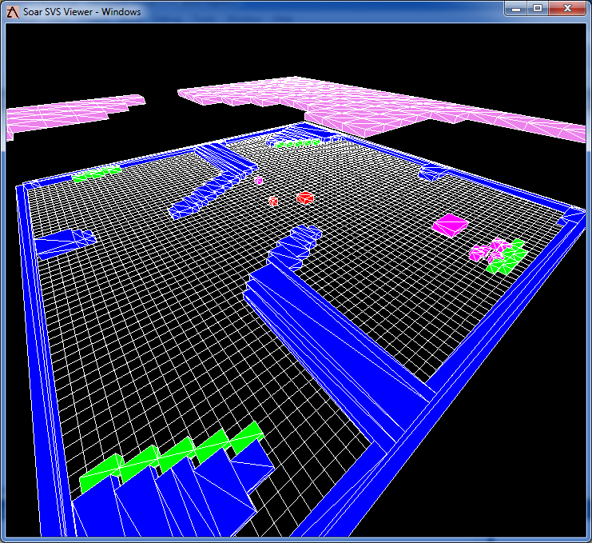
Soar-SC Design - Perception
StarCraft Environment as seen from Soar-SC
Violet: Fog of War Tiles
Blue: Terrain
Green: Resources
Magenta: Soar-SC’s units
Red: Enemy Units

Slide 8
What can Soar-SC do?
Soar-SC can
Parse the terrain and send it to SVS
Gather resources
Scout in semi-complicated ways
Build units of arbitrary type
Build buildings of arbitrary type at arbitrary locations
Attack the enemy without rushing

Slide 9
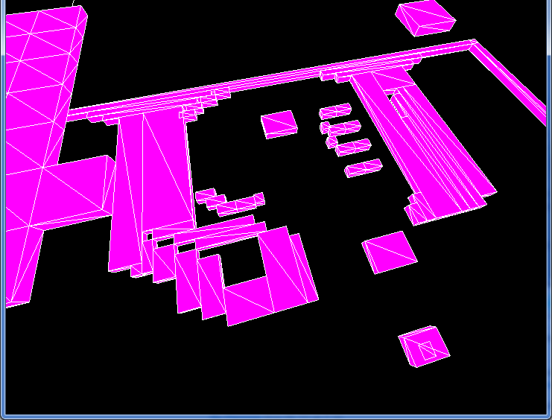
Terrain
StarCraft
64x64 map has 256x256 “walk” tiles
“walk” tile: Tile StarCraft uses to determine
whether a unit can walk there
256x256 map has 1024x1024 “walk” tiles
Too many for SVS to handle
Algorithm
Flood Fill
Fills all open sections of the map with “water”
Marks sections with no “water” as inaccessible
Groups each filled section
Sections with less than 5 “walk” tiles in them are marked as inaccessible
Starting at the upper left tries to generate largest possible continuous rectangles to put into SVS.

Slide 10
Gathering Resources
Soar-SC can gather resources
Uses SVS to do this
Method
If Soar-SC has a worker which can gather resources and is idle
Then it will propose an operator to gather resources with that worker
Asks SVS to give it the closest resource to that worker
Use the result to place the resource location on the operator
Tell the middleware to move the worker to that resource

Slide 11
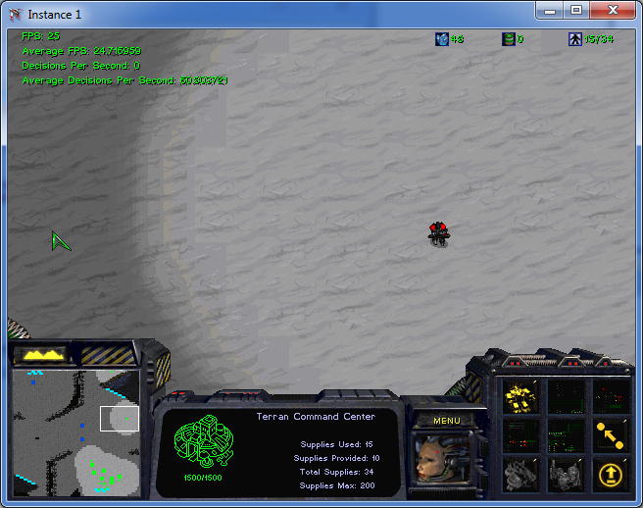
Scouting
RTS games
Advantageous to see what your enemy is up to
Need for scouting
Creates a scout
Can be either a worker or a marine
Prefers marines over workers

Slide 12
Scouting
Method – Fog of War Tiles
If there is an idle scout and there is at least one potentially accessible fog of war tile, propose to scout a fog of war tile
Asks SVS for which is the closest fog of war tile to the scout
Places the tile on the scout as its location
Tells the middleware to move the scout to the fog of war tile location

Slide 13
Scouting
Method – Key Location
If there is an idle scout, and there are no fog of war tiles a scout can reach, and there is at least one key-location, propose to scout a key location
Key-location: either enemy building or map corner
Places the key-location on the scout as it’s location
Tells the middleware to move the scout to the key-location’s location

Slide 14
Building Units
Soar-SC can build units of any type
Instead of specific rules per unit and building combination
Uses general rules
In order to add the building of a new type of unit, just have to add a proposal rule for that unit type
Example: Marine
Proposes a build-unit operator with a unit type of marine and a location of a barracks
Applies the build-unit operator
Tells the middleware to build a unit of type marine at the barracks
Apply rule can build any unit type at any location as long as it is capable of building that type of unit

Slide 15
Building Buildings – Virtual Objects
Soar-SC can build buildings at arbitrary locations and of arbitrary type
Can build any type of building
Does not use a human to predetermine locations for buildings
“Virtual Objects”
StarCraft is the “real world” and objects Soar-SC reasons about and wants to place are “virtual” to the StarCraft world.
Similar to Building Units
In order to build a building of a new type, all you need to do is add a proposal rule for that building
The generic build operators will take care all of the virtual objects

Slide 16
Building Buildings – Virtual Objects
Method
Proposes to build a building of a certain type
No-Change Impasse
Tells SVS to return a location for the new building
Passes the building’s size to SVS
Passes the building’s type to SVS
Returns an upper-left location in (x,y)
Puts location on the operator
Resolves impasse
Outputs to the middleware to build at that location

Slide 17
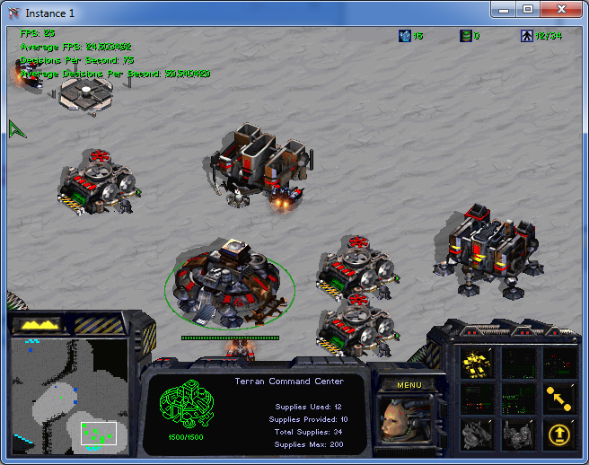
Building Buildings – Virtual Objects
Filter Algorithm
Takes an x-size, y-size, and building type
Gets all the buildings, resources, and terrain objects from the SVS scene graph
Generates a grid around each building
Eliminates all the conflicts
Buildings
Resources
Path to resources from resource collectors
Terrain
If there is a building of the same type, eliminates all grids not within 1 build tile + the shape’s size
From all the remaining, randomly chooses one
Returns that grid

Slide 18
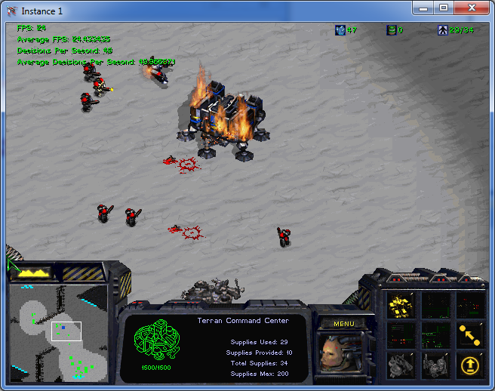
Attacking the Enemy
Soar-SC can attack an enemy
Can Counter Attack
Can Attack Enemy Units
Can Attack Enemy Buildings
Attack is generalized
Can attack with any unit that there is a proposal rule for attacking with
Could be more generalized to attacking with any unit which can attack

Slide 19
Attacking the Enemy
Method
Proposes to attack a specific enemy building or unit with a specific marine
If there is a counter attack operator, reject other types of attack
If there is a unit attack operator, reject other types of attack
Applies the attack
Outputs a move command to the middleware with a specific ID to attack

Slide 20
Soar-SC
Good
Very Flexible Platform that uses SVS
Without SVS a lot of this would be difficult to do
Reached some of the limits of the current version of SVS
Middleware provides a solid base and platform
Would allow for Agents for other races
Would allow for Agents of many different types
Agent can be extended
Bad
Middleware and Agent have some speed issues
Runs at only 60-70 decisions per second
Occasionally drops to 20-30 decisions per second under heavy SVS load
Middleware is not architecture independent yet
Cannot use JSoar instead of CSoar for instance

Slide 21
Future Work
Future Work
Better Attack Strategies
Grouping Unit Attacks
“Concaves”
“Concaves” are surrounding of enemy units to attack
Better Base Building
More reasoning about how to plan out and build a base
Reinforcement Learning
Take advantage of the other memories Soar has

Slide 22
Acknowledgements
Jon Voigt
Soar Tech
Professor John Laird
Joseph Xu – SVS
Mitchel Bloch - Programming advice
University of Michigan
Department of Electrical Engineering and Computer Science

Slide 23
Questions?

