Slide 1
Ambiguity and Knowledge Transfer in ITL
James Kirk
John Laird
Soar Workshop 2019

Slide 2
Interactive Task Learning^{[1]}
Interactive
Real time, Fast with few examples
Natural (language, demonstrations)
Situated in a shared environment
Task
The problem formulation or definition (action preconditions, goals, etc.)
Learning
Acquires all knowledge necessary to understand, solve, and perform the task
Not
(In our case) learning a policy or procedure for the task
Programmed to handle new tasks, conditions, situations
Using offline batch processing
[1] Laird, J. E., Gluck, K., Anderson, J., Forbus, K., Jenkins, O., Lebiere, C., Salvucci, D., Scheutz, M., Thomaz, A., Trafton, G., Wray, R. E., Mohan, S., Kirk, J. R. (2017). Interactive Task Learning, IEEE Intelligent Systems, 32(4), 6-21, (invited).

Slide 3
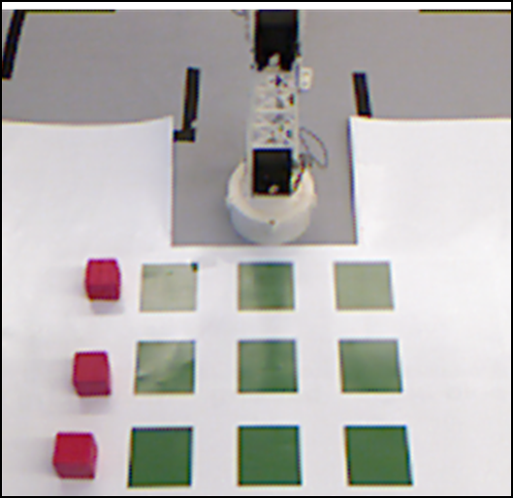

Big Picture of this Work
In a Shared Situated Environment
Teacher describes the task using language
How can the agent learn to understand and solve the task in given context?
“You can move a free piece… the goal is that…”

Slide 4
Learning Approach
Rosie learns all the task elements used to define goal-oriented tasks from ‘scratch’
Task elements:
Goals (final states): “The goal is that there are five matching locations.”
Actions (operators): “You can move a red block onto a clear location.”
Failure conditions (path constraints): “If a block is larger than the object it is on then you lose.”
Task specific terms: “clear”, “matching”
Focusing on learning the rules for games and puzzles

Slide 5
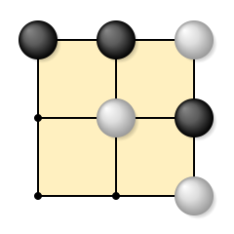

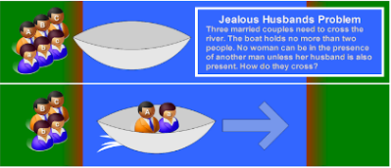
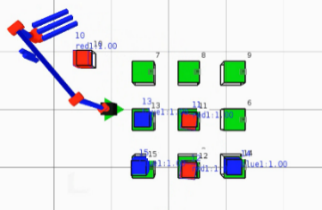


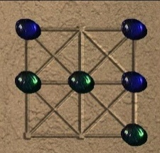
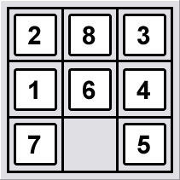
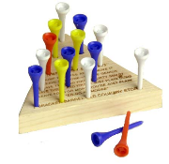
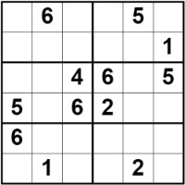
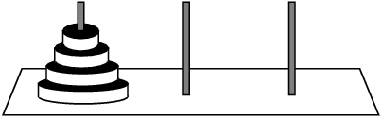
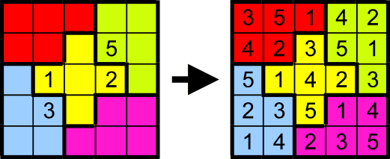
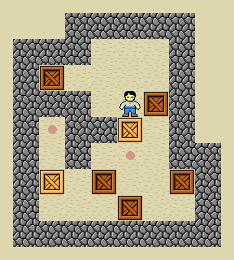
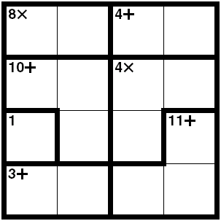
Learns 55 Games and Puzzles
Board Games
Tic-Tac-Toe
3 Men’s Morris
Picaria
Nine Holes
Breakthrough
Connect 4
Simplified Risk
Mini-Othello
River Crossing Puzzles
Family River Crossing
Jealous Husbands
Missionaries and Cannibals
Fox, Goose & Beans
Manager-Actor Crossing
Grid Puzzles
5/8/15 puzzle
Sokoban
Knight’s Tour
Traveling Salesman
Simple/Pushing Maze
Side Swapping puzzles
Frogs and Toads puzzle
8 Men on a Raft
Knight swapping
4 Corner knight swapping
Block Puzzles
Blocks Worlds
Tower of Hanoi (3, 4, 5)
Stacking Frogs
King/Lazy Stacking Frogs
Sorting tasks
N-Queens/Kings/Knights/Rooks
Marking/Logic Puzzles
Sudoku (small)
Killer Sudoku
Jigsawdoku
KenKen
Logi-5
Shuffle, Survo
Kakuro
Suko, Sujiko
Map coloring
Solitaire and Card Games
Mahjong
Peg Solitaire
Pyramid Solitaire
Tri peaks Solitaire
Golf Solitaire
Crazy Eights
President’s

Slide 6
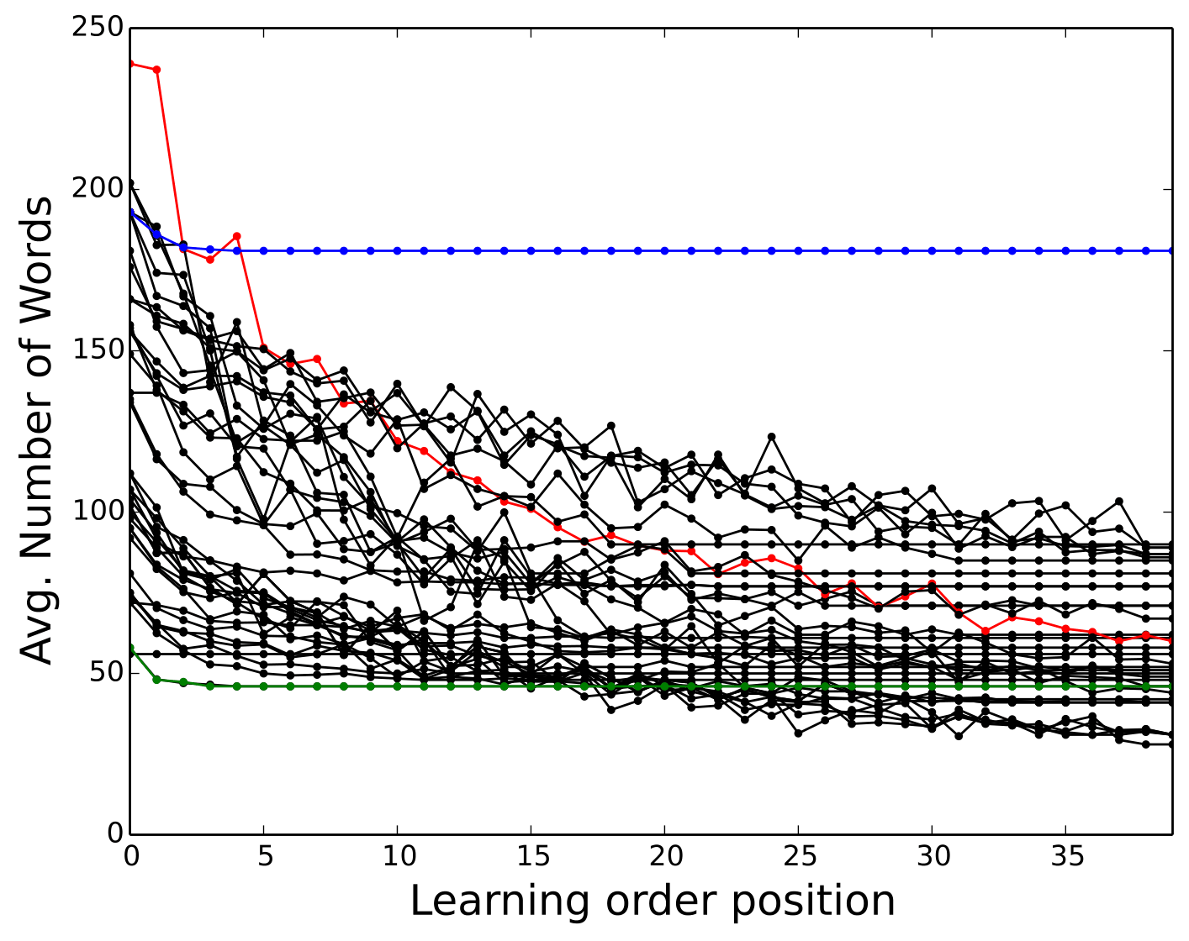
Transfer of Unambiguous Instructions
40 games - 1000 randomly generated permutations
Scripted interaction, simulate domains
Evaluate effects of order (transfer) & communication time (number of words)
Killer Sudoku
Frogs and Toads
Blocks World

Slide 7
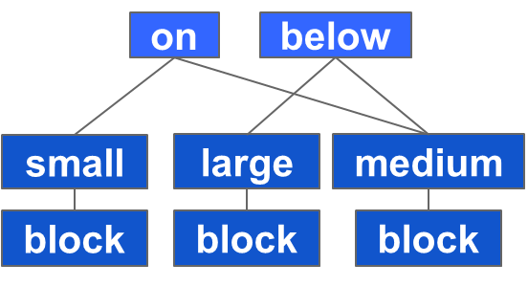
Learning Structure Representation
“The goal is that a small block is on a medium block and a large block is below the medium block.”

Slide 8
Ground and Operationalize
<A,B>
<C,B>
Evaluate individual predicates within context of world state and input arguments
Result is the objects, sets, and values that satisfy all constraints
A
C
B
A,B,C
A,B,C
A,B,C
A,B,C,X,Y,Z
A,B,C,X,Y,Z
A,B,C,X,Y,Z
Resolve Bottom Up

Slide 9
Learns Hierarchical Structures
If a block is adjacent to a clear location then you can move the block onto the clear location.
Please describe the meaning of ‘adjacent' in this context.
If a block is next to a location but it is not diagonal with the location then it is adjacent to the location.
next-to
~diagonal
move
adjacent
input1
input2
block
clear
location

Slide 10

What if Multiple Definitions?
If a toad is to the right of a clear location then you can move the toad onto the location.
What if agent knows two definitions of “clear.”
Clear = not under a block
Clear = not marked (Tic-Tac-Toe)
Which meaning should it use?

Slide 11
Video

Slide 12
Disambiguation Strategies
Case 0: Single valid (grounded) interpretation structure
No interaction required
Case 1: Multiple versions, different # of results
Rosie asks teacher “How many actions are present X or Y?”
Case 2: Same # of results, different # of predicate results
Rosie asks teacher “How many ‘clear’ objects are visible Y or Z?”
Case 3: No numeric differences between structures
Rosie asks for a new state: “Please setup another state containing the action.”

Slide 13
Nuggets and Coals
Nuggets
Partial transfer of knowledge between tasks even with interference
Can Disambiguate between many interpretations, using the structures we learn (and by creating many versions)
Autogenerate on the fly graphical representation that help (an expert) understand what the agent has learned (or failed to learn)
also great for debugging!
Coals
Many other disambiguating strategies could employ (ex: “does clear mean …”)
Not guaranteed to find correct interpretation
Visualizer useful, but for experts: would be useful to expand visibility of internal knowledge so that nonexperts can understand what the agent knows/sees

Slide 14
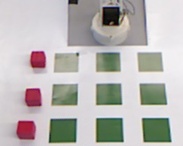


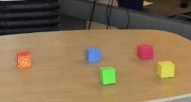

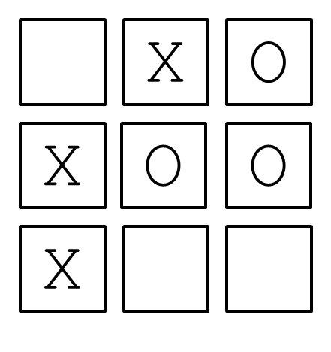
Problem Characteristics
“..piece..”
block
Lack of Common Ground
Compositional
Accumulative Learning
Many-to-many Mappings
action
move a piece onto a clear location
not below an object
Term
Meaning
“clear”
transparent
uncovered
“empty”
unfilled

Slide 15
Creating Multiple Interpretations
“If a toad is to the right of a clear location then you can move the toad onto the location.”
6
7
8
9
1
2
3
4
5
Clear when there is no mark.
Clear when there is no block.
8 onto 3
9 onto 4
8 onto 3
move
move
on-to
on-to
(8,3);(9,4)
(8,3)
right-of
right-of
3
8,9
1-5
1-5
8,9
3
~below
toad
clear₁
~has-attribute
toad
clear₂
1-5
6-9
1-5
1-5
1-5
input
block
location
input1
‘value’
location
Rosie: “How many actions are present: 1 or 2?”

