Slide 1
(Still Trying To) Learn To Soar

Slide 2
Project Background
Goal: Create an interactive model that flies “like” particular pilot(s)
Application: Training for “talk down” air controllers
Many platforms; varied instrumentation
Pilots with various skill levels
Challenge: Variation in flight trajectories / pilot control
Approach:
Use Soar cognitive architecture and previously-explored knowledge-based flight model for basic aircraft control (including interaction with flight
Use integrated RL to tune performance to captured flight trajectories for particular kinds of pilots
Modest Scope:
~1000 hrs (3 person team; includes systems integration goals)

Slide 3
Systems Perspective (for Deployment)

Slide 4
General Project Challenges
Find the “right” task decomposition.
Support adaptive, autonomous behavior.
Support the types of reinforcement learning we are targeting.
Seamlessly integrate RL and non-RL decisions.
Soar provides a good framework for this.
Find a data representation that supports the learning goals.
One of the key challenges for any RL problem.
Tradeoff between
Ensuring the search space actually contains a solution that can be learned (the richer the language, the better)
Letting RL do “the hard work” (the less fine tuning of the search space, better → tends to produce large search spaces)
Managing the ability to learn in a reasonable number of training trials (paring down the search space in “smart” ways that don’t violate the previous two tradeoffs)
Determine the “right” reward signals.
One of the key challenges for any RL problem
In particular: Appropriately weight multiple reward signals

Slide 5
Specific Project Challenges
There are multiple types of decisions we want to learn about.
Semi-independent, but some interactions
There is more than one “correct” decision policy.
Rewards are delayed.
It gets worse…the task is not a Markov Decision Process.
The “value” of the current state depends largely on a decision the agent made some (indeterminate) number of decisions in the past.
“Correct” policies depend on second derivatives.
Expands the representation language, which increases the search space.

Slide 6
The Task: Aircraft Landing
Short and narrow runway…
We are modeling the final approach - about 20 seconds of flight time.
Constraints:
Too much vertical velocity can be catastrophic.
Too much forward velocity makes it too difficult to hit the target.
Too little forward velocity can cause a stall (catastrophic).
Forward velocity must be parallel to the runway and close to the center of the runway.
Aircraft nose must be pointed down the runway at landing time.
There is an “ideal glide path” that the pilot tries to maintain.

Slide 7
Task Controls and Decisions
Desired aircraft “angle of attack” maximizes lift-to-drag ratio.
Controlled primarily by pitch, stick forward/backward
Desired aircraft glide slope specifies a path that would hit the target wire at the velocity produced by the desired angle of attack.
Controlled primarily by thrust, once the angle of attack is achieved
Desired aircraft line up specifies that the aircraft is near the center of the runway with velocity parallel to the runway.
Adjustments controlled primarily by roll, stick right/left
Roll can affect angle of attack, which can affect speed, which can affect glide slope.

Slide 8
Simplified Initial Focus: Learn to Stay on Glide Slope
Achieving glide slope requires increase in thrust (if too low) or decrease in thrust (if too high).
Amount of increase/decrease depends on size of error.
Two types of error:
Absolute distance from desired glide slope
Difference between actual and ideal descent rate
Thrust corrections must be terminated before the desired glide slope position and descent rate are achieved.
Otherwise, the result is an “over correction”.

Slide 9
Using Soar RL: Challenges and Solutions
Which decision policy should we use?
Boltzmann was the likely candidate.
Initial training runs seemed to be taking forever, with no convergence.
We discovered that the default “Boltzmann temperature“ value is pretty huge, which implies lots of randomness even after learning has occurred.

Slide 10
Using Soar RL: Challenges and Solutions
How should we manage the Boltzmann temperature?
Soar includes parameters for “automated temperature reduction”, but the documentation does not make very clear how it works.
Is this known “lore” at UM or do others struggle with this issue as well?
The built-in functionality did not appear to give us the control we wanted.
We created our own control system:
Set temperature for learning.
Run a batch of training trials.
Set temperature for testing.
Run a batch of testing trials.
Reduce learning temperature.
Repeat until learning temperature approaches testing temperature.

Slide 11
Using Soar RL: Challenges and Solutions
How often should the agent make RL decisions about thrust adjustments?
It cannot be too frequently, or the agent does not have time to do anything.
Not to mention that the RL update process is expensive.
It cannot be too seldom, or the agent does not have enough control to achieve a good landing.
We created a parameter to allow the agent to make thrust decisions every N seconds, then used trial and error to determine a good value for N (resulted in about 4 or 5 thrust decisions per landing).

Slide 12
Using Soar RL: Challenges and Solutions
What should the reward signals be, and how should they be weighted, relative to each other?
Quality of the final landing position (only one reward per run).
Normalized combined distance from ideal glide slope and ideal descent rate (one reward per decision).
Note: The Soar Manual says “Soar will check each structure for a numeric reward signal for the last operator executed in the associated state at the beginning of every decision phase.”
This appears to be false. Looking at the source code, it appears that Soar only checks the reward link when to comes across a new RL decision. It does not check the reward link during other decisions.
In theory, both of these are “good” rewards, which should eventually allow the agent to learn a good policy.
In practice, if the glide-slope reward was too high, it would cause the agent to over-learn early decisions and get into an “inescapable policy trap”.
There is an interaction here with the need to use eligibility traces (next).

Slide 13
Using Soar RL: Challenges and Solutions
Should we use eligibility traces and if so, how?
We definitely need eligibility traces.
Eligibility traces are an addition to RL that allows the algorithm to allocate reward signals to multiple decisions in the past, rather than just the most recent decision
The “current” glide-slope reward signal needs to be allocated to the decision we made 2 or 3 decisions previously.
There is no good way for the agent to know how far back to go.
We performed many, many experiments trying to get this right.
Eventually, we settled on setting the eligibility-trace-decay-rate to a relatively high value of 0.8.
Even when using eligibility traces, we found lots of inconsistencies in the learning (see next).

Slide 14
Using Soar RL: Challenges and Solutions
Should we use Q learning or SARSA?
There is a lot of information about the technical differences between Q learning and SARSA, but there is not much (or any) pragmatic advice on when to choose one or the other.
So we randomly chose to start our explorations with Q learning.
We chose poorly.
After a lot of strange results and digging through the source code, we found that Q learning throws away eligibility trace history any time the agent makes a choice that does not have the current highest Q value.
(We still don’t know what the reason for this is, but we’re sure it’s good.)
So our choice of Q learning was making our use of eligibility traces mostly ineffective.
Once we discovered this and switched to SARSA, the eligibility traces started working like a charm.
This feature is completely undocumented, as far as we can tell.

Slide 15
Using Soar RL: Challenges and Solutions
How can we handle the large search space?
The number of RL rules we are learning about is over 40,000.
This is AFTER we did lots of trial-and-error work to prune down the search-space size.
This number of rules overwhelms JSoar.
If you use rule templates, the agent spends almost all its time creating duplicate rules, and it cannot be responsive.
JSoar does not yet have the “gp” command.
We tried using a TCL version of GP but that took dozens of minutes to run.
We instead pre-generated our rule sets using Java code (fast) and then loaded them into the agent (still takes 10 minutes or more to load).
Writing out a newly learned rule set also takes 10 minutes or more.
Our “batch learning control module” therefore used “init-soar” to restart each trial, and we would only write out the learned rule set very occasionally
By setting SimJr to run 10 times real time, we were able to get the training-trial time down to about 2 seconds (and possibly we could go faster).

Slide 16
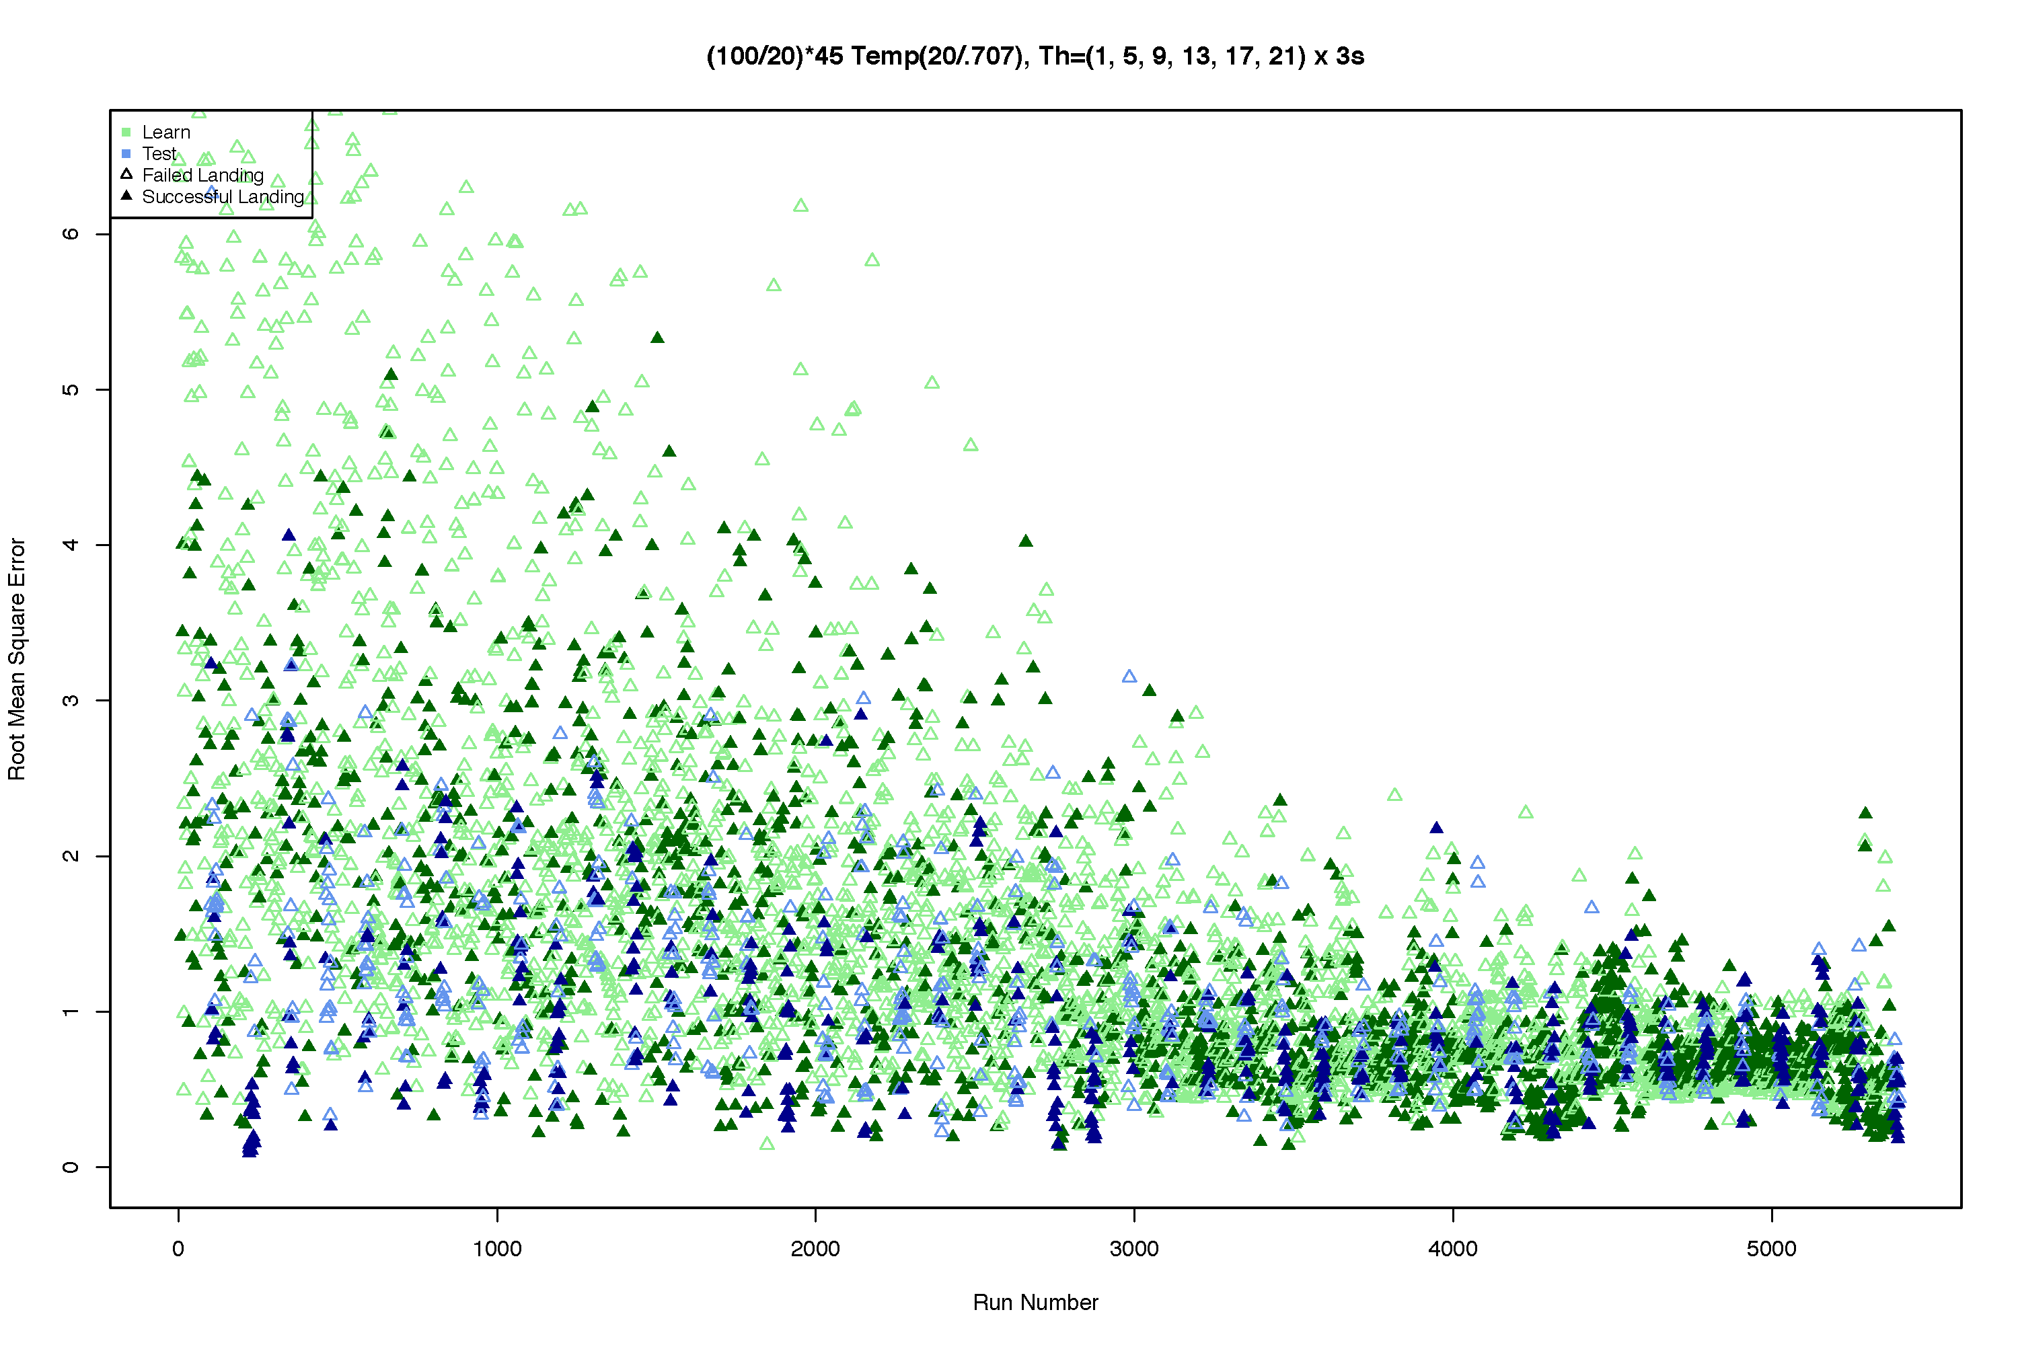
Learning to Control Glideslope…

Slide 17
Lumps and Nuggets
Nugget: RL and Soar RL are a “good fit” to our problem
After much grief, we did finally find a way to get the agent to learn what we wanted it to learn.
The resulting system is a recognizable/standard Soar system, and it successfully tackles a very difficult learning problem.
Lump: RL and Soar’s implementation of RL are not a “best fit” to our problem.
RL: Delayed rewards, multiple rewards, non-MDP
Soar RL: Interleaved rewards and decisions
It is not possible to “tie” a reward to a particular decision.
Lump: We anticipate several new problems in the next research phase.
How to structure agent and environment to learn three distinct control policies at the same time?
Workarounds?
Lump: Documentation of Soar RL is incomplete and sometimes incorrect.

