Slide 1
Integrating Visual Reasoning into a Cognitive Architecture
James Boggs
University of Michigan
Notes:
Hello, I’m James Boggs, I’m in the Soar lab led by John Laird, and I’ll be presenting my work on integrating visual memory into a cognitive architecture.

Slide 2
Cognitive architectures
Overarching goal: design a blueprint for cognition
Establish what are the necessary components and interactions for an intelligent agent?
Make commitments!
Strongly biased towards symbolic representations
Implement agents in the CA, test what it can do, adjust CA
Ideal for testing how parts of cognition (e.g., vision!) interact
100+ cognitive architectures
Used extensively in cognitive modeling and cognitive agent/robot development
Effect on world
Acting
Decisions
Planning
Short-term Memory
Long-term memory
Learning
Perception
Goals
Notes:
The development of these requirements was guided by the core philosophy of cognitive architectures, of which Soar is one: proposing a set of functionalities and interactions aimed at producing intelligence. Cognitive architectures are, at their core, functional theories of intelligence which describe the components needed for producing an intelligent agent. Since the capabilities of an agent are dependent on the components which constitute it and their interactions, testing agents within a cognitive architecture sheds light on the broader theory of cognition it embodies. As I’ll discuss later, a similar approach is taken for this work.

Slide 3
What’s Missing in Cognitive Architectures
Integration of vision-based reasoning and symbolic reasoning
Bidirectional processing between vision and symbolic representations
Specifically:
Compositional reasoning over image-based representations controlled by symbolic knowledge
Long-term visual knowledge/memory and associations with symbolic knowledge/memory

Slide 4
Research Statement
Visual-symbolic integration within a cognitive architecture

Slide 5
Overall Methodology
Develop requirements for visual-symbolic integration
Use Soar cognitive architecture as symbolic foundation
Extend with three new visual memories (SVS 2):
Visual sensory memory
Visual working memory
Visual long-term memory
Evaluate in visual character domain
Simple proof-of-concept to explore visual-symbolic integration
Enables testing of major visual-symbolic integration requirements
Notes:
Talk about will discuss high level reqs in next slide, then go through motivating example. More detail in paper

Slide 6
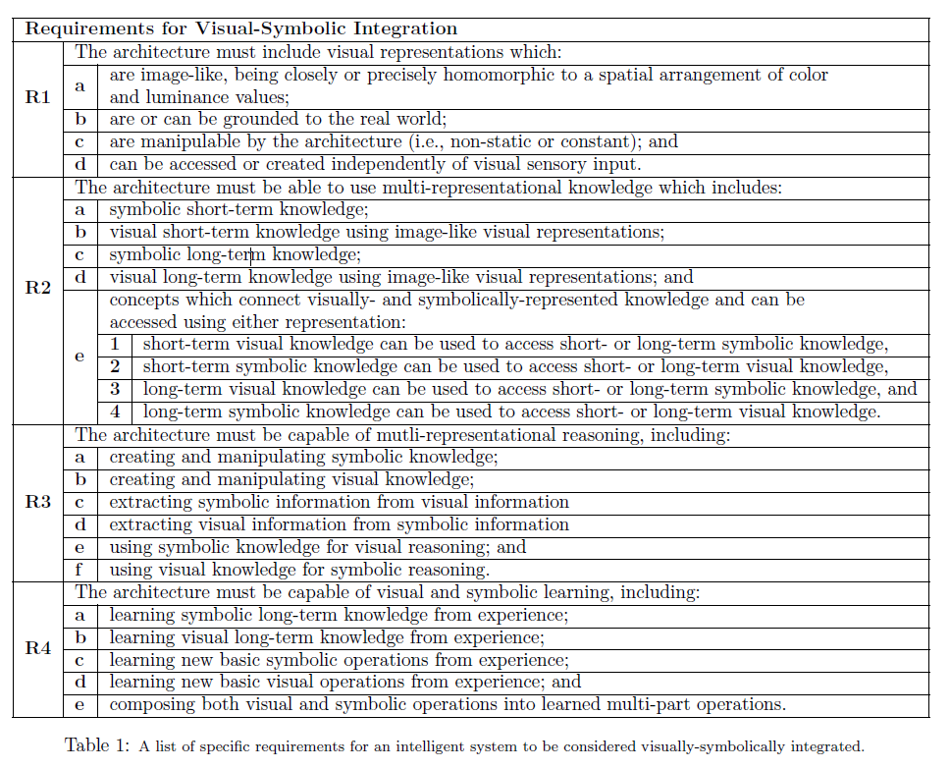
Visual-Symbolic Integration Requirements

Slide 7
Visual-Symbolic Integration Requirements
2
2
Visual Knowledge
2
Symbolic Knowledge
Visual Representations
Symbolic Representations
1
1
3
3
3
Visual Reasoning
3
Symbolic Reasoning
4
4
Procedural Knowledge
4
Notes:
So, what does visual-symbolic integration actually mean? I go into far more detail in my paper, but there are four key aspects to VSI. First, the system needs to be able to use both visual and symbolic representations. Second, it needs a way to store both kinds of knowledge and, more significantly, the knowledge needs to span both representations. Third, it needs the ability to reason with each representation using either or both kinds of knowledge. Finally, it needs to be able to learn new ways of reasoning and acting which can utilize both kinds of reasoning. This set of capabilities defines visual-symbolic integration: a system that has all these is visually-symbolically integrated, at least for the purposes of this project.

Slide 8


Motivating Example
WOW
spouse is
Notes:
Here’s an example I’m sure you remember from my paper. First, I want you to imagine the word “WOW” in your head. Visualize the letters. Now rotate it 180 degrees. When was the last time you saw the spouse of that person? I’m sure you can all answer that question relatively easily, but it represents a problem which is challenging for AI systems today. Consider what you need to do in your head in order to answer the question. First, you have to visualize the word WOW, then rotate it. From there, you need to recognize that M-O-M is a new word, “MOM,” and that MOM can have a spouse. Then you need to think about who that spouse is and recall the last time you saw them.

Slide 9
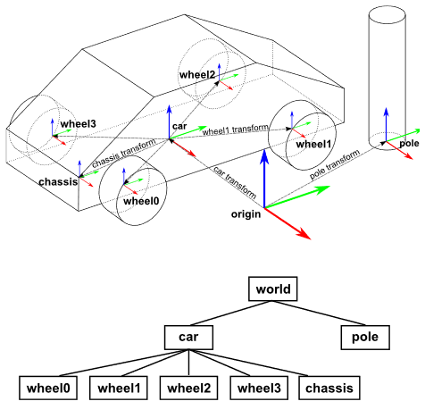
Spatial-Visual System & Spatial Scene
Allows Soar to imagine a 3D scene
Like WM, based on a graph structure
Doesn’t have image-based representations
No connections to long-term memory
Notes:
That memory is the “spatial scene”, a part of the spatial-visual system, or SVS. Although it’s uniquely non-symbolic, the spatial scene is similar to the other memories in Soar in that it is structured as a graph of composable units of knowledge, in this case 3D objects and their relationships. In the example on the slide, the top shows the 3D scene as it might be rendered, the bottom shows the representation of that scene in the spatial scene. The most important thing to note is the composability of the components. The car node collects the four wheel nodes and the chassis to make a more complex structure. The spatial scene enables an agent to imagine and reason on a 3D scene, for example by checking whether two objects intersect or determining the nearest other object to a source object. This is incredibly useful, but it is not visual reasoning. SVS has effectively no visual aspect, and so it cannot be used for visual reasoning.

Slide 10
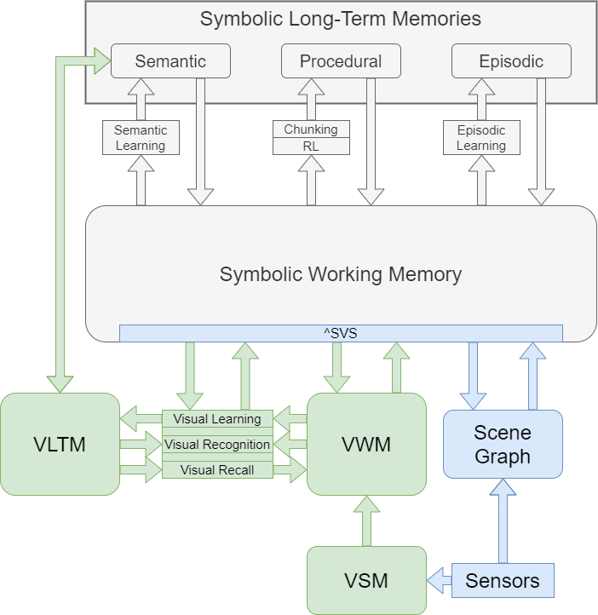
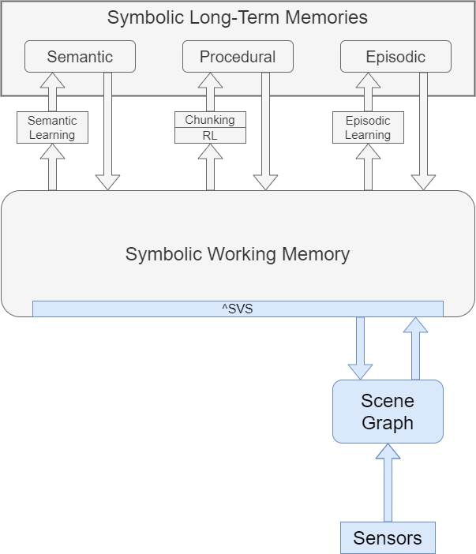
Soar
Soar-SVS2
Working memory: short-term goal-oriented knowledge
Procedural memory: long-term knowledge of symbol manipulation rules
Semantic memory: long-term goal-agnostic knowledge
Episodic memory: snapshots of working memory across time
SVS: spatial quantitative knowledge in 3D
Lacks image-based visual reasoning
Lacks visual-symbolic connections, especially in long-term memories
Working memory: short-term goal-oriented knowledge
Procedural memory: long-term knowledge of symbol manipulation rules
Semantic memory: long-term goal-agnostic knowledge
Episodic memory: snapshots of working memory across time
SVS: spatial quantitative knowledge in 3D
VWM: short-term visual memory, center of visual reasoning
VLTM: Long-term visual knowledge with connections to symbolic
VSM: visual input buffer
Notes:
ince Soar was used as the foundation for this project, a brief overview is in order. At the core of Soar is working memory, a short-term memory which, together with procedural memory, is the core of Soar’s reasoning capabilities. Working memory is composed of symbols called working memory elements organized into a graph structure. Through flexible if-then rules stored in procedural memory, an agent can create complex symbolic structures which allow it to model and reason about the world. I go into more detail about how this works in my paper. The semantic and episodic memories are long-term memories with different functionalities. Semantic memory stores knowledge about the world which needs to be stored more permanently than working memory allows. Episodic memory stores “episodes,” basically snapshots of working memory at different points of the agent’s lifetime. More recently, a new memory was added, this one non-symbolic.
Notes: Present old diagram first, fade out old diagram, fade in new diagram representation of Soar, with text changes representing changes in diagram, adding in functionality

Slide 11


Visual Sensory Memory
Purpose:
Holds visual input from sensors
Enables easy separation between mental and perceptual imagery
Visual Sensory Memory
Working Memory
vision-updated true
Notes:
Visual sensory memory is the first stop for new visual knowledge. It serves as a visual input buffer, providing a way for the agent to receive visual input from sensors such as a camera. In this example, the agent is shown an image of a w character on a black background. This image is copied exactly to VSM and held there until the next image is shown. Each time VSM receives a new image, it updates a symbol in symbolic working memory, alerting the agent that new visual input has arrived. VSM serves two key purposes. First, it allows the agent to connect to the outside world natively, rather than requiring a visual parser. Second, it gives the agent a dedicated buffer for direct visual input which is separate from the center of visual reasoning. This means that the agent always has access to up-to-date visual inputs regardless of the visual reasoning or manipulations it is doing.

Slide 12

Visual Working Memory
Purpose:
Center of visual reasoning: enables imagination, composition, manipulation, and reasoning
Working Memory
Visual Working Memory
^svs
rotate 180
Notes:
When the agent does need to do visual reasoning, visual working memory is where it happens. Visual working memory parallels its symbolic counterpart in several ways. Structurally, VWM is a graph of composable elements, much like both symbolic working memory and the spatial scene. In VWM, these elements are called visual working memory elements, or vwmes. VWMEs are image-like, composable visual representations. Right now they’re implemented as standard four-channel bitmaps, but that particular representation isn’t required. The diagram at the bottom left kinda illustrates the idea: each character in the word wow has an individual VWME, and these are combined to form a higher-level VWME which contains the entire word wow. Just like WM, VWM is the hub of visual reasoning, and all visual operations and manipulations happen here. These can take two forms. In that diagram I just pointed out, the edges actually serve as visual operations by defining a compositional relationship between the various VWMEs, merging them into the higher-level VWME. The other form works on a particular VWME itself using an operation (in this case, rotation) which is signaled by adding a specific WME structure to working memory. In order to facilitate visual-symbolic integration, visual working memory is connected to symbolic working memory through a designated symbolic WME structure.

Slide 13
Visual Long-Term Memory
Purpose:
Store long-term visual knowledge
Enable visualization, visual recall
Working Memory
^svs
^svs
^svs
Visual Working Memory
Visual Long-term Memory
match
M
recall
O
remember
Notes:
In order to learn and use visual knowledge beyond an immediate goal, visual long-term memory is required. VLTM stores visual knowledge in visual perceptual archetypes, a representation which allows two key things. First, as you can see here on the right, each VPA has both a visual and a symbolic aspect. The italicized letters on the left are symbolic identifiers which tie the visual knowledge on the right side to symbolic representations in Soar. Either aspect of the VPA can be used to retrieve the entire VPA using one of the operations in green here. The match operation matches a VWME to the visual knowledge of each VPA, and gives symbolic working memory the associated symbolic identifier. The recall operation uses a symbolic identifier provided by working memory to recall the associated visual knowledge from VLTM as a VWME. Finally, the remember operation takes a VWME and a symbolic identifier from working memory, and stores the VWME as visual knowledge associated with the given identifier. Together, as you can see from this diagram, these three operations allow VWM, VLTM, and symbolic WM to fully interoperate.

Slide 14
Evaluation
Visual character domain
Six tasks
Demonstrate meeting visual-symbolic integration requirements

Slide 15
Visual Character Domain
Simple proof-of-concept domain
Based on Latin alphanumeric characters
Leverages dual visual-symbolic nature of characters
w
Symbolic
letter
identifier char-w
part-of word-wow
Visual
Notes:
As it turns out, the WOW to MOM example isn’t the only situation in which solving a task needs both symbolic and visual reasoning, not by a long shot. That example is actually just a subset of a new task domain I’ve developed: the visual character domain. In the VCD, an agent can be given visual inputs in the form of alphanumeric characters and symbolic inputs in the form of questions. The agent then has to answer the given question given its current visual input and learned visual and symbolic knowledge. The wow example is one such task, but there are plenty of others, ranging from questions as simple as “what character is this?” to complex tasks requiring the agent to understand words. The crux of this domain is the dual nature of characters as both visual and symbolic representations. An agent can’t (easily) solve tasks in this domain without the ability to reason about the shape and form of the characters as well as the meaning and semantics of the characters.

Slide 16
Task 1
2
2
Visual Knowledge
Visual Knowledge
2
Symbolic Knowledge
Visual Representations
Visual Representations
Symbolic Representations
1
1
“What character is this?”
3
3
3
Visual Reasoning
3
Symbolic Reasoning
Step 3: Recognize letter
Step 2: Move to VWM
Step 1: Input
4
4
Procedural Knowledge
4
Working Memory
Visual Working Memory
Visual Long-term Memory
Visual Sensory Memory
^svs
w
get vision
match
O
“w”
100% accuracy
Notes:
Need screenshots, indicate what task is showing in terms of requirements

Slide 17
Task 2
2
2
Visual Knowledge
2
Symbolic Knowledge
Visual Representations
Symbolic Representations
1
1
“What does this character look like?”
3
3
3
Visual Reasoning
3
Symbolic Reasoning
Step 2: Recall character
Step 1: Input
4
4
Procedural Knowledge
4
Working Memory
“w”
w
^svs
Visual Working Memory
Visual Long-term Memory
w
recall
O
100% accuracy

Slide 18
Task 3
2
2
Visual Knowledge
2
Symbolic Knowledge
Visual Representations
Symbolic Representations
1
1
“What does this character look like upside-down?”
3
3
3
Visual Reasoning
3
Symbolic Reasoning
Visual Reasoning
Step 1: Input
4
4
Procedural Knowledge
4
Working Memory
“rotate 180”
180
^svs
Visual Working Memory
Visual Working Memory
rotate
180
100% accuracy

Slide 19
Task 4
2
2
Visual Knowledge
2
Symbolic Knowledge
Visual Representations
Symbolic Representations
1
1
“What other character does the specified character look like when the specified character is rotated?”
3
3
3
Visual Reasoning
3
Symbolic Reasoning
4
Procedural Knowledge
4
4
“rotate 180”
Working Memory
m
180
w
“w”
^svs
Visual Long-term Memory
Visual Working Memory
Visual Working Memory
Visual Long-term Memory
~94% accuracy
m
w
match
recall
rotate
180
O
O
“m”

Slide 20
Task 5
2
2
Visual Knowledge
2
Symbolic Knowledge
Visual Representations
Symbolic Representations
1
1
“Imagine the word ‘WOW’ and then flip it upside-down. Who’s their spouse?”
3
3
3
Visual Reasoning
3
Symbolic Reasoning
4
Procedural Knowledge
4
Semantic Memory
4
“flip on x”
Working Memory
spouse
mom
mom
dad
180
wow
“wow”
^svs
Visual Working Memory
Visual Long-term Memory
w
rotate
recall
match
spouse
180
dad
O

Slide 21
What Has Been Done
Defined requirements for visual-symbolic integration
Extended Soar with three new visual memories (SVS 2):
Visual sensory memory
Visual working memory
Visual long-term memory
Successful evaluation in visual character domain

Slide 22
Future Work
Improvements
Domains
More visual operations
Streamlining memory connectivity?
Neural operations and representations
Expand the VCD
Uncertainty, inputs, complexity
Raven’s Progressive Matrices
Atari games
Jigsaw puzzles

Slide 23
Task 6
“What does this word mean when upside-down?”
Semantic Memory
“flip on x”
Working Memory
def
female parent
mom
mom
180
wow
“wow”
^svs
Visual Working Memory
Visual Long-term Memory
w
rotate
recall
match
def
180
female parent
O

Slide 24
Agenda
Problem
Symbolic representations
Motivating example
Visual-symbolic integration
Context
Cognitive architectures
Soar
SVS
Contributions
Visual Character Domain
SVS 2
Evaluation
Future Work
Notes:
I’ll start by introducing symbolic representations, which are demonstrably powerful in terms of planning and inference but struggle with visual domains, and then discuss why having both visual and symbolic representations is important, setting up a key problem: the need for visual-symbolic integration. After defining VSI, I’ll quickly give some context for my work, and then move on to my main contributions: the development of a new domain for testing VSI and extensions to the Soar cognitive architecture which bring it closer to fully VSI. Then I’ll demonstrate that my extensions to Soar allow it to handle the new domain, providing a proof-of-concept for visual-symbolic integration within Soar. Finally, I’ll discuss what work remains to be done in the near future, as well as potential long-term extensions.

Slide 25
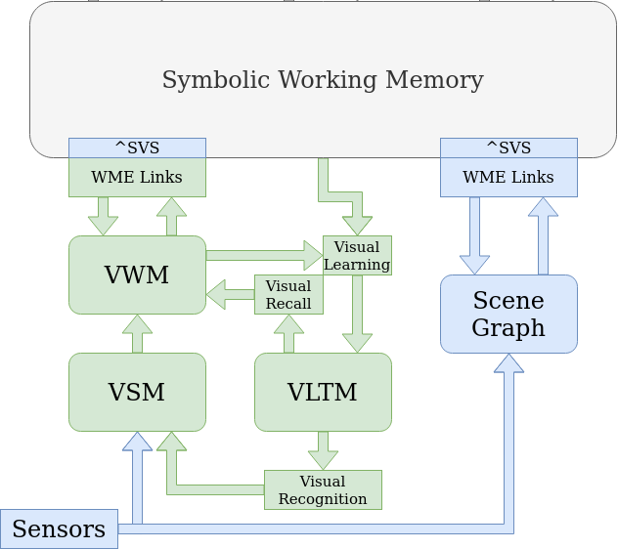
Scrapsheet
a |  | R1 | a
b |  |  | b
c |  |  | c
d |  |  | d
a |  | R2 | a
b |  |  | b
c |  |  | c
d |  |  | d
1 | e |  | e | 1
2 |  |  |  | 2
3 |  |  |  | 3
4 |  |  |  | 4
a |  | R3 | a
b |  |  | b
c |  |  | c
d |  |  | d
e |  |  | e
f |  |  | f
a |  | R4 | a
b |  |  | b
c |  |  | c
d |  |  | d
e |  |  | e

Slide 26
Motivating Example
Imagine “WOW”
What letters look like
Their order
Mental visualization
Turn it upside-down
Mental image to target
Knowledge of “turn it upside-down”
Ability to rotate/mirror mental image
Parse “MOM”
Recognize letters
Get letter spatial relationship
Know letters make words
Know “MOM” is a word
Last time spouse seen
Know spouse of mom is dad
Have episodic recall retrievable by element

Slide 27
Visual-Symbolic Integration
“Visual”
Ranges from “anything derived from vision” to “specifically the image-like representation received from vision”
here, means “image-like representations derived from vision”
“Symbolic”
Representations which encapsulate logical propositions and permit logical or relational operations
VSI:
Ability to use visual and symbolic representations (knowledge & reasoning) in conjunction

Slide 28
Cognitive architectures
Effect on world
Overarching goal: design a blueprint for cognition
Establish what are the necessary components and interactions for an intelligent agent?
Make commitments!
Implement agents in the CA, test what it can do, adjust CA
Ideal for testing how parts of cognition (e.g., vision!) interact
Acting
Decisions
Planning
Long-term memory
Short-term Memory
Learning
Goals
Perception

Slide 29
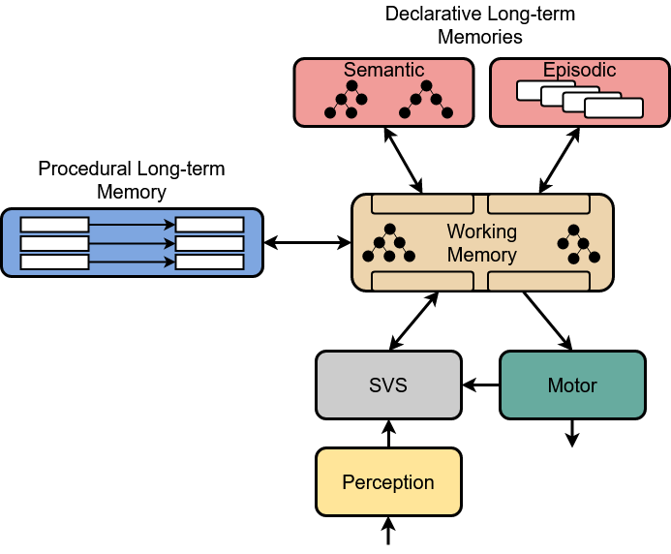
Background: Soar
A cognitive architecture, tries to emulate cognition in general (not specifically human!)
Core memories: working memory, procedural memory
Reasoning mechanisms
Atomic: procedural rules
Complex: operators, Soar Cycle
Declarative long-term memories:
EpMem
Smem
All knowledge represented symbolically

Slide 30
Motivating Example
WOW
spouse is
Notes:
Before I get into the meat of my work, here’s a motivating appetizer I’m sure you remember from my paper. First, I want you to imagine the word “WOW” in your head. Visualize the letters. Now rotate it 180 degrees. When was the last time you saw the spouse of that person? I’m sure you can all answer that question relatively easily, but it represents a problem which is challenging for AI systems today. Consider what you need to do in your head in order to answer the question. First, you have to visualize the word WOW, then rotate it. From there, you need to recognize that M-O-M is a new word, “MOM,” and that MOM can have a spouse. Then you need to think about who that spouse is and recall the last time you saw them.

Slide 31
Visual-Symbolic Integration
What does “visual” mean?
Broader
Narrower
“Anything that derives from vision”
“Exactly what is provided by visual sensors”
Image-like
Not just spatial
Groundable
There are three blocks above the table
Block 1 is orange and 5cm x 5cm x 5cm
Block 2 is blue and 7cm x 4cm x 8cm
Block 3 is green and 3cm x 2cm x 4cm
Block 1 is on block 2
Block 2 is on the table
Block 3 is on the table
Notes:
So, what does visual-symbolic integration actually mean? Well, I’ve already discussed symbolic representations, so what’s left is “visual” and “integration.” Let’s start with nailing down “visual,” a term which has a wide range of meanings. The focus on this work is on
Some have construed it very broadly to include any information which derives from vision, for example these symbolic statements about blocks on a table. Others restrict it to exactly the data captured by visual sensors, and use “mental imagery” or similar for internal image representations. This work falls somewhere in the middle, but more narrow than broad. A visual representation is, first and foremost, image-like in nature. I’ll define that more specifically shortly. It’s also more than spatial data. Although spatial information can be implicitly or explicitly represented, other visual, non-spatial aspects like color or texture also must be included. Finally, as I mentioned earlier

Slide 32

Visual Character Domain
Visual Inputs
WOW -> MOM
Other Tasks
“What character is this?”
“What does an ‘o’ look like?”
“What does this character look like upside-down?”
“What other character does this one look like upside-down?”
“What does this word mean?”
Notes:
As it turns out, the WOW to MOM example isn’t the only situation in which solving a task needs both symbolic and visual reasoning, not by a long shot. That example is actually just a subset of a new task domain I’ve developed: the visual character domain. In the VCD, an agent can be given visual inputs in the form of alphanumeric characters and symbolic inputs in the form of questions. The agent then has to answer the given question given its current visual input and learned visual and symbolic knowledge. The wow example is one such task, but there are plenty of others, ranging from questions as simple as “what character is this?” to complex tasks requiring the agent to understand words. The crux of this domain is the dual nature of characters as both visual and symbolic representations. An agent can’t (easily) solve tasks in this domain without the ability to reason about the shape and form of the characters as well as the meaning and semantics of the characters.

Slide 33
Visual-Symbolic Integration
What does “integration” entail?
Ability to use visual and symbolic representations (knowledge & reasoning) separately and in conjunction.
Notes:
Assuming that the term symbolic is fairly clear, what remains is to consider what it means for visual and symbolic knowledge and reasoning to be “integrated.” At a high level, it means that symbolic and visual knowledge representations are tightly linked, so that one can be used to retrieve the other from memory, and that symbolic and visual reasoning processes can make use of either representation of knowledge.

Slide 34
Soar
Semantic Memory
Episodic Memory
Working Memory
Procedural Memory
Spatial Scene
Notes:
Since Soar was used as the foundation for this project, a brief overview is in order. At the core of Soar is working memory, a short-term memory which, together with procedural memory, is the core of Soar’s reasoning capabilities. Working memory is composed of symbols called working memory elements organized into a graph structure. Through flexible if-then rules stored in procedural memory, an agent can create complex symbolic structures which allow it to model and reason about the world. I go into more detail about how this works in my paper. The semantic and episodic memories are long-term memories with different functionalities. Semantic memory stores knowledge about the world which needs to be stored more permanently than working memory allows. Episodic memory stores “episodes,” basically snapshots of working memory at different points of the agent’s lifetime.
The three long-term memories are colored blue; working memory and the spatial scene are short-term memories and green here.

Slide 35
SVS 2 Changes
Spatial Scene:
Unchanged
Visual Buffer:
Renamed “Visual Sensory Memory”
No longer place for image manipulation
Perceptual LTM:
Replaced with “Visual Long-Term Memory”
Added means of storage and retrieval
Created Visual Working Memory

Slide 36

Motivational Insight
Intelligent action requires visual & symbolic reasoning in concert:
 |  | From
 |  | Visual | Symbolic
To | Visual
 | Symbolic
WOW
WOW
DAD
WOW
MOM
MOM
spouse-of dad
parent-of me
Notes:
So what insight does this example give? It shows us that visual and symbolic knowledge and reasoning must work in concert for at least some tasks. Sticking with the wow to mom example, we can see visual and symbolic knowledge interacting in various ways. In the top left example, visual reasoning is used to transform visual knowledge of W-O-W into new visual knowledge of its rotated form. Below that, visual and symbolic reasoning are both used to turn that new visual knowledge of “wow” upside-down into a symbolic representation of the word “mom.” Then, in the bottom right, that symbolic representation is used by symbolic reasoning to retrieve other symbolic knowledge about the word mom. In the top-right corner, the symbolic knowledge that the spouse of mom is dad is used to generate a visual image of dad, in order to aid episodic recall.

Slide 37
VSI Requirements
R1: Visual representations
R2: Multi-representational knowledge
R3: Multi-representational reasoning
R4: Visual & symbolic learning
Notes:
To be more specific, I have created a list of 4 high-level requirements, each composed of a handful of sub-requirements, which an intelligent system or agent needs to meet to be visually-symbolically integrated. The first major requirement focuses on the nature of the visual representations used by the system, the second focuses on cross-representational knowledge, the third on cross-representational reasoning, and the fourth dictates that the system should be able to learn both symbolic and visual knowledge and reasoning methods.

Slide 38
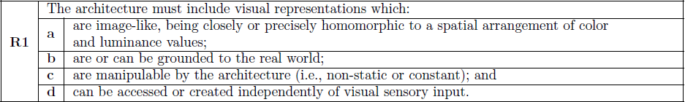
R1: Image-like representations
a) should be able to recover images from visual representations
b) vision is largely about seeing what’s going on around the agent
c) agent needs to be able to think about how things change/combine
d) want to be able to imagine things while still seeing

Slide 39
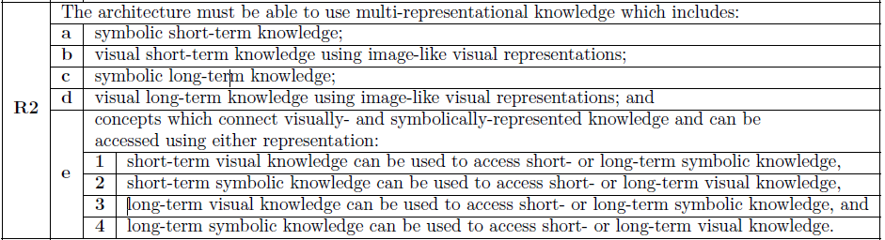
R2: Multi-representational knowledge
a – d) needs short- and long- term memories for both knowledge representations
e) agent knowledge should be able to span both representations

Slide 40
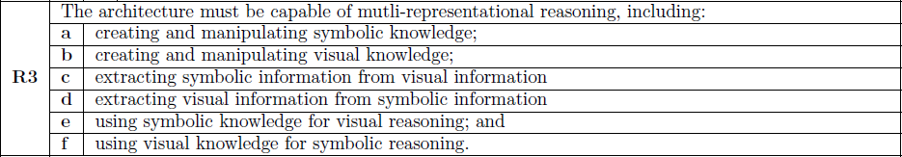
R3: Multi-representational reasoning
a – b) needs to be able to use either kind of knowledge while reasoning
c – d) should be able to get one kind of knowledge from the other using reasoning
e – f) should be able to use one kind of knowledge when reasoning on the other

Slide 41
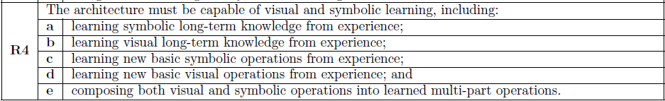
R4: Visual & symbolic learning
a – b) needs to be able to learn knowledge in either representation
c – d) needs to be able to learn new ways to manipulate either kind of knowledge
e) task and action learning must be able to include both kinds of reasoning

Slide 42





Symbolic Representation
B1
T1
B2
D2
Parser
B3
D4
B3
B2
B1
D7
“G”
“O”
“B”
C1
C1
R1
P1
P2
…
P128
R2
P129
P130
…
P256

Slide 43







Soar & Symbolic Representation
B1
G1
B1
0,1
1,0
1,2
2,1
R2
R3
E1
E2
A1
A2
F1
10
F2
15
S1
S2
win
Notes:
This kind of representation is relatively simple but really quite powerful. Soar, for example, has been used to make agents in a wide variety of domains, from games to robotics to military simulations. Importantly, symbolic representations allow a single agent to easily operate in many different domains. For example, James Kirk, who recently graduated from the Soar lab, showed that a single Soar agent can be interactively taught 60 games, using its existing knowledge of games to make learning future games significantly faster. The power of symbolic representations comes from their simplicity and composability. Since symbols and symbol structures don’t have inherent meaning, and since symbols can be combined arbitrarily to create more complex structures, they can be used to represent nearly anything, regardless of the domain or sensor. This means an agent can learn quickly (even one-shot or no-shot), can do complex planning, reasoning, and inference, and can explain its beliefs and actions.

Slide 44
SVS 2
Notes:
This, then, is where my research comes in. I

Slide 45
Visual Sensory Memory
Purpose:
Holds visual input from sensors
Enables easy separation between mental and perceptual imagery
Representation:
Highly-detailed, highly-grounded
Copy of input image
Indicates in WM when image is updated
Manipulation & reasoning:
No manipulation of image, no writing to VSM
Copy latest input to VWM

Slide 46
Visual Working Memory
Purpose:
Holds short-term visual knowledge
Center of visual reasoning: enables imagination, composition, manipulation, and reasoning
Representation:
Graph structure of Visual Working Memory Elements
Edges between WMEs are relational: indicate how WMEs combine (translation, rotation, scale, etc.)
Moderately abstracted
Manipulable by visual operations
Manipulation & reasoning:
Operations which mutate a VWME directly (non-compositional)
Operations which combine VWMEs into a new VWME (compositional, edges)

Slide 47
Visual Working Memory Elements
Purpose:
Holds an item of short-term visual knowledge
Enables VWM to compose and manipulate visual knowledge
Connects short-term visual knowledge to short- and long-term symbolic knowledge
Representation:
Leaf VWMEs represent basic (atomic, non-composed) visual knowledge
Non-leafs compose other VWMEs
Both are image-like, both have paired symbolic WME

Slide 48
Visual Perceptual Archetypes
Purpose:
Store an item of long-term visual knowledge
Connect visual long-term knowledge with symbolic short- and long-term knowledge
Allow visualizing and composing of visual knowledge by VWM
Representation:
Collection of Visual Perceptual Archetypes
Can create, update, retrieve VPAs
Unlike SMem, VWM, is not graph-structured

Slide 49
What CAs Can Do
T1
B3
B2
B1
“G”
“O”
“B”
B1
B1
0,1
1,0
1,2
2,1
R2
R3
F1
10
F1
15
win
Notes:
Fundamentally, this research is about filling a gap in Soar in particular, and in the space of cognitive architectures more generally. Before I talk about what Soar couldn’t do prior to this project, though, it’s probably a good idea to highlight what it could do in order to motivate why it’s worth extending Soar in the first place. Soar is a cognitive architecture, a sort of blueprint for cognition designed to enable the creation of intelligent agents. I’ll get more into the way Soar works later, but at its core, Soar is a symbolic system. That means it uses symbols to represent knowledge, goals, actions, and nearly everything else it uses for intelligent action. In this context, a symbol is a “mental” pointer which represents some real object within the agent’s memory, and thereby allows the agent to reason, plan, and act in reference to that object. By composing symbols into structures according to a set of rules, an agent can model an infinite variety of scenarios and problem spaces. On the left, the symbols represent blocks on a table, indicating their spatial relationships and colors. In the center, an agent is using a symbolic model of tic-tac-toe to devise a winning strategy. And on the right, an agent controlling a robot is planning how to retrieve some food from the fridge. All of these domains, and many more, have been successfully accomplished by Soar agents thanks to the power of symbolic representations and reasoning.

Slide 50
What Soar Can’t Do
C1
C1
R1
P1
P2
…
P128
R2
P129
P130
…
P256
T1
Parser
B3
B2
B1
“G”
“O”
“B”
Notes:
Yet this strength is also a major weakness: symbolic systems are most effective when the knowledge they have is abstracted away from sensor inputs. In order to represent a picture with perfect accuracy, a symbolic system would need to create a cumbersome representation with symbol structures for each pixel, row, and column, and countless relations between them. As you can see, the top representation is essentially just a more complicated version of a normal bitmap. So most symbolic systems use an intermediate module to parse sensory inputs like vision into simplified symbol structures. The problem is, this doesn’t leave the agent with any internal visual representations, just abstract knowledge. This is fine in some cases, but many tasks need the agent to be able to reason visually as well as symbolically.

