Slide 1
Multiple Source Knowledge in Soar for Atari Games: Initial Thoughts
John Laird & Bob Wray
University of Michigan and Center for Integrated Cognition
June 14, 2021
2021 Soar Workshop

Slide 2
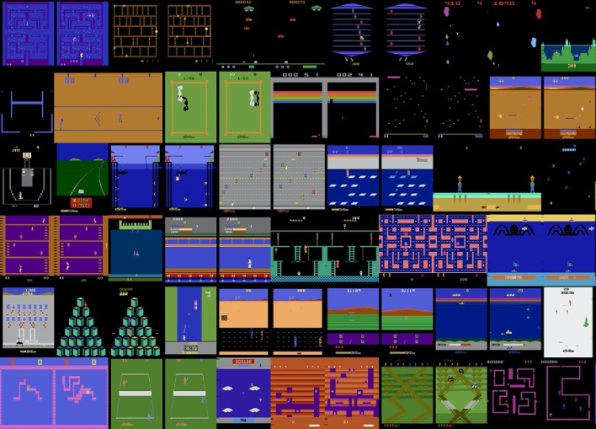
Atari 2600 Learning Environment (ALE) 57 Atari 2600 Games

Slide 3
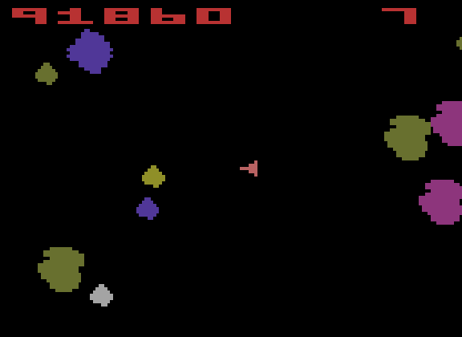
Example Atari Game
https://www.youtube.com/watch?v=igR-uo8frtQ

Slide 4
Atari 2600 Learning Environment (ALE) 57 Atari 2600 Games
“(i) varied enough to claim generality,
(ii) each interesting enough to be representative of settings that might be faced in practice, and
(iii) each created by an independent party to be free of experimenter’s bias”
Evaluate on human normalized scores (HNS)
Bellemare, Marc G., Yavar Naddaf, Joel Veness, and Michael Bowling. “The Arcade Learning Environment: An Evaluation Platform for General Agents.” Journal of Artificial Intelligence Research 47 (June 14, 2013): 253–79. https://doi.org/10.1613/jair.3912.
Notes:
REW: Added citation so that it is clear what is being quoted…

Slide 5
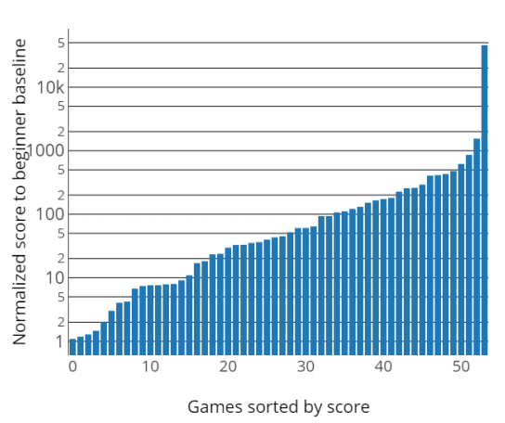
Evaluate on human normalized scores (HNS)
“Despite the human baseline scores potentially underestimating human performance relative to what is possible.” –Agent57 paper
HNS = 100 x (agent score – random score)/(human expert score – random score)
Underestimation of human world records by a lot!
“… for VideoPinball, the world record is 50,000 times higher than the human baseline …”
Toromanoff, Marin, Emilie Wirbel, and Fabien Moutarde. “Is Deep Reinforcement Learning Really Superhuman on Atari?” In Deep Reinforcement Learning Workshop of 39th Conference on Neural InformationProcessing Systems (Neurips’2019), 23. Vancouver, Dec.
Notes:
REW: you probably know this, but it took me a while to figure out. These are not the HNS scores. These are world record scores. Toromanoff recommends using these scores for the games with world record holders rather than the expert score used in Minh
In the Minh et al paper,
HNS = 100 x (agent score – random score)/(human expert score – random score)

Slide 6
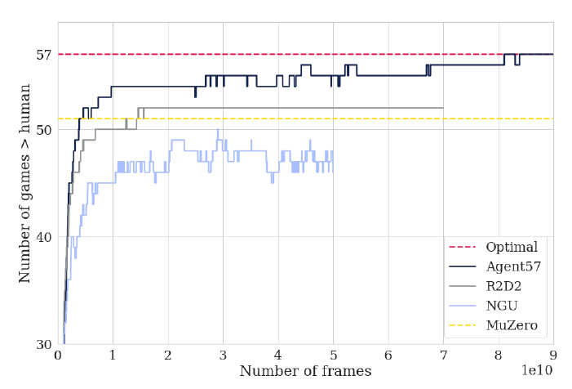
Performance of Different DeepRL agents
Hard?
Exploration required before any reward
Long-term credit assignment
Easy?
3-18 actions
Stable environments
Deterministic
State is 128-byte RAM (+ timers and registers)
10’s of billions frames

Slide 7
Deep Mind’s Agent57: Learns to Play 57 Atari Games
Exceeds human “expert” performance on all games.
DeepRL with intrinsic reward (novelty), meta-controller, …
Learns from scratch.
Learns only a single game at a time – no transfer or reuse.
Takes lots of interactions with a game
Asteroids: 4 Billion frames; Skiing: 78 Billion frames
1 Billion frames @60 fps = ~4,600 hours = 190 days
Does not handle small game variations (shift paddle one pixel)
https://deepmind.com/blog/article/Agent57-Outperforming-the-human-Atari-benchmark
Notes:
Delayed reward – only get score at end of a ski run.
570 days if 8 hours/days.
REW: I read thru the blogpost and scanned the paper but I cannot tell if these play the full game or just 5m of the game as the original DeepMind agents did? I don’t yet understand how the HNS is computed and what it derives from – is the HNS just based on the professional game player that was used in the original Atari paper?

Slide 8
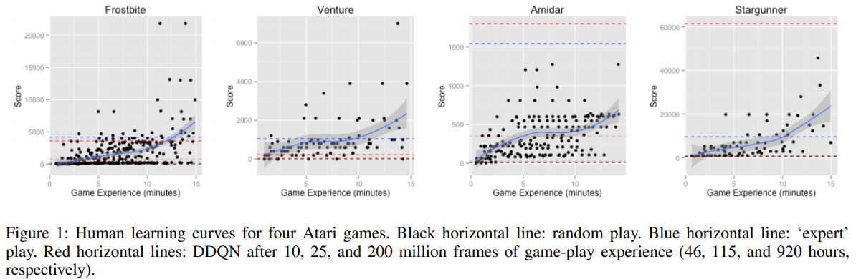
Human Learning: 15 minutes
Human performance is above random performance within the first minute of play;
In 3/4 games, humans reach ‘expert’ performance within the allotted 15 minutes (on Amidar they are well on their way);
In all games, humans exceed the DDQN’s 10- and 25-million-frame score within just a few minutes;
In Frostbite and Venture humans exceed even the DDQN’s asymptotic performance
Tsividis, Pedro A. et al. "Human learning in Atari." 2017 AAAI Spring Symposium Series, Science of Intelligence: Computational Principles of Natural and Artificial Intelligence, Technical Report SS-17-07 (2017) © 2017 Association for the Advancement of Artificial Intelligence.
Notes:
From the paper:
human performance is above random performance within the first minute of play;
in three out of the four games, humans reach ‘expert’ performance within the allotted 15 minutes(on Amidar they are well on their way);
in all of the games, humans exceed the DDQN’s 10- and 25-million-frame score within just a few minutes;
in Frostbite and Venture humans exceed even the DDQN’s asymptotic performance

Slide 9
Our Goal: Human-like Learning
Single system learns and plays “all” the games
Well maybe only 10–15. Include some of the hard ones…
Transfer between games!!!!
Learning at same rate as humans
1-2-3 orders of magnitude faster than Agent57?
Learn to play well in a few hours; expert-level performance level in weeks?
Understand contribution of different learning mechanisms
Especially as relate to human learning characteristics (speed, strategies, …)
Learn more stable solutions: Robust to small variations in domain
Explain what it is doing (icing on the cake).
Why not do something useful?
If we can do this, it will have a big impact.
Contribution of different capabilities should be clear.
Notes:
REW: I added the idea of capturing other regularities/characteristics of human learning. It’s not just the “never played the game before” learning rate we would want to go after, but also some of the other things we know about, like the impact on observation on initial playing capability.

Slide 10
Development Methodology
Create 2-3 game agents by hand (yes!)
Becomes an interesting baseline.
Industrial quality code.
Probably create (multiple?) front-ends for parsing screen.
Create varying capabilities that can be swapped in and out.
Measure learning time to reach a certain criteria (score = )
Document and measure different types of knowledge that get used
Before and after training on other games
…
Might have to do human studies…

Slide 11
Agent Methodology: ”Cheat!” Multi-source Knowledge
Not everything will be learned by experience: RL is not enough!
But still all in a single running agent: Rosie 2.0
Innate knowledge (priors…)
Game instructions
Experience: RL + ???
Observation/Demonstration
Interactive instructions
Use Means-Ends Analysis and subgoals!
Notes:
REW: Im not sure I would characterize this as “cheating”. Another way to say this is that we want to create a context for the agent to learn that is reasonably comparable to the context that a human who’s never seen Atari (and maybe not seen a lot of video games) would have, but without having to encode a lot of knowledge that is relevant but very abstract for the task (like qualitative physics).

Slide 12

Innate Knowledge
Code to “parse” the video frames into important areas
Could be learned with NN or hand-coded.
Shared with human coded agents?
Atari-game Core (Common Sense) Knowledge
Simple 2D physics for objects
Qualitative physics (Forbus)
Simple knowledge of avatar control
…
More complex real-world knowledge: fuel, treasure, …
Mapping of words (“key”) to game objects ( )
Will incorporate in SVS 2.0!
Notes:
REW: Is the examples I added in the last bullet what you are thinking by this?

Slide 13
Innate Knowledge
“Atari games are designed for human players, so they rely on implicit prior knowledge. This will give a human player information on actions that are probably positive, but with no immediate score reward (climbing a ladder, avoiding a skull, etc.). The most representative example can be seen in River Raid: shooting a fuel container gives an immediate score reward, but taking it makes it possible to play longer. Current general RL agents do not identify it as a potential bonus, and so die quickly. Even with smart exploration, this remains an open challenge for any general agent.”
Toromanoff, Marin, Emilie Wirbel, and Fabien Moutarde. “Is Deep Reinforcement Learning Really Superhuman on Atari?” In Deep Reinforcement Learning Workshop of 39th Conference on Neural InformationProcessing Systems (Neurips’2019), 23. Vancouver, Dec.

Slide 14
Game Instructions
“If people’s rapid learning is due to the formation of a model-like representation, then anything that would enable them to learn this representation should result in an increase in early performance.”
Human experiment suggests reading instructions leads to performance that corresponds to about 5 minutes of play.
Human Learning in Atari, Tsividis, et al. 2017.

Slide 15
Game Hints
Hint for Skiing: “Minimize total time.”
Asteroids:
“As each wave begins, all the asteroids are large. Point your ship to the closet asteroid and fire.
Once you have destroyed all asteroids on that side of the field, rotate your ship and blast away at the other side.
Destroy the small asteroids before shooting any large or medium asteroids.”
Asteroids (Atari 2600) (How To Beat Home Video Games 1)

Slide 16
Learning from Experience
Symbolic RL learning
The Atari57 agent encodes various explore/exploit strategies. What are the comparable strategies in Soar?
Hierarchical RL learning
Need to have system “discover” need for abstract operators.
Might be from instruction…
Episodic learning!
Notes:
REW: Added the note about explore/exploit
REW: I also added episodic learning. Im not sure the extent to which we would go down this path, but it seems possible. Im also thinking about the benefits of watching someone else play, which has an immediate impact on players (as in the next slide ;).

Slide 17
Learning by Observation
“Humans’ ability to form a theory-like representation of the game should also be aided by observing others play.”
Note lots of work in DeepRL on learning by observation.
In human experiment, observation results in new players initial performance matching the performance of non-observing players after ~5m

Slide 18
Interactive Instructions
Pointing and naming
“This is a key.”
“This is a ladder.”
Point out important object to go to.
“Pick up the red object.”
Actions to take
“If you see a ladder, you can climb it.”
“If you see a monster, avoid it.”
Connections between goals and subgoals
“To open the door, you need a key.”

Slide 19
Changing the Game
Deep RL agents are fragile: Unable to respond to changes in the game
Our expectation/intuition is that human players can easily do this
Change game layout – move objects, walls, object colors, …
Change when get points – but strategy should stay the same
Change actions – remove auto-pickup or add it.
Might be hard to do this in most games
Will explore these game variants for agents learning to play the game
Are Soar agents adaptable to new tasks within games?
How do various knowledge and learning configurations interact with the adaptability of the agents?
Notes:
REW: Added this slide based on the ideas we had in the NG paper

Slide 20
Conclusion
No Funding! But looking…
Looking for volunteers and potential collaborators!
Notes:
REW: We especially could use some input about encoding the game in Soar – this is a roadblock for getting started. Maybe not something to put in the slides, but consider saying it.

Slide 21
Maybe in a few years…
“Hi John, I want to play a game.”
Let’s play Pong.
“I don’t know that game.”
It’s like Breakout without bricks.
“It has a paddle and a ball?”
“I see two paddles but no ball.”
“But the paddles are on the sides and not the bottom.”
Yes, you control the paddle on the right side of the screen.
“Yes, I can move the paddle up and down.”
“What is the goal?”
To keep the ball from going past your paddle.
“That is one of the goals in Breakout.”
“I’m ready to play.”

