Slide 1
A Model of Working Memory with Attention
Peter Lindes
University of Michigan
plindes@umich.edu
Soar Workshop
14 June 2021

Slide 2
Embodied
Comprehension
Comprehension Engine
Action Module
Messages
Language Knowledge
Grounding
World Knowledge

Slide 3
End-to-End
Comprehension

Slide 4
Incremental
Processing
Construction Cycle
1 or more per word
Choose the next construction
Add it to the comprehension state
Connect it to world knowledge
Select
Integrate
Ground
Lexical and composite versions
Our Focus
Immediate
Interpretation

Slide 5
General Cognitive Mechanisms
Declarative to Procedural Knowledge
Knowledge of Language
Processing Knowledge
Shared World Knowledge
Compre-hension State

Slide 6
The problem:
Composite Selection
Retrieval of composite constructions:
A structure in working memory
Many patterns to match in semantic memory
The solution:
Attention in working memory
Breadth retrieval

Slide 9
Composite Selection
Semantic Memory
Attention in WM
Working Memory
BLA in WM

Slide 10
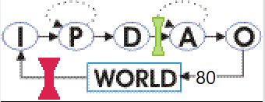
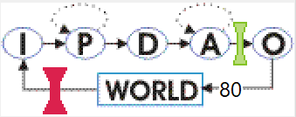
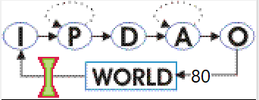
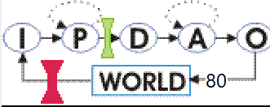
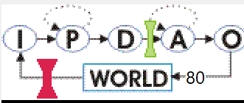
Select for Precise Fit
Propose query
80: O: O103 (cxn-query)
Make query
(L15 ^command C4 ^result R10)
(C4 ^attention L189 (P) ^breadth 6 ^depth 1 ^query Q22)
(Q22 ^cxn-name X15 ^span X16)
DVTT[V(0.5), P(1.0)] => 1.5
REPP[R(0.5), P(1.0)] => 1.5
RIPP[R(0.5), X(0.0), P(1.0)] => 1.5
IOR[X(0.0), R(0.5), P(1.0)] => 1.5
RNPP[R(0.5), X(0.0), P(1.0)] => 1.5
IWL[X(0.0), P(1.0)] => 1.0
Get results
acceptables:
O105 (build-cxn) + :I [level 2]
O104 (no-cxn-found) + :I [level 2]
betters:
O105 (build-cxn) > O104 (no-cxn-found) :I [level 2]
Propose precise fits
Preferences,
Operator selected
81: O: O105 (build-cxn)
(O105 ^part-1 L189 (P) ^part-2 L16 (V)
^retrieved L258 (DVTT) ^span 2)

Slide 11
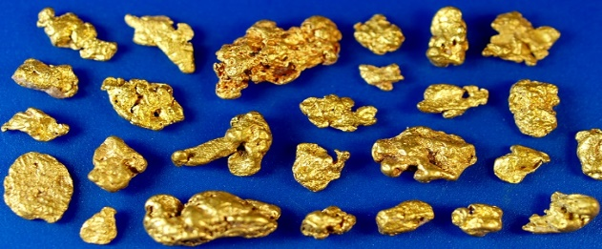
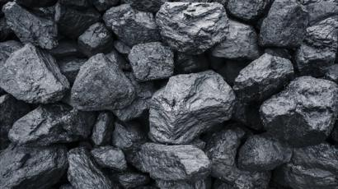
Nuggets and Coal
Retrieval of composite constructions
Attention as a possible model of human working memory
Breadth retrieval enables real-time
Models structural distance principle
Need to test on more sentences
Parameter values are arbitrary so far

Slide 12
Lexical Selection
shot
Money
bank
(billiards)
Context
(billiards)
canoe
River
bank
Semantic Memory
(river)
Context
(river)
check
Airplane
bank
(money)
Context
(money)
plane
Take the canoe down to the bank.
Take the check down to the bank.
Put the plane in a bank.
Bounce your shot off the bank.
(airplane)
Billiards
bank
Context
(airplane)
Money
Working Memory
CHECK
(money)
BANK
(money)
Take the check down to the bank.

Slide 13
Incremental
Processing
Construction Cycle
Word Cycle
Start Sentence
Next Word
Select Lexical
Select Composite
Format Message
?
?
Done
Integrate
Our Focus
Immediate
Interpretation
Ground

Slide 14
Why do we need working memory attention?
“the computational rules of language ignore the very simple property of minimal linear distance and keep to the much more complex property of minimal structural distance.” (Chomsky, 2017, p. 298)

Slide 15
Pick up the green block on the stove.

Slide 16
Pick up the green block on the stove.

Slide 17
Composite Selection
Semantic Memory
Working Memory

