Slide 1
The PROPs Development Kit for Building Soar Agents
Bryan Stearns
University of Michigan
June 2021

Slide 2
For Discussion
Purpose of this talk:
Starting to develop a Soar programming tool
Based on thesis research
I’ll describe basics of the plan
Do you think it would be useful?
What challenges or considerations do you see?

Slide 3
Thesis Work
Built the PROPs system
Task-independent
Models human procedural learning
General symbolic task representation
Change agent task behavior by changing SMEM only
Simpler to program than full Soar agent
Provides heavy-lifting of managing states and operators

Slide 4
PROPs Development Kit
Proposed
Reduced version of PROPs agent
Remove impractical features for human modeling
Still a library of agent rules that do heavy lifting
Programmer defines:
Fundamental task conditions
Fundamental task actions
Compositions of these for operator proposals/actions
Arrangement of operators for problem spaces

Slide 5
Normal Soar Programming
sp {propose*move-block
(state <s> ^space <sp1>
^space <sp2>)
(<sp1> ^top-block {<b> <> |empty|})
(<sp2> ^top-block |empty|)
-->
(<s> ^operator <o> +)
(<o> ^name |move-block|)
}
sp {apply*move-block
(state <s> ^operator.name |move-block|)
(<sp1> ^top-block {<b> <> |empty|})
(<sp2> ^top-block |empty|)
-->
(<sp1> ^top-block <b> -
^top-block |empty|)
(<sp2> ^top-block |empty| -
^top-block <b>)
}

Slide 6
PDK Programming
Separately define:
Conditions
Operator
Actions
Can reuse written
components
(<s> ^space <sp>)
(<sp> ^top-block {<b> <> |empty|})
(<sp> ^top-block <b> -
^top-block |empty|)
(move-block)
(<s> ^space <sp2>)
(<sp2> ^top-block |empty|)
(<sp2> ^top-block |empty| -
^top-block <b>)
Separable Conditions
(Proposal)
Operator
Separable Actions
(Application)

Slide 7
PDK Language
Higher-level language for operator structure
Named conditions/actions
(<s> ^space <sp>)
(<sp> ^top-block {<b> <> |empty|})
(move-block)
(<s> ^space <sp2>)
(<sp2> ^top-block |empty|)
PDK compiles code into
SMEM instruction
(op blocks-world*move-block
(condition top-block-nonempty <source-space>)
(condition top-block-empty <target-space>)
(action move-block <source-space> <target-space>) )

Slide 8
Program Problem Space
Bundle operators together
…
(pick-up-block)
…
…
…
…
(remove-block)
(move-arm)
…
…
…
Operator
…
(drop-block)
…
…
Substate Operators

Slide 9
Six Component Types
Problem Spaces
Conditions
Proposals
Operators
Applications
Other Elaborations
…
(pick-up-block)
…
…
(remove-block)
…
(move-arm)
…
…
…
(drop-block)
…
…
(<s> ^space <sp>)
(<sp> ^top-block {<b> <> |empty|})
(<sp> ^top-block <b> -
^top-block |empty|)
(move-block)
(<s> ^space <sp2>)
(<sp2> ^top-block |empty|)
(<sp2> ^top-block |empty| -
^top-block <b>)

Slide 10
Six Component Types
Problem Spaces
Conditions
Proposals
Operators
Applications
Other Elaborations
…
(pick-up-block)
…
…
(remove-block)
…
(move-arm)
…
…
…
(drop-block)
…
…
(probspace remove-block
(proposal pick-up-block)
(proposal move-arm)
(proposal drop-block)
)

Slide 11
Six Component Types
Problem Spaces
Conditions
Proposals
Operators
Applications
Other Elaborations
(condition top-block-nonempty
(state <s> ^space <sp>)
(<sp> ^top-block {<b> <> |empty|})
)
(<s> ^space <sp>)
(<sp> ^top-block {<b> <> |empty|})
(<sp> ^top-block <b> -
^top-block |empty|)
(move-block)
(<s> ^space <sp2>)
(<sp2> ^top-block |empty|)
(<sp2> ^top-block |empty| -
^top-block <b>)

Slide 12
Six Component Types
Problem Spaces
Conditions
Proposals
Operators
Applications
Other Elaborations
(proposal move-block
(condition top-block-nonempty <src>)
(condition top-block-empty <dst>)
(op move-block <src> <dst>)
)
(<s> ^space <sp>)
(<sp> ^top-block {<b> <> |empty|})
(<sp> ^top-block <b> -
^top-block |empty|)
(move-block)
(<s> ^space <sp2>)
(<sp2> ^top-block |empty|)
(<sp2> ^top-block |empty| -
^top-block <b>)

Slide 13
Six Component Types
Problem Spaces
Conditions
Proposals
Operators
Applications
Other Elaborations
(operator move-block <src> <dst>
(action clear-space <src>)
(action add-to-space <dst>)
)
(<s> ^space <sp>)
(<sp> ^top-block {<b> <> |empty|})
(<sp> ^top-block <b> -
^top-block |empty|)
(move-block)
(<s> ^space <sp2>)
(<sp2> ^top-block |empty|)
(<sp2> ^top-block |empty| -
^top-block <b>)

Slide 14
Six Component Types
Problem Spaces
Conditions
Proposals
Operators
Applications
Other Elaborations
(action clear-space <src>
(<src> ^top-block <b>)
-->
(<src> ^top-block <b> -
^top-block |empty|)
)
(<s> ^space <sp>)
(<sp> ^top-block {<b> <> |empty|})
(<sp> ^top-block <b> -
^top-block |empty|)
(move-block)
(<s> ^space <sp2>)
(<sp2> ^top-block |empty|)
(<sp2> ^top-block |empty| -
^top-block <b>)

Slide 15
Six Component Types
Problem Spaces
Conditions
Proposals
Operators
Applications
Other Elaborations
…
(pick-up-block)
…
…
(remove-block)
…
(move-arm)
…
…
…
(drop-block)
…
…
(elaboration prefer*move-arm
(condition proposed-move-arm <o1>)
(condition proposed-drop-block <o2>)
(action prefer-better <o1> <o2>)
)

Slide 16
Preference Rules
Simplified operator preference
(elaboration prefer*move-arm
(condition proposed-move-arm <o1>)
(condition proposed-drop-block <o2>)
(action prefer-better <o1> <o2>)
)
(condition proposed-move-arm <o1>
(state <s> ^operator <o1> +)
(<o1> ^name |move-arm|)
)
(action prefer-better <o1> <o2>
-->
(state <s> ^operator <o1> > <o2>)
)

Slide 17
Linked RHS Variables
Pass object references to actions
(<s> ^space <sp>)
(<sp> ^top-block {<b> <> |empty|})
(<sp> ^top-block <b> -
^top-block |empty|)
(move-block)
(<s> ^space <sp2>)
(<sp2> ^top-block |empty|)
(<sp2> ^top-block |empty| -
^top-block <b>)

Slide 18
Linked RHS Variables
Pass object references to actions
Conditions define variables
(action clear-space <src>
(<src> ^top-block <b>)
-->
(<src> ^top-block <b> -
^top-block |empty|)
)
(condition top-block-nonempty <sp>
(state <s> ^space <sp>)
(<sp> ^top-block {<b> <> |empty|})
)
(proposal move-block
(condition top-block-nonempty <src>)
(condition top-block-empty <dst>)
(op move-block <src> <dst>)
)
(operator move-block <src> <dst>
(action clear-space <src>)
(action add-to-space <dst>)
)

Slide 19
Downsides
More constrained agent design
Substates managed automatically (PRO+CON)
Less customizable
Topstate goal management, comparable to NGS
Potentially more complex coding?
Need to remember named conditions/actions

Slide 20
Visual Programming?
PDL could be used for drag-n-drop coding
…
(pick-up-block)
…
…
(remove-block)
…
(move-arm)
…
…
…
(drop-block)
…
…
(<s> ^space <sp>)
(<sp> ^top-block {<b> <> |empty|})
(<sp> ^top-block <b> -
^top-block |empty|)
(move-block)
(<s> ^space <sp2>)
(<sp2> ^top-block |empty|)
(<sp2> ^top-block |empty| -
^top-block <b>)

Slide 21
Compositional Coding
sp {propose*move-block
(state <s> ^space <sp1>
^space <sp2>)
(<sp1> ^top-block {<b> <> |empty|})
(<sp2> ^top-block |empty|)
-->
(<s> ^operator <o> +)
(<o> ^name |move-block|)
}
(proposal move-block
(condition top-block-nonempty <src>)
(condition top-block-empty <dst>)
(op move-block <src> <dst>) )
(condition top-block-nonempty <sp>
(state <s> ^space <sp>)
(<sp> ^top-block {<b> <> |empty|}) )
Vs.
sp {apply*move-block
(state <s> ^operator.name |move-block|)
(<sp1> ^top-block {<b> <> |empty|})
(<sp2> ^top-block |empty|)
-->
(<sp1> ^top-block <b> -
^top-block |empty|)
(<sp2> ^top-block |empty| -
^top-block <b>)
}
(operator move-block <src> <dst>
(action clear-space <src>)
(action add-to-space <dst>) )
(action clear-space <src>
(<src> ^top-block <b>)
-->
(<src> ^top-block <b> -
^top-block |empty|) )

Slide 22


Conclusion
Nuggets
SMEM task representation
Organization from composition structure
Automatic operator management
Reusable composition elements
Coal
Still under development
More constrained
Unnoticed Issues?
Worth it?

Slide 23
PROPs Development Kit
Bryan Stearns
Thoughts?

Slide 24
Backup Slides
Things the live audience didn’t get to see!

Slide 25
Condition/Action Programming
Could source conditions/actions as normal rules
PRO: Familiar Soar programming
CON: Need to learn framework conventions
sp {condition*top-block-nonempty
# Name the condition for PDK:
(state <s> ^instruction.condition <c>)
(<c> ^name |top-block-nonempty|)
# Actual condition test:
(<s> ^space <sp>)
(<sp> ^top-block {<b> <> |empty|})
-->
(<c> ^satisfied |true|) }

Slide 26
Condition/Action Programming
Generate with higher-level language
PRO: Programmer doesn’t need to remember conventions
PRO: More compact
CON: (Slightly) New syntax
sp {condition*top-block-nonempty
# Name the condition for PDK:
(state <s> ^instruction.condition <c>)
(<c> ^name |top-block-nonempty|)
# Actual condition test:
(<s> ^space <sp>)
(<sp> ^top-block {<b> <> |empty|})
-->
(<c> ^satisfied |true|) }
(condition top-block-nonempty
(state <s> ^space <sp>)
(<sp> ^top-block {<b> <> |empty|})
)

Slide 27
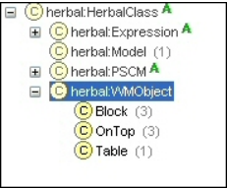
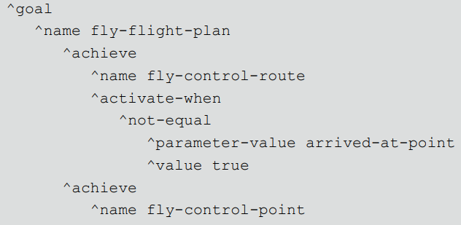
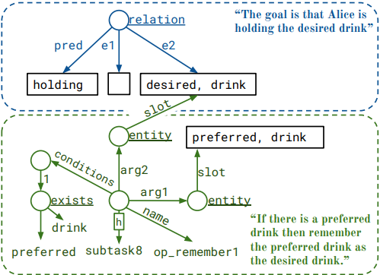
Related Work
Herbal
(Cohen et. al, 2005)
Compiles into rules, not SMEM
Built for much older Soar
RIDL
Reusable Intelligence Declarative Language
(Jones, 2012)
Declarative goal representations
XML-style coding
Not for encoding entire Soar agent
Rosie
(Mininger, 2021)
Declarative skill representation
Interactive (on-line) task learning
Includes general search/planning routines
Constrained to particular task / reasoning representation
Herbal
RIDL
Rosie
Cohen, M. A., Ritter, F. E., & Haynes, S. R. (2005). Herbal: A high-level language and development environment for developing cognitive models in Soar.
In Proceedings of the 14th Conference on Behavior Representation in Modeling and Simulation. 177-182. 05-BRIMS-044. Orlando, FL: U. of Central Florida.
Jones, R. (2012). Interpreted Declarative Representations of Task Knowledge. In Proceedings from the 32st Soar Workshop.
Mininger, A. (2021). Expanding Task Diversity in Explanation-Based Interactive Task Learning, Dissertation. University of Michigan.

