Slide 1
Modeling Cyberspace Operations
16 May 2018
Robert Bixler
Fernando Maymi

Slide 2
Motivation
Sophisticated threats
Train humans to counteract them
Build better automated defenses
Soar is being used to create cyber cognitive (cycog) agents
We model cyberspace operations using tactics, techniques, and procedures
Notes:
As threats become more sophisticated, countermeasures must become more sophisticated as well.
One approach is to train humans to counteract them, and another is to build better automated systems.
At SoarTech, we are using Soar to create cyber cognitive (or, cycog agents) that can aid in training humans by giving them a realistic adversary, but can also be used for
real cyber operations
So, how do we model cyberspace operations in a way that allows our Soar agent to both behave as a real threat for training purposes? We need to model operations in a way that facilitates both generating behaviors for humans to observe and reasoning about the current context of an ongoing operation by observing actions in the environment.
We’ve chosen to adopt a commonly used model of threat behavior patterns of tactics, techniques, and procedures

Slide 3
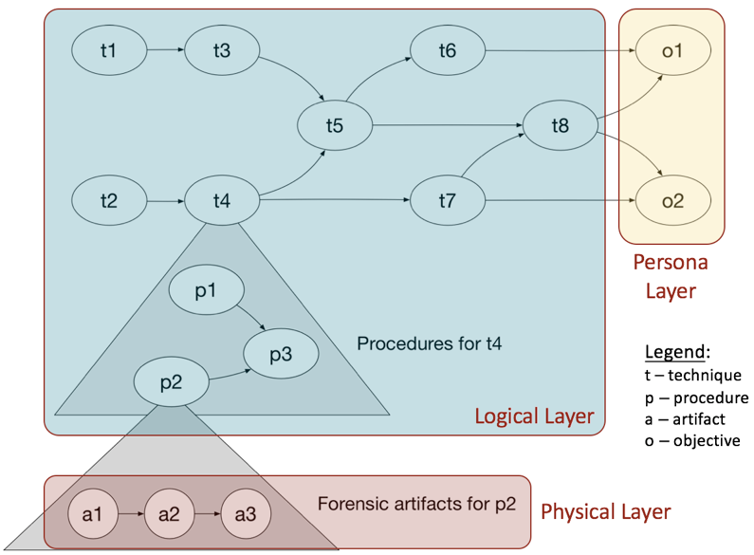
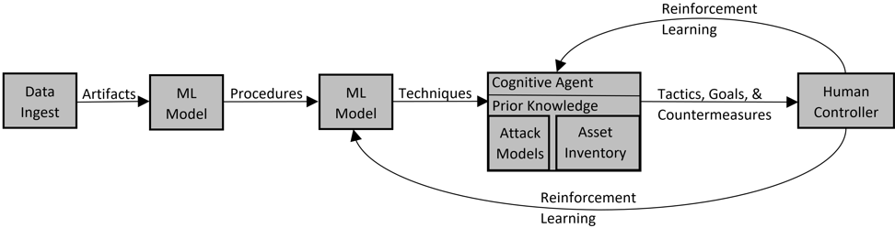
Tactics, Techniques, and Procedures
Tactic –employment and ordered arrangement of forces in relation to each other
Technique – non-prescriptive way to perform missions, functions, or tasks
Procedure – standard, detailed steps that prescribe how to perform specific tasks
Notes:
Here’s what this looks like from a high level.
A cyberspace operation is composed of tactics, which is an ordered arrangement of resources (such as a computer, or list of email addresses) and tactics.
Techniques are higher level tasks that are performed in order to accomplish an operation, such as “send email” or “create a fake malicious website”.
Procedures are the standard, detailed steps that prescribe how to perform specific tasks. Examples would be “write email” and “send email”.
Forensic artifacts are the evidence left behind by certain techniques. These would be what we are looking to generate in a training scenario, or to observe and build tactics, techniques, and procedures from in a defensive agent.
The problem is that the current definitions are imprecise and the current model is not defined well enough for use by autonomous systems. It is not currently implemented in a manner that can be easily ingested into Soar.
We need Soar agents that can reason about their current context, which requires the capability to ingest information from the environment and match it to expected behaviors, while also being able to take a given model of an operation and reproduce the observable artifacts associated with it. By modeling cyberspace operations as TTPs, we can accomplish this goal.

Slide 4
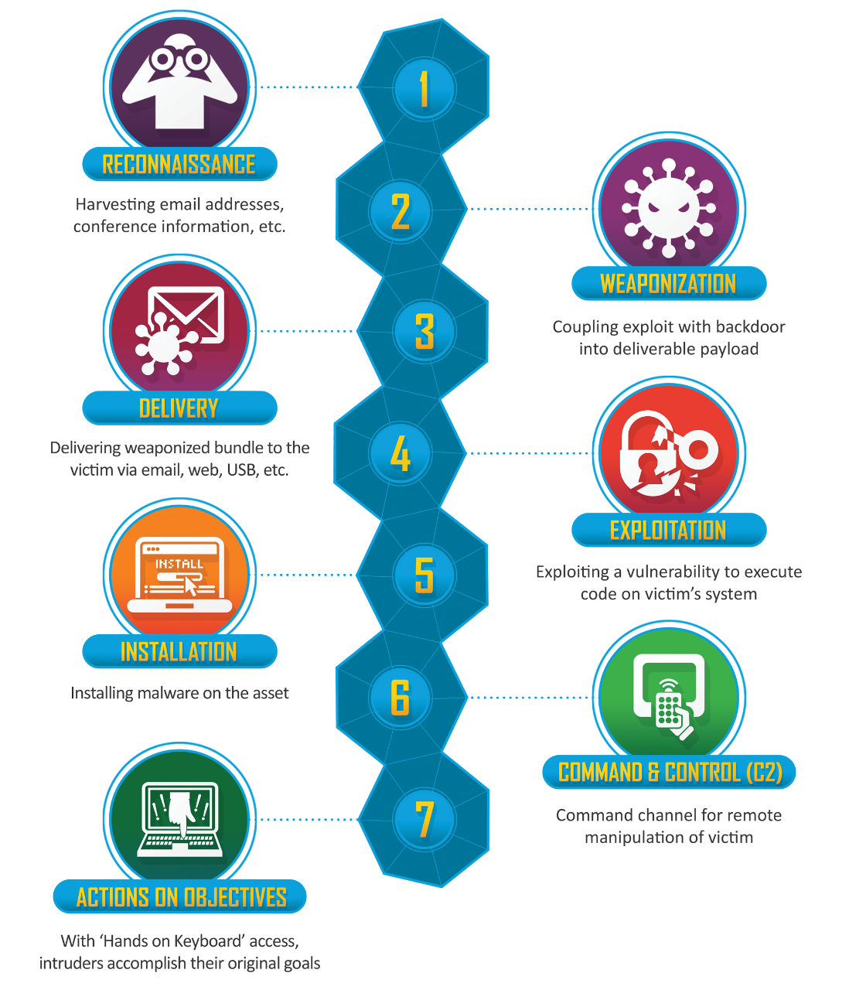
Cyber Kill Chain
Notes:
As another visualization of a cyberspace operation, here is the cyber kill chain. Certain techniques would fall under each of these steps. For example, sending a phishing email would be an example of the delivery.

Slide 5
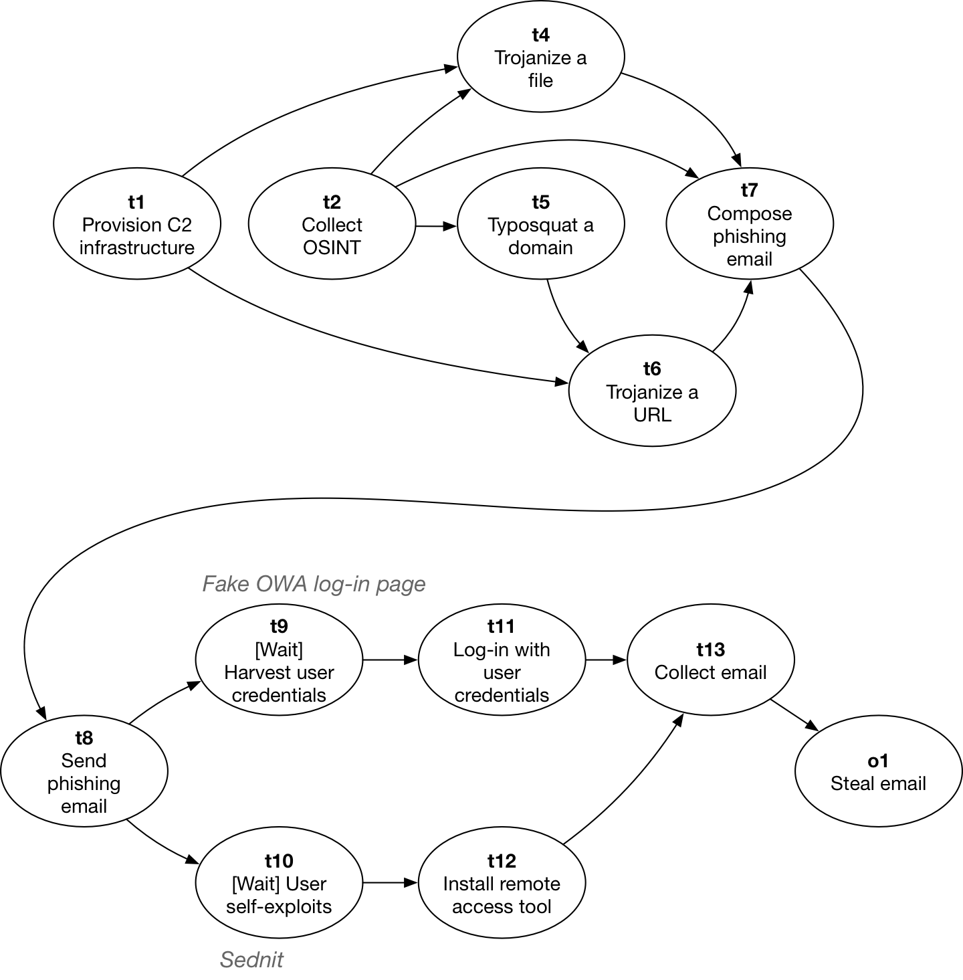
Operation Model
Notes:
High level map of an operation with specific techniques

Slide 6
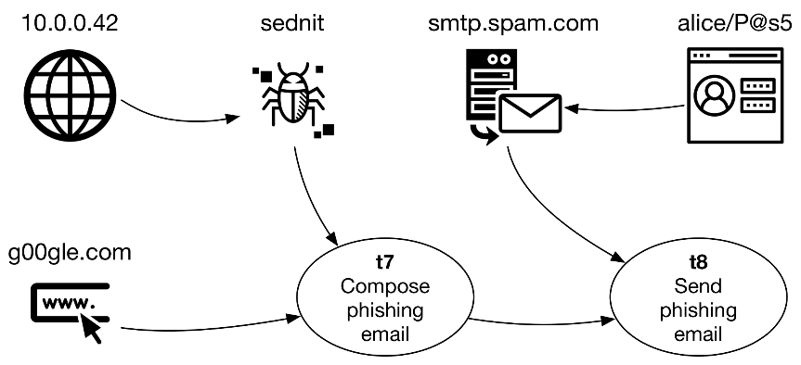
Operations
Operation: a directed graph of tactics and objectives
Notes:
Operation to steal secret formula (objective) and tactics to get there

Slide 7
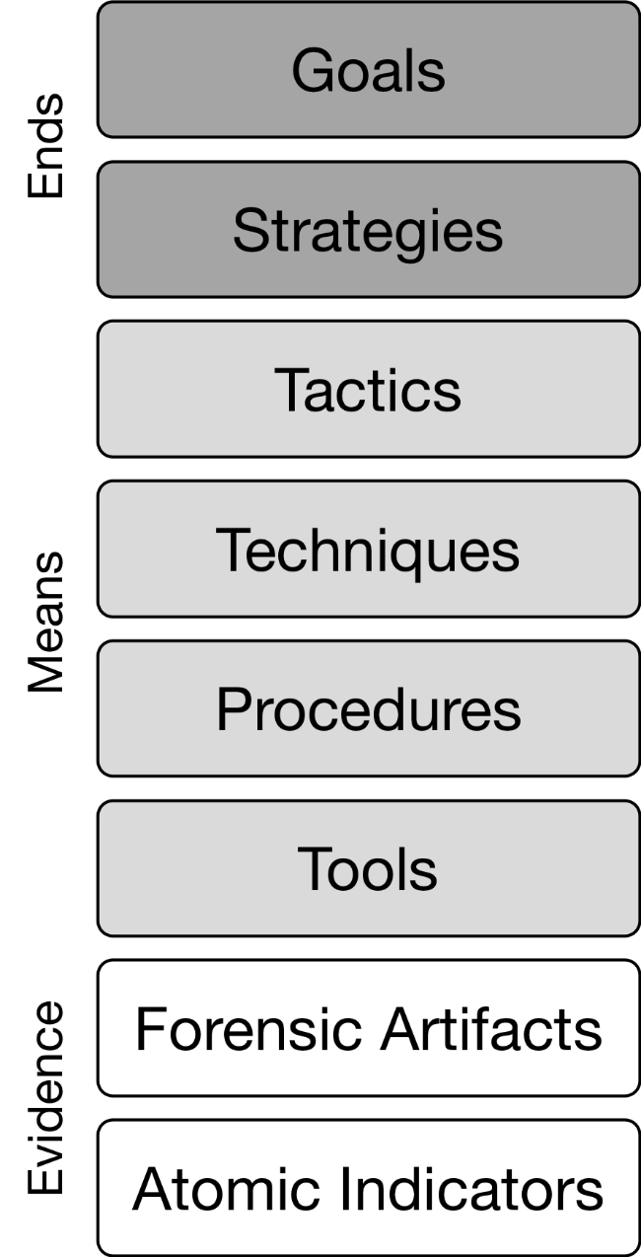
Tactics
Tactic: a directed graph of techniques and resources
Notes:
Specific tactic to send a phising email composed of techniques and resources

Slide 8
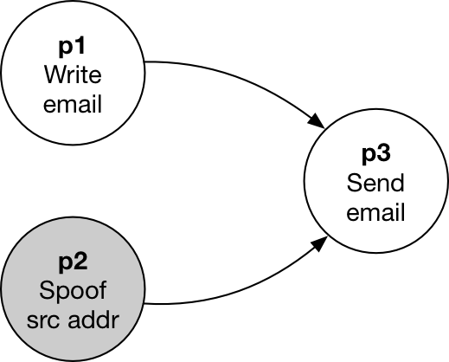
Techniques
Technique: a directed graph of procedures, some of them optional
Notes:
Specific example of the procedures in a send email technique

Slide 9
Procedures
ID: | p9
Name: | Drop netids.dll
Predecessors: | p5, p6, p7
Preconditions: | A process running with elevated privileges on a Windows host Network connectivity to the tool server
Parameters: | server_name – IP address or FQDN of tool server server_port – port number on tool server rem_file_name – name of file on tool server loc_directory – directory for local file
Steps: | Establish HTTPS connection to server_name on server_port Download rem_file_name and save it as netids.dll in loc_directory Execute netids.dll
Post-conditions: | netids.dll is executing with elevated privileges
Procedure: an algorithmic way to accomplish a task
Notes:
Standard, detailed step in specific task
Fixed, ordered, complete sequences of primitive actions
Procedures have a unique ID, stuff in table. Can be chained together. Represented as nodes in a DAG

Slide 10
Primitive Action
Primitive Action: atomic unit of process
ip source | ip dest | time
192.168.5.122 | 224.0.0.251 | 11:01:06.037
192.168.1.101 | 67.212.184.66 | 11:01:06.082
192.168.5.123 | 64.12.90.98 | 11:01:06.831
64.12.90.98 | 192.168.5.122 | 11:01:07.239
64.12.90.66 | 192.168.5.122 | 11:01:07.567
192.168.5.122 | 64.12.90.66 | 11:01:07.870
192.168.5.122 | 205.188.59.19 | 11:01:08.145
Notes:
Atomic unit, observable through forensic artifacts such as packets in pcap file
May differ based on system
CLI would have different actions than a GUI, for example.
More examples – instruction set for particular architecture, commands associated with network protocol (get/post)
Could be procedure in one system and action in another

Slide 11
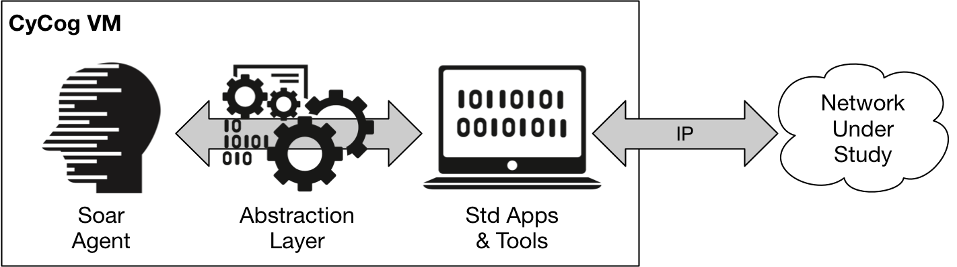
Soar Implementation
Techniques
Procedures
Tools
Forensic Artifacts
Notes:
Techniques line up with Soar Goals.
An abstraction layer allows the soar agent to perform procedures of that technique, and tools implemented in java (or any other language that can actually perform the action) perform actions that ultimately generate forensic artifacts.

Slide 12
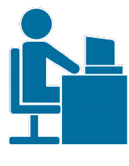
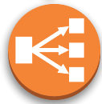
Soar Implementation
ML Classifier
Human Analyst
Tactics
Techniques
Procedures
Forensic Artifacts
Notes:
Reverse, detecting procedures and predicting future tactics based on observable artifacts

Slide 13

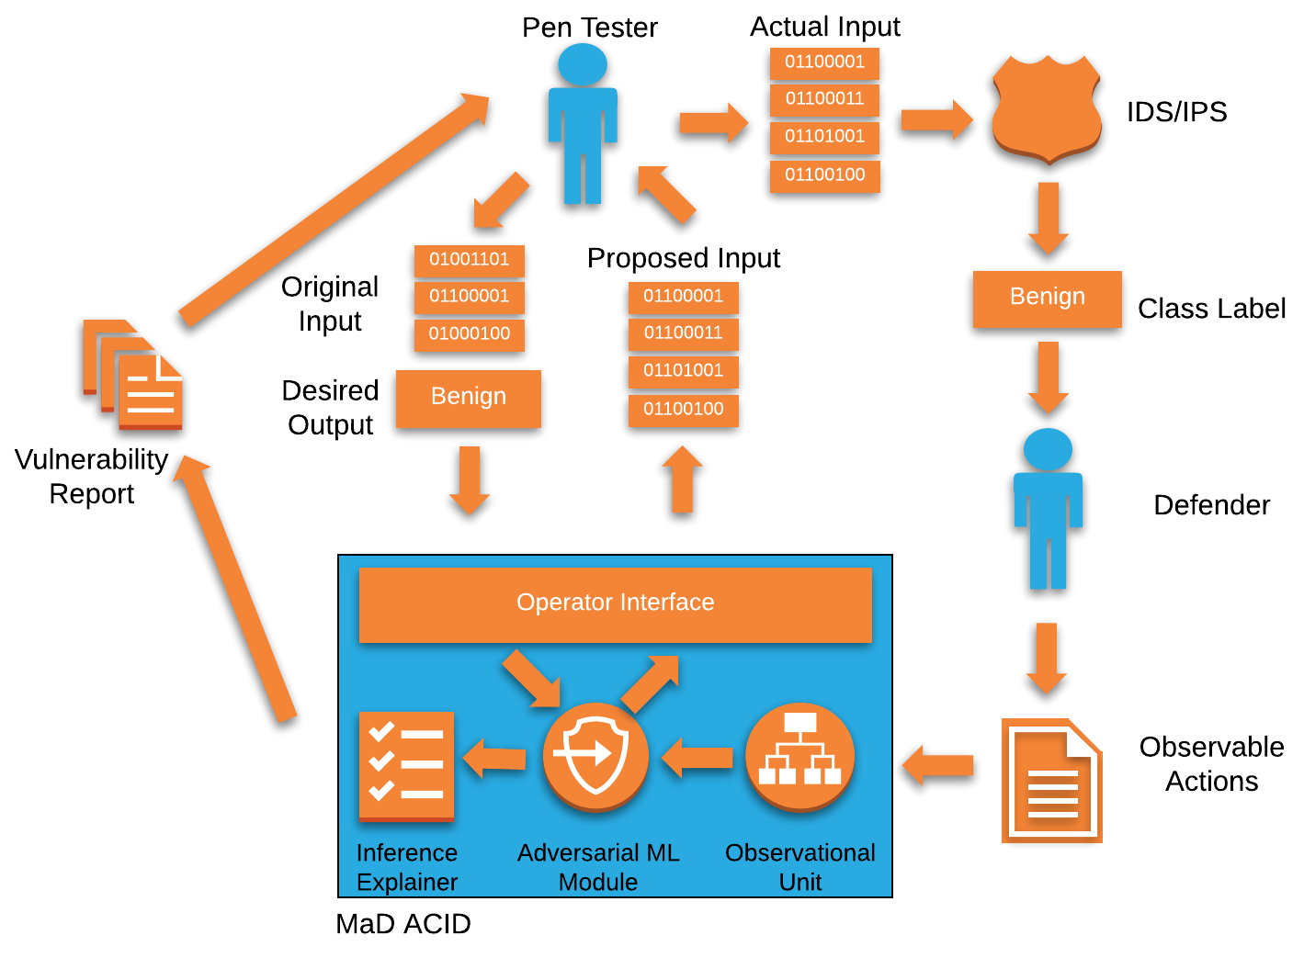
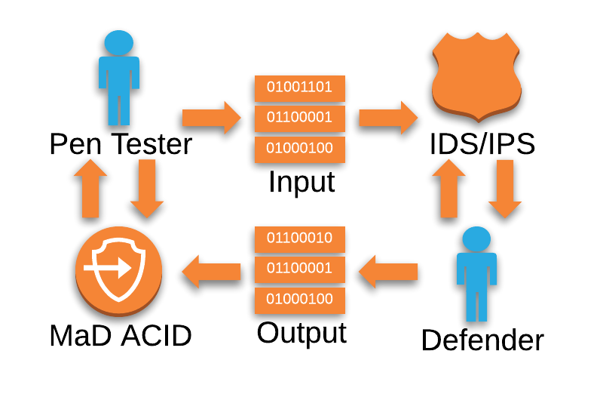
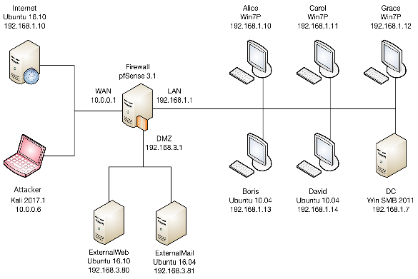
Training Use Case
Notes:
Training – By following a given ATP model, we can develop agents that act in ways consistent with actual human activities to a high level of fidelity. This can be beneficial to train human and (eventually) cycog agents.
A given Soar agent would have all the knowledge of possible actions to take (goals), and would choose among them based on a ttp model that we give it. A given operation would look like a set of preference weights for goals (or, techniques)
It would then be let loose in a cyber range
A human (or other cycog) agent would then try to counteract the attacker agent within the cyber range

Slide 14
Prediction Use Case
Notes:
We would first train an agent to detect procedures from observable actions, and load it with possible TTPs. An anomaly detection problem.
This agent would then be deployed in a real system, and would monitor a network, looking for actions that may be procedures from threats.
As it detects procedures, it would build a graph of techniques. It would match this graph against previously loaded known attack patterns, and would be able to predict future actions based on what it has observed.
It would then display probabilities for predicted attack patterns to a human analyst.

Slide 15
Nuggets/Coal
Nuggets
Human explainable
Flexible
Less changes to Soar code as new attacks are learned
Can generate new attack patterns
Levels can be developed independently
Reason with incomplete information
Coal
Large amount of procedures and tactics
Anomaly detection is a difficult problem
Still can’t detect all novel attack patterns
Notes:
What does this allow us to do?
Can reason at different levels
Flexible to changes in overall plan. Topological sorting of operation graph allows for the modeling of multiple different paths to completion
Possible to detect techniques if actions are missing
Once models for various actors are defined, can swap them in and out of a cognitive agent’s memory
Hierarchical – detect actions with ML while using different techniques to reason about overall goal.
A human can understand what is happening at a higher level when working with the cognitive agent.

Slide 16


