Slide 1




Update on A Common Model of Cognition [A Standard Model of the Mind] May 14, 2018 38th Soar Workshop
John E. Laird, University of Michigan
Andrea Stocco, University of Washington Christian Lebiere, Carnegie Mellon University
Paul S. Rosenbloom, University of Southern California
Slides originally created by Andrea Stocco and Paul S. Rosenbloom
Stocco, A., Laird, J. E., Lebiere, C., & Rosenbloom, P. S. (2018) Empirical Evidence from Neuroimaging Data for a Standard Model of the Mind, To Appear at the Cognitive Science Conference.
Laird, J. E., Lebiere, C. & Rosenbloom, P. S. (2017). A Standard Model of the Mind: Toward a Common Computational Framework across Artificial Intelligence, Cognitive Science, Neuroscience, and Robotics. AI Magazine.
Notes:
Not a machine learning talk per se, but here for timing issues
Some work that followed up on the last session of the 2013 AAAI Fall Symposium on Integrated Cognition

Slide 2


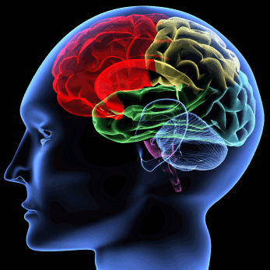

Approaches to Understanding Minds
Artificial Intelligence (& AGI)
Concerns building artificial minds
Cares most for how such minds can be built
Cognitive Science
Concerns modeling natural minds
Cares most for understanding human cognitive processes
Neuroscience
Concerns structure and function of brains
Cares most for how minds arise from brains
Robotics
Concerns building and controlling artificial bodies
Cares most for how minds control such bodies

Slide 3
Towards a Common Understanding
Deep scientific question whether will converge on a single understanding of mind
Must at least happen for cognitive science and neuroscience
Naturally inspired AI/robotics may also fit if class slightly abstracted
So also may other work that is similar for functional reasons
Call this slightly abstracted class human-like minds
More the bounded rationality found in humans than AI optimality
Broader than naturally inspired minds
Narrower than human-level intelligence
Notes:
Includes natural and non-naturally-inspired but similar minds

Slide 4
History of a Common Model of Cognition
Grew out the 2013 AAAI Fall Symposium on Integrated Cognition
Surprising consensus of those in attendance
An article for AI Magazine
Extend consensus via a dialectic among ACT-R, Soar & Sigma
Laird, J. E., Lebiere, C. & Rosenbloom, P. S. (2017). A Standard Model of the Mind: Toward a Common Computational Framework across Artificial Intelligence, Cognitive Science, Neuroscience, and Robotics. AI Magazine.
2017 AAAI Fall Symposium on Standard Model of the Mind
~70 attendees. Not of consensus and enthusiasm to continue
Formed a mailing list and subgroups: >50 people
Voted on new name: Common Model of Cognition (CMC)
Cognitive Science Paper: July 2018
Stocco, A., Laird, J. E., Lebiere, C., & Rosenbloom, P. S. (2018) Empirical Evidence from Neuroimaging Data for a Standard Model of the Mind, To Appear at the Cognitive Science Conference.
Proposed Workshop at Cognitive Science: Rejected
Proposed AAAI Fall Symposium for 2018: Accepted yesterday!
Proposed Dagstuhl meeting for 2019: Under Review

Slide 5
Common Model of Cognition
What needs to be in a human-like cognitive architecture
An abstract community consensus
Not itself a cognitive architecture
Potential benefits
Coherent baseline to facilitate shared cumulative progress
Focus efforts to extend and break the consensus
Framework around which evaluation data can be organized
Interlingua for describing and comparing architectural approaches
Guidance in
Extending research on individual components
Interpreting experiments and suggesting new ones
Constructing intelligent applications
Testable theory for different structures and functions of the mind
Notes:
Cognitive architecture: Working model of fixed structures that define a mind
For example, extending deep learning with memory, attention, etc.

Slide 6
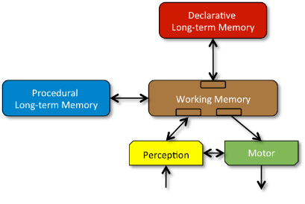
Standard Model
Structure and Processing
Memory and Content
Learning
Perception and Motor

Slide 7
A. Structure and Processing
Processing yields bounded rationality, not optimality
Processing based on a few task-independent modules
There is significant parallelism in architectural processing
Processing is parallel across modules
Processing is parallel within modules
A cognitive cycle that runs at ~50 ms per cycle in humans drives behavior via sequential action selection
Complex behavior arises from a sequence of independent cognitive cycles that operate in their local context
Notes:
Not distinct modules for more complex behavior

Slide 8
B. Memory and Content
Declarative and procedural LTMs contain symbol* structures and associated quantitative metadata
Global communication is provided by a short-term WM
Global control is provided by procedural LTM
Composed of rule-like conditions and actions
Exerts control by altering contents of WM
Factual knowledge is provided by declarative LTM
Notes:
*Symbols as earlier discussed

Slide 9
C. Learning
All forms of LTM content are learnable
Learning occurs online and incrementally, as a side effect of performance and is often based on an inversion of the flow of information from performance
Procedural learning involves at least reinforcement learning and procedural composition
Reinforcement learning yields weights over action selection
Procedural composition yields behavioral automatization
Declarative learning involves the acquisition of facts and tuning of their metadata
More complex forms of learning involve combinations of the fixed set of simpler forms of learning

Slide 10
D. Perception and Motor
Perception yields symbol* structures with associated metadata in specific WM buffers
There can be many different such perception modules
Perceptual learning acquires new patterns & tunes existing ones
Attentional bottleneck constrains information available in WM
Perception can be influenced by top-down information from WM
Motor control converts symbol* structures in its buffers into external actions
There can be multiple such motor modules
Motor learning acquires new action patterns & tunes existing ones
Notes:
*Symbols as earlier discussed
Least well defined aspect of SMM

Slide 11
Testing it
The CMC evolved from both AI and cognitive psychology
The CMC is designed to abstract and fit multiple forms of intelligence (human and not)
However, it must at least fit the architecture of human cognition.
Idea: Test how well the CMC fits neuroimaging data from multiple experiments, using Dynamic Causal Modeling

Slide 12
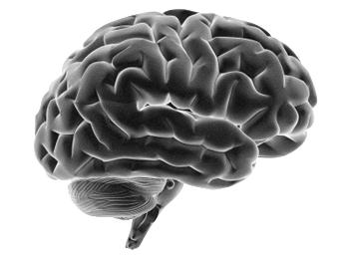
Dynamic Causal Modeling (DCM)
Dynamic Causal Modeling
Traditional, GLM analysis
β₁
β₂
Estimated
parameters
A_{1,2}
B_{2,3}
C_{2,1}
D_{1,2}
y₂
y₂
y₁
y₃
Observed timecourse of neuroimaging data
y₁
y₃
Timecourse of Experimental conditions
x₁
x₂
x₁
x₂
dy/dt = Ay + Σ_{i}x_{i}B(i)y + Σ_{j}y_{j}D(j)y + Cx
y = Σ_{i} β_{i}*x_{i}

Slide 13
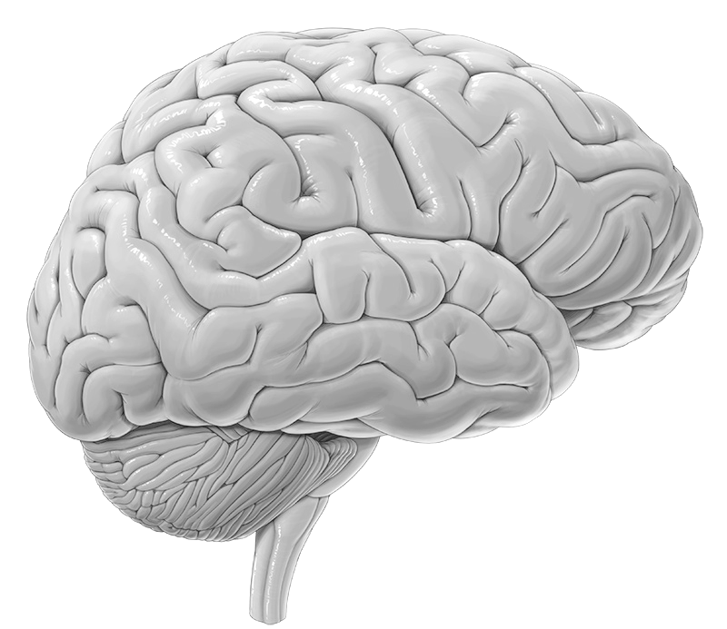
Implementing CMC in DCM: Step 1
Step 1: Each box is assigned to a given region of the human brain. The associations between brain and regions are relatively straightforward and justified
Action
(Motor cortex)
Long-term
Memory
Procedural
(Basal ganglia)
Working
Memory
(Prefrontal)
Procedural
Memory
Working
Memory
Perception
(Occipital cortex)
Long-term
Memory
(Hippocampus)
Perception
Action

Slide 14
Implementing CMC in DCM: Step 2
Step 2: To capture the condition/action nature of procedural knowledge, it is implemented as a modulatory drive that gates signals to PFC.
Action
(Motor cortex)
Action
(Motor cortex)
Procedural
(Basal ganglia)
Working
Memory
(Prefrontal)
Procedural
(Basal ganglia)
Working
Memory
(Prefrontal)
Perception
(Occipital cortex)
Perception
(Occipital cortex)
Long-term
Memory
(Hippocampus)
Long-term
Memory
(Hippocampus)

Slide 15
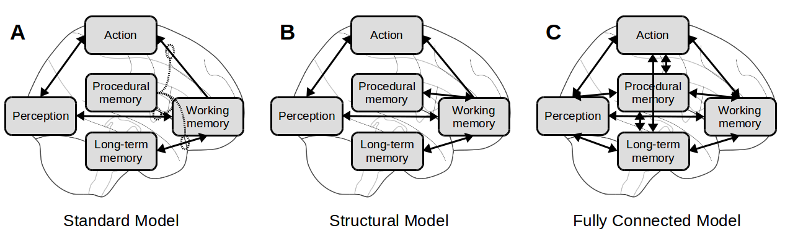
Alternative Models
Procedural memory is condition-action and modulates changes to WM: cue-based retrieval from LTM.
Procedural memory is not condition-action and directly modifies WM.

Slide 16
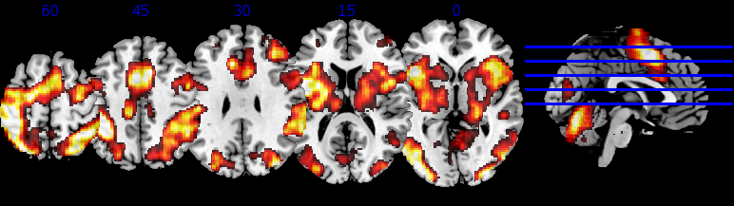
Flanker task Cognitive Control and Executive Function
Participants respond to a central arrow-like symbol (“<”) with the hand corresponding to the symbol's direction (left). The central symbol, however, is surrounded by four distractors, or “flankers”, that either point in the same direction trials, (“<<<<<” ) or in the opposite direction (“<<><<” ).
Published by Mennes, M., Zuo, X.N., Kelly, C., Di Martino, A., Zang, Y.F., Biswal, B., Castellanos, F.X., Milham, M.P. (2011). Neuroimage, 54(4):2950-9

Slide 17
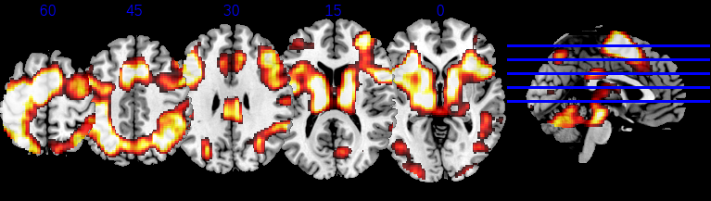
Stroop task Perception & Memory Interference
Words are color names in printed in same or conflicting colors. Must name word:
BLUE
GREEN
Published by Verstynen, T. D. (2014). J. Neurophys., 112(10), 2457-2469

Slide 18
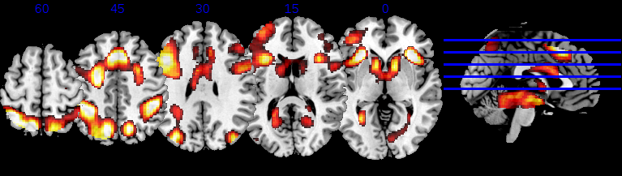
Rapid Instructed Task Learning Cognitive Flexibility and Dynamic Control
Participants perform a different task each trial. Each trial is divided into an “instruction” phase (where the task is communicated in a simple, predefined notation) and an “execution” phase, during which the instructions are applied to a specific stimulus.

Slide 19
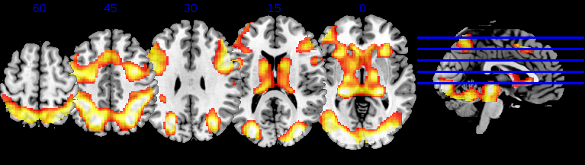
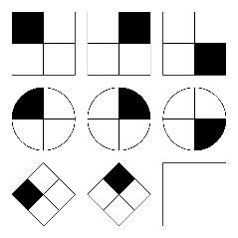
Raven’s Advanced Progressive Matrices (RAPM) Non-verbal test of fluid intelligence and reasoning
Each problem consists of a 3-by-3 matrix. Eight cells of the matrix contain a figure made of different elements, while the bottom-right cell is empty. The visual features (such as color or orientation) of each figure vary across rows and columns according to specific but undisclosed rules. Participants must infer the rules and correctly identify the figure that completes the matrix within an array of four possible options

Slide 20
Task Encoding
Every stimulus that is presented is encoded as an input to the visual cortex. To account for variability in input, different categories of stimuli are represented by separate types of inputs.
All tasks share a basic comparison between an ``easy'' and a ``difficult'' condition (Flanker incongruent).

Slide 21
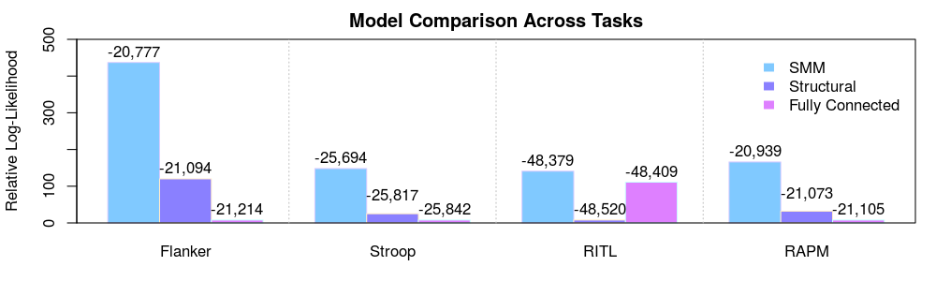
To compare the three models across the four datasets, we used a group-level Bayesian model selection algorithm. To make a relative comparison across a common scale, the plots use relative log-likelihood, while the labels above the bars are true log-likelihood values from the analysis.
Across all comparisons, the posterior probability of the SMM being the best explanation of the data was > 0.99.

Slide 22
Coal
Still some skeptics about the value of this type of analysis.
Community organization is definitely worse than herding cats….

Slide 23
Nuggets
Lots of interest to continue development of CMC.
Not forcing agreement on a single architecture
Some indications that the CMC has empirical support.
Lots of ideas for the future investigation.

