Slide 1
A Task-General Learning Model
Part 2: Task control using spreading activation
Bryan Stearns
University of Michigan
Soar Workshop - May 2018
Notes:
Check animation consistency

Slide 2
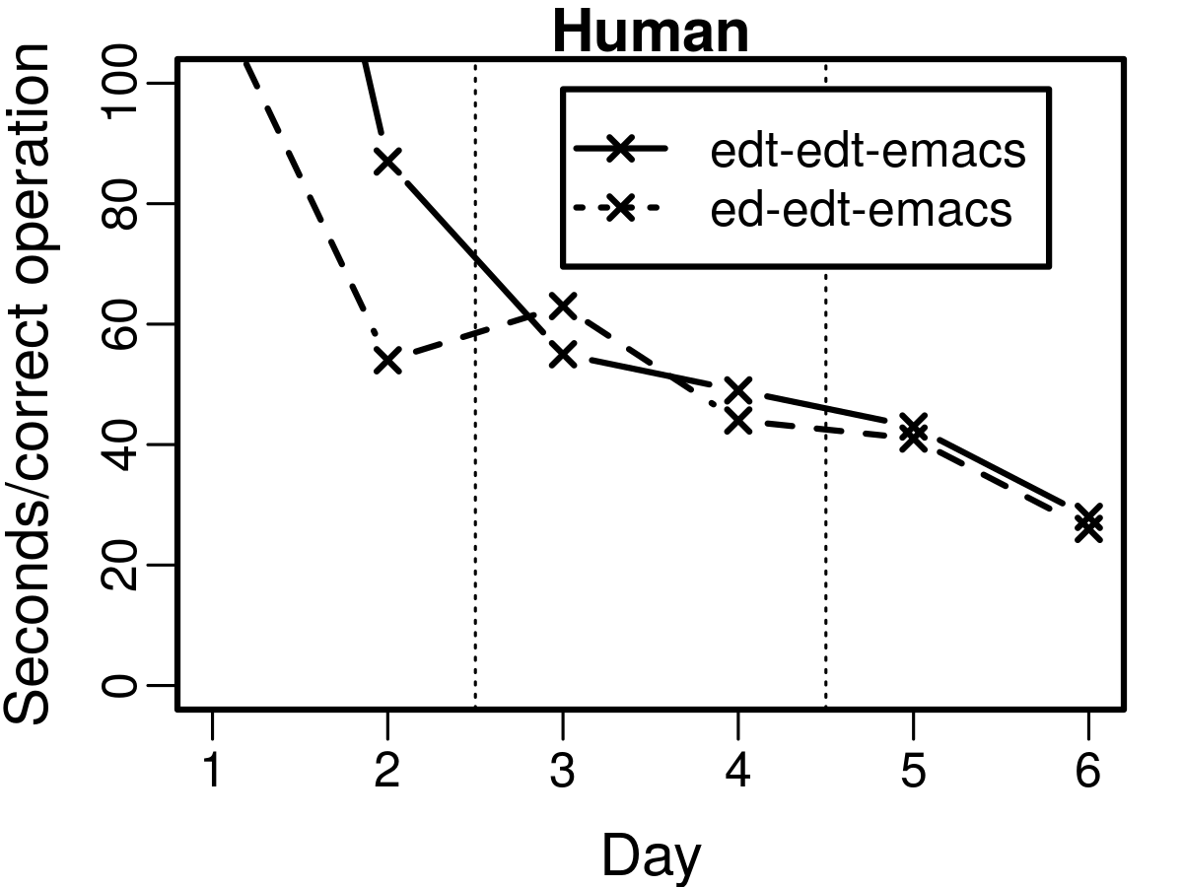
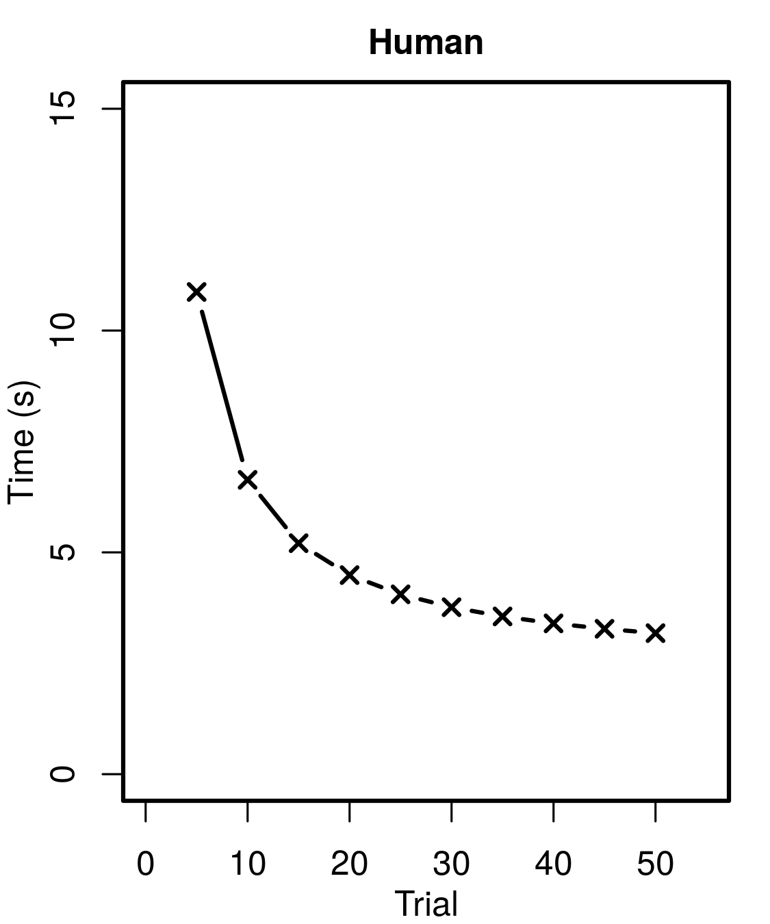
Human Modeling
ED
or
EDT
We want to model human task-general learning
General model using general Soar
No hard-coding the task
Architecture-based fetch and execute model
EDT
EMACS
Human Latency

Slide 3
Learning Fetch and Execute
SMEM
Press Enter
Type Letter
PREV TALK
Task operators:
Task-general rule learning
Using gradual chunking
Task order:
Task-general fetch learning
Using spreading activation
Instructions →
I1
^condition
^action
^action
P1
P2
P3
THIS TALK
1
2
3
4
Read Direction
Read Screen
Type Text
Type Letter
Press Enter

Slide 4
Current Ordering
Taught order:
SMEM
Read Direction
Read Screen
Type Letter
Press Enter
Depends on given fixed sequence
Extra fetch work
Fetch taught ordering
Fetch next instructions
Increment current position in ordering

Slide 5
Desired Ordering
Taught order:
SMEM
Autonomous “Free Recall”
Flexible task order
Less fetch work:
Read Direction
Read Screen
Type Letter
Press Enter
Fetch instructions automatically
If retrieved OK, execute
else revert to given order
Use given fixed sequence to train autonomous fetch

Slide 6
Fetch by Activation
SMEM
N1
^instruction
^instruction
^instruction
^instruction
Each SMEM memory has activation
Read Direction
Read Screen
Type Letter
Press Enter
+0.11
-0.02
+0.00
+0.01
Activation breaks query ties
(<N1> ^instruction <read-dir>) (<N1> ^instruction <read-scr>) (<N1> ^instruction <type-ltr>) (<N1> ^instruction <press-etr>)
Instruction query:
sp {example*query (state <s> ^smem.command <scmd>) --> (<scmd> ^query <q>) (<q> ^instruction <any>) }

Slide 7
Boosting Activation
SMEM
+1.00
+1.00
Not finished typing
Direction: Type text
Items in Working Memory have increased activation
Read Direction
Read Screen
Type Letter
Press Enter
+0.11
-0.02
+0.00
+0.01
+1.11
WM
Read Direction
Direction: “type”
Direction: “type”
“Hello World”
Not done typing
Not done typing
Text-len: 11

Slide 8
Spreading Activation
SMEM
+1.00
+1.00
Not finished typing
Direction: Type text
+0.9
+0.9
Activation spreads in SMEM
Decays with distance
Read Direction
Read Screen
Type Letter
Press Enter
+1.11
-0.02
+0.00
+0.01
+1.80
WM
Read Direction
Direction: “type”
“Hello World”
Not done typing
Text-len: 11

Slide 9
Fetching Correctly
SMEM
Not finished typing
Direction: Type text
Type Letter
Press Enter
Which one should be fetched?
Should fetch instructions with true conditions
Type Letter:
Press Enter:
Test direction is “type”
Test direction is “type”
Test if not done typing
Test if done typing
Type next letter
Press Enter
WM
Read Direction
Direction: “type”
“Hello World”
Not done typing
Text-len: 11

Slide 10
Spread Correctly
SMEM
Direction: “type”
Not done typing
Done typing
+0.9
+0.9
+0.9
Type Letter
Press Enter
Spread from conditions when true
+1.80
+0.90
Type Letter:
Press Enter:
How to learn condition WMEs?
Chunking!
Test direction is “type”
Test direction is “type”
Test if not done typing
Test if done typing
Type next letter
Press Enter
WM
Read Direction
Direction: “type”
“Hello World”
Not done typing
Text-len: 11

Slide 11
Chunk Conditions
SMEM
Direction: “type”
Not done typing
+0.9
+0.9
1. Fetch instructions with given order
Type Letter
2. Evaluate instructions in substate
+1.80
3. Return WME for each true condition
4. Chunking learns each condition
5. Chunk fires or retracts when needed
Read Direction
Read Screen
Type Letter
Press Enter
CHUNK:
CHUNK:
CHUNK:
Test direction is “type”
-->
(create spread-wme)
Test if not done typing
-->
(create spread-wme)
Test direction is “type”
Test if not done typing -->
Type next letter
Type Letter:
Test direction is “type”
Substate:
Test if not done typing
Test dir: “type”
Test if not done
Type next letter
Type next letter

Slide 12
Fetching Correctly
true
true
true
false
true
true
C1
C2
C3
C4
C5
C6
Soar normalizes spread
Number of descendant nodes
(#conds)*(decay)^{(depth)} (#descendants)
Normalize over conditions
Intermediate structure
K1
K2
N1
N2
N3
N4
N5
N6
+3*0.9³ 4+1
+2*0.9³ 2+1
+3 4
I1
I2
+2 2
0.437
0.486

Slide 13
Are we done?
ED
or
EDT
We have task-general fetch & execute
We have gradual chunking of:
Task operations
Task order
Let’s try it!
EDT
EMACS
Human Latency

Slide 14
Parameter 1: LEARNED or GIVEN
LEARNED
Learn to fetch during task execution
No condition spreading at start
Initial fetch is random (slower)
GIVEN
Assumes learned how to fetch before task execution
All spread chunks provided at start
Only task operations need learning
Spread Chunk:
“Type Letter” Chunk:
Test if not done typing
-->
(create spread-wme)
Test direction is “type”
Test if not done typing -->
Type next letter

Slide 15
Interference from Operator Rules
Test if not end of text
Type next letter
Increment text pos
Test if not end of text
Type next letter
Increment text position
Fetch only when agent idle
Learned operator rules override fetching
Turns control into reflex
Can’t decide to follow instructions
Option: Disable interference
Partial operator composition only
Test if not end of text
-->
Type next letter
Increment text position
sp {chunk*create-spread-wme (state <s> ^text-pos <pos>) --> (<s> ^spread-wme <C5>) }
sp {described*rule*type-letter (state <s> ^text-pos <pos> ) (<o> ^text-len <> <pos> ) --> (<s> ^operator <o> +) (<o> ^name |type-letter| ) }

Slide 16
Parameter 2: REACT or CONTROL
REACT
Instructions fully chunked into task rules
Chunks react to tasks without deliberation
Behaves like hard-coded-task agent
CONTROL
Instructions not fully chunked
Partial hierarchical composition only
Task always requires deliberate, controlled fetch
Spread Chunk:
“Type Letter” Chunk:
Test if not done typing
-->
(create spread-wme)
Test direction is “type”
Test if not done typing -->
Type next letter
Test dir: “type”
Test if not done
Type next letter

Slide 17
Model Parameters
LEARNED or GIVEN
LEARNED: Spread chunks are learned
GIVEN: Spread chunks are given
REACT or CONTROL
REACT: Can react to task with chunks
CONTROL: Must use controlled fetch
LEARNED
GIVEN
REACT
LEARNED-REACT | GIVEN-REACT
LEARNED-CONTROL | GIVEN-CONTROL
CONTROL

Slide 18
Model Parameters
LEARNED or GIVEN
LEARNED: Spread chunks are learned
GIVEN: Spread chunks are given
REACT or CONTROL
REACT: Can react to task with chunks
CONTROL: Must use controlled fetch
LEARNED
GIVEN
REACT
LEARNED-REACT | GIVEN-REACT
LEARNED-CONTROL | GIVEN-CONTROL
CONTROL
GIVEN-REACT corresponds to the old model (prev talk)

Slide 19
Evaluation
ED
or
EDT
EDT
EMACS
Two domains:
Text editors task (Singley and Anderson, 1985)
Evaluates transfer
Arithmetic task (Elio, 1986)
Evaluates learning curve
Expectation:
Slower time at start for learning fetch
Slower time by end if not fully chunking
Human Latency

Slide 20
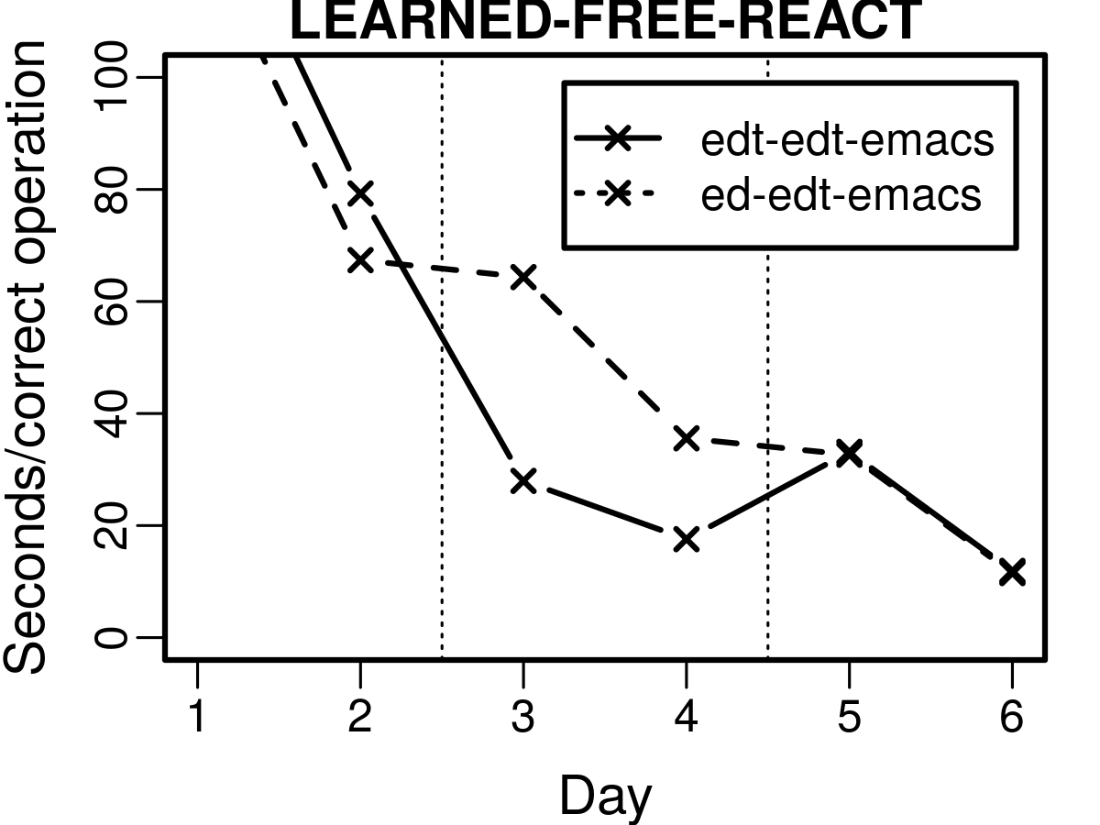
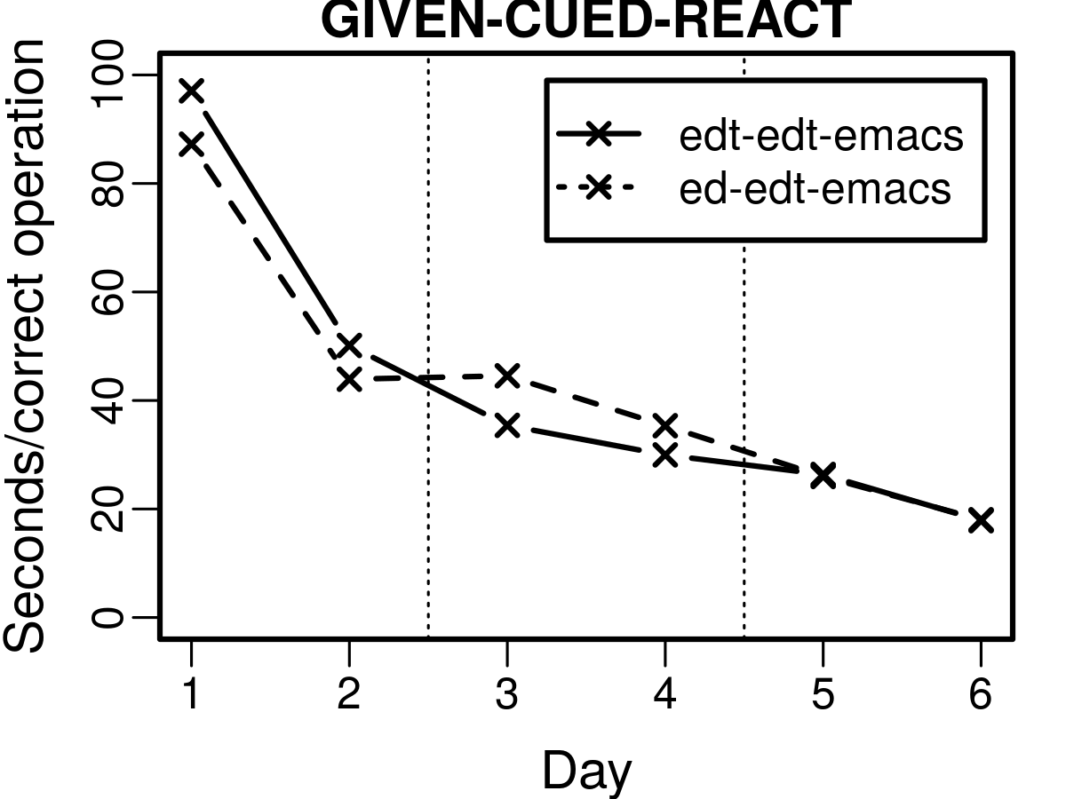
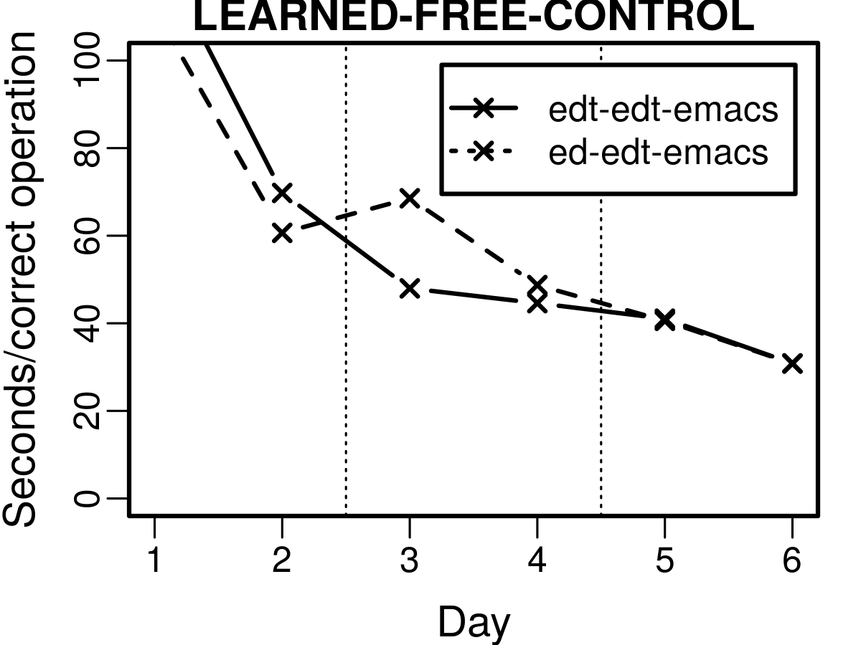
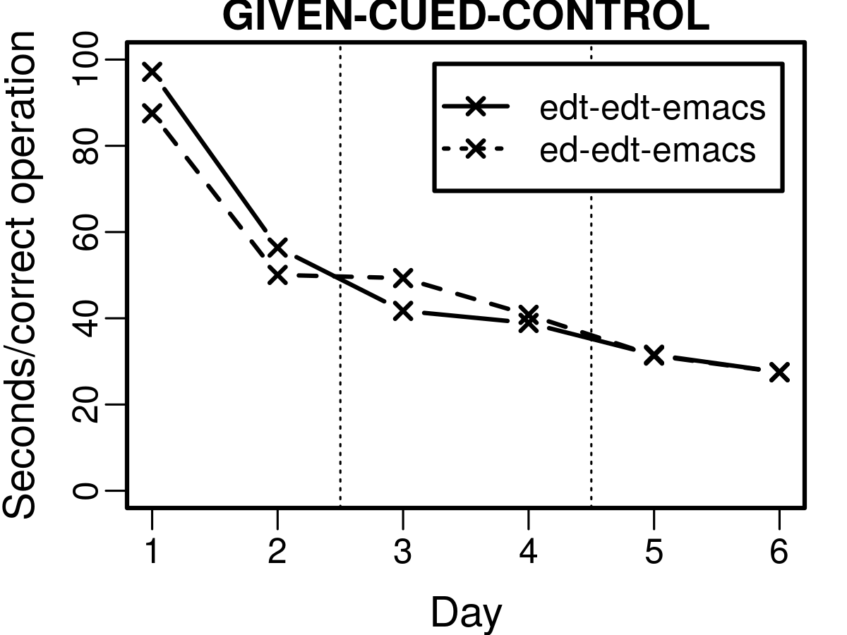
Editors Model Results
LEARNED-REACT
GIVEN-REACT
For each parameter permutation
LEARNED-CONTROL
GIVEN-CONTROL

Slide 21
Editors Model Results
LEARNED-REACT
GIVEN-REACT
LEARNED starts slower than GIVEN
Learning to fetch
LEARNED more human-like
LEARNED-CONTROL
GIVEN-CONTROL

Slide 22
Editors Model Results
LEARNED-REACT
GIVEN-REACT
REACT outperforms CONTROL
Stops fetching
CONTROL more human-like
LEARNED-CONTROL
GIVEN-CONTROL

Slide 23
Editors Model Results
LEARNED-REACT
GIVEN-REACT
LEARNED-CONTROL is closest human fit
LEARNED-CONTROL
GIVEN-CONTROL

Slide 24
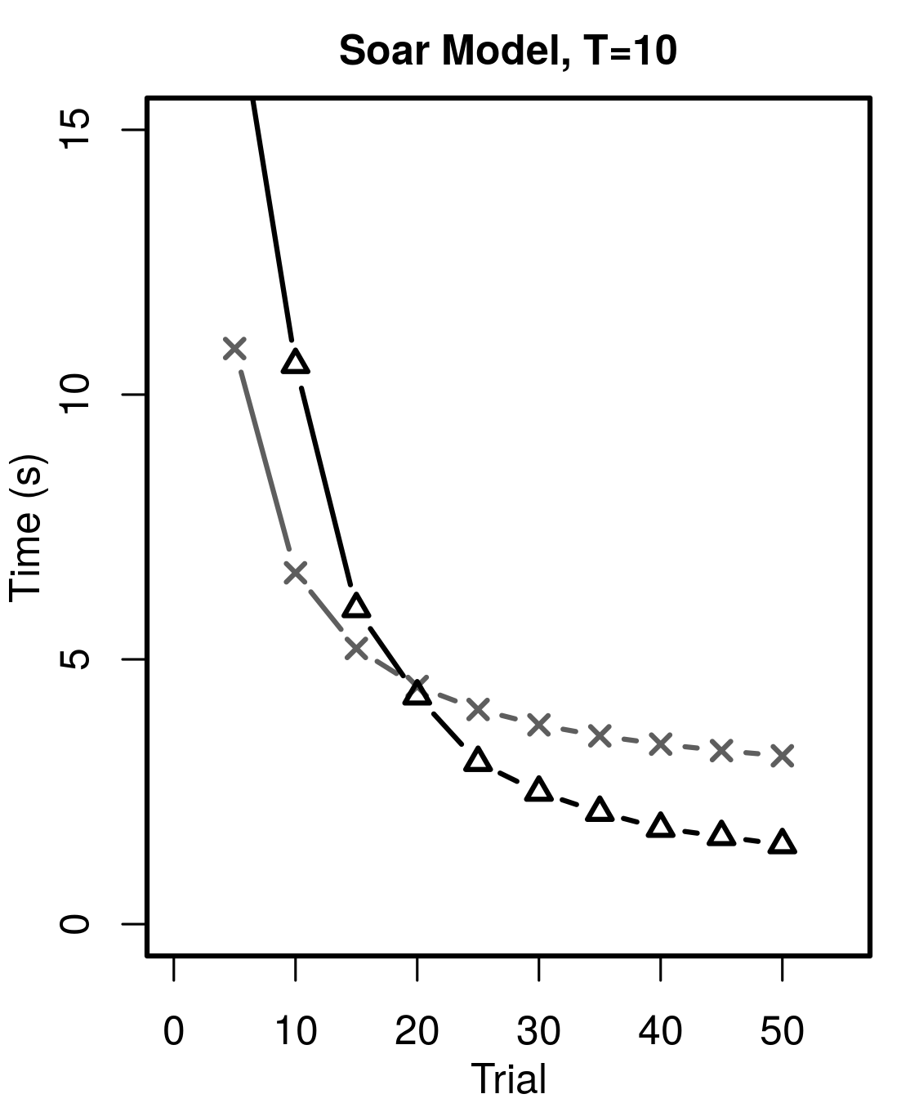
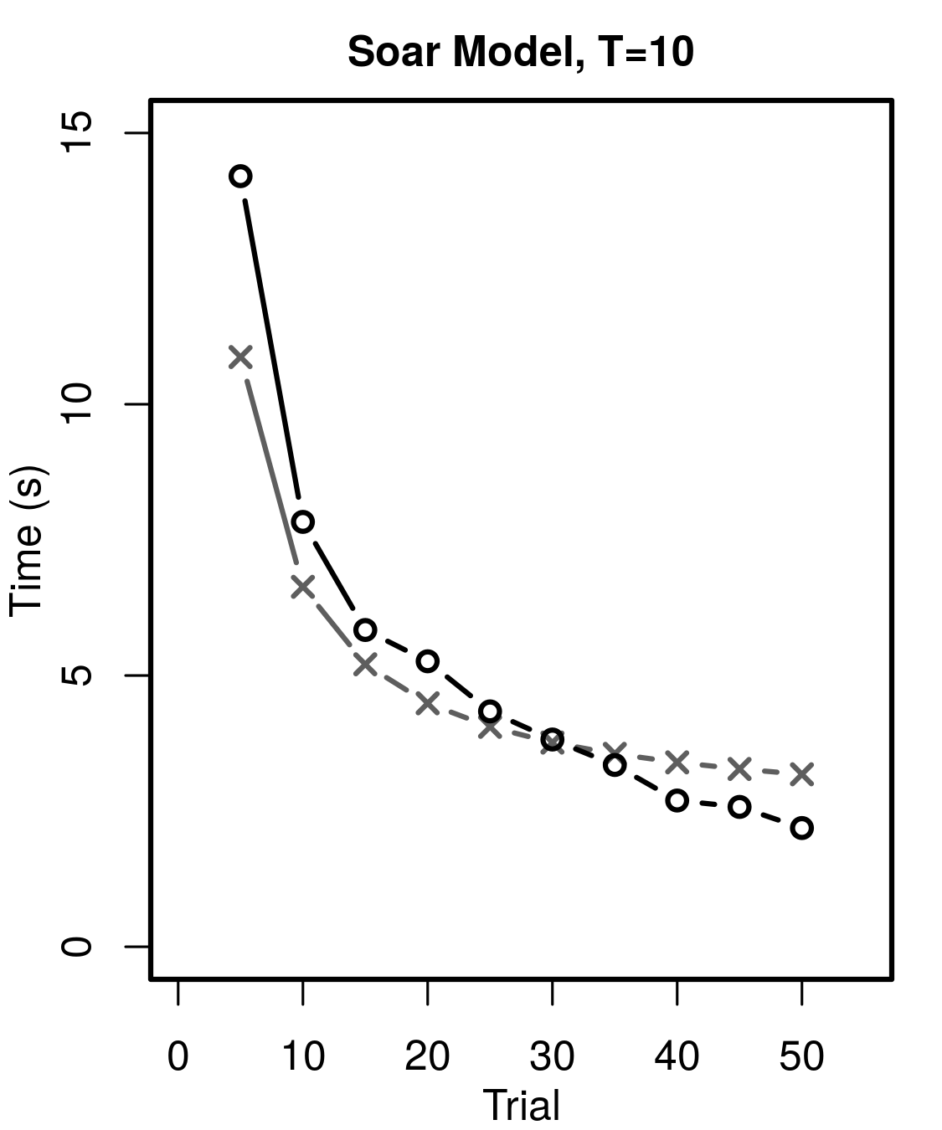
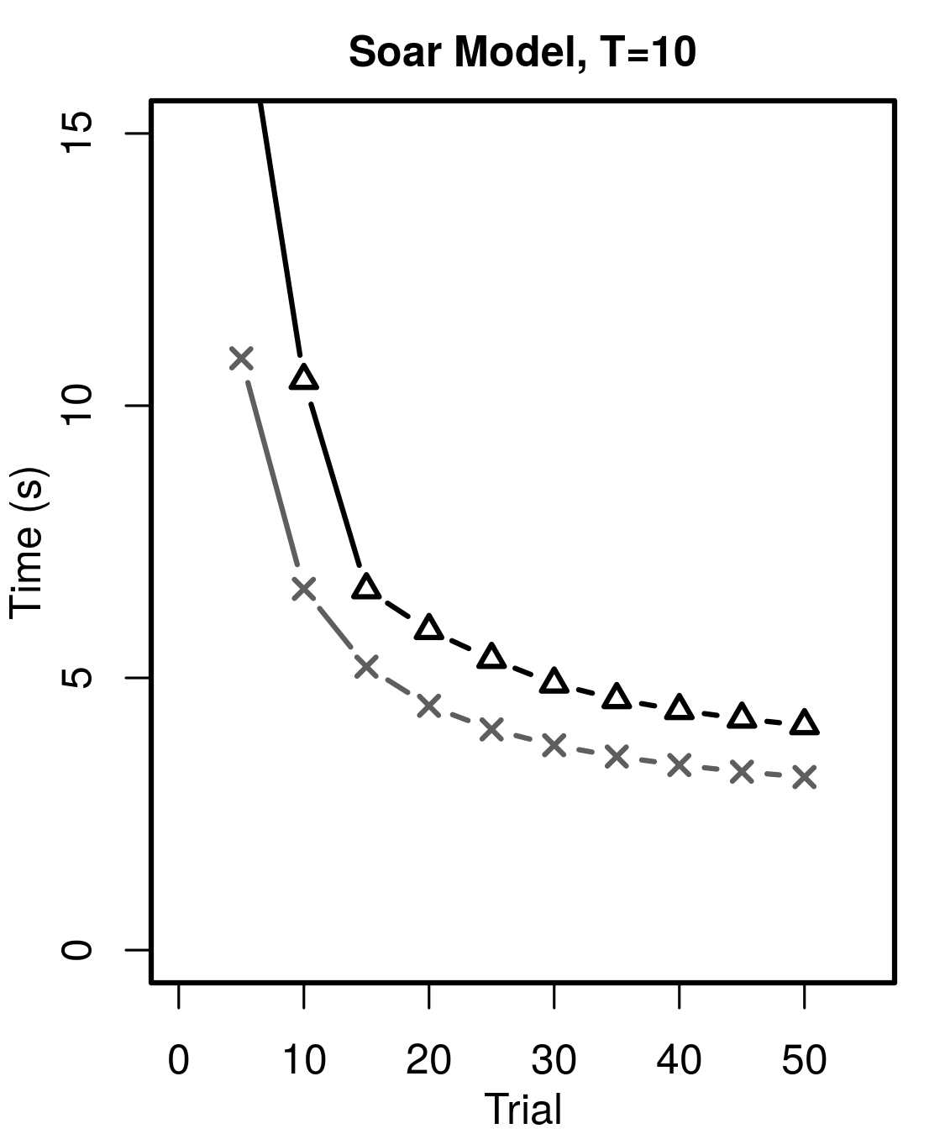
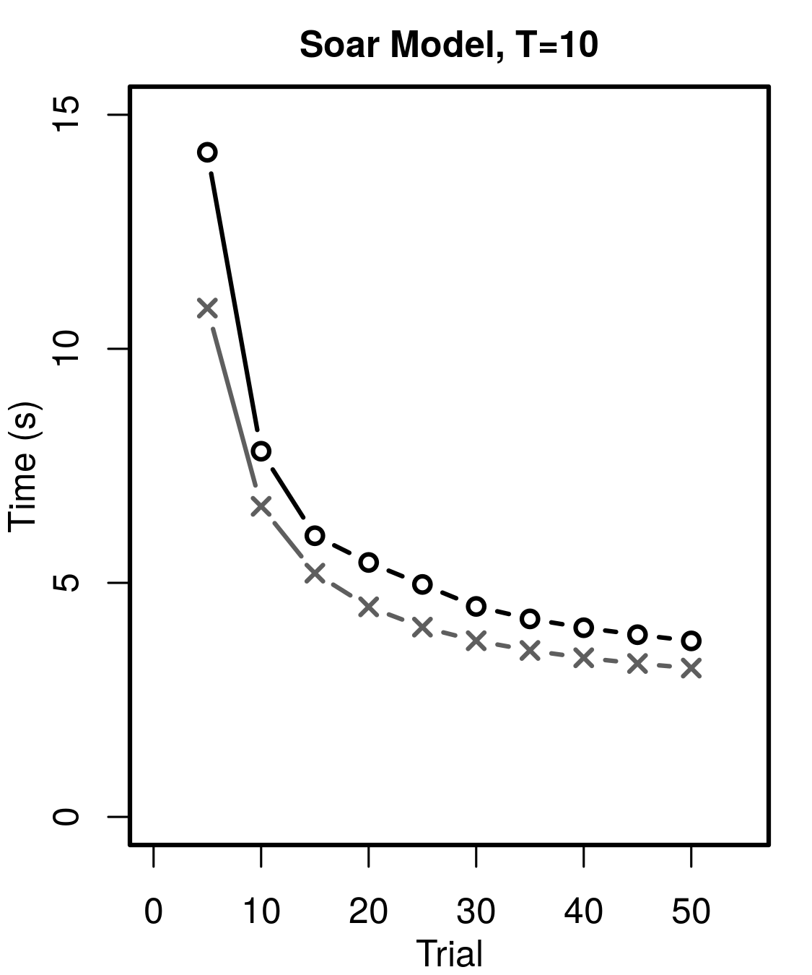
Arithmetic Model Results
LEARNED-REACT
GIVEN-REACT
Same parameter permutations
HUMAN
LEARNED-CONTROL
GIVEN-CONTROL

Slide 25
Arithmetic Model Results
LEARNED-REACT
GIVEN-REACT
REACT outperforms CONTROL
Again, CONTROL more human-like
HUMAN
LEARNED-CONTROL
GIVEN-CONTROL

Slide 26
Arithmetic Model Results
LEARNED-REACT
GIVEN-REACT
GIVEN starts faster than LEARNED
Different: GIVEN more human-like
HUMAN
LEARNED-CONTROL
GIVEN-CONTROL

Slide 27
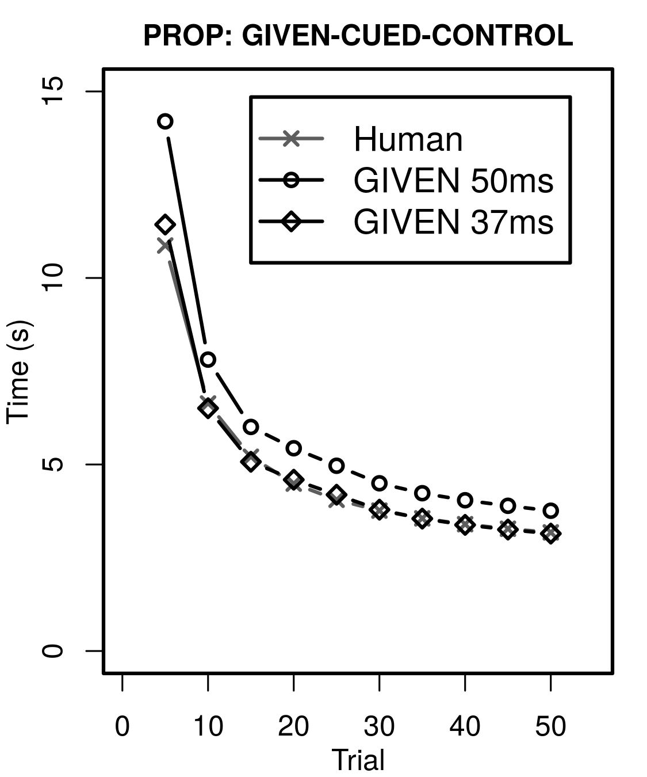
Soar Model - Interesting Variation
GIVEN-CONTROL only off from human by decision cycle time
Reduce cycle time from 50 msec to 37 msec
Related work: Neural model predicts ~38 msec cycle times (Stewart et al., 2010)
GIVEN-CONTROL
MSE: 1.695
MSE: 0.0382

Slide 28
REACT or CONTROL?
CONTROL: Decide what to do based on what is fetched
REACT: Act by reflex without fetching or deliberating
REACT
CONTROL
In both domains,
CONTROL is more human like
REACT optimally fast
Model prediction:
Humans are not optimally fast because we keep task control

Slide 29
LEARNED or GIVEN?
LEARNED-CONTROL
Editors subjects practiced for the first time during the task
LEARNED is the better human fit
Arithmetic subjects were trained in the algorithms before the task
GIVEN is the better human fit
GIVEN-CONTROL
Take-away:
Models should account for real life task-order training

Slide 30


Summary
Questions
Soar Model
Learns to fetch
From instruction
Becomes autonomous
Task-general learning
Same code, 2 domains
Theoretical implications
LEARNED/GIVEN principles
CONTROL is human-like
Undefined origin of SMEM instructions
Still imperfect model
Only 2 domains so far
GIVEN-CONTROL

Slide 31
Bibliography
Elio, R. (1986). Representation of similar well-learned cognitive procedures. Cognitive Science, 10(1), 41 - 73.
Singley, M. K., & Anderson, J. R. (1985). The transfer of text-editing skill. International Journal of Man-Machine Studies, 22(4), 403 - 423.
Stearns, B., Assanie, M., & Laird, J. E. (2017). Applying primitive elements theory for procedural transfer in soar. In International conference on cognitive modeling.
Stewart, T. C., Choo, X., & Eliasmith, C. (2010). Dynamic behaviour of a spiking model of action selection in the basal ganglia. In International conference on cognitive modeling (pp. 235–40).
Taatgen, N. A. (2013). The nature and transfer of cognitive skills. Psychological Review, 120(3), 439–471.

