Slide 1
Long-Term Learning with TankSoar
Bill Kennedy
George Mason University
21st Soar Workshop
Sunday, May 6, 2001

Slide 2
Long-Term Learning
Fundamental Questions
Will learning go on forever?
How much of learned knowledge is ever used?

Slide 3
Previous work related to the fundamental questions
Will learning go on forever?
  Bob Doorenbos’ 100K chunks in 20 problem spaces: mixed
  Experiments with physics demo: trending toward stopping
  Experiments with blocks-world: ended by 150 problems
  Experiments with SCA: 1 chunk per example, of course

Slide 4
Previous work related to the fundamental questions
How much of learned knowledge is ever used?
  Bob Doorenbos’ 100,000 chunks in 20 problem spaces: unknown
  Experiments with physics demo: constant “average” use but ...
    different chunks used to make up the constant average
    most recently learned used more
    earlier chunks continue to be used
  Experiments with blocks-world: all used, but 2-3 were ~75% of use
  Experiments with SCA: less than about 10% after 300 examples

Slide 5
Experimenting with
TankSoar2.5
Experimental design:
  Modify “simple” tank to learn at “T” intersections
  Extend “score limit” to allow to time out at 4,000 decision cycles (dc)
  Collect stats every 50 dc
  Run both alone and with a “simple” tank

Slide 6
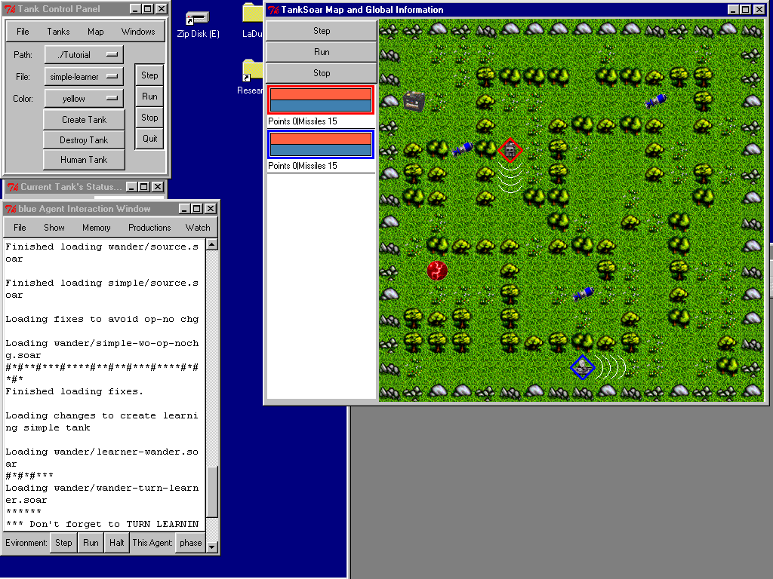
Experiments with
“simple-learner” alone
At least 7 occasions for chunking
More depending on starting position
Initial circuit is 140 dc
After chunking, 132 dc
Chunking ends & all chunks on circuit are used each cycle

Slide 7
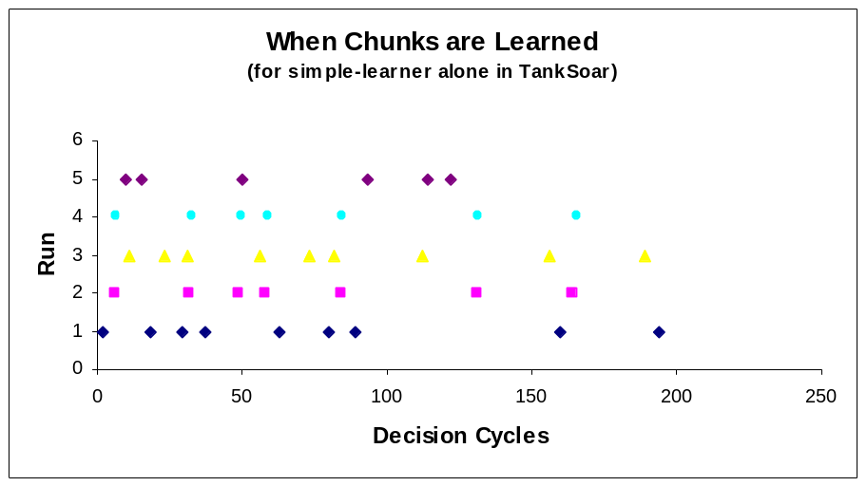
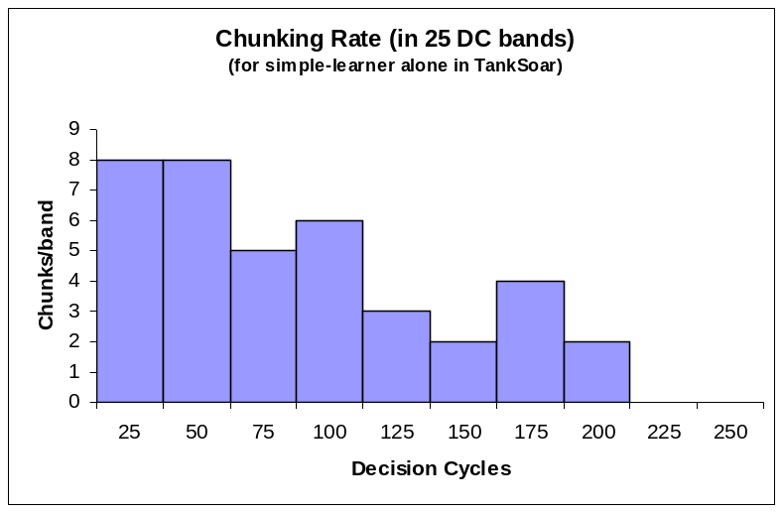
Chunk Learning in
“simple-learner” alone

Slide 8
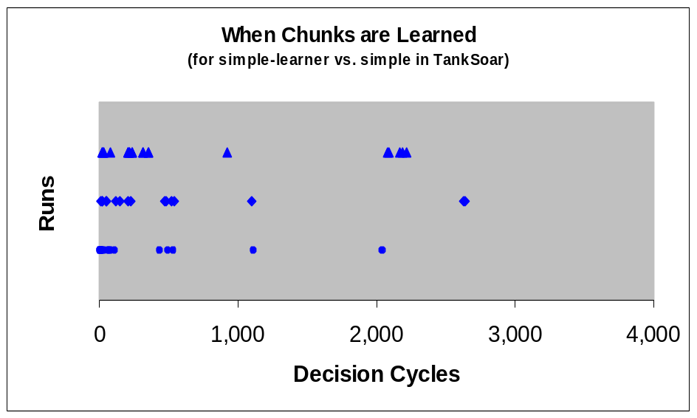
Experiments with
“simple-learner” with “simple” tank
Learning forever?
  Learning continues much longer
  Learns more chunks

Slide 9
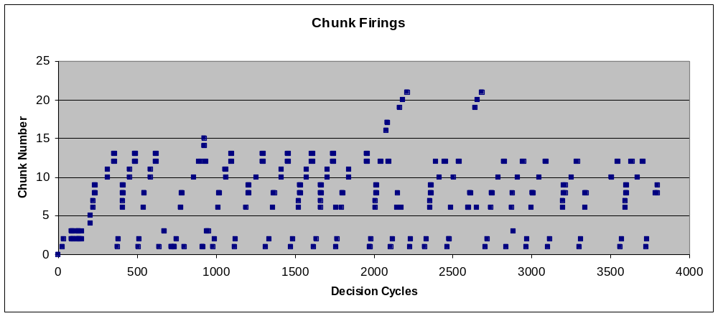
Experiments with
“simple-learner” with “simple” tank
Learning continues much longer
Learns more chunks

Slide 10
Future long-term experimenting with TankSoar
Plans:
  Make tank’s learning more meaningful
  Use more sophisticated opponents
Advice?
  Experimental design change?
  Advice on making learning more meaningful?
  Other advice?

