Slide 1
The COSA Framework
A Cognitive System Architecture
with its implementation based on
a CORBA-wrapped SOAR process

Slide 2
Who are we ?

Slide 3
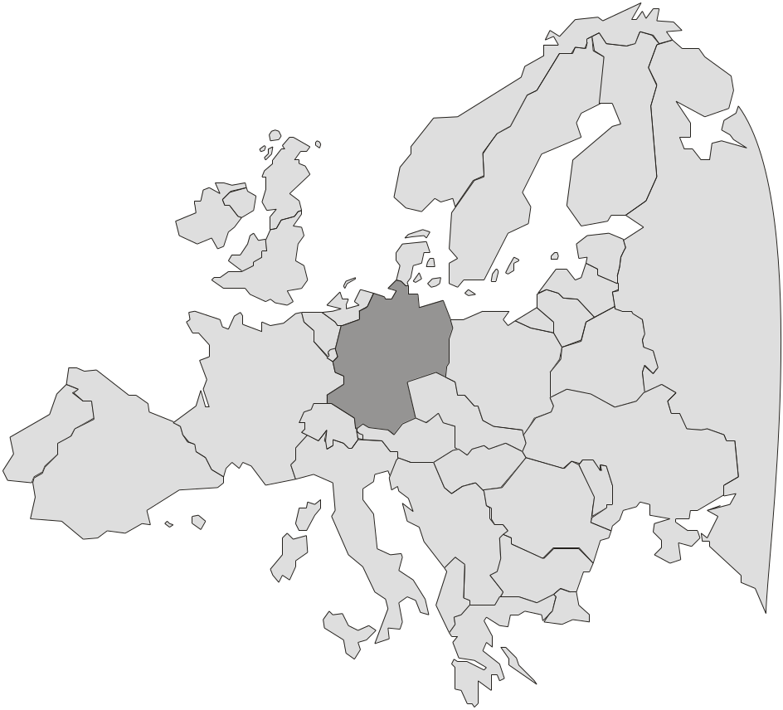
Who are we ?
Institut für Systemdynamik und Flugmechanik
Universität der Bundeswehr München, Germany
Research objectives
  flight guidance and control
  “Human Engineering”,
  not Psychology
  top down (architecture),
  not bottom up (sensors)
  cognitive systems (assistants, tutors, UAV, etc.)
  architecture with target system in mind
first contact with SOAR one year ago
  while searching for knowledge processors via the web
  but not much experience so far (focus on architecture)

Slide 4
What are we doing ?

Slide 5
Motivation
Increasing:
  system complexity
  automated functions
  complexity of situation
  complexity of mission
  complex planning
  and decisions
but:
constant crew resources
cognitive
automation
“mode confusion”
effectiveness / safety
conventional
automation
today’s situation
complexity of automation

Slide 6
System Evolution
1990
1994
2000
2002
time
ASPIO
CASSY
CAMA
?
research yielded operational systems
systems improved over time in ...
  software development
  architecture
  functionality

Slide 7
System Evolution - CAMA
1990
1994
2000
2002
time
ASPIO
CASSY
CAMA
?
Crew Assistant Military Aircraft
... but:
grown over years and now
hard to maintain or extend.
functional extension of CASSY
(for military transport missions)
  modular architecture
  central situation representation
  based on CASSY, coded in C and C++
successfully flight tested in 2000
great acceptance by pilots

Slide 8
Analysis
functional view
  cognitive system
  cooperative system
  symbolic knowledge processing
  simulating human behavior
architectural view
  distributed system and knowledge
  separate architecture from application
  maintainability, extendibility
  uniform representation
  knowledge processor
the
Cognitive
Process
(system’s behavior is understandable)

Slide 9
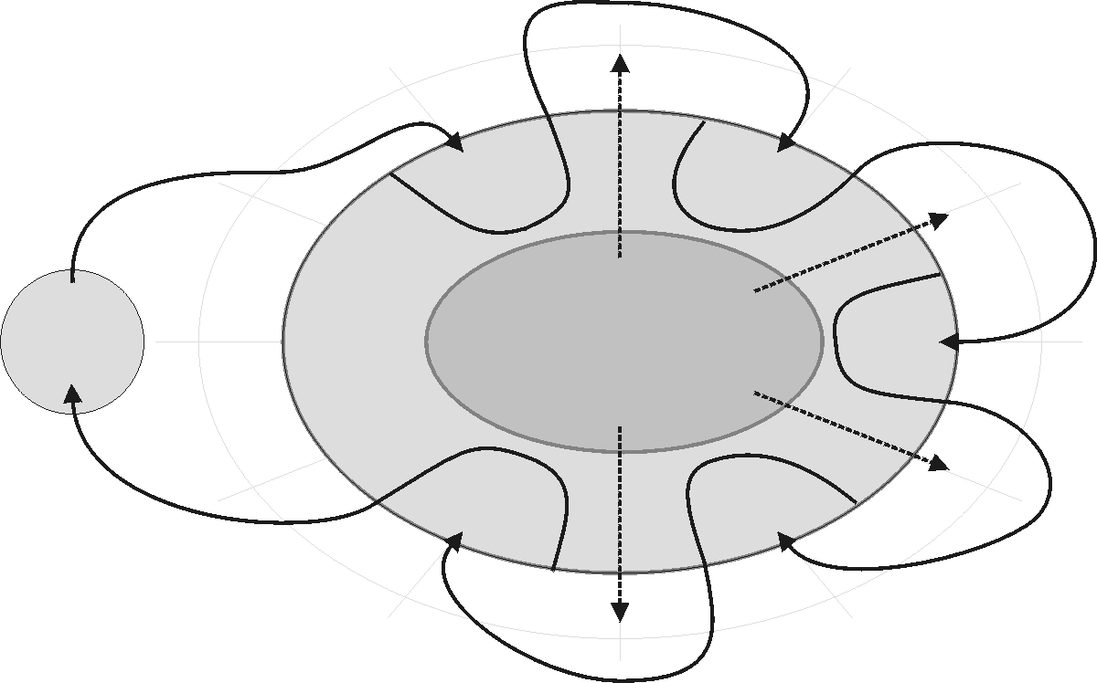
Substructure for all Cognitive Processes
body (data):
  a-priori knowledge
  generated knowledge
  (=cognitive yield)
transformators
(functions):
  reading
  in whole
  body
  writing in
  designated areas
  use of models
cognitive process consists of 4 transformators (+ I/O)
character
Interpretation
symbols
signals
conflicts
opportunities
Input-Data
Belief
data acquisition
Goal
Activation
Object-Models
Real
World
a priori
knowledge
Desires
body
Goals
Abilities
Resources
control +
execution
Tasks
Plan
Planning
Scheduling

Slide 10
Decomposition and OO approach
the Cognitive Process is the fix architecture
  target systems are established solely by
  ‘communicating’ a priori knowledge into the body
  this knowledge as the uniform structure of models
object models from an image of the real world
  templates have functions describing the behavior of each instance (including creation and deletion)
  instances have data members describing the state
aggregation
  the combination of all micro behaviors of all objects within the body of the cognitive process form the macro behavior of the whole system.

Slide 11
Analysis
functional view
  cognitive system
  cooperative system
  symbolic knowledge processing
  simulating human behavior
architectural view
  distributed system and knowledge
  separate architecture from application
  maintainability, extendibility
  uniform representation
  knowledge processor
the
Cognitive
Process
features
COSA
SOAR
SOAR

Slide 12
What is COSA?

Slide 13
What is COSA ?
Kernel
  Processor: SOAR
        uniform data (WM)
        uniform algorithm / behavior (rules)
  Library: Cognitive Process
        realizes the Cognitive Process
        object oriented abstraction in SOAR
        knows about components
CORBA encapsulation
        distributed system / component handling (make use of kernel)
        knowledge abstraction (wrapping for distribution via CORBA)
        interfacing with other (external) systems (e.g. in the cockpit)
Language Front End
  Compiler
        input is knowledge, which is compiled to run on the kernel
        other knowledge descriptions (besides SOAR) are possible
COSA

Slide 14
COSA: block model architecture
Knowledge Modeling (text editors so far)
Domain Specific Knowledge
SOAR or
own creation based on CommonKADS-ML
(other representations possible)
Server
Black-Box,
Callback,
etc.
character
Interpretation
symbols
signals
target
system
conflicts
opportunities
Input-Data
Belief
data acquisition
Goal
Activation
Object-Models
COSA
with
kernel
Real
World
Desires
Compiler - based on lex/yacc
body
a priori
knowledge
Goals
Abilities
Adapter /
Templates
SOAR
Processor
encapsulated
by CORBA
Cognitive Process
basic CP functions
implemented with SOAR
Controller
Resources
control +
execution
Tasks
Plan
Planning
Scheduling
basic
layer
CORBA middle ware (MICO)
Operating System (IRIX)

Slide 15
COSA: Layer Model of Architecture
internal processing by
registered knowledge
compiled to run on kernel
external processing by black boxes
and knowledge once registered at
the controller - organized as
modules within functional layers
kernel
Component 1*
CP - Library
Interface, I/O
Component 2*
Component n*
SOAR processor
Compiler
Component 1
Component 2
Black Box
Controller
Component n
Modul
Modul
Modul
external subsystems,
Server, etc.
CORBA (MICO, system‘s framework)
Operating System (IRIX, LINUX, Windows, ...)
Computer Network

Slide 16
What can COSA be used for?
goals
  high level decisions / decision support
  implement the Cognitive Process
  complex symbolic processing
  distributed system
  separation of architecture and target system
  flexible knowledge front end and reuse of knowledge
not addressed (but can be done by extern. components)
  high frequent control loops
  number crunching

Slide 17
How do we use SOAR ?

Slide 18
COSA - Usage of SOAR
Kernel
  Processor: SOAR
        uniform data (WM)
        uniform algorithm / behavior (rules)
  Library: Cognitive Process
        realizes the Cognitive Process
        object oriented abstraction in SOAR
        knows about components
CORBA encapsulation
        distributed system / component handling (make use of kernel)
        knowledge abstraction (wrapping for distribution via CORBA)
        interfacing with other (external) systems (e.g. in the cockpit)
Language Front End
  Compiler
        input is knowledge, which is compiled to run on the kernel
        other knowledge descriptions (besides SOAR) are possible
COSA

Slide 19
Locating SOAR with in COSA
Knowledge Modeling (text editors so far)
Domain Specific Knowledge
SOAR or
own creation based on CommonKADS-ML
(other representations possible)
Server
Black-Box,
Callback,
etc.
target
system
COSA
with
kernel
Compiler - based on lex/yacc
Adapter /
Templates
Controller
SOAR
Processor
encapsulated
by CORBA
Cognitive Process
basic CP functions
implemented with SOAR
basic
layer
CORBA middle ware (MICO)
Operating System (IRIX)

Slide 20
Usage of SOAR within COSA
Kernel is formed by SOAR
  SOAR is the processor
  SOAR library implementing the Cognitive Process
  (CP-Library)
Why SOAR ?
  Uniform representation of knowledge: WM
  Uniform representation of behavioral parts: productions
  features and research in many areas we need
    learning
    cooperation with other agents
    using several levels of knowledge
    ... (much more)

Slide 21
Features of the CP-Library
Cognitive Process is the top level SOAR state
organization of WM
  special area used by architecture
    components, signals, ...
  a-priori-knowledge
  cognitive yield
object oriented view within SOAR
  classes (= models or templates)
  instances
  process of creation and deletion
  behavior or instances
  inheritance (data members (=attributes) only)

Slide 22
CP-Library - The ‘global’ tree
‘global’ is an augmentation of each state
  automatically linked to every state at creation time
the ‘global’ tree within the WM includes
  ‘trigger’ - for internal synchronization (signals)
  (unused so far, but tests are running)
  ‘components’ - to organize registered components
    component dependencies
    monitor state
    (activation, errors, ...)
    operator selection
    within SOAR
  ‘body’
    a-priori knowledge and cognitive yield
(S1 ^global G1)
(G1 ^trigger T1 )
(G1 ^components C1)
(G1 ^body B1)

Slide 23
CP-Library - Components
representation of
  internal components
  (system or transformators)
  external components
  (parts of target system)
augmentations
  ‘name’, ‘type’
  ‘used’ components
  ‘connect’ - true if all used components are found
architecture generates
  ‘depend’ - transitive hull of ‘used’
  ‘active’ - true if connected and all depend are active
  ‘rang’ - kind of comp. hierarchy for operator selection
(S1 ^global.components C1)
(C1 ^comp C2 C3 C4 ... )
(C4 ^name |name|)
(C4 ^type [sys,cpt,model])
(C4 ^uses <comp>* )
(C4 ^connect t)
(C4 ^depend <comp*>)
(C4 ^active t)
(C4 ^rang [int])

Slide 24
CP-Library - Body
‘body’ area ...
  is part of the
  ‘global’ structure
  represents the
  data within the
  cognitive process
    a priori data
    = ‘model’
    cognitive yield
    = ‘instance’
(S1 ^global.body B1)
(B1 ^belief B4)
(B4 ^model M1)
(B4 ^instance I1)
(B1 ^goal G4)
(G4 ^model M1)
(G4 ^instance I1)
(B1 ^plan P4)
(P4 ^model M1)
(P4 ^instance I1)
(B1 ^schedule S4)
(S4 ^model M1)
(S4 ^instance I1)

Slide 25
CP-Library - Models
models are part
of components
models consist of
  a general description
  This is the ‘class’ or
  the ‘template’ with all
  possible attributes,
  optional default values
  and information about
  inheritance.
  productions for creation
  productions for the
  behavior of instances
architecture provides operators for instantiation
and attribute consistency in case of inheritance
(S1 ^global.body.belief B9)
(B9 ^model M1 M2 M3 ... )
(B9 ^instance I1 I2 I3 ... )
(M1 ^name aircraft)
(M1 ^attrib A1 A2 ... )
(A1 ^name callsign)
(A2 ^name alt ^default 0)
...
(I1 ^name own-vehicle)
(I1 ^model M1)
(I1 ^callsign |D-ADAM| )
(I1 ^alt 0)
...

Slide 26
CP-Library - Overview
COSA
  is a system architecture which uses SOAR
SOAR is the kernel of COSA
  SOAR processor
    all research of SOAR community (re-) usable
  SOAR library implementing the Cognitive Process
    organization and object oriented view by models

Slide 27
What about the CORBA encapsulation ?

Slide 28
COSA - Wrapping SOAR with CORBA
Kernel
  Processor: SOAR
        uniform data (WM)
        uniform algorithm / behavior (rules)
  Library: Cognitive Process
        realizes the Cognitive Process
        object oriented abstraction in SOAR
        knows about components
CORBA encapsulation
        distributed system / component handling (make use of kernel)
        knowledge abstraction (wrapping for distribution via CORBA)
        interfacing with external systems (e.g. FMS in the cockpit)
Language Front End
  Compiler
        input is knowledge, which is compiled to run on the kernel
        other knowledge descriptions (besides SOAR) are possible
COSA

Slide 29
Wrapping with CORBA - COSA architecture
Knowledge Modeling (text editors so far)
Domain Specific Knowledge
SOAR or
own creation based on CommonKADS-ML
(other representations possible)
Server
Black-Box,
Callback,
etc.
target
system
COSA
with
kernel
Compiler - based on lex/yacc
Adapter /
Templates
Controller
SOAR
Processor
encapsulated
by CORBA
Cognitive Process
basic CP functions
implemented with SOAR
basic
layer
CORBA middle ware (MICO)
Operating System (IRIX)

Slide 30
Wrapping with CORBA - Why wrapping SOAR?
SOAR has ...
  central situation representation (working memory)
  efficient implementation of access (rules)
  uniform representation of data (WMEs)
  uniform representation of algorithms (productions)
SOAR lacks ...
  ability to be used in distributed environments
  interface to handle components
  CORBA is good at these deficiencies

Slide 31
Wrapping with CORBA - What is CORBA?
Common Object Request Broker Architecture
  industrial standard for
  distributed systems
  middle ware to connect
  software components
  client-server system
  OO replacement for RPC
features
  independent of programming language
  independent of operating system
  independent of hardware (even network)
  easy to use
object
object
object
SOAR
server
component
knowledge
component
I/O interface
adapter
adapter
adapter
ORB
get knowledge
call objects / get result
operating system

Slide 32
Wrapping with CORBA
SOAR elements which need to be wrapped
  knowledge
    build a suitable abstraction of the working memory
    have interface to let CORBA objects communicate
  I/O functions, RHS functions
    call functions via the network
    transfer and receive small portions of knowledge
  callbacks
    no uniform interfacing to SOAR

Slide 33
Wrapping Knowledge - Concept
knowledge abstraction
  similar to conceptual graph (others are possible, e.g. frames)
interfaces possible
  copy and reintegrate areas of the WM: easy to use
  have ‘pointer’ access: highest flexibility
( R1 ^object C4 )
R1
object
C4
motor
type
( C4 ^type car )
( C4 ^color red )
( C4 ^doors 2 )
( C4 ^motor M11 )
( M11 ... )
color
doors
car
red
2
M11

Slide 34
Wrapping Knowledge - Solved Problems
mapping SOAR types to CORBA
  straight forward mapping of values (integer, string, ...)
  special mapping for nodes which are not a value
depth of copying WMEs
  given by structure of models within COSA
reintegration with links to other symbols in the WM
  used special mapping and internal SOAR functions
‘pointer’ access
  not yet available, but experimented with it
  consequences might not be intended !
  (location of knowledge)

Slide 35
Wrapping Functions - Concept
Example: RHS function
COSA kernel
  convert parameters
  into knowledge graphs
  send knowledge to
  appropriate component
component
  receive parameters
  calculate return result
COSA kernel
  receive and unpack result
  reintegrate into WM
Note:
RHS-function ‘sqt’ must be
registered within the controller
sp {test*production
(state <s> ^operator <o>)
(<o> ^name calc-sqt
(<o> ^value <v>)
-->
(<o> ^result (call sqt <v>))
}

Slide 36
Wrapping Functions - integration into SOAR
registering dispatcher as SOAR callbacks
      function: link between SOAR callbacks and object oriented world
      input: gets target object’s name as parameters along with call
      action: dispatches the call to that object
using dispatcher for ...
  special RHS functions
      need to use RHS function ‘call’
      first parameter defines the target CORBA object
      following parameters define the parameters to the call
  special I/O-callbacks executed during I/O phase
      target CORBA object is derived from structure of io-link
      parts of the output-link are transmitted while output phase
      incoming knowledge (input phase) is stored at the input-link
  callbacks (not implemented so far - not needed so far)

Slide 37
Wrapping with CORBA - Benchmark
setup of bench:
  COSA server and ‘mirroring’ object; test I/O phase
duration of one SOAR cycle (on a dual 250 MHz Octane, IRIX6.5)
  38ms / 60ms (for 113 nodes and 108 edges, local / via network)
  72ms / 100ms (for 226 nodes and 216 edges, local / via network)
COSA Controller
mirroring object
SOAR Processor
to COSA:
restore
output-link
input-link
Output
Phase:
Input
Phase:
calling
direction
from COSA:
save
identify
pack
unpack
integrate
COSA framework - (MICO)

Slide 38
Wrapping with CORBA - Implementation
using MICO
  CORBA is a standard, MICO is a free implementation
  (see http://www.mico.org)
using the Standard Template Library STL
  standard C++ library
  easy to use classes to handle knowledge graphs
using the new C API of SOAR
  extended in some areas
documented with “doxygen”
  free tool (see http://www.stack.nl/~dimitri/doxygen)
  generates documentation from special C++ comments
  “doxygen” is used for the C API as well

Slide 39
What is the “language front end” ?

Slide 40
COSA - language front end
Kernel
  Processor: SOAR
        uniform data (WM)
        uniform algorithm / behavior (rules)
  Library: Cognitive Process
        realizes the Cognitive Process
        object oriented abstraction in SOAR
        knows about components
CORBA encapsulation
        distributed system / component handling (make use of kernel)
        knowledge abstraction (wrapping for distribution via CORBA)
        interfacing with other (external) systems (e.g. in the cockpit)
Language Front End
  Compiler
        input is knowledge, which is compiled to run on the kernel
        other knowledge descriptions (besides SOAR) are possible
COSA

Slide 41
Language front end - components of COSA
Knowledge Modeling (text editors so far)
Domain Specific Knowledge
SOAR or
own creation based on CommonKADS-ML
(other representations possible)
Server
Black-Box,
Callback,
etc.
target
system
COSA
with
kernel
Compiler - based on lex/yacc
Adapter /
Templates
Controller
SOAR
Processor
encapsulated
by CORBA
Cognitive Process
basic CP functions
implemented with SOAR
basic
layer
CORBA middle ware (MICO)
Operating System (IRIX)

Slide 42
Language front end - features
language front end
  compiled to run on the COSA kernel
  will save the user from the need of learning SOAR
main problem
  (not only) mapping to SOAR
  mapping on to the kernel of COSA:
  SOAR and the Cognitive Process library
  languages are basing on own model, not CP
first promising tries are using CommonKADS-ML
others are planned
  more object oriented languages (similar to C++ ?)

Slide 43
Summary and Conclusion

Slide 44
What have we done ?
COSA - cognitive system architecture
  new approach towards cognitive systems
wrapped SOAR with CORBA
  knowledge processor of COSA
  distributed system
  knowledge mapping similar to conceptual graph
cognitive process
  implementation on top of SOAR
  introduced an object oriented view (models) to SOAR
languages / knowledge front end
  first abstractions towards other representations

Slide 45
Actual State
state of implementation
  SOAR wrapper in use
      speed improvements planned if necessary
  Prototype using COSA is running (COSY^{flight})
      simple implementation in some areas of the cognitive process
      improvements and further development
future
  perfecting COSA and the SOAR kernel in it
  improve existing and add new knowledge front ends
  next milestone: build a more complex system (UAV)

Slide 46
Benefit for others
use experience
  limited; indirect by using COSA
extend COSA to test other theories or languages
  implementation of any block from the architecture can be changed
use COSA as architecture - communicate knowledge
  need to wait until it is ready to be used (2002)
use wrapping of SOAR only
  some minor work to do
  no pure SOAR encapsulation

Slide 47
Contact Information
postal
  Henrik Putzer
  Universität der Bundeswehr München - LRT13
  Werner-Heisenberg-Weg 39
  85577 Neubiberg
  Germany
wire
  Phone: +49-(0)89-6004-3579
  Fax: +49-(0)89-6004-2082
web
  http://www.unibw-muenchen.de/campus/LRT/LRT13
e-mail
  Henrik.Putzer@UniBw-Muenchen.DE

Slide 48
References
CORBA (standard of the Object Management Group)
  http://www.omg.org
  http://www.corba.org
MICO (free CORMA implementation)
  http://www.mico.org
DOXYGEN (free documentation tool)
  http://www.stack.nl/~dimitri/doxygen

