Slide 1
Learning and Planning in TankSoar
John E. Laird
University of Michigan

Slide 2
Learn to play a complex game
Task specification & rules of the game
  What actions can be performed in the world?
  What are the “physics” of the world?
  How do you win the game?
Tactics
  What action(s) should be performed now?
Compare learning to hand-coding
  How much effort?
    Task-independent vs.Task-dependent knowledge
  How good is the behavior?

Slide 3
Strategy for Learning Tactics
Use planning to pick best move
  Internal look-ahead planning in Soar
    Apply operators via internal simulation
    Evaluate and compare results to pick operator
    NO OPPONENT MODELING!!!!
Cache results and eliminate planning
  Chunking in Soar
?

Slide 4
Knowledge to plan and learn
Task-independent planning
Task support knowledge
Internal simulation of actions
Evaluation of states

Slide 5
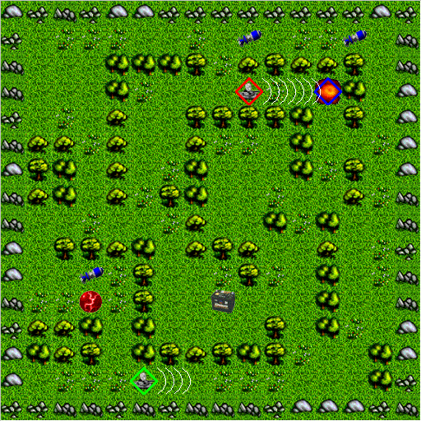

Slide 6
What are the operators?
Exclusive major actions
    rotate left/right
    move forward/back/left/right
    none
Inclusive independent minor actions
    Shields on/off
    Fire missile yes/no
    Radar-power: 0-13
Major action changes minor action results
    Turning changes what you shoot at
    Moving changes whether you will get hit
Total operators =
  7 major actions * 18 minor = 126 (vs. 392)

Slide 7
Simulating Operators
Two stages:
  In parallel, independent changes to world model
    Move, rotate, shields on/off, radar power, missile in air
  Sequentially update impact on energy, health, …
Fire Missile (3 rules)
  Decreases number of missiles
  Put missile in air toward enemy
Move (16 rules)
  Change square (indirectly changes radar)
  Detect collision
  Update sensors (open squares, incoming)

Slide 8
Evaluation Function
Must compute components sequentially
  No parallel addition in Soar!
Components of Evaluation Function:
  Live/Die (incoming)
  Energy (shields, radar, recharger)
  Health (recharger)
  Wall collisions (Ouch!)
  Missiles (fire missiles, pickup missiles)
  Hit enemy
  Clear in front
  Up-to-date knowledge of map (radar, move)
    Computes value of seeing squares – Argh!

Slide 9
==>state no-change
generate-operator [turn right]
extend-operator
generate-operator [shields on]
evaluate-operator
[turn right, shields on]
evaluate-dimension [radar-explore]
test-square
test-square
…
evaluate-dimension [shields]
…
finish-evaluation [45]
generate-operator [radar 13]
…
finish-extend [pick best extensions]
evaluate-operator
[turn right, radar 5, shields off]
evaluate-dimension […]
…
generate-operator

Slide 10
Example Chunks
If evaluating an operator that movies forward and
turns on the radar to 13 and
the facing east and
there are 10 open positions to the east that haven’t been viewed recently and then an obstacle
Then
the exploration value is 250

Slide 11
Chunking Challenges
Shouldn’t be specific to current health/energy
  Preclassifies health/energy into buckets
  Avoids blowing away subgoals
Must learn when operator should terminate
  Associate parameters with each actions
Overgeneralization
  See 10 things I hate about Soar

Slide 12
Knowledge to plan and learn
Task-independent planning
  62
TankSoar support knowledge
  69 of 170 from handcoded version
Internal simulation of actions
  63
Evaluation of states
  61
Total 255
  62 + 193 vs. 170 hand coded

Slide 13
Observations
Hand-coded system
  Only 1-2 rules to power up radar during a turn
  No chained tactics except:
    Will return to charger when low on health/energy
      Uses internal features that would be hard to learn
    Some tactics implicitly have some opponent model
Learning system
  Must learn a lot of chunks!
    Most are pretty good
  Does a good job in using radar
  Should require less work for changes to game
  Can’t learn from experience with enemy
    NO OPPONENT MODEL

Slide 14
Nuggets and Coal
Nuggets
  Identify knowledge required to learn from planning
  Shows how hard learning is
  Almost works – chunking all the time
  Writing this talk gave me ideas to simplify system
Coal
  Comparison to hand-coded incomplete
  Engineering evaluation function is hard
    Planning always finds holes in evaluation
  Getting chunking to generalize correctly is hard
  Shouldn’t be this hard!
    Some of the hardest Soar code I’ve ever written
    Up there with mapping in Quakebot

