Slide 1
Revisiting Asimov’s First Law:
A Response to the Call to Arms
David V. Pynadath, Milind Tambe
USC Information Sciences Institute
{pynadath,tambe}@isi.edu

Slide 2
Outline
Electric Elves
MDPs for Adjustable Autonomy
Safety Constraints for MDPs
Results, Summary, Future Work

Slide 3

Deployed MAS supporting collaboration at USC/ISI
We want autonomous agents to:
  perform tasks humans cannot do
  automate tasks that humans can do
Agent proxies helping users in daily activities:
  location tracking
  rescheduling meetings when delayed
  assigning presenters for research meetings
  ordering lunch

Slide 4


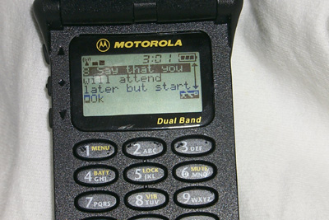
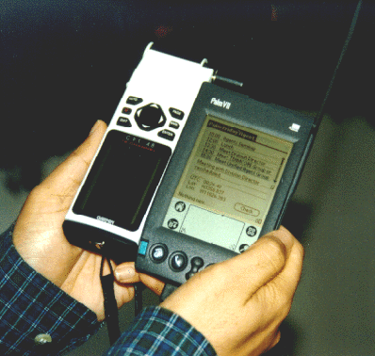

Electric Elves Architecture
Teamcore
proxy
Teamcore
proxy
Teamcore
proxy
Teamcore
proxy
Teamcore Broadcast
Teamcore
proxy
Schedule
Extractor
Teamcore
proxy
Teamcore
proxy
Interest
Matcher
Capability
Matcher
Scheduler
agent
Interest
Finder
Meet
maker
Paper
Titles
abstract
Research
Publication
agent
Teamcore
Loom
Ariadne
Expect

Slide 5
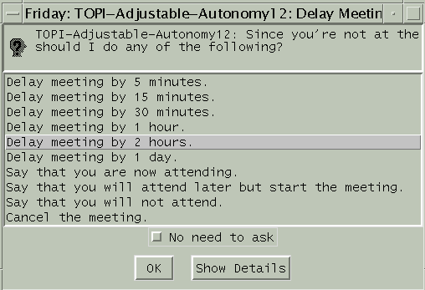
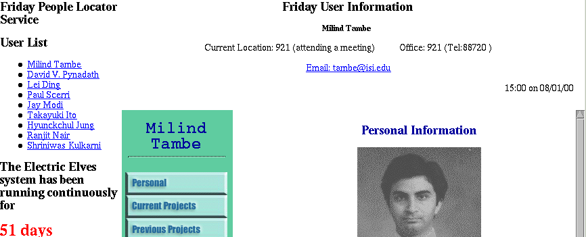
Monitoring Meetings

Slide 6
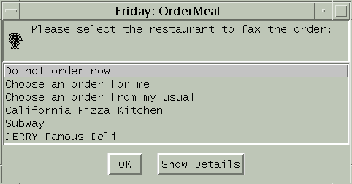
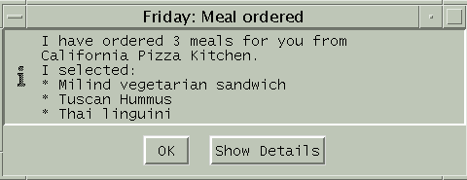
Ordering Food

Slide 7
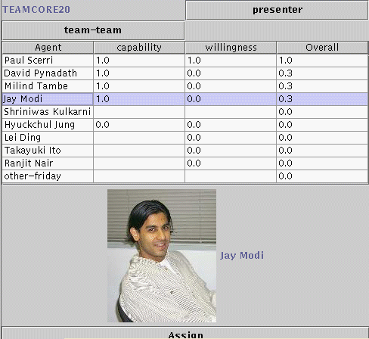
Assigning Presenters

Slide 8
What is Adjustable Autonomy?
Agents operating in a human organization:
  act autonomously to save human effort
  give up autonomy to avoid mistakes
Adjustable Autonomy (AA):
  “Dynamically adjusting the level of autonomy of an agent depending on the situation” [AAAI Spring Symp CFP 99]
Key question:
  When to transfer control/responsibility for decisions

Slide 9
Novel Issues in Team Settings
Effects extend beyond individual user
  Uncertainty in individual model
  Actions that have global cost/benefit
  Decision theory
Flexibility in transfer of control: coordination challenge
  User may not always be available to respond
  Agent cannot wait indefinitely for response
  Planning

Slide 10
Meeting Delay MDP
5 min before
not @ISI
delay
10 min before
not @ISI
wait
delay
ask
cancel
wait
Mtg time
not @ISI
Mtg time
@mtg
meeting
cancelled
wait
response
received
5 min after
not @ISI
5 min after
@mtg
Notes:
Agent can look ahead to future transitions as well:
- e.g., if it waits until meeting time, it can *then* choose to delay if the user still doesn’t show up (or may wait further to get a smaller reward if the user shows up late)
- eventually maps out future states (likelihood and rewards) for evaluation
Value Iteration:
- Well-studied technique for computing optimal policy for MDPs
- Computes expected value of performing each action in each state
Policy is optimal with respect to Friday’s knowledge, but user may know more (thus rendering policy suboptimal for particular instances):
- user may have more information (e.g., I’m just getting a cup of coffee on my way to the meeting)
- MDP model may have error in transition probabilities and rewards
Thus, it may be to Friday’s advantage to ask the user...

Slide 11

Safety
Asimov’s First Law of Robotics: “A robot may not injure a human being, or, through inaction, allow a human being to come to harm.”
MDP Reward function can represent a notion of “safety”, but...
  No single reward function will satisfy all users
  Learning personalized reward function may take a long time
Instead, user provides agent with prior knowledge about safety
  Must be easily expressed
  Must have clear semantics

Slide 12
Constraints
Solution: Individual users specify personalized constraints,
  User expresses strong preferences over actions and states
  Analogous to Soar’s prohibit and require preferences
Forbidden (~)
Necessary (!)
It’s past 3PM, but
I have not eaten lunch
My teammates are informed
of my status
States
Actions
Cancel meeting
Recharge battery

Slide 13
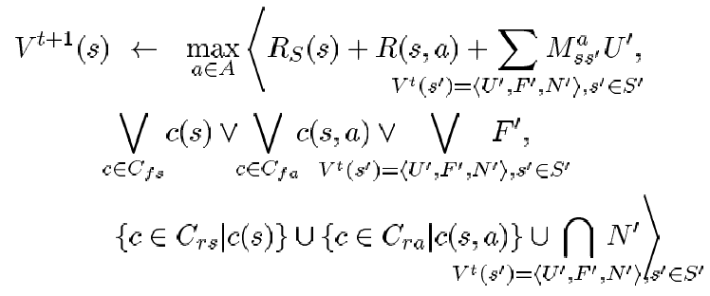
Constraint Propagation
Value of state = <expected value, violation of forbidding constraints, satisfaction of necessary constraints>
Standard value iteration
Violated if state is forbidden or ANY child is forbidden
Satisfied if state is necessary or ALL children are necessary
Expected
Value
Forbidding
Constraints
Necessary
Constraints

Slide 14
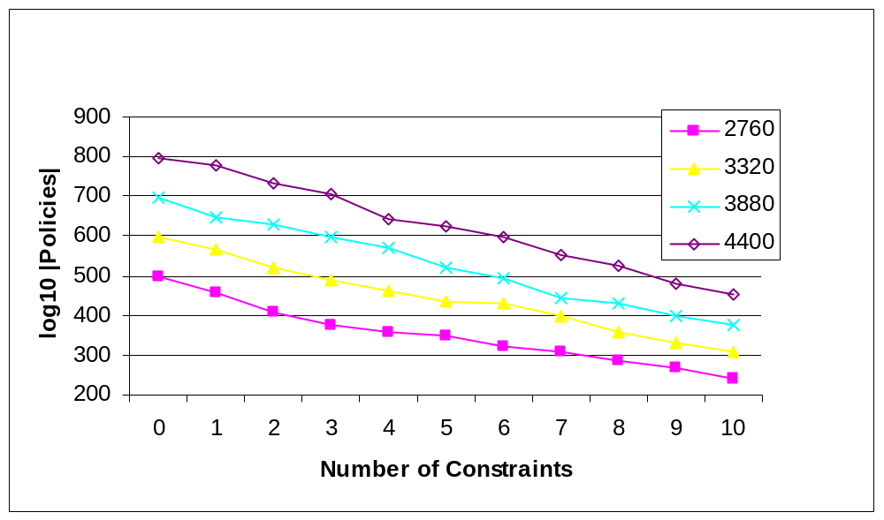
Elimination of Undesirable Behaviors

Slide 15
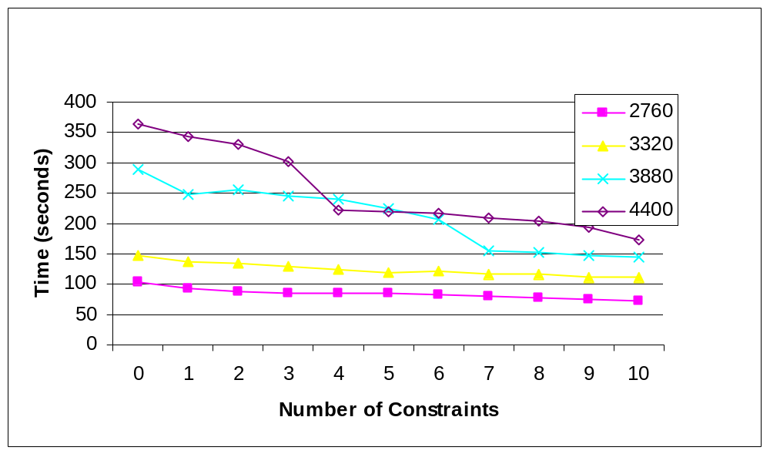
Policy Generation Time

Slide 16
Overall Electric Elves Results
Multi-agent deployment in a real organization
  Running 24/7 since June 1, 2000
  No catastrophic failures
Assists us in our daily activities
  No emails about delays, cancels, etc.
  No emails about scheduling talks at research meeting
  Mobile devices extend interactions with agents
  Fringe benefit: Friday is “active” reminder

Slide 17
Meetings Rescheduled
Meeting
Resched
Unique meets
Person meets
Total resched
Auto resched
User resched
387
642
346
208
138
Presenters Assigned
Presenter
decisions
# meet
Auto decisions
Max bids
Avg bids
10
8
9
6

Slide 18
Ongoing & Future Work
Formalize general MDP model across decisions
Evaluation of optimality of decisions
Constraints that express other types of preferences
Translate MDP policy into Soar rules
http://www.isi.edu/agents-united

Slide 19
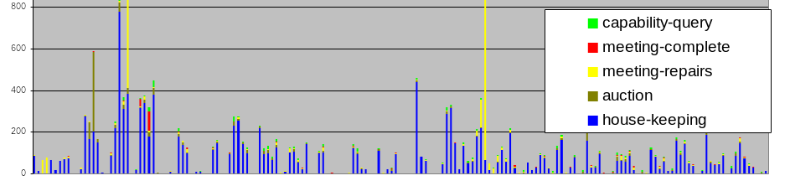
Messages over Seven Months
Messages

Slide 20
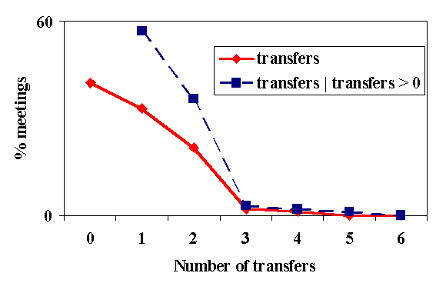
Flexible Transfers of Control

Slide 21
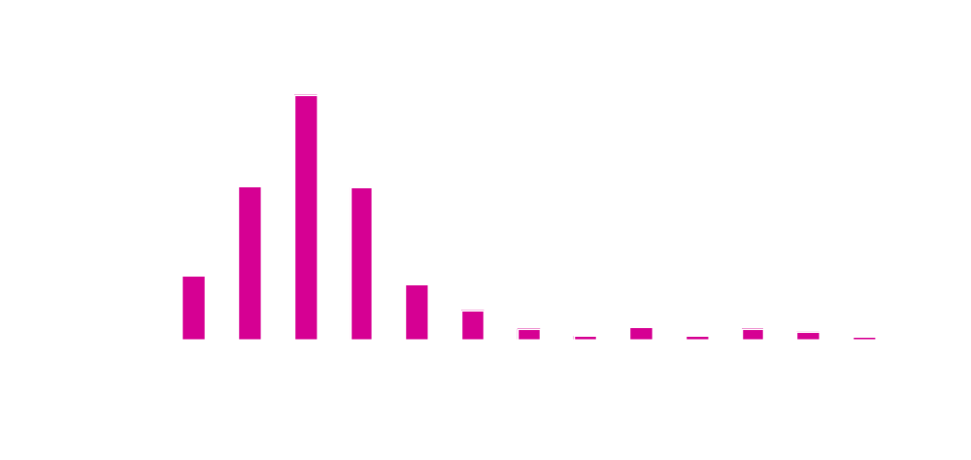
Are multi-step policies actually used?

