Slide 1
Graphic Visualization of Agent Thinking
Randolph M. Jones,
Glenn Taylor, Rich Frederiksen,
Laura Carter (et al.)

Slide 2
The Situational Awareness Panel
Graphically presents
  Agent’s current picture of situation
  Current perception of world
  Internal states and goals
  Significant milestones that can (and should) affect behavior

Slide 3
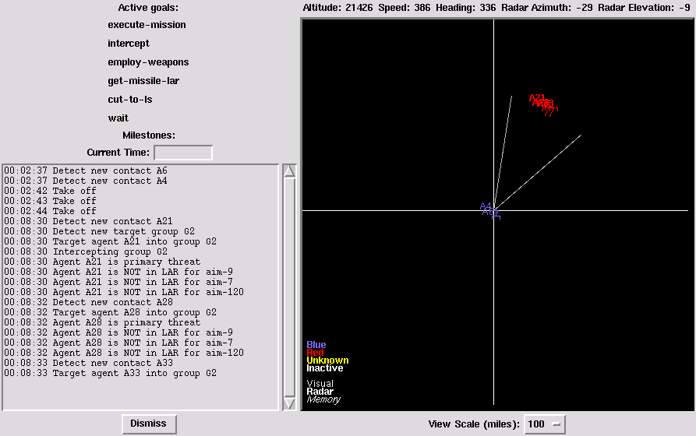
Original Prototype

Slide 4
Expanding the Role of the SAP
Project funded by Naval Air Warfare Center Training Systems Division (NAWCTSD), US Navy
  Currently in second of three years
Turn the SAP into a tool for developers, subject-matter experts, trainers, and trainees

Slide 5
Project Goals
Improve effectiveness of training (by improving understanding of agent behavior)
Improve validation and acceptance of agent behavior
Improve agent development
Generalize across behavior architectures

Slide 6
Technical Objectives
Value-oriented improvements in usability
Symbol-level API
  For compatibility across cognitive architectures
Behavior logging and replay
Point-and-click question answering and behavior traceability

Slide 7
This Year’s Accomplishments
Software component-oriented API design
  Short-term and Long-term knowledge objects; viewer and logger objects
Reimplementation of prototype
  Including integration with task-frame agents
  Soar demo, task frames demo
Usability testing by Ritter

Slide 8
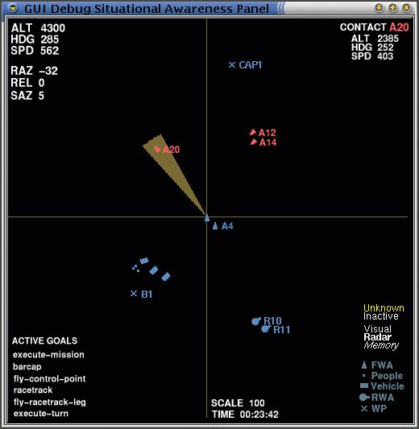
New Prototype Layout

Slide 9
In Development
Inquiries about selected goals and alternatives
Replay of reasoning
Traceability through long-term knowledge to documentation
Study of prototype reimplementation in Java
  Including network interface

