Slide 1
Spatial Visual System Tutorial
Joseph Xu
Soar Workshop 2013

Slide 2
Download Tutorial Materials
SVS viewer
Last minute bug fixed kernel
Please drop this into the bin/ directory of the Soar distro
text-to-copy.txt
Contains text from slides that you need to type
http://web.eecs.umich.edu/~soar/workshop_tutorial/svs_tutorial.zip

Slide 3
Overview
Provides a general framework for Soar to reason about continuous environments
Environment state is represented as 3D scene
Agent queries for spatial relationships in scene using filters
Has a working memory interface similar to EpMem and SMem

Slide 4
Typical Environment Setup
Environment reports state with task-specific representation
All possibly important relations are reported all the time
Environment Code
Soar Agent
Input Link
Scene
Relations
SML API
(I2 ^on O1 ^on O2
^clear C1
^clear C2)
(O1 ^top C ^bot B)
(O2 ^top A ^bot table)
(C1 ^obj A)
(C2 ^obj C)
C
on(C, B)
on(A, table)
clear(A)
clear(C)
A
B
table

Slide 5
Environment With SVS
Environment reports state with task-agnostic language (Scene Graph Edit Language)
Agent queries only relations of interest
Relations fixed across environments
Environment Code
Soar Agent
SVS
WM
(S1 ^svs S3)
(S3 ^command C3)
(C3 ^extract E2)
(E2 ^a A1 ^b B1
^type on
^result R7)
(A1 ^id A ^type node)
(B1 ^id B ^type node)
(R7 ^record R17)
(R17 ^params P1
^value f)
(P1 ^a A ^b B)
Scene
Scene Graph
Filters
SGEL
on(A,B)
C
C
A
B
A
B
on(B,C)
table
table
clear(A)

Slide 6
Scene Graph
Organizes objects as tree of nodes
Child nodes are a part of the parent node
Group nodes
Geometry nodes
Each node as position, rotation, transform
Transforms are accumulated from parent to child
world
pole
car
wheel0
wheel1
wheel2
wheel3
chassis

Slide 7
Scene Graph Edit Language
a NAME TYPE PARENT [GEOMETRY] [TRANSFORM]
Add object to the scene graph
d NAME
Delete object from scene graph
c NAME [GEOMETRY] [TRANSFORM]
Change object geometry and/or transform
p NAME PROPERTY VALUE
Set custom property
Geometries
b RADIUS
v X1 Y1 Z1 X2 Y2 Z2 ...
Transforms
[p X Y Z] [r X Y Z] [s X Y Z]

Slide 8
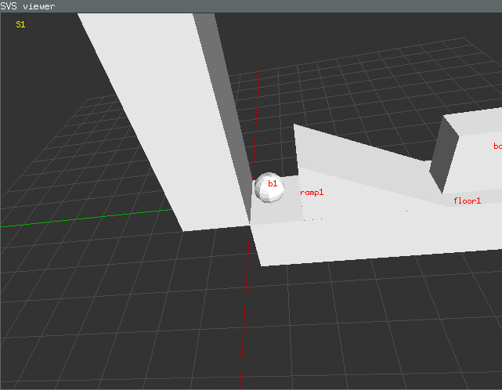
SVS Viewer
Displays scene graph contents
Separate program that SVS communicates with via TCP sockets

Slide 9
Connect to Viewer
On Windows:
run.bat # windows
run.command # mac
run.sh # linux
svs_viewer -s 8999
In Soar command line:
svs state.0.scene.sgel a b1 ball world b 1
svs connect_viewer 8999

Slide 10
Viewer Navigation
Rotate | Hold RMB
Pan | Hold Shift + RMB
Pull | Hold Ctrl + RMB
Zoom | Mouse Wheel
Reset | Press 1, 2, or 3
Wireframe | Press w
Ortho | Press o
Show names | n
Show grid | g
Change grid scale | =/-
Screen shot | s

Slide 11
Try SGEL Commands
Add some objects
svs state.0.scene.sgel a g1 grp world
svs state.0.scene.sgel a b2 ball g1 b 1 p 2 0 0
svs state.0.scene.sgel a b3 ball g1 b 1 p 0 2 0
svs state.0.scene.sgel a b4 ball g1 b 1 p 0 0 2
Change b1 position (notice b2, b3, b4 positions also change)
svs state.0.scene.sgel c g1 p 3 0 0
Delete b4
svs state.0.scene.sgel d b4

Slide 12
3 Ways to Inspect Scene Graph
SVS Viewer
Working memory
(S1 ^svs S3)
(S3 ^spatial-scene S4)
(S4 ^id world ^child C1 ^child C2)
(C1 ^id b1)
(C2 ^id g1 ^child C3 ^child C4)
(C3 ^id b2)
(C4 ^id b3)
Command Line
> svs state.0.scene.world dir
b1
g1
b2
b3
> svs state.0.scene.world.b1
id: 101
name: b1
type: ball
parent: world
Local transform:
pos: 0 0 0
rot: 0 0 0 0 1
scale: 1 1 1

Slide 13
SVS Command Line
You can interact with most objects in SVS via the svs command
General form
svs state.0.scene.sgel a g1 grp world
svs <path> dir # lists children
svs <path> help # print help
Paths have dot notation
state.0.scene # top state scene graph
filters.intersect # intersect filter
path
arguments

Slide 14
Filters
Transforms continuous information from scene graph into symbolic information in working memory
Implements spatial relations, among other things
Can be combined into pipeline
Caches results and avoids recomputation when possible
Filter
Inputs
Output
Extract Command (WM)
Filter
arg1
Filter
arg2

Slide 15
Working Memory Interface
(S1 ^svs S3)
(S3 ^command C3 ^spatial-scene S4)
(C3 ^extract E2)
(E2 ^a A1 ^b B1 ^type intersect)
(A1 ^id b1 ^type node)
(B1 ^id b2 ^type node)
(S1 ^svs S3)
(S3 ^command C3 ^spatial-scene S4)
(C3 ^extract E2)
(E2 ^a A1 ^b B1 ^type intersect ^result R7
^status success)
(A1 ^id b1 ^type node ^status success)
(B1 ^id b2 ^type node ^status success)
(R7 ^record R17)
(R17 ^params P1 ^value f)
(P1 ^a b1 ^b b2)
Scene Graph
node
Extract Command Result
intersect
node

Slide 16
Create a Filter Pipeline
sp {make-filter1
(state <s> ^superstate nil
^svs.command <c>)
-->
(<c> ^extract <e>)
(<e> ^type intersect ^a <a> ^b <b>)
(<a> ^type node ^id b1)
(<b> ^type node ^id b2)}
Scene Graph
node
Extract Command Result
intersect
node

Slide 17
Multiple Inputs to Filters
Sometimes you want to run a filter on many objects
Example: Does X intersect anything?
It’s annoying and inefficient to make a filter for every pair of objects
Filters can take multiple objects as inputs and outputs
Different combination methods:
Cartesian product (most common)
Grouped
Flattened
A
B
intersect
f(A,C)
f(A,D)
f(A,E)
f(B,C)
f(B,D)
f(B,E)
C
D
E

Slide 18
Create Another Filter Pipeline
sp {make-filter2
(state <s> ^superstate nil
^svs.command <c>)
-->
(<c> ^extract <e>)
(<e> ^type intersect ^a <a> ^b <b>)
(<a> ^type node ^id b1)
(<b> ^type all_nodes)}
Scene Graph
node
Extract Command Result
intersect
all_nodes

Slide 19

Filter Subclasses
A
B
map_filter
(dist, intersect)
f(A,C)
f(A,D)
f(A,E)
f(B,C)
f(B,D)
f(B,E)
C
D
E
A
B
reduce_filter
(colinear)
f(AC,AD,AE,BC,BD,BE)
C
D
E
A
B
rank_filter
(min, closest)
$$\begin{matrix}\text{a}\text{rgmax} \\ x\end{matrix}f(x)$$
C
D
E

Slide 20
Some Built-in Filters
Filter | Parameters | Type | Output type
node | id | map | node
all_nodes | none | special | node
[xyz]-greater-than | a, b | map | boolean
[xyz]-less-than | a, b | map | boolean
[xyz]-aligned-than | a, b | map | boolean
on-top | a, b | map | boolean
intersect | a, b | map | boolean
distance | a, b | map | float
closest | a, b | rank | node
smaller-than | a, b | map | boolean

Slide 21
Sending State Updates via SML
Environment sends SVS state updates via SML call Agent::SendSVSInput(sgel)
Best called in input event callback
Environment
Soar Agent
Input Event Callback
Scene Graph
Update Environment
Generate SGEL
Call SendSVSInput
Input
Phase
C
A
B
table
SGEL

Slide 22
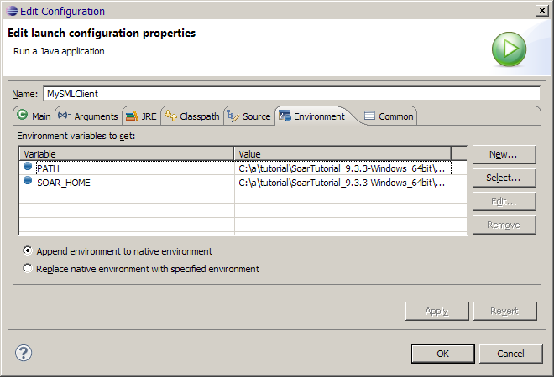
More Eclipse Setup
Project -> properties -> Run/Debug Settings -> Edit -> Environment -> New…
SOAR_HOME: bin/ directory of Soar distro

Slide 23
Create Input Callback Class
import sml.Agent;
import sml.Kernel;
public class MySMLClient {
public static class SVSInputCallback implements sml.Agent.RunEventInterface {
public SVSInputCallback() {
}
public void runEventHandler(int id, Object userdata, Agent agent, int phase) {
}
}
public static void main(String[] args) {
Kernel kernel = Kernel.CreateKernelInNewThread();
Agent agent = kernel.CreateAgent("soar");
System.out.println(agent.ExecuteCommandLine("print s1"));
}
}

Slide 24
Run Debugger from SML
public static void main(String[] args) {
Kernel kernel = Kernel.CreateKernelInNewThread();
Agent agent = kernel.CreateAgent("soar");
System.out.println(agent.ExecuteCommandLine("print s1"));
agent.ExecuteCommandLine("waitsnc -e");
agent.ExecuteCommandLine("svs connect_viewer 8999");
agent.RegisterForRunEvent(sml.smlRunEventId.smlEVENT_BEFORE_INPUT_PHASE,
new SVSInputCallback(), null);
if (!agent.SpawnDebugger()) {
System.err.println("Debugger spawning failed");
System.exit(1);
}
while (true) {
try {
Thread.sleep(1000);
} catch (InterruptedException e) {}
}
}
Setup
Register Input callback
Launch Java debugger and connect to this agent
Give control to debugger and wait

Slide 25
Implement Input Callback
public static class SVSInputCallback implements sml.Agent.RunEventInterface {
int x;
boolean first;
public SVSInputCallback() {
x = 0;
first = true;
}
public void runEventHandler(int id, Object userdata, Agent agent, int phase) {
String sgel;
if (first) {
sgel = "a b1 ball world b 1";
first = false;
} else {
sgel = String.format("c b1 p %d 0 0", x);
x += 1;
}
System.out.println("Sending " + sgel);
agent.SendSVSInput(sgel);
}
}

Slide 26
import sml.Agent;
import sml.Kernel;
public class MySMLClient {
public static class SVSInputCallback implements sml.Agent.RunEventInterface {
int x;
boolean first;
public SVSInputCallback() {
x = 0;
first = true;
}
public void runEventHandler(int id, Object userdata, Agent agent, int phase) {
String sgel;
if (first) {
sgel = "a b1 ball world b 1";
first = false;
} else {
sgel = String.format("c b1 p %d 0 0", x);
x += 1;
}
System.out.println("Sending " + sgel);
agent.SendSVSInput(sgel);
}
}
public static void main(String[] args) {
Kernel kernel = Kernel.CreateKernelInNewThread();
Agent agent = kernel.CreateAgent("soar");
System.out.println(agent.ExecuteCommandLine("print s1"));
agent.ExecuteCommandLine("waitsnc -e");
agent.ExecuteCommandLine("svs connect_viewer 8999");
agent.RegisterForRunEvent(sml.smlRunEventId.smlEVENT_BEFORE_INPUT_PHASE, new SVSInputCallback(), null);
if (!agent.SpawnDebugger()) {
System.err.println("Debugger spawning failed");
System.exit(1);
}
while (true) {
try {
Thread.sleep(1000);
} catch (InterruptedException e) {
}
}
}
}

Slide 27
Run It

Slide 28
Writing a New Filter
Write new class inheriting from an existing filter subclass
probably typed_map_filter
Register the new filter in the filter_table constructor
Recompile Soar

Slide 29
Write a New Class
// intersect_filter.cpp
class intersect_filter : public typed_map_filter<bool> {
public:
intersect_filter(Symbol *root, soar_interface *si, filter_input *input, scene *scn)
: typed_map_filter<bool>(root, si, input) {}
bool compute(const filter_params *p, bool adding, bool &result, bool &changed) {
bool new_result;
const sgnode *a, *b;
if (!get_filter_param(this, p, "a", a) || !get_filter_param(this, p, "b", b))
return false;
new_result = intersects(a, b);
if (result == new_result) {
changed = false;
} else {
changed = true;
}
result = new_result;
return true;
}
};
constructor
main virtual function
get parameter values
run actual logic
signal value changed
set result

Slide 30
Write Factory Function
// intersect_filter.cpp
filter *make_intersect_filter(Symbol *root, soar_interface *si,
scene *scn, filter_input *input)
{
return new intersect_filter(root, si, input, scn);
}

Slide 31
Write Filter Table Entry Populator
// intersect_filter.cpp
filter_table_entry *intersect_fill_entry() {
filter_table_entry *e = new filter_table_entry;
e->name = "intersect";
e->parameters.push_back("a");
e->parameters.push_back("b");
e->create = &make_intersect_filter;
return e;
}

Slide 32
Register In Filter Table
// filter_table.cpp
filter_table_entry *intersect_fill_entry();
filter_table_entry *distance_fill_entry();
filter_table_entry *centroid_distance_fill_entry();
...
filter_table::filter_table() {
add(intersect_fill_entry());
add(distance_fill_entry());
add(centroid_distance_fill_entry());
...
}

Slide 33
Summary
Scene graph represents environment as 3D scene
Tree of nodes with position, rotation, scaling transforms relative to parent
Filters
Composed into pipelines to extract symbolic information from continuous scene representation
Environment talks to SVS using SGEL

Slide 34
Credits
SVS theory was developed by Sam Wintermute
Wintermute, S. Imagery in Cognitive Architecture: Representation and Control at Multiple Levels of Abstraction. Cognitive Systems Research, 19-20,1-29.
“I put a virtual machine on the server where everything is working”
Soar Visual Imagery (SVI) was developed by Scott Lathrop
Lathrop, S.D., and Laird, J.E. (2007). Towards Incorporating Visual Imagery into a Cognitive Architecture. Proceedings of the Eighth International Conference on Cognitive Modeling. Ann Arbor, MI.
Performed operations on pixel representations

