Slide 1
A Multi-Domain Evaluation of Scaling in Soar’s Episodic Memory
Nate Derbinsky, Justin Li, John E. Laird
University of Michigan

Slide 2
Motivation
Prior Work
Nuxoll & Laird (‘12): integration and capabilities
Derbinsky & Laird (‘09): efficient algorithms
Core Question
To what extent is Soar’s episodic memory effective and efficient for real-time agents that persist for long periods of time across a variety of tasks?

Slide 3
Approach: Multi-Domain Evaluation
Existing agents from diverse tasks (49)
Linguistics, planning, games, robotics
Long agent runs
Hours-days RT (10⁵ – 10⁸ episodes)
Evaluate at each X episodes
Memory consumption
Reactivity for >100 task relevant cues
Maximum time for cue matching <? 50 msec.

Slide 4
Outline
Overview of Soar’s EpMem
Word Sense Disambiguation (WSD)
Planning
Video Games & Robotics

Slide 5
Episodic Memory Problem Formulation
Representation
Episode: connected di-graph
Encoding/Storage
Automatic
Retrieval
Semantics: desired features in context
Store: temporal sequence
Cue: acyclic graph
Find the most recent episode that shares the most leaf nodes in common with the cue
No dynamics
Episodic Memory
Matching
Storage
Encoding
Working Memory
Cue

Slide 6
Episodic Memory Algorithmic Overview
Storage
Capture WM-changes as temporal intervals
Cue Matching (reverse walk of cue-relevant Δ’s)
2-phase search
Only graph-match episodes that have all cue features independently
Only evaluate episodes that have changes relevant to cue features
Incrementally re-score episodes

Slide 7
Episodic Memory Storage Characterization
1 week, 8GB
1 day, 8GB

Slide 8
Episodic Memory Retrieval Characterization
Assumptions
Few changes per episode (temporal contiguity)
Representational re-use (structural regularity)
Small cue
Scaling
Search distance (# changes to walk)
Temporal Selectivity: how often does a WME change
Feature Co-Occurrence: how often do WMEs co-occur within a single episode (related to search-space size)
Episode scoring (similar to rule matching)
Structural Selectivity: how many ways can a cue WME match an episode (i.e. multi-valued attributes)

Slide 9
Word Sense Disambiguation Experimental Setup
Input: <“word”, POS>; Output: sense #; Result
Corpus: SemCor (~900K eps/exposure)
Agent
Maintain context as n-gram
Query EpMem for context
If success, get next episode, output result
If failure, null
Accuracy | First | Second
2-gram | 14.57% | 92.82%
3-gram | 2.32% | 99.47%

Slide 10
Word Sense Disambiguation Results
Storage
Avg. 234 bytes/episode
Cue Matching
All 1-, 2-, and 3-gram cues reactive
0.2% of 4-grams exceed 50msec.

Slide 11
N-gram Retrieval Scaling Retrieval Time (msec) vs. Episodes (x1000)
Feature Co-Occurrence
Temporal Selectivity

Slide 12
Planning Experimental Setup
12 automatically converted PDDL domains
Logistics, Blocksworld, Eight-puzzle, Grid, Gripper, Hanoi, Maze, Mine-Eater, Miconic, Mystery, Rockets, and Taxi
44 distinct problem instances (e.g. # blocks)
Agent: randomly explore state space
50K episodes, measure every 1K

Slide 13
Planning Results
Storage
Reactive: <12.04 msec./episode
Memory: 562 – 5454 bytes/episode
Cue Matching (reactive: < 50 msec.)
Full State: only smallest state + space size (12)
Relational: none
Schema: all (max = 0.08 msec.)
Notes:
9-91M eps / 48GB RAM

Slide 14
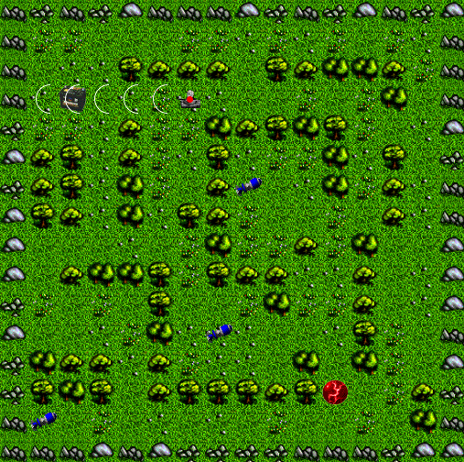
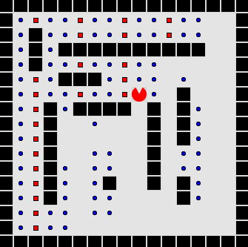
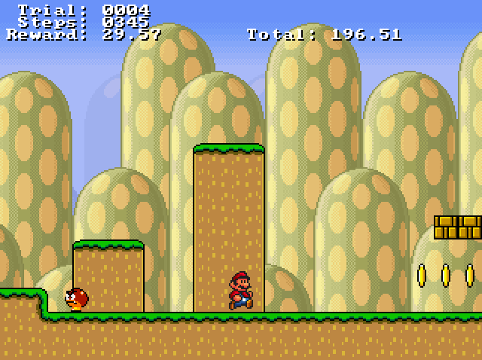
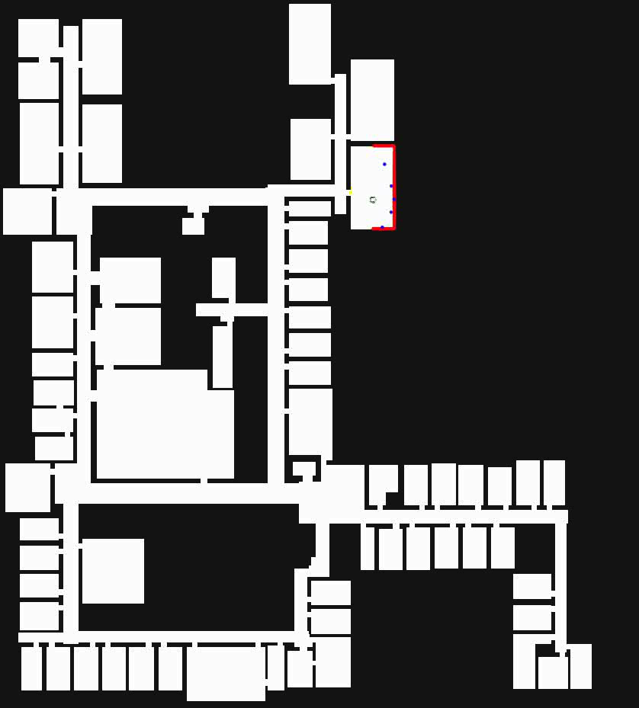
Video Games & Mobile Robotics Experimental Setup
Hand-coded cues (per domain)
Domain | Agent | Duration | Eval. Rate
TankSoar | mapping-bot | 3.5M | 50K
Eaters | advanced-move | 3.5M | 50K
Infinite Mario | [Mohan & Laird ‘11] | 3.5M | 50K
Rooms World | [Laird, Derbinsky & Voigt ‘11] | 12 hours | 300K

Slide 15
Data: Eaters
813 bytes/episode

Slide 16
Data: Infinite Mario
Structural Selectivity
2646 bytes/episode

Slide 17
Data: TankSoar
Co-Occurrence
1035 bytes/episode

Slide 18
Data: Mobile Robotics
Temporal Selectivity
113 bytes/episode

Slide 19

Summary of Results
Generality
Demonstrated 7 cognitive capabilities
Virtual sensing, action modeling, long-term goal management, …
Reactivity
<50 msec. storage time for all tasks (ex. temporal discontiguity)
<50 msec. cue matching for many cues
Scalability
No growth in cue matching for many cues (days!)
Validated predictive performance models
0.18 - 4 kb/episode (days – months)

Slide 20
Evaluation
Nuggets
Coal
Unprecedented evaluation of general episodic memory
Breadth, temporal extent, analysis
Characterization of EpMem performance via task-independent properties
Soar’s EpMem (v9.3.2) is effective and efficient for many tasks and cues!
Domains and cues available
Still easy to construct domain/cue that makes Soar unreactive
Unbounded memory consumption (given enough time)
For more details, see paper in proceedings of
AAAI 2012

