Slide 1
MAST: A motion planning strategy for Soar (and friends)
Lizzie Mamantov
Soar Lab, university of Michigan

Slide 2
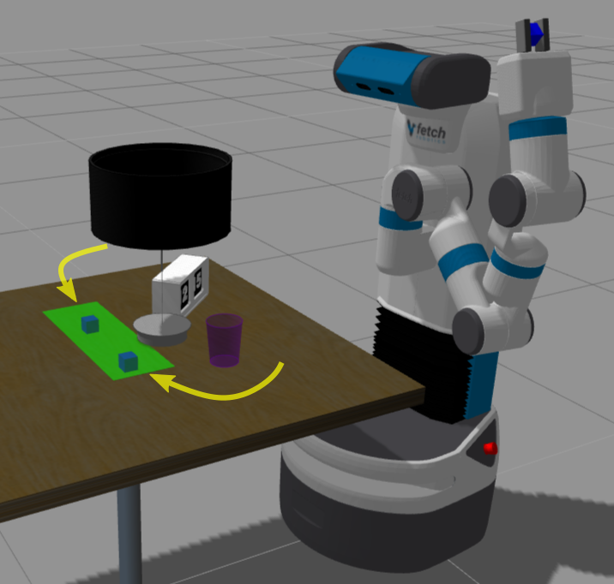
Potential robot scenario
The goal is that the blue block is on the green location.
How should the robot perform this action?
Notes:
There are infinite possible arm trajectories that reach the desired goal...
How does the robot decide what kind it wants? (right/left lamp? careful/efficient?)
How do we find those desired trajectories?

Slide 3
Outline
Motivation
MAST approach
Evaluation
Future directions
Nuggets + Coal
Notes:
This talk is mostly about answering that second question, how to find reaching trajectories that meet agent needs and wants.

Slide 4
Outline
Motivation
MAST approach
Evaluation
Future directions
Nuggets + Coal

Slide 5
Potential Rosie scenario
Agent queries a motion planner:
Constraint = end with block in green region
Objective = short trajectory
Trajectory 1
<0.616 0.339 0.725 0.379 0.143 0.019 0.244>,
< 0.773 0.339 0.622 0.382 0.003 0.014 0.244>,
…
< 0.175 0.214 0.956 0.440 0.907 0.999 0.404>
Trajectory 2
<0.616 0.339 0.725 0.379 0.143 0.019 0.244>,
< 0.773 0.339 0.622 0.382 0.003 0.014 0.244>,
…
< 0.175 0.214 0.956 0.440 0.907 0.999 0.404>

Slide 6
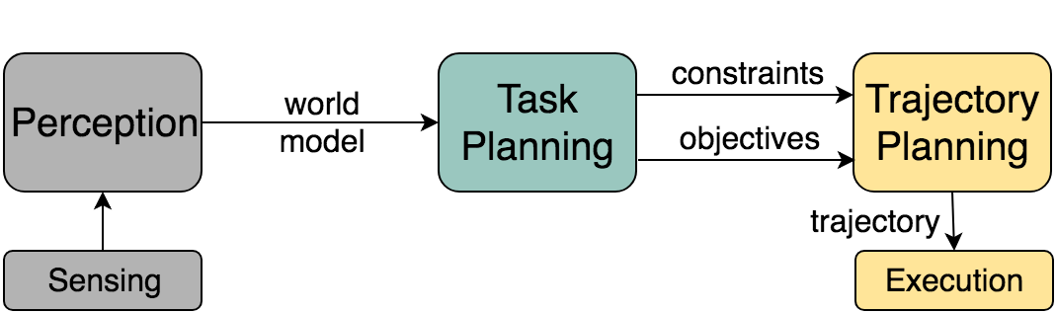
Sense-Plan-Act
??
“needs”
“wants”
difficult :(
Notes:
Structural issue: Agent unaware of trajectory options—always stuck with whatever the trajectory planner finds for it.
Practical issue: Including objectives makes the trajectory planning problem nonconvex optimization in a high dimensional space. Trying to get the wants decreases ability to get the needs.

Slide 7
What are the problems with this?
Structural: Trajectory details black-boxed from agent (Soar)
Agent is not provided with options that exist
Query details impact planner performance
Practical: Optimizing trajectories is difficult
Finding collision-free 7 DOF arm trajectories is a costly process
Some algorithms can optimize trajectories, but…
Nonconvex optimization
Useful objective functions expensive to compute
Notes:
*Basically, handling planning of valid trajectories at the same time as optimizing objectives makes both problems harder. And really, valid trajectories are more important than optimal ones in the context of most agents.

Slide 8
Outline
Motivation
MAST approach
Evaluation
Future directions
Nuggets + Coal

Slide 9
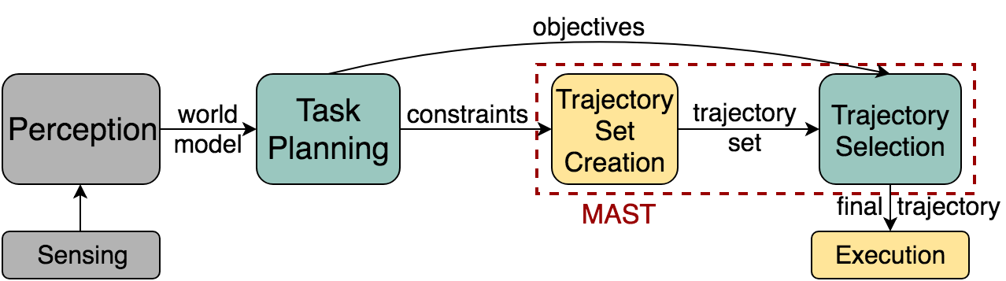
MAST
2
1
Motion planning with Agent Selection of Trajectory
a strategy for agents interacting with trajectory planners
not a motion planning algorithm by itself
Notes:
MAST partially reorganizes the pipeline it into two different steps, handling constraints before considering objectives.
Doing only constraints first solves the problem of optimization making the trajectory planning too hard.
The two steps interleave agent reasoning and trajectory planning, which addresses the structural problem of the agent being unaware of its options.

Slide 10
Trajectory set creation
Input: Motion constraints (not objectives)
Output: Set of n trajectories that are valid and satisfy constraints
Key tool = sampling based motion planners, particularly RRTs
Possible algorithms:
Multi-query planner (such as probabilistic roadmap)
Planner that produces alternate routes (such as RRT*-AR)
Many queries to efficient single-query planner (such as RRT-Connect)
We used many RRT-Connect queries and tested n = 1 – 30 trajectories in the set
Simple to implement
Inherently parallel
Notes:
Sampling based motion planners solve trajectory planning very efficiently (even in high dimensions) through randomized search.

Slide 11
Trajectory selection
Input: The n valid trajectories found in the previous step + agent objectives
Output: One final trajectory to be executed
We used a simple ranking strategy
For one objective, choose best trajectory by that metric
For two objectives, choose top k trajectories by top-priority objective then best trajectory out of k by second-priority objective

Slide 12
Outline
Motivation
MAST approach
Implementation
Evaluation
Future directions
Nuggets + Coal

Slide 13
System details
Trajectory planning
Simulated Fetch mobile manipulator
ROS ecosystem required
Planning algorithms from OMPL
MoveIt! used for interface
Selection
NOT connected to Soar
Assume most important objective(s) is(are) given
Ranking method based on 1 or 2 objectives
Implemented in postprocessing

Slide 14
Outline
Motivation
MAST approach
Evaluation
Future directions
Nuggets + Coal

Slide 15
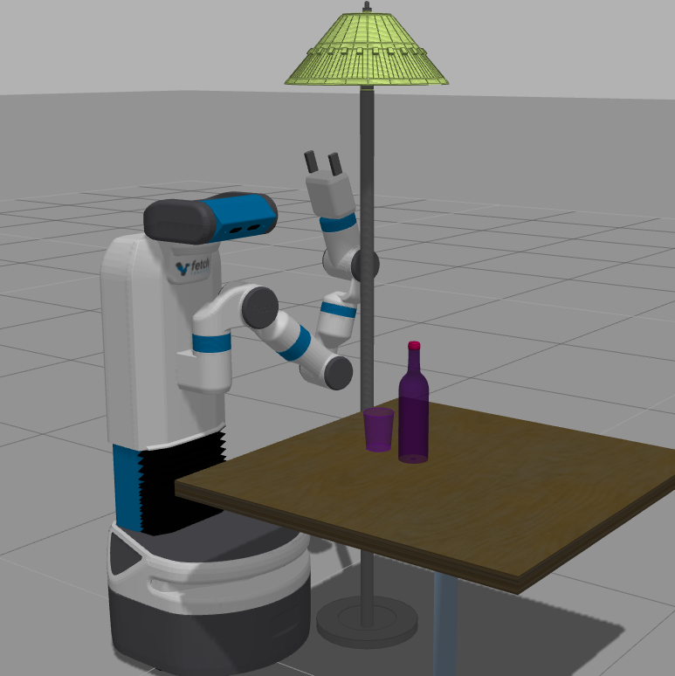
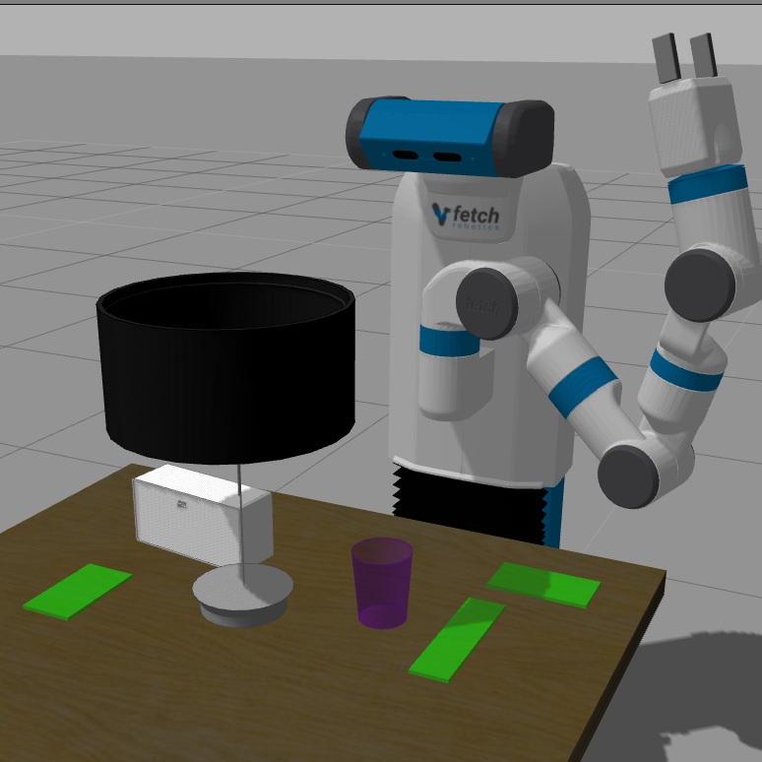
Experiments
Robot is “placing object” on table
Created 6 environments
Realistic house-inspired obstacles
20 target regions per environment
300 trajectories per region

Slide 16
Objectives
Action Execution Time (AET)
Measures trajectory length through execution time in seconds
Length in Task Space (LTS)
Measures trajectory length through gripper movement in meters
Weighted Average Clearance (WAC)
Measures clearance from environment obstacles
Many other possibilities…
Visibility of objects in environment or gripper
HCI concerns
Notes:
Two are different ways to measure trajectory length, final one measures clearance from obstacles.

Slide 17
Main questions
Is there generally enough variety in trajectory sets to improve objective values?
Is planning a large number of trajectories prohibitively expensive?
Would we be better off simply using an optimizing trajectory planner?

Slide 18
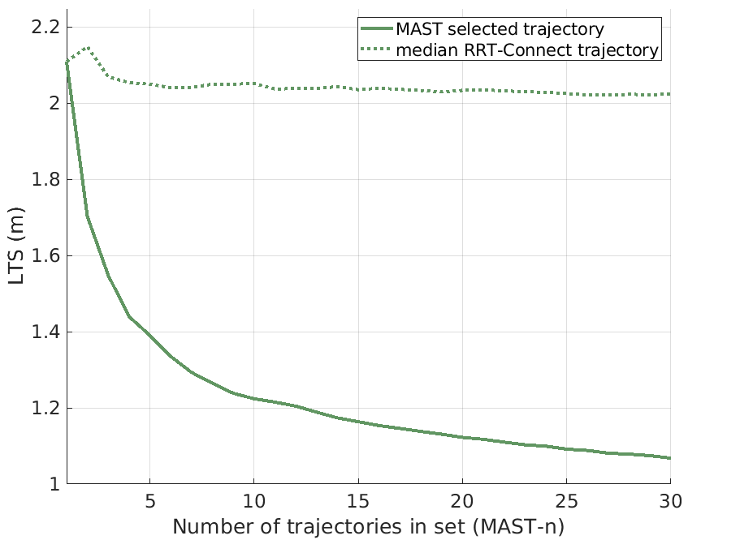
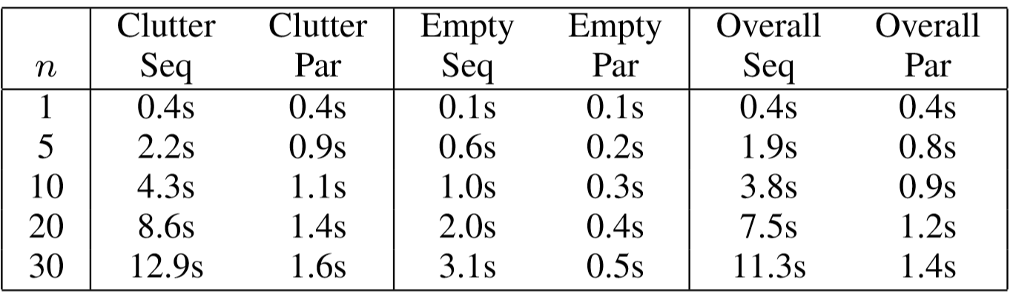
MAST works for any objective(s)
better final trajectories
MAST planning times
larger trajectory set
Notes:
Y axis = Gripper movement objective, smaller is better
X axis = Number of trajectories in MAST set
More trajectories -> more variety -> better final trajectory -> MAST idea works!

Slide 19
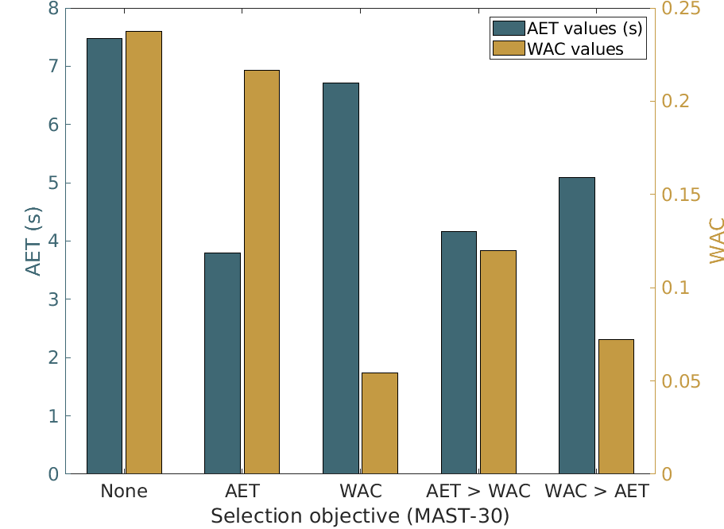
MAST works for any objective(s)

Slide 20
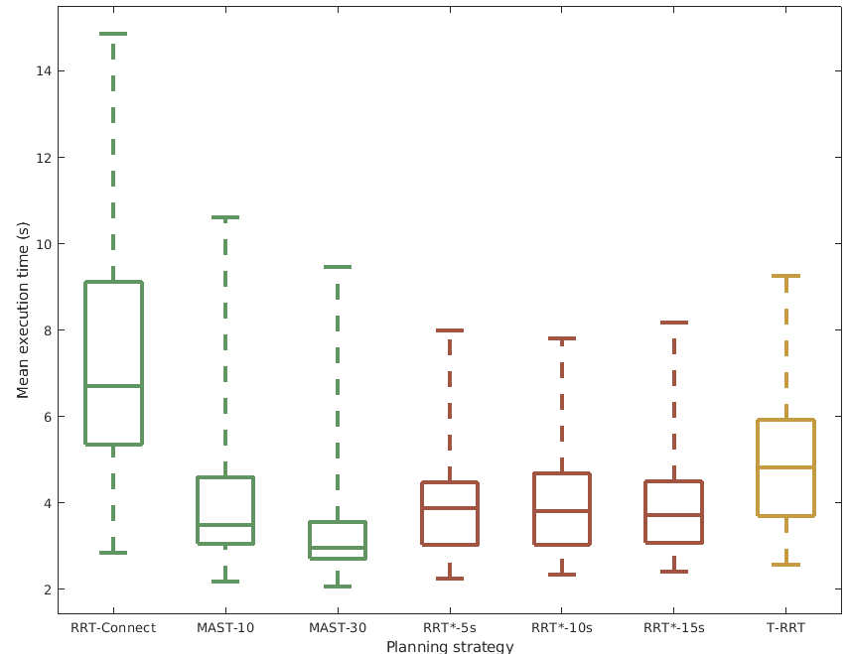
MAST vs. optimizing planners
Work pretty well for shorter paths, but not able to efficiently handle clearance objectives!
MAST planning times
Mean T-RRT planning time: 0.9s
Notes:
Box/whiskers show us the distribution of objective values. Whiskers = max, min; Box = 25th-75th percentile.
MAST performs on par with comparison methods here.
BUT! for expensive objective functions, the comparisons were so slow we had to run them for half an hour per query to get any sort of results.

Slide 21
Outline
Motivation
MAST approach
Evaluation
Future directions
Nuggets + Coal

Slide 22
MAST + Soar
Integration of MAST and SVS
Trajectories represented within SVS
Choice between options implemented through Soar/SVS interface
Advance trajectory set creation based on Soar cues
Motion plans are made in parallel with agent reasoning
Agent could provide hints
Meta-reasoning could provide hints

Slide 23
Outline
Motivation
MAST approach
Evaluation
Future directions
Nuggets + Coal

Slide 24
Nuggets
Coal
We had an idea and it works well
Useful general motion planning strategy
Well-suited for use by Soar
Makes new reasoning abilities available
No guaranteed optimality or theoretical claims
Need to measure many more objectives
Not yet integrated with Soar
Reasoning side largely unexplored

